Slide 1



BridgeScope: A Universal Toolkit for Bridging Large Language Models and Databases
January 18-21
2026 Chaminade, USA
Lianggui Weng, Dandan Liu, Rong Zhu, Bolin Ding, Jingren Zhou
TONGYI

Slide 2
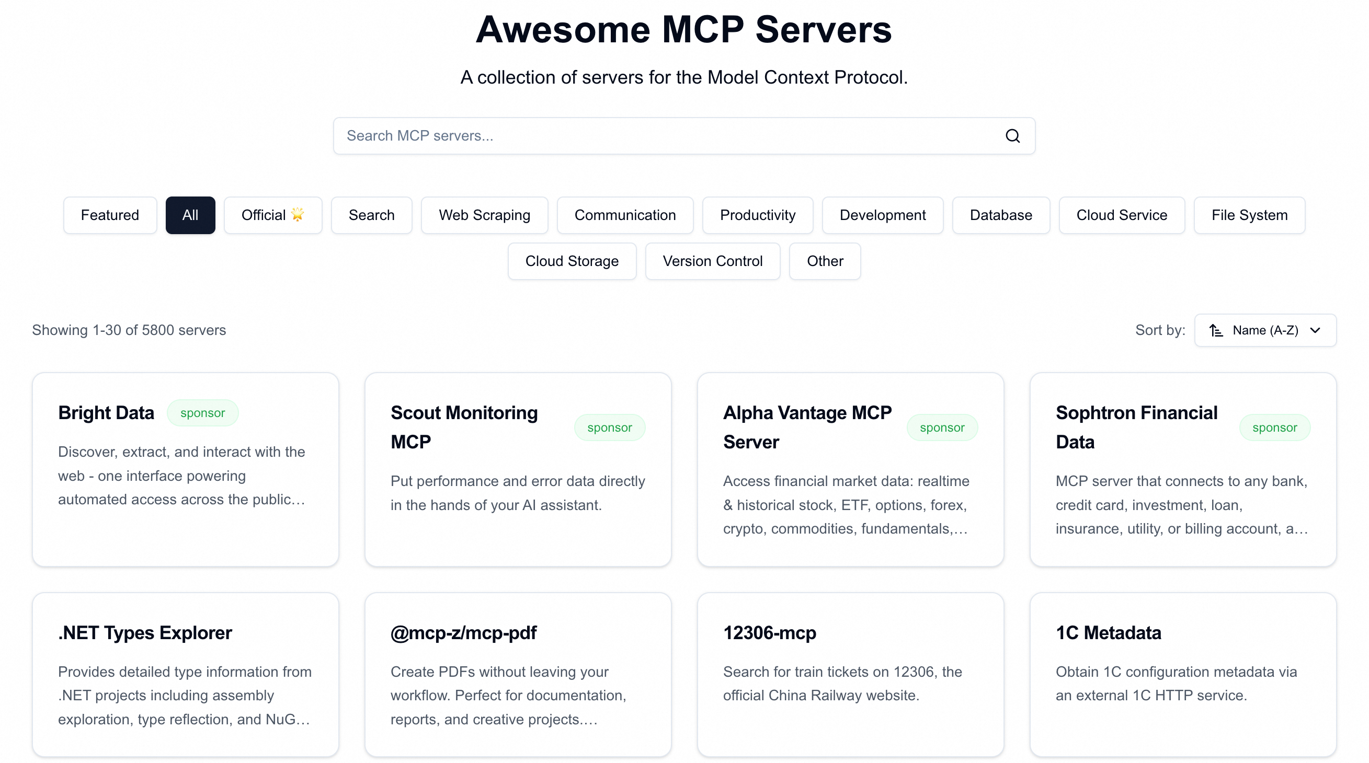

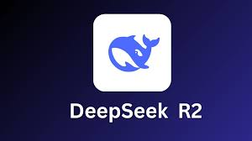

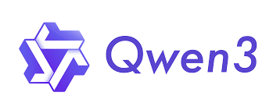




Background
The advancing of LLMs’ reasoning and orchestration capabilities and MCP ecosystems is unlocking truly general-purpose agents.

Slide 3













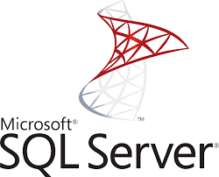



Background
Agents handling general-purpose, data-intensive tasks can be highly problematic.
Interact with users
Task reasoning
Tool calling
Data transmission
…
Steps
Simple
feedback
Query data (MB/GB)
Toolkits (MCP servers)
SELECT
DELETE
DROP
BLIP
BART
x
❌
Objects
Operations
Databases
Other backend systems / services

Slide 4



Background
Agents handling general-purpose, data-intensive tasks can be highly problematic.
Coarse-Grained Tooling
Interact with users
Task reasoning
Tool calling
Data transmission
> execute_sql(“DROP DB”)
…
LLM Agent
(MCP Client)
Steps
Simple
feedback
Query data (MB/GB)
Security Risk
Toolkits (MCP servers)
MCP Server for DB
> execute_sql(“SELECT”)
SELECT
DELETE
DROP
BLIP
get_schema()
BART
> execute_sql(“BEGIN”)
x
❌
execute_sql()
> execute_sql(“UPDATE”)
Objects
Operations
> execute_sql(“…”)
Other backend systems / services
Tool Selection Error
Databases

Slide 5
Background
Agents handling general-purpose, data-intensive tasks can be highly problematic.
Coarse-Grained Tooling
Privilege-Unaware Planning
Interact with users
Task reasoning
Tool calling
Data transmission
…
step
Steps
Simple
feedback
Query data (MB/GB)
❌
Toolkits (MCP servers)
reject by DB engine
SELECT
DELETE
DROP
BLIP
BART
❌
x
❌
Objects
Operations
Databases
Other backend systems / services
Wasted planning/tool calling resource

Slide 6

Background
Agents handling general-purpose, data-intensive tasks can be highly problematic.
Coarse-Grained Tooling
Privilege-Unaware Planning
Data Transmission via LLM
Interact with users
Task reasoning
Tool calling
Data transmission
…
Steps
Simple
feedback
Query data (MB/GB)
Toolkits (MCP servers)
BLIP
select()
result
SELECT
DELETE
DROP
BART
x
❌
Objects
Operations
Other backend systems / services
Hallucinations in data transmission
Databases
Task failure upon LLM context exhausted

Slide 7



BridgeScope Overview
Get database schema
Context Retrieval
Schema retrieval
Exemplar retrieval
I’m a chain store manager and I need to daily update sales and refunds records, and analyze recent sales trends
Begin a transaction
SQL Execution
Select
Update
Insert
Delete
Insert daily sales data
Insert daily refunds data
Begin a transaction
Commit transaction
Rollback transaction
Transaction Management
Commit transaction
Query recent sales data
Data Transmission
Execution via proxy
Run analyze
Trends:
A chain store use case
Functionalities
BridgeScope

Slide 8
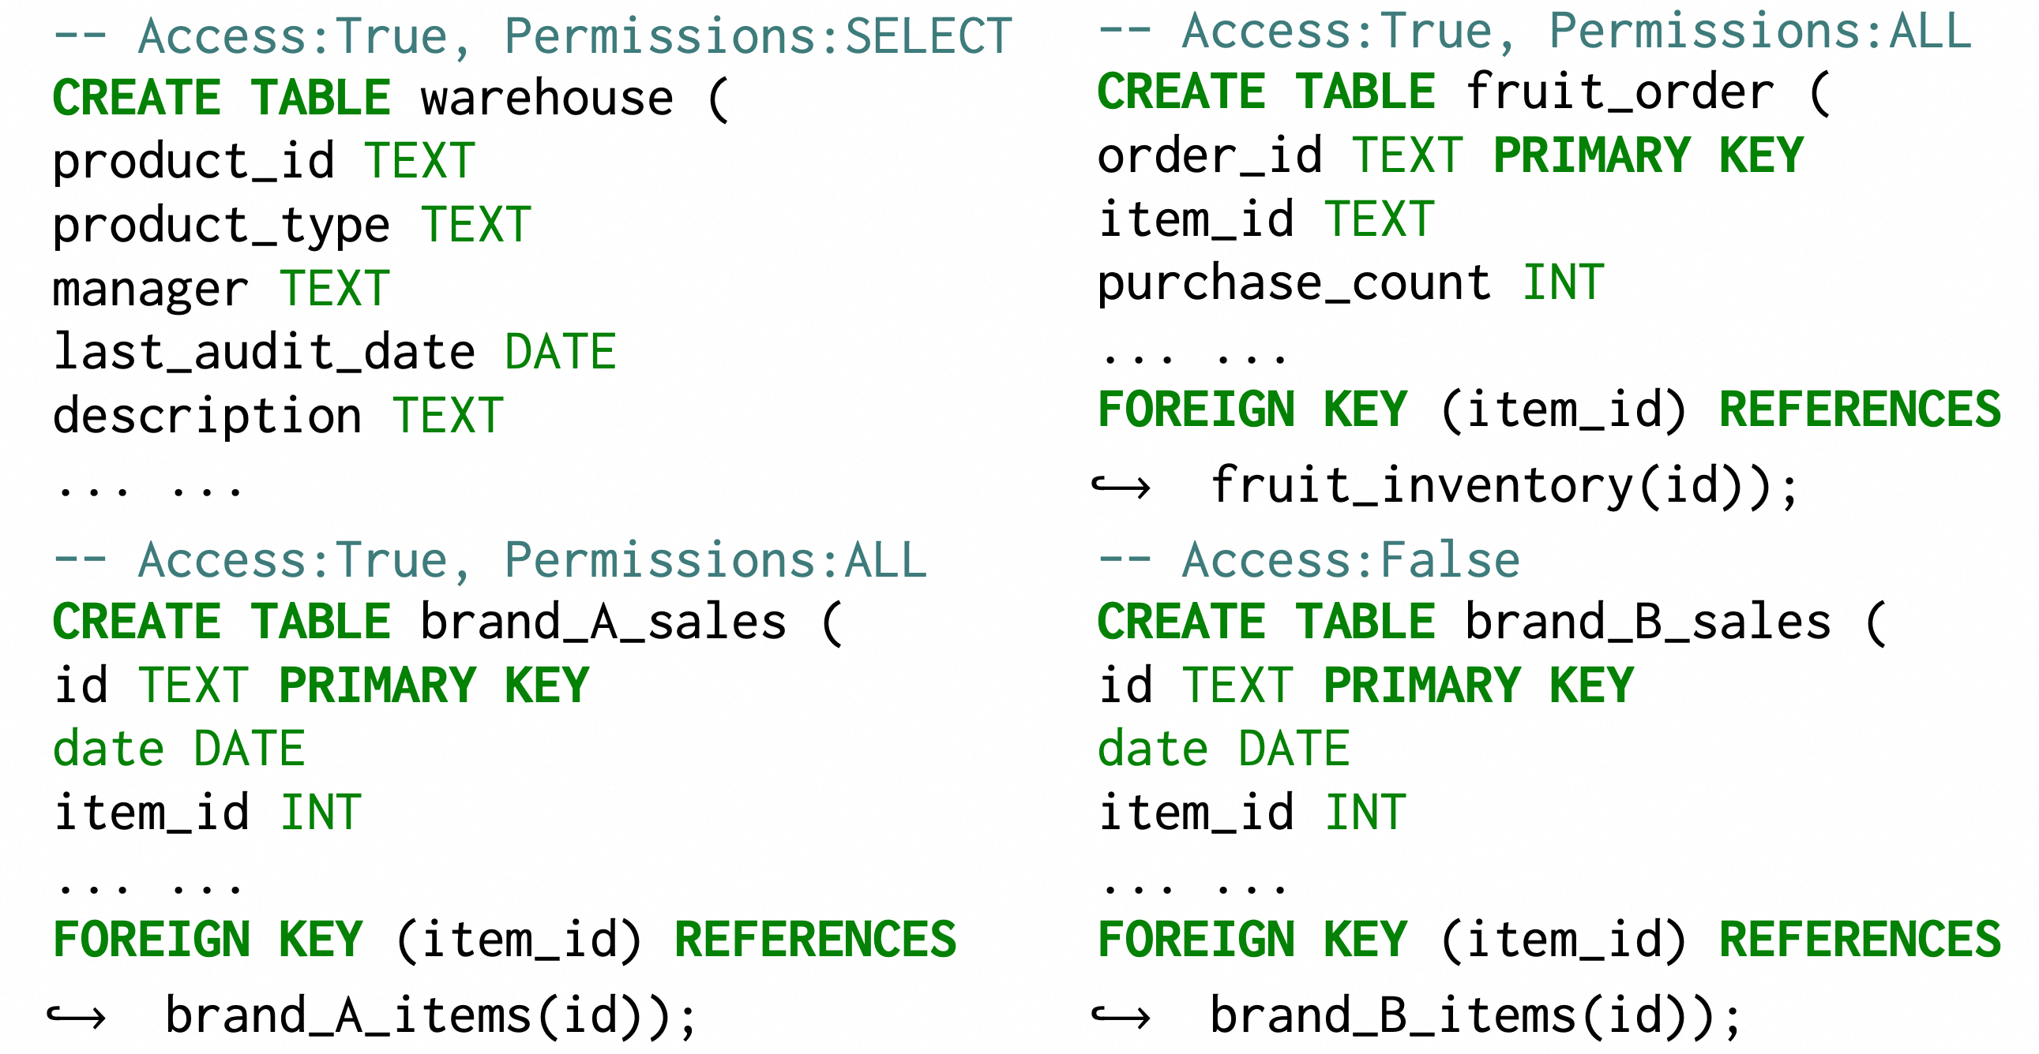
Context Retrieval
DB-side privileges and user-side restrictions are made explicit to the LLM via annotations
Object set
User-side restrictions
Schema exposed to LLM

Slide 9




SQL Execution
Action-level tool modularization
Object-level verification
Action-level tool modularization
def execute(sql): # execute an arbitrary SQL
select (“SELECT from brand_B_sales”)
required: SELECT on brand_B_sales
def select(sql): # execute a SELECT SQL
def update(sql): # execute an UPDATE SQL
def insert(sql): # execute an INSERT SQL
def delete(sql): # execute a DELECT SQL
…
In user privilege?
Reject
Manager for Brand A
update (“UPDATE brand_A_sales”)
required: UPDATE on brand_A_sales
select
Insert
update
delete
…
select
In user privilege?
Sales assistant
Under user restriction?
Manager
Reject

Slide 10
Execution via Proxy
Organize data flows instead of LLMs
lambda data:
[[row[0] for row in data],
[row[1] for row in data]]],
[row[2] for row in data],
[row[3] for row in data]]
select()
result
transform
consumer
producer(s)
trend_detect()
result
date | product | Prices/ weight | weight | supplier
06-01 | apple | 3.14 | 1 | A
06-01 | pear | 2.79 | 2 | A
06-02 | grape | 7.02 | 1 | A
def trend_detect (
date,
product,
price_per_weight,
weight)
select()
result
trend_detect()
proxy tool

Slide 11
Experimental Settings
ReAct agents built on
GPT-4
Claude-4
Benchmark
BIRD-Ext: Extended from BIRD, including SELECT, INSERT, DELETE, UPDATE NL2SQL tasks, 50 each.
NL2ML: ML tasks on a table of 20w rows of 3 complexity levels
write SQL
=
write semantic
+
write condition
Rule-based Generation
Origin BIRD SELECT task
L1
Data Query
Model Training
L2
Data Query
Data Processing
Model Training
L3
Data Query
Data Processing
Model Training
Predicting

Slide 12
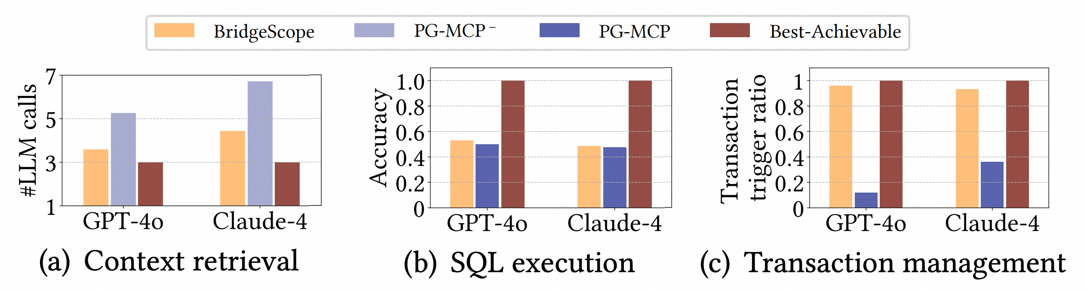
Experimental Evaluation
Coarse-Grained vs. Fine-Grained Tooling
execute_sql()
get_schema() + execute_sql()
~30%
Explicit context retrieval tools reduce schema hallucinations and reduce LLM calls by 30%
Fine-grained tools maintain accuracy while enabling enhanced security controls
Explicit transaction tools enable correct transaction initiation, which PG-MCP fails to achieve

Slide 13
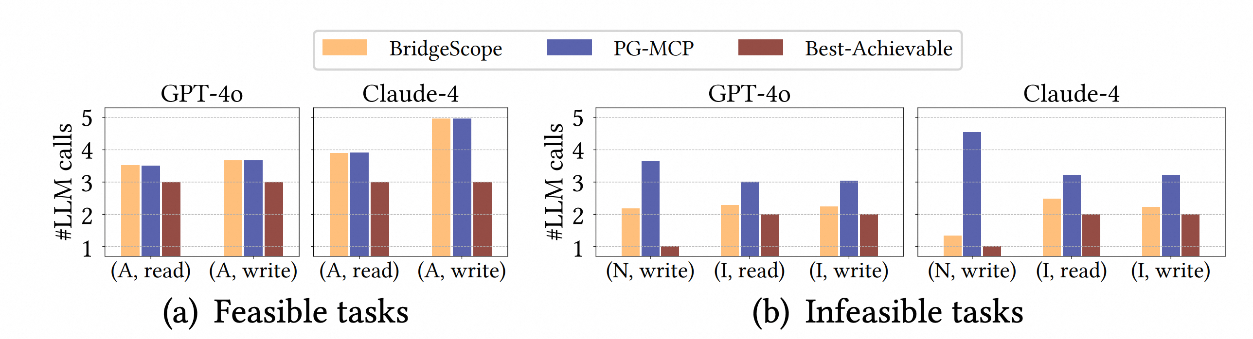
Experimental Evaluation
Effectiveness of Privilege-Aware Tooling
A: Administrator
N: Normal user
I: Irrelevant user
Privilege-aware design adds no overhead when users have sufficient privileges
BridgeScope reduces LLM calls by 23–71% and token costs by 30–82% for infeasible tasks
Restricting visible tools based on privileges helps LLMs quickly recognize task infeasibility

Slide 14
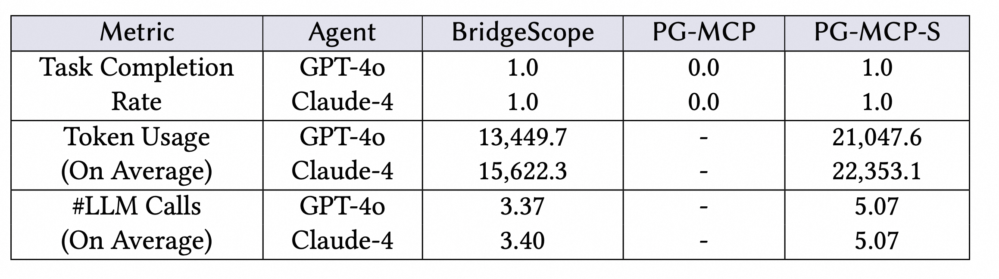
Experimental Evaluation
Effectiveness of Proxy
Modern LLMs are capable of abstracting and using the proxy tool to organize data flows
Direct data routing enables 100% task completion vs. 0% for context-based routing
BridgeScope maintains high efficiency in terms of both token usage and LLM calls on full datasets while context-based approaches fail or degrade even on small data scales

Slide 15
Conclusions
Existing database toolkits offer coarse-grained tools that are insecure, privilege-unaware, and fail on data-intensive tasks.
BridgeScope enables secure, efficient, and scalable database operations by three key innovations: fine-grained tool modularization, privilege-aware tool implementation, and a proxy mechanism for efficient data transmission.
Being database-agnostic and working transparently, BridgeScope integrates seamlessly with any agentic framework and MCP server to support diverse data-intensive tasks.

Slide 16


Thanks for Listening!
lianggui.wlg@alibaba-inc.com
https://github.com/duoyw/bridgescope/

