Slide 1
Admissions Process
Quarto PowerPoint Example
Admissions Office

Slide 2
Overview

Slide 3
Admissions Workflow
Student submits application
University verifies documents
Committee reviews application
Final decision is sent to student

Slide 4
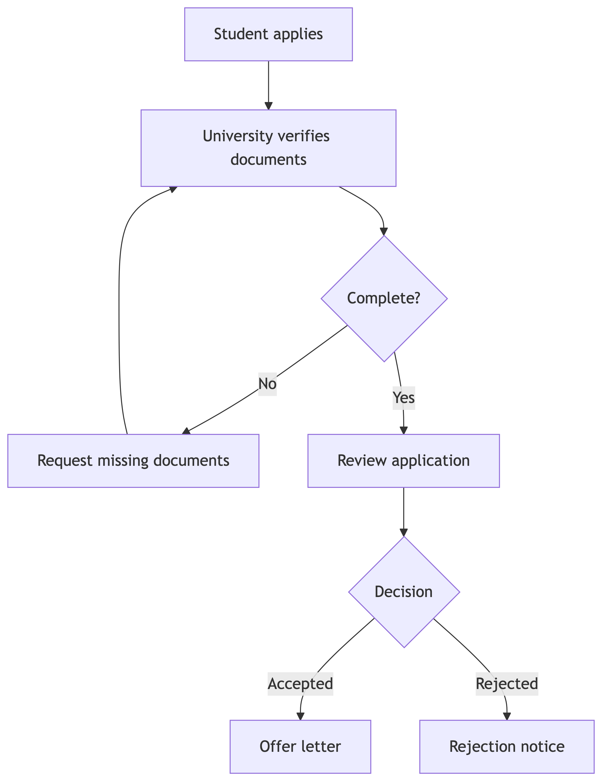
Admission Flow Diagram

Slide 5
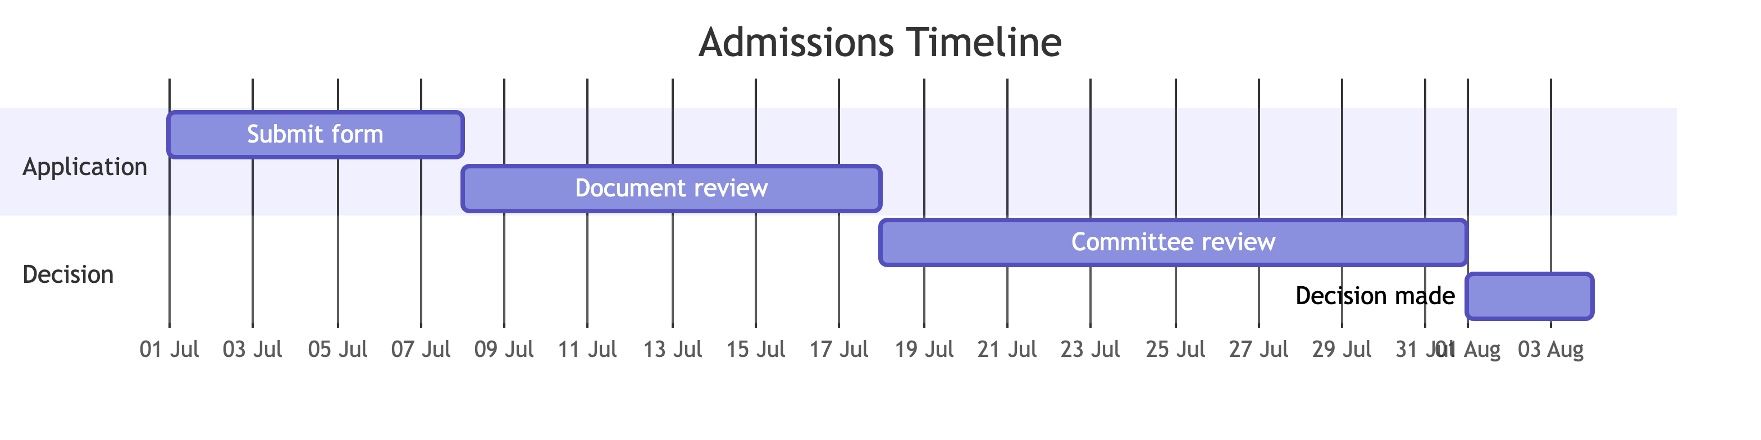
Admissions Timeline

Slide 6
Summary

Slide 7
Key Points
Use format: pptx in YAML
Use ## for individual slides
Mermaid diagrams can be included directly
Render with:
quarto render q1_ppt.qmd --to pptx

