Slide 1


Hybrid Attack Graphs for
Modeling Cyber-physical Systems
George Louthan
M.S. Candidate
17 Nov 2011

Slide 2

Overview
  Introduction and Motivation
    Cyber-physical systems
    Attack graphs
  Background
    Related formalisms
    Attack graphs
  Enhanced Discrete Attack Graph
  Hybrid Attack Graph
  Performance
  Conclusions and Future Work
Computer Science / www.isec.utulsa.edu

Slide 3
Introduction – Cyber-physical systems (CPS)
  Systems with tight physical-digital-network coupling
  Security threats can come from both sides
  Serious security challenges (Crenshaw and Beyer, 2010):
    Concentration in safety critical domains
    Integration of many third-party or unrelated components
    Dependence upon unreliable data collection
    Pervasiveness
Computer Science / www.isec.utulsa.edu

Slide 4
Introduction – Attack graphs
  Discrete domain formalism grounded in graph theory
  Model networks, systems, and attacks
  Excel at highlighting systems' and attacks' interactions
Computer Science / www.isec.utulsa.edu

Slide 5
Introduction – Motivation
  Why a formal model for CPS security?
  Safety criticality calls for verification
  Dearth of useful models for the cyber-physical boundary
    Need a common language for these systems
  Why attack graphs, specifically?
    System heterogeneity makes them a natural fit
Computer Science / www.isec.utulsa.edu

Slide 6
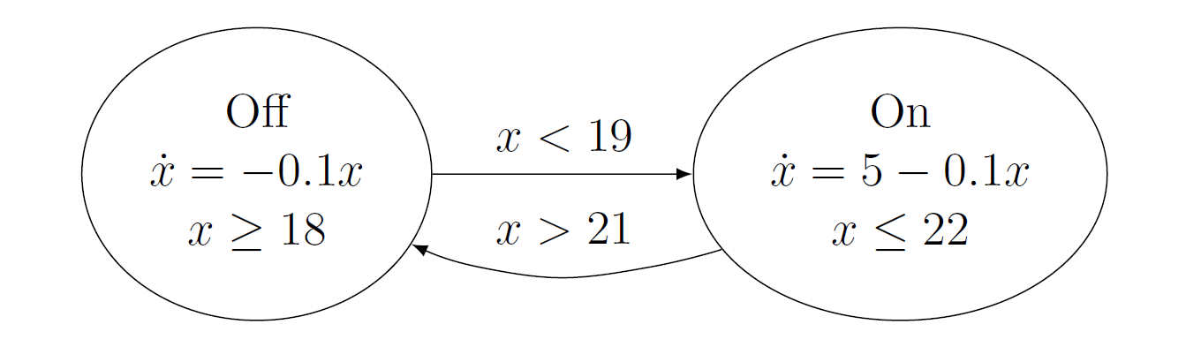
Background – Hybrid systems modeling
  Typical hybrid system model: Hybrid Automata (HA)
  State transition system paired with differential equations
  Operational “modes” and “switches” between them
  Guarded by conditions that govern state variables
Computer Science / www.isec.utulsa.edu

Slide 7
Background – HAs
  Idiomatic of hybrid systems modeling
    Differential equations
    Operating modes with guards
    Limited composition capability
  Idea:
    Model “micro” scale with HA like strategy
    Model “macro” scale with AGs
Computer Science / www.isec.utulsa.edu

Slide 8
Background – Attack graphs
  Best understood in relation to attack trees
  Attack trees:
    Goal-oriented model of a system abuse
    Root is “goal”
    Children encode prerequisites
Computer Science / www.isec.utulsa.edu

Slide 9
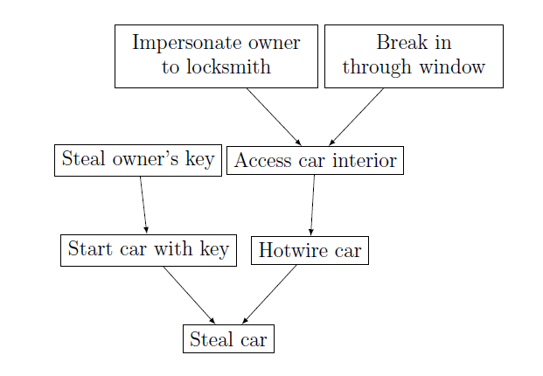
Background – AGs – Attack Tree example
Computer Science / www.isec.utulsa.edu

Slide 10
Background – Attack Graphs
  What if we want to “work forwards” – start with a system characterization and explore its possible abuses?
  What about automating this (basically a formal, simulated penetration test)?
  Attack graphs
Computer Science / www.isec.utulsa.edu

Slide 11
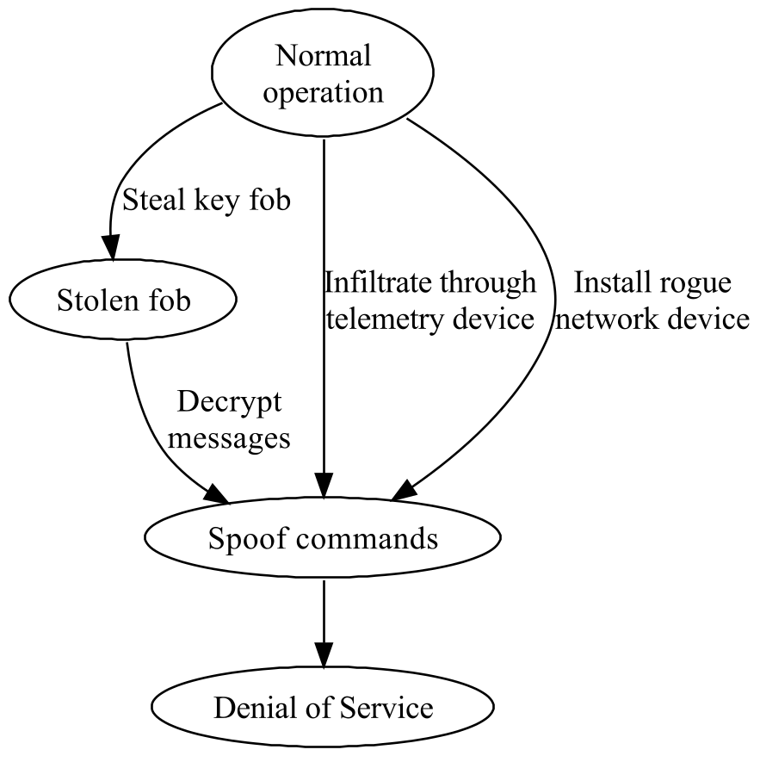
Background – Attack Graphs
Formal model for network attacks
Uses graph theory to represent attacks
Automatic generation: matches “exploit patterns” to network objects to create chains
Network model + exploit patterns + generator = attack graph
Hand-generated attack graph for locking a driver out of a car
Computer Science / www.isec.utulsa.edu

Slide 12
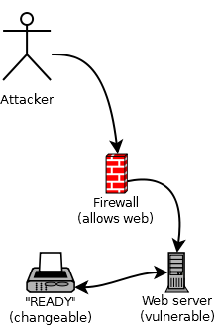
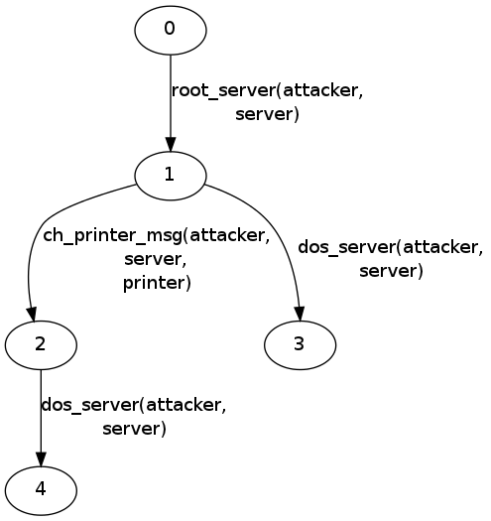
Background – Attack Graphs – Example
Computer Science / www.isec.utulsa.edu

Slide 13
Background – Attack Graphs – Approaches
  Free form vs. domain driven
    *Free form – liberal specification semantics, arbitrary keywords, properties, qualities, assets (requires standardized vocabulary)
    Domain driven – specification uses networking specific concepts (requires heavy lifting in the model)
  Other mixins:
    Metrics
    Likelihood weights
    Adversary characterization
    Cost ($$$) of mitigation
Computer Science / www.isec.utulsa.edu

Slide 14
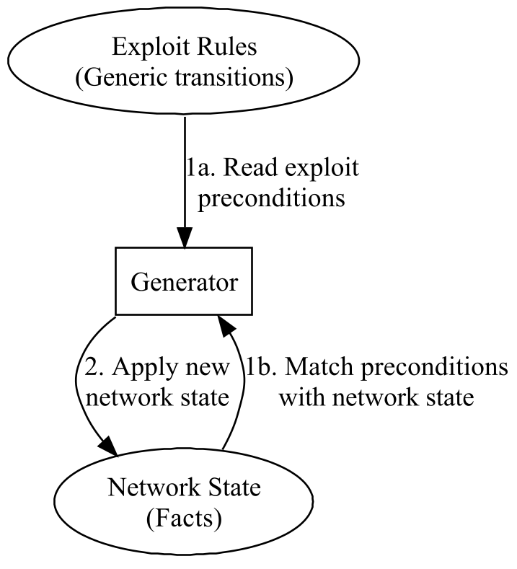
Background – Attack Graphs – Framework
  Underlying model based on “assets” and “facts”
    Assets – network objects
    Qualities – property facts about assets
    Topologies – relationship facts between assets
  Set of assets + set of facts = state
  Exploits match states' facts and generate new states
Automated attack graph generation process
Computer Science / www.isec.utulsa.edu

Slide 15
Background – Attack Graphs – Domains
Network
Model
  Asset
    Security principal
  Quality
    Property of an asset
  Topologies
    Relation on two assets
    Directed
  Exploits (free) / Attacks (bound)
    Function-like
    Parameters
    Preconditions
    Postconditions
assets=
asset1; asset2;
facts=
quality:asset1,q1=v;
topology:asset1->asset2,t;
Facts
ex(a1, a2)=
preconditions:
topology:a1,q1,v;
postconditions:
insert quality:asset1,q2=v;
Computer Science / www.isec.utulsa.edu

Slide 16
Enhanced Discrete Attack Graphs
  Stepping stone to Hybrid attack graphs (HAGs)
  Contributions
    Lexicon
      Access topologies
      Connection topologies
      Host status qualities
    Syntactic improvements
    Platform facts
    Global/grouped exploits
Computer Science / www.isec.utulsa.edu

Slide 17
Enhanced Discrete Attack Graphs - Lexicon
  Free-form modeling capability requires conventions
  Based upon Common Vulnerability Enumeration and National Vulnerability Database specifications
  NVD/CVE specify useful characteristics of vulnerabilities:
    “Security Protection” (unauthorized access) types:
      User access
      Administrative access
      Other access (e.g. service account)
    Access vector:
      Local
      Adjacent (same broadcast or collision domain)
      Network (e.g. Internet)
Computer Science / www.isec.utulsa.edu

Slide 18
Enhanced Discrete Attack Graphs - Lexicon
  Status qualities
    Denote hosts that are up or down
    Quality name: “status”, values “up” or “down”
  Access topologies
    Denote (possibly legitimate) trust relationships
    Topology name: “access_<type>”
    Type = “user” | “root” | “other” | “other_<name>”
  Connection topologies
    Denote communication relationships
    Topology name: “connected_<type>”
    Type = “adjacent” | “local” | “network_<protocol>”
Computer Science / www.isec.utulsa.edu

Slide 19
Enhanced Discrete Attack Graphs - Platforms
  Uses Common Platform Enumeration (CPE)
    Provides a language for specifying platform hardware, software, version, language, etc.
    Format: “cpe:/<part>:<vendor>:<version>:<update>:<edition>:<language>”
    Example: “cpe:/a:adobe:reader:8.1::en”
    Prefix and wildcard properties apply
  New fact type: platforms (special case of quality)
    platform:asset1,cpe:/a:adobe:reader:8.1;
Computer Science / www.isec.utulsa.edu

Slide 20
Enhanced Discrete Attack Graphs – Example
Computer Science / www.isec.utulsa.edu

Slide 21
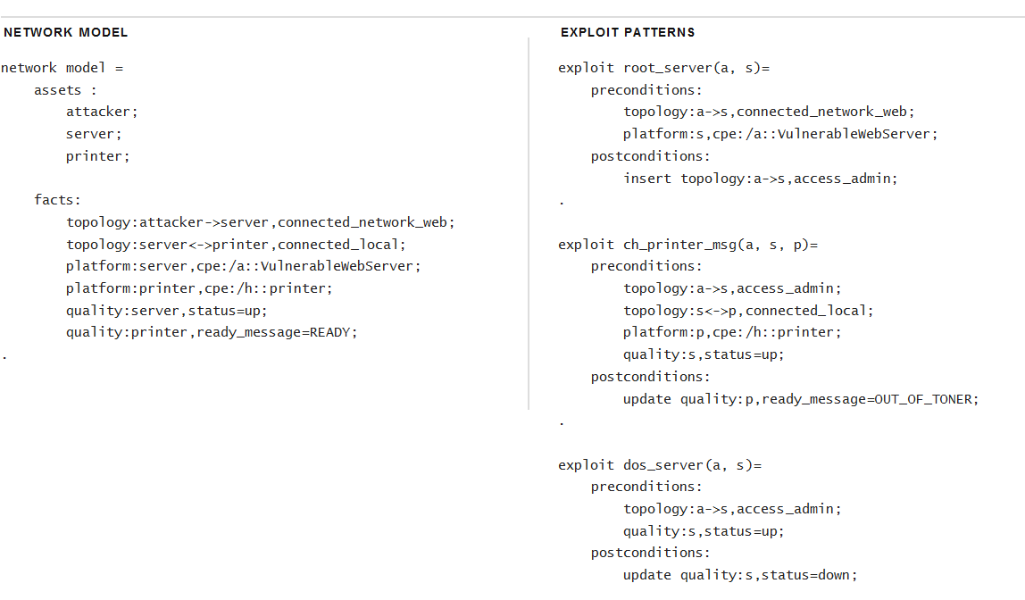
Enhanced Discrete Attack Graphs – Example
Computer Science / www.isec.utulsa.edu

Slide 22
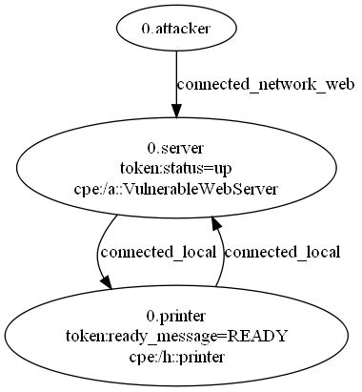
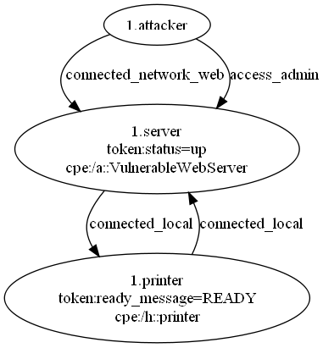
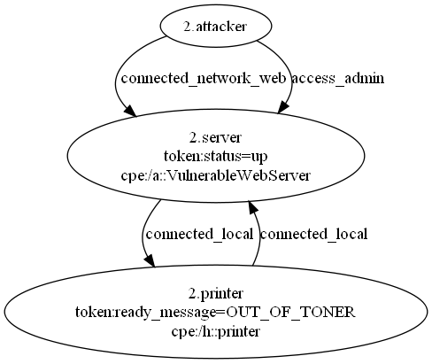
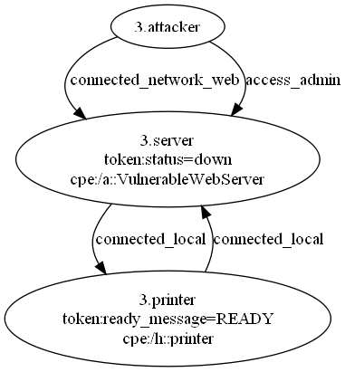

Scenario example – Attack graph
Computer Science / www.isec.utulsa.edu

Slide 23
Enhanced Discrete Attack Graphs - Grouping
  It is useful to cause attacks to fire simultaneously
  Aggregate AG edge transition to include multiple attacks
  Group exploits
    group(group1) exploit ex1(ap) = …
    group (group1) exploit ex2(ap) = …
    When possible, ex1(a) and ex2(a) use same edge
  Global exploits
    global exploit ex3(a) = …
    When possible, ex2(a), ex2(b), etc. use same edge
  Global group exploits
    global group(group2) exploit ex4(ap)
    Combines both mechanics
Computer Science / www.isec.utulsa.edu

Slide 24
Hybrid Attack Graphs (HAG)
  AG excel at modeling disparate components' interactions
    Recall that this is a principal challenge in CPS
  HAG extend AG with real-values, physical reasoning:
    RFID inventory tag distance to reader
    Generator temperature or pressure
    Centrifuge speed
Computer Science / www.isec.utulsa.edu

Slide 25
Hybrid Attack Graphs (HAG)
  What does a hybrid attack look like?
    System placed into harmful mode (think HAs)
      Centrifuge spins too fast
      Brakes stop working, accelerator stuck
      Power consumption increased
  Requires time
    Enabled by global/group exploits
Computer Science / www.isec.utulsa.edu

Slide 26
Additions
  Type system
    Facts are “token” (string) or “real” valued
    Types denoted by operators
      Token
        Assignment: =
        Relational: =, !=
      Real
        Assignment: :=, +=, -=, *=, /=
        Relational: ==, <>
    Every test or assignment has an explicit type
  Real (but not token) values for topologies
Computer Science / www.isec.utulsa.edu

Slide 27
Additions
  Modeling time
    Implemented with exploits: global group(time)
    Discretize time into steps of equal size
    Each time attack is one timestep
  Automotive example
Computer Science / www.isec.utulsa.edu

Slide 28
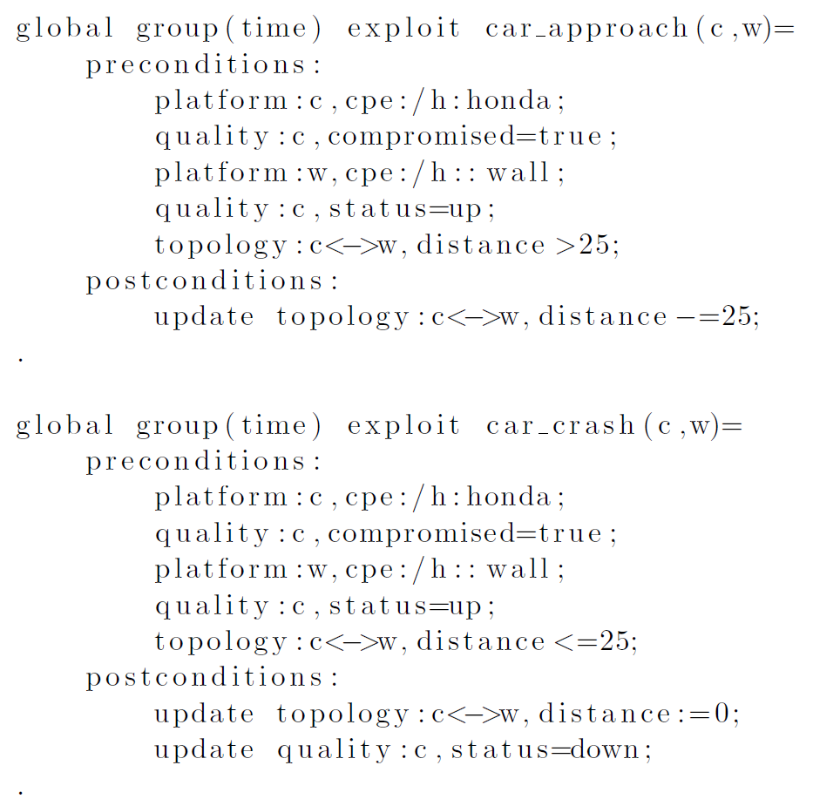
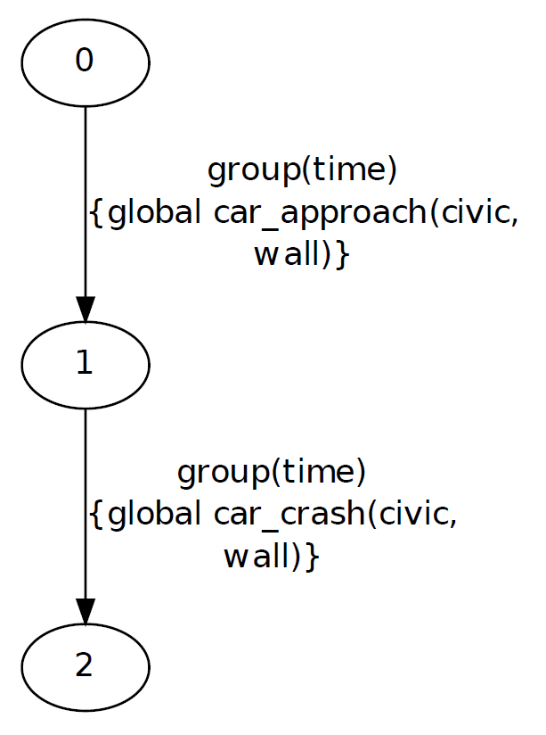
Computer Science / www.isec.utulsa.edu

Slide 29
RFID Example
  ISO 18000-7 RFID system used by DOD and DOE for inventory tracking
  Tags are active and battery powered
  Usage includes inventory on nuclear material containers
  Tags have “active” and “sleep” modes
  A “denial of sleep” attack from a rogue or compromised reader causes battery drain
Computer Science / www.isec.utulsa.edu

Slide 30
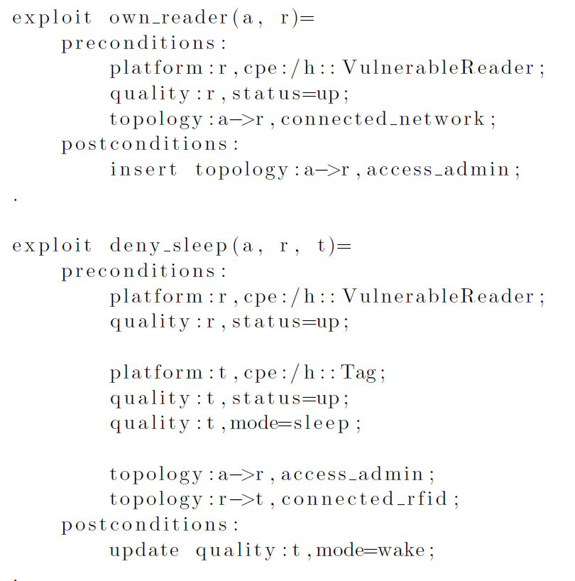
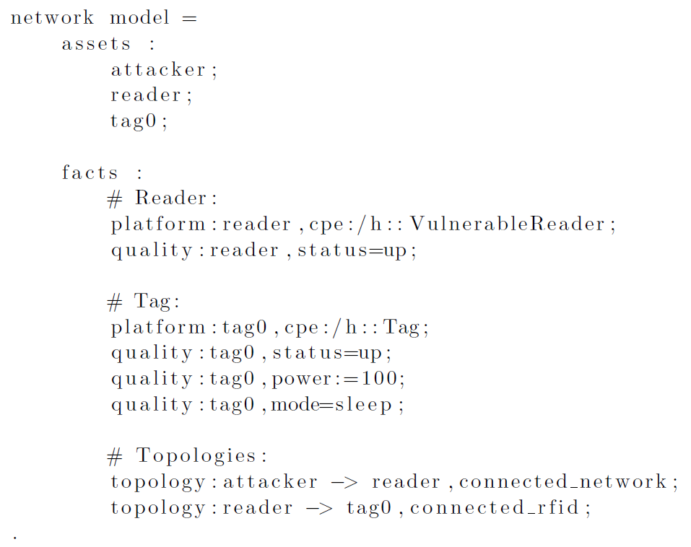
RFID Example
Discrete exploits
Computer Science / www.isec.utulsa.edu

Slide 31
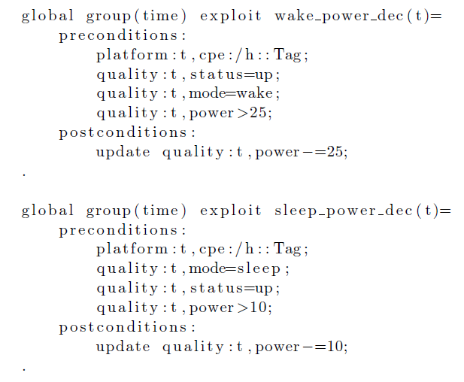
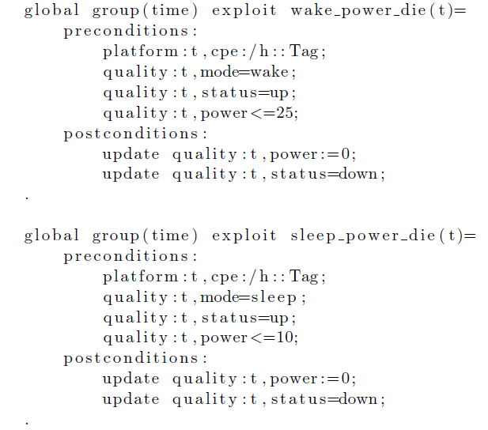
RFID Example
Time exploits
Computer Science / www.isec.utulsa.edu

Slide 32
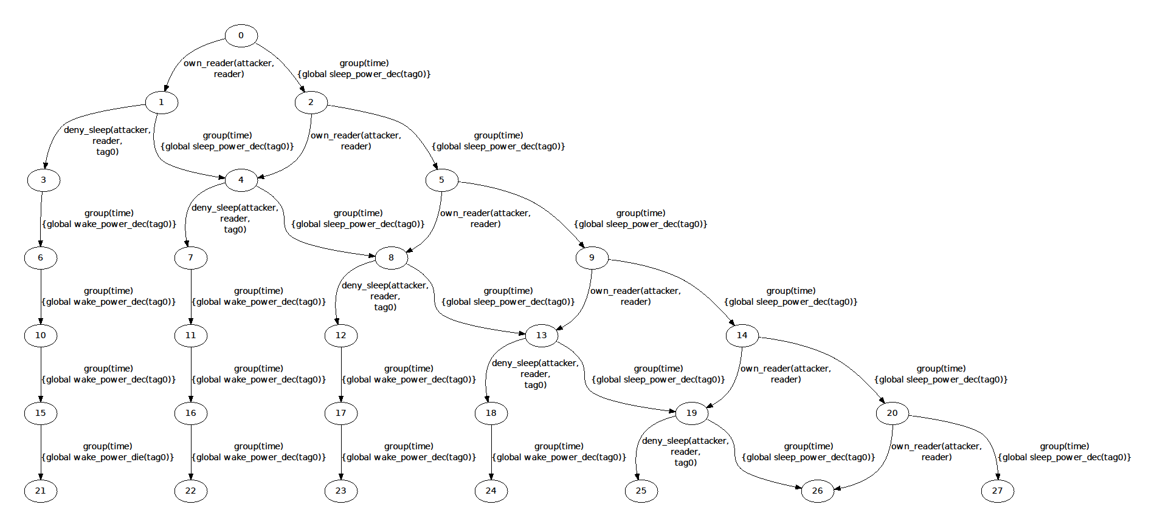
RFID Example
●
●
●
●
●
●
●
●
●
●
●
●
●
●
●
●
●
●
Computer Science / www.isec.utulsa.edu

Slide 33
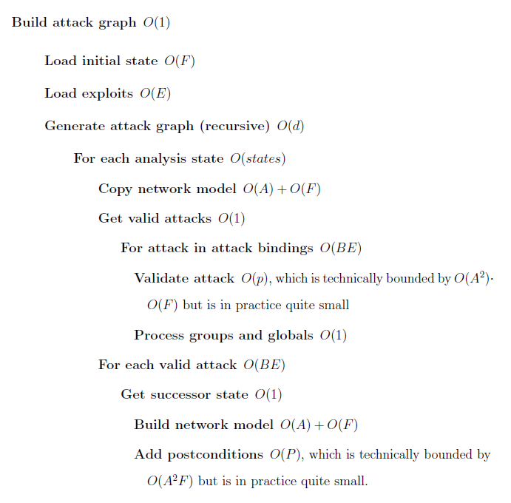

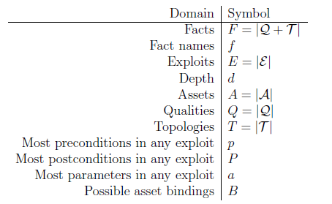
Performance
Computer Science / www.isec.utulsa.edu

Slide 34
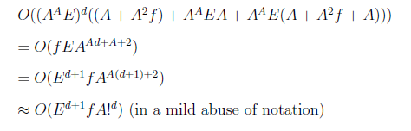
Performance
Computer Science / www.isec.utulsa.edu

Slide 35
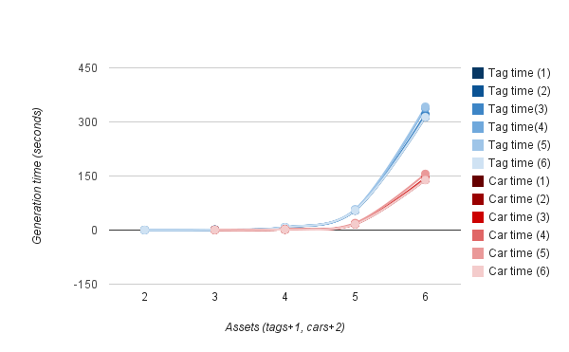
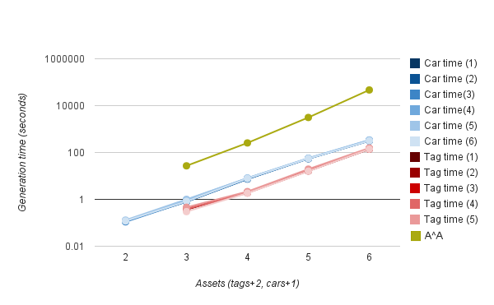
Performance – Number of assets
Computer Science / www.isec.utulsa.edu

Slide 36
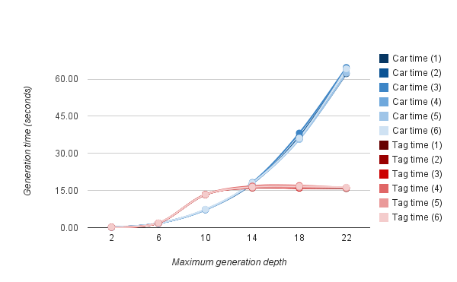
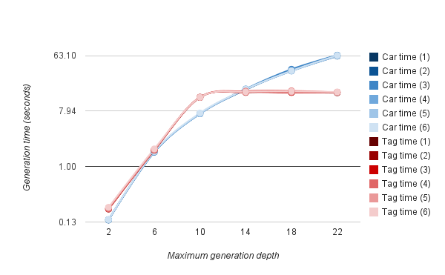
Performance – Generation depth
Computer Science / www.isec.utulsa.edu

Slide 37
Performance Summary
  Execution time scales factorially with input assets and exponentially with maximum depth
  Falls well short of the state of the art
    This was expected
    This is fine
Computer Science / www.isec.utulsa.edu

Slide 38
Conclusions – Summary
  Enhanced discrete attack graph with applications to information systems (IS)
  Expanded attack graph with applications to CPS, possibly to IS as well
  Faithfully model well-behaved subset of hybrid systems
  Falls short of the state of the art in performance
Computer Science / www.isec.utulsa.edu

Slide 39
Conclusions - Challenges
  Performance
    HAGs make little changes to algorithmically expensive portions of the generation process, however
  Cognitive scalability
    Even more marked in time driven HAGs
  Model acquisition
  Less serious:
    Separation of concerns (exploits vs. network)
    Wildcard and pivot exploits
    Complex preconditions
    Variable hybrid postconditions (HA applications)
Computer Science / www.isec.utulsa.edu

Slide 40
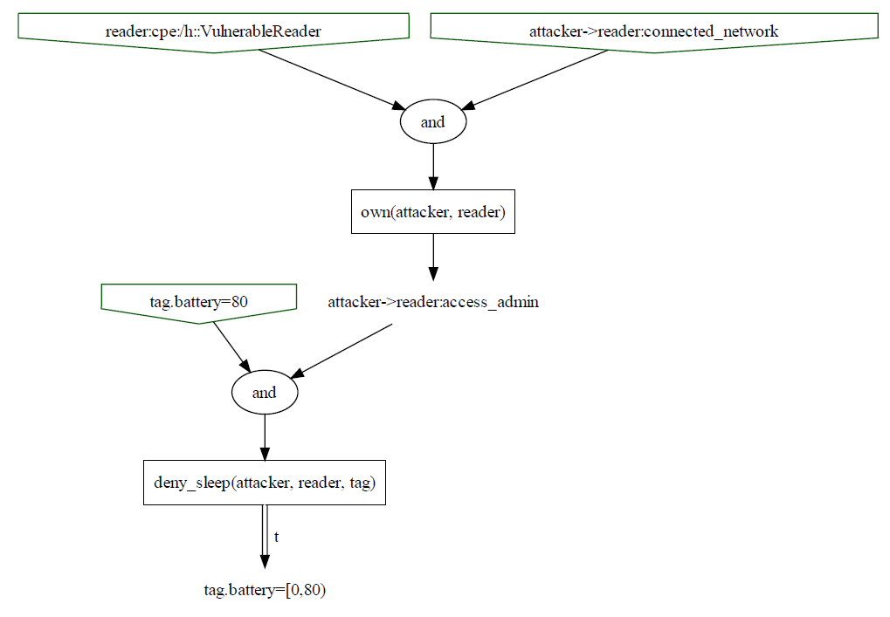
Future Work
  Hybrid attack dependency graphs
Computer Science / www.isec.utulsa.edu

Slide 41
Acknowledgments
  Committee
    Dr. John Hale, Dr. Mauricio Papa, Dr. Peter Hawrylak
  Collaborators
    Chris Hartney, Matt Young, Carsten Mueller, Aleks Kissinger, Zach Harbort, Jordan Sanderson, Phoebe Hardwicke
  Funding (DARPA)
This material is based on research sponsored by DARPA under agreement number
FA8750-09-1-0208. The U.S. Government is authorized to reproduce and distribute
reprints for Governmental purposes notwithstanding any copyright notation
thereon. The views and conclusions contained herein are those of the authors and
should not be interpreted as necessarily representing the official policies or
endorsements, either expressed or implied, of DARPA or the U.S. Government.
Computer Science / www.isec.utulsa.edu

