Slide 1
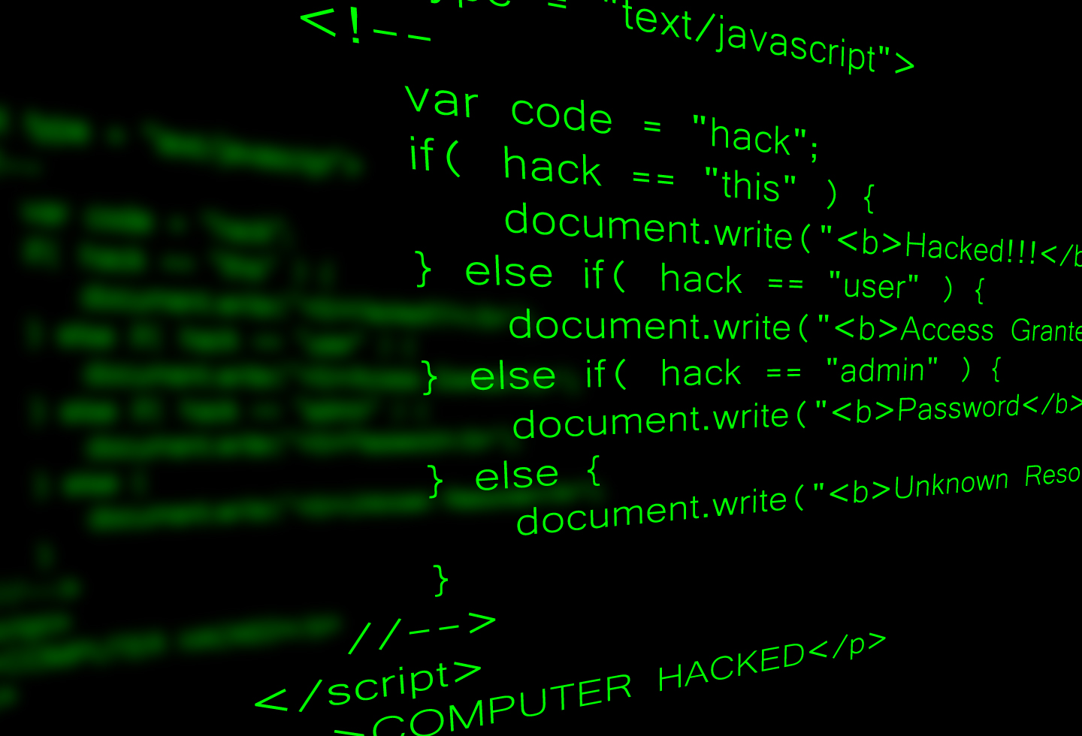
Constant Vigilance in the Workplace
Rachel Dupuy

Slide 2

Introduction
To be vigilant is to be aware of one’s surroundings and to be suspicious of what is deemed slightly askew from normal.
As an ICT Specialist, constant vigilance is an invaluable skill in everyday workplace life.
This is none so much as important as when my role dictates that we handle personal data.
Any breach of personal data will not only have serious consequences for myself as an ICT Specialist, but also the organisation.
Therefore, it is essential to be aware of all areas in which a breach or attack could occur.

Slide 3
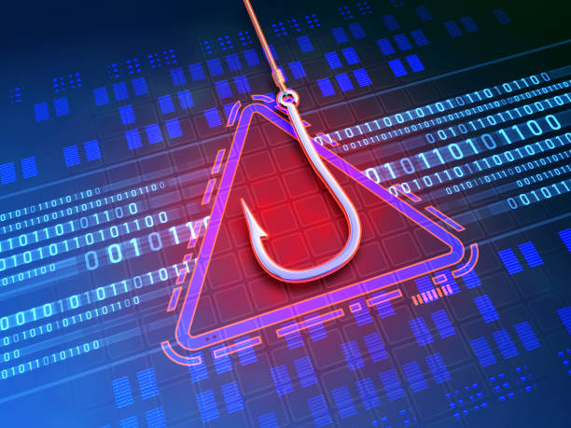
Phishing
Phishing is the act of enclosing malicious code in various types of social engineering such as emails or texts with the intent of acquiring personal data from unsuspecting victims.
The personal data can be a fraudulent SMS message in which scammers pretend to be from the victim’s bank using some sort of urgent emergency in which the victim will feel obliged to follow any links or call any numbers in the text, or an email pertaining to a non-existent Amazon order that required attention.
These can be linked to a sub type of phishing known as spear fishing, in which a specific person or company is targeted via email/SMS or even a phone call.
This is especially important as an ICT Specialist, as a phishing email could be used to gain access to my organisation, and to steal personal data.
Therefore, it is important to be constantly vigilant of any emails or messages sent to me, even from persons I trust, especially if they seem unusual.

Slide 4
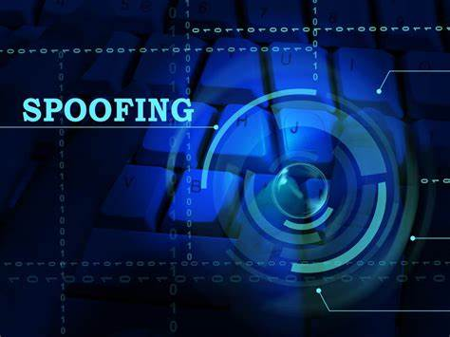
Spoofing
Spoofing is when attackers pretend to be someone else, such as a legitimate company or work colleague in order to trick victims into handing over personal information pertaining to themselves or their company.
This personal information is usually login credentials or banking credentials.
Attackers will usually spoof emails and phone numbers either belonging to the victim’s bank, manager, or even family members. They will send fraudulent urgent emails and SMS messages, wherein if any links are followed, and personal information given, this information will be accessed by the attackers and could be used to breach an organisation.
This is important as an ICT Specialist as any attacker that is successful will compromise the security of my organisation.
Therefore, it is important to be constantly vigilant of all emails and messages even if the sender is a legitimate email, as it could be spoofed.

Slide 5
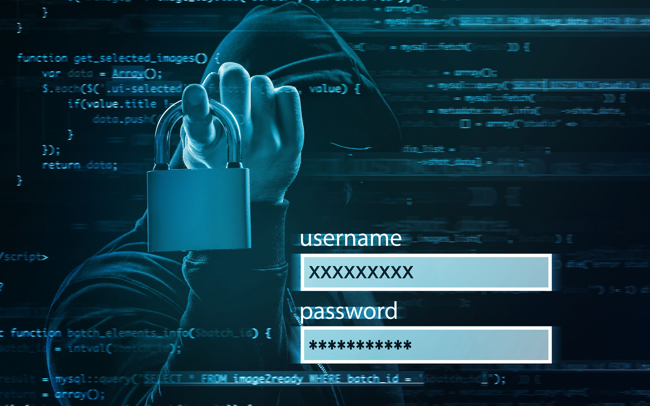
SQL Injection Attacks
SQL Injection Attacks are attacks in which a web security vulnerability is exploited to inject malicious SQL commands into an application’s database. This usually occurs when user input is indirectly concatenated into a SQL query without proper validation and sanitisation.
These malicious SQL commands can be used to acquire the personal data of all application users with saved data in the database. This can be especially harmful if the data contains banking information or data that can be used to commit identity theft.
An example of such malicious SQL commands would be inserting ‘ OR ‘1’ = ‘1 into an input box wherein user credentials are checked using the following command ‘SELECT * FROM users WHERE username = ‘user’ AND password = ‘pass’.
The inserted command would create the SQL command ‘SELECT * FROM users WHERE username = ‘ OR ‘1’ = ‘1’ AND password = ‘ which would return a list of all user credentials saved in the database to the attackers, which then can be used for malicious purposes.
Different types of SQL Injection include: In-band SQL Injection wherein the attacker uses the same channels to launch the attack and to gather the results of said attack, Blind SQL Injection wherein the attacker does not know the outcome of the SQL command but can infer some of the results based on the performance of the application, and Out-of-Band SQL Injection wherein the attacker uses one channel for launching the attack and another for gathering the results of said attack.
This is important as an ICT Specialist who has worked on projects that involve connections to a SQL database, as the majority of data in these databases are personal details regarding land holdings, which if compromised would lead to serious consequences for my organisation.
Therefore, it is important to be constantly vigilant and use parametrised queries, prepared statements, validation and sanitisation of user input to ensure it is of the correct format, restricting database access to least privilege, and reducing the amount of information provided in error messages to ensue as little information as possible is given about the database.

Slide 6

GDPR
Throughout this presentation, I have discussed how cyber-attacks can have serious consequences for my organisation. This concerns the data protection laws put in place by the EU to protect user data from attacks, and to hold any organisation accountable for lacklustre security if a data breach should occur. These data protection laws are collectively known as General Data Protection Regulation, or GDPR for short.
GDPR oversees the handling of personal data by organisations within the EU. These organisations may only retain personal data for six lawful reasons as outlined by the GDPR. These are defined as follows:
The data owner has given free and informed consent for the data to be stored
The processing of the data is necessary to carry out any contracts that the data owner is party to
The processing of the data is necessary in order for the data controller to meet any legal obligations
The processing of the data is necessary to protect the vital interests of the data owner
The processing of the data is necessary to carry out tasks that are in the public interest or over which the data controller has official authority, and
The processing of data is necessary in the legitimate interests of the data controller and does not conflict with the data owner’s rights.

Slide 7
GDPR (continued)
The data owner is entitled to enquire about and receive answers on the following in regard to their personal data: the reasons for the storage of the data, who will have access to the data, how long will it be stored for, if they are required by law to sign a contract to provide the data, will their data be subject to any automated processing.
The data owner is also entitled to request the correction. Erasure, and restriction of their data as well as request access to, a copy the data so it can be given to others, and to withdraw consent to the processing of their personal data.
Any organisation that is handling personal data must secure it by using methods such as anonymisation, encryption, anti-virus security measures and by backing up data. If an organisation suffers a data breach they must report it to the Data Protection Commission within 72 hours, with any delays substantially justified.
Any organisation that does not adhere to what is outlined in the GDPR and suffers a data breach is subject to large fines, which can be as high as 2 million euro or 4% of the organisation’s global annual turnover, whichever is higher.

Slide 8

What I can do as an ICT Specialist
When receiving emails, I must always be wary of requests, links or attachments, even if they seem to be from a trusted source.
It is important to check any links before clicking on them, as even just a click could infect my system with malware. By hovering over the link with the cursor, I can see the full URL address and determine whether it is malicious or not.
Sometimes even a trusted source might not be all that trustworthy. If an email seems suspicious, it is always a good idea to check with the sender before interacting with any links or attachments in the email, to ensure that it is legitimate and not a spoofing attack.
Understand and be aware of the GSPR and ensure that I properly adhere to its principles when I am handling personal data.
Be aware of and correct any vulnerabilities when contacting databases in applications.

Slide 9
</presentation>

