Slide 1

Phase 3 requirements specification
What Dawra Campus
has to do
Dawra Campus student project
COSC 336 / Group 4
Khalifa University
13 October 2026
Sultan Almheiri 100065654
Zayed Alfadli 100064657
Ghaith Alhinaai 100066185
Phase 3 submission: Software Requirements Specification (SRS)

Slide 2
What's in our SRS
98
14
61
functional requirements
use cases
states
14 classic features, sections 4.3–4.16
UML diagram + a full description for each
for assets, requests, transfers, repairs and more
20
14
9
business rules
screens
sustainability requirements
who can do what, and when
what each page must show and allow
with a formula for every number
Built on our Phase 1 requirements and Phase 2 decisions, using the course SRS template
Group 4 / 02

Slide 3
Nine roles, three do the daily work
Primary users
Everyone else
Requester
Finance officer Approves over-limit spending and write-offs
Searches, asks for items and reserves them
Procurement officer Approves procurement-controlled transfers
Sustainability officer Checks reuse was tried before disposal
Asset custodian
Registers items, hands them over and confirms receipt
Maintenance staff Assesses and repairs items
Business administrator Sets up departments and authorises roles
Department representative
Approves listings, requests, transfers and repairs
System administrator Runs accounts and applies roles
IT access never turns into approval power (BR-01)
Group 4 / 03

Slide 4
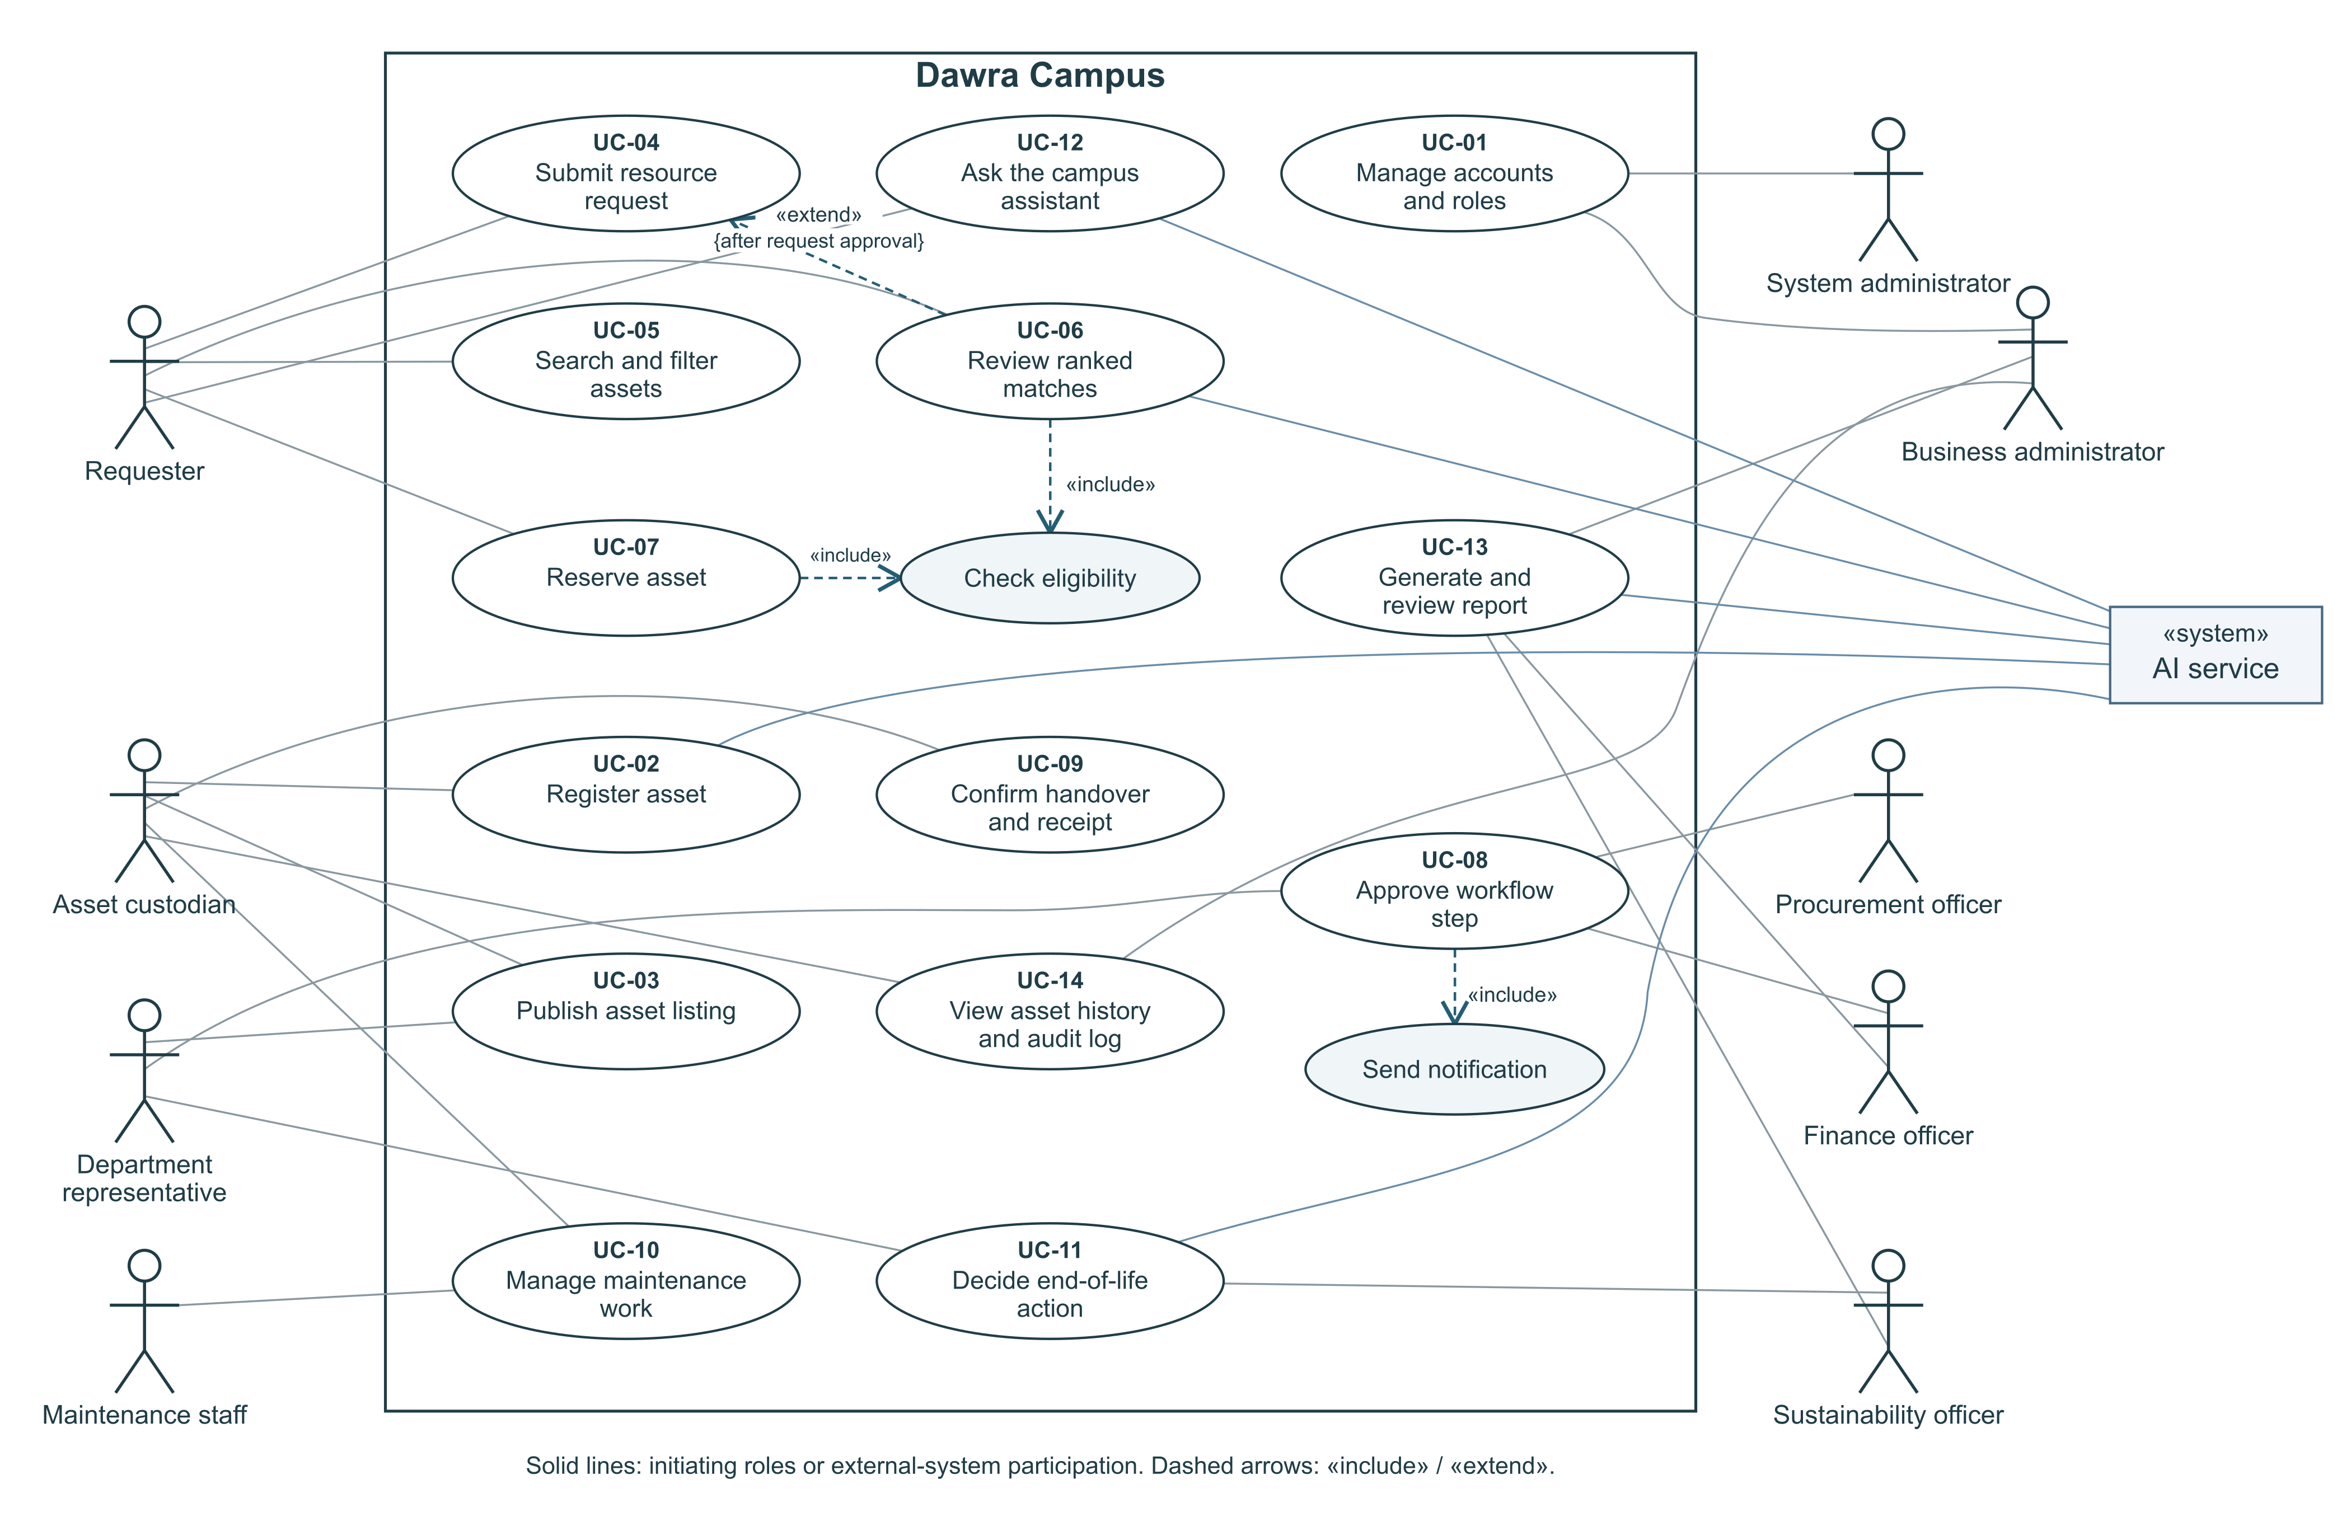
Use-case diagram
14 use cases; every approval goes through UC-08 (Approve workflow step)
Group 4 / 04

Slide 5
Example: UC-09 Confirm handover and receipt
Actors: releasing and receiving Asset custodians Starts when: the transfer is Approved (TR-04)
Normal flow
If something goes wrong
Both custodians confirm the delivery plan
Releasing custodian records quantity and condition, then hands over
System marks it Handed over; the item is In transfer
Receiving custodian checks it and confirms receipt
System completes the transfer, moves ownership and fulfils the request
Approval missing
handover is blocked
Cancelled before handover
the quantity goes back to the listing
Quantity or condition differs
transfer becomes Disputed and ownership stays put
Ownership only changes after the receiving custodian confirms (BR-13)
Group 4 / 05

Slide 6
How a transfer moves through its states
only if over the Finance limit or procurement-controlled (BR-06)
Pending release approval
Pending receipt approval
Pending policy approval
Approved
Handed over
Completed
TR-01
TR-02
TR-03
TR-04
TR-05
TR-06
Rejected (TR-08)
Cancelled (TR-09)
Disputed (TR-07)
Any approver says no, with a reason
Stopped before handover; quantity returns
Receipt doesn't match; ownership stays put
61 states across 8 record types; any change not allowed is blocked and logged
Group 4 / 06

Slide 7
Who approves what
Workflow | Approved by, in order
Listing an item | The owning department's representative
A request | The requester's department representative
A transfer | Releasing representative → receiving representative → Finance / Procurement if over the limit
Repair spending | The department representative → Finance if over the limit
End of life (donate, recycle, dispose) | Sustainability officer → Finance officer
Giving someone a role | Business administrator authorises → System administrator applies
Nobody can approve their own request (BR-02)
Group 4 / 07

Slide 8
Requirements written so we can test them
We used the EARS patterns from the Chapter 3 slides. Examples from our SRS:
Pattern | Example
When (event) | When two users try to reserve the last units at the same time, the system shall confirm only one. (FR-09.5)
While (state) | While an asset is under maintenance, in transfer or retired, the system shall not allow it to be listed or reserved. (FR-05.4)
If … then (problem) | If the received quantity or condition is different, then the system shall mark the transfer Disputed and keep ownership unchanged. (FR-11.5)
Where (optional) | Where email is enabled, the system shall also send each notification by email. (FR-16.6)
Every "shall" becomes a test case in Phase 7
Group 4 / 08

Slide 9
Where AI fits
AI features (sections 4.17–4.23)
The rules for AI
Suggest category and description
Essential
Normal rules remove items that can't be used before AI ranks anything (BR-14)
Picking a match isn't a reservation, and a reservation isn't an approval (BR-15)
Every suggestion shows its reasons and how sure it is
If AI is down, normal search and forms still work
Match requests to items by meaning
Essential
Rank matches with score, reasons and confidence
Essential
Draft report summaries
Essential
Track model version, overrides and fallback
Essential
Suggest what to do with old items
Desirable
Campus chat assistant
Desirable
AI suggests, people decide, and normal search always works
Group 4 / 09

Slide 10
Measuring sustainability
Avoided purchases
Net savings
Requests filled with an existing item that a reviewer confirms would otherwise be bought × replacement cost
Avoided purchase value − transfer, inspection and repair costs
Reuse rate
Carbon saved
Listed quantity that was transferred and received ÷ total listed quantity × 100
Avoided quantity × emission factor for the category − transport and parts emissions
Only finished, approved actions count; our made-up data shows the method, not real savings
Group 4 / 10

Slide 11
Quality targets
2 s
4 of 5
15 s
0
95% of searches return within 2 seconds
test users finish the main tasks without help
to switch to normal features if AI fails
paid accounts or AI keys needed
500 test assets, 5 users at once
register, find an item, submit a request
nothing the user typed is lost
the classic system runs straight from the repo
Every target can be measured; details are in section 5
Group 4 / 11

Slide 12
Priorities, and what we need from you
Essential
Open questions for the instructors
All classic features, AI classification and matching, basic AI reports, sustainability dashboard
What value needs Finance approval for a transfer or repair? (TBD-1, TBD-2)
Is 5 working days right for holding a reservation? (TBD-3)
Which items need EHS handling? (TBD-8)
Which source should we use for carbon factors? (TBD-6)
Desirable
Old-item suggestions, chat assistant, configurable limits, report export, hosting online
Future
Email alerts, demand forecasting, map view, Arabic version, KU system integration
Next: architecture and design in Phases 4 and 5
Group 4 / 12

Slide 13
Who did what
Sultan
Zayed
Ghaith
Introduction and scope, record states, 14 classic features, business rules and approvals, sustainability, priorities
Roles and permissions, 14 screens, use-case diagram and the 14 use-case descriptions
Operating environment, interfaces, AI features and the quality requirements
Each member wrote their own sections on GitHub, and teammates reviewed them through pull requests.
Thank you – questions?
Group 4 / 13

