Slide 1
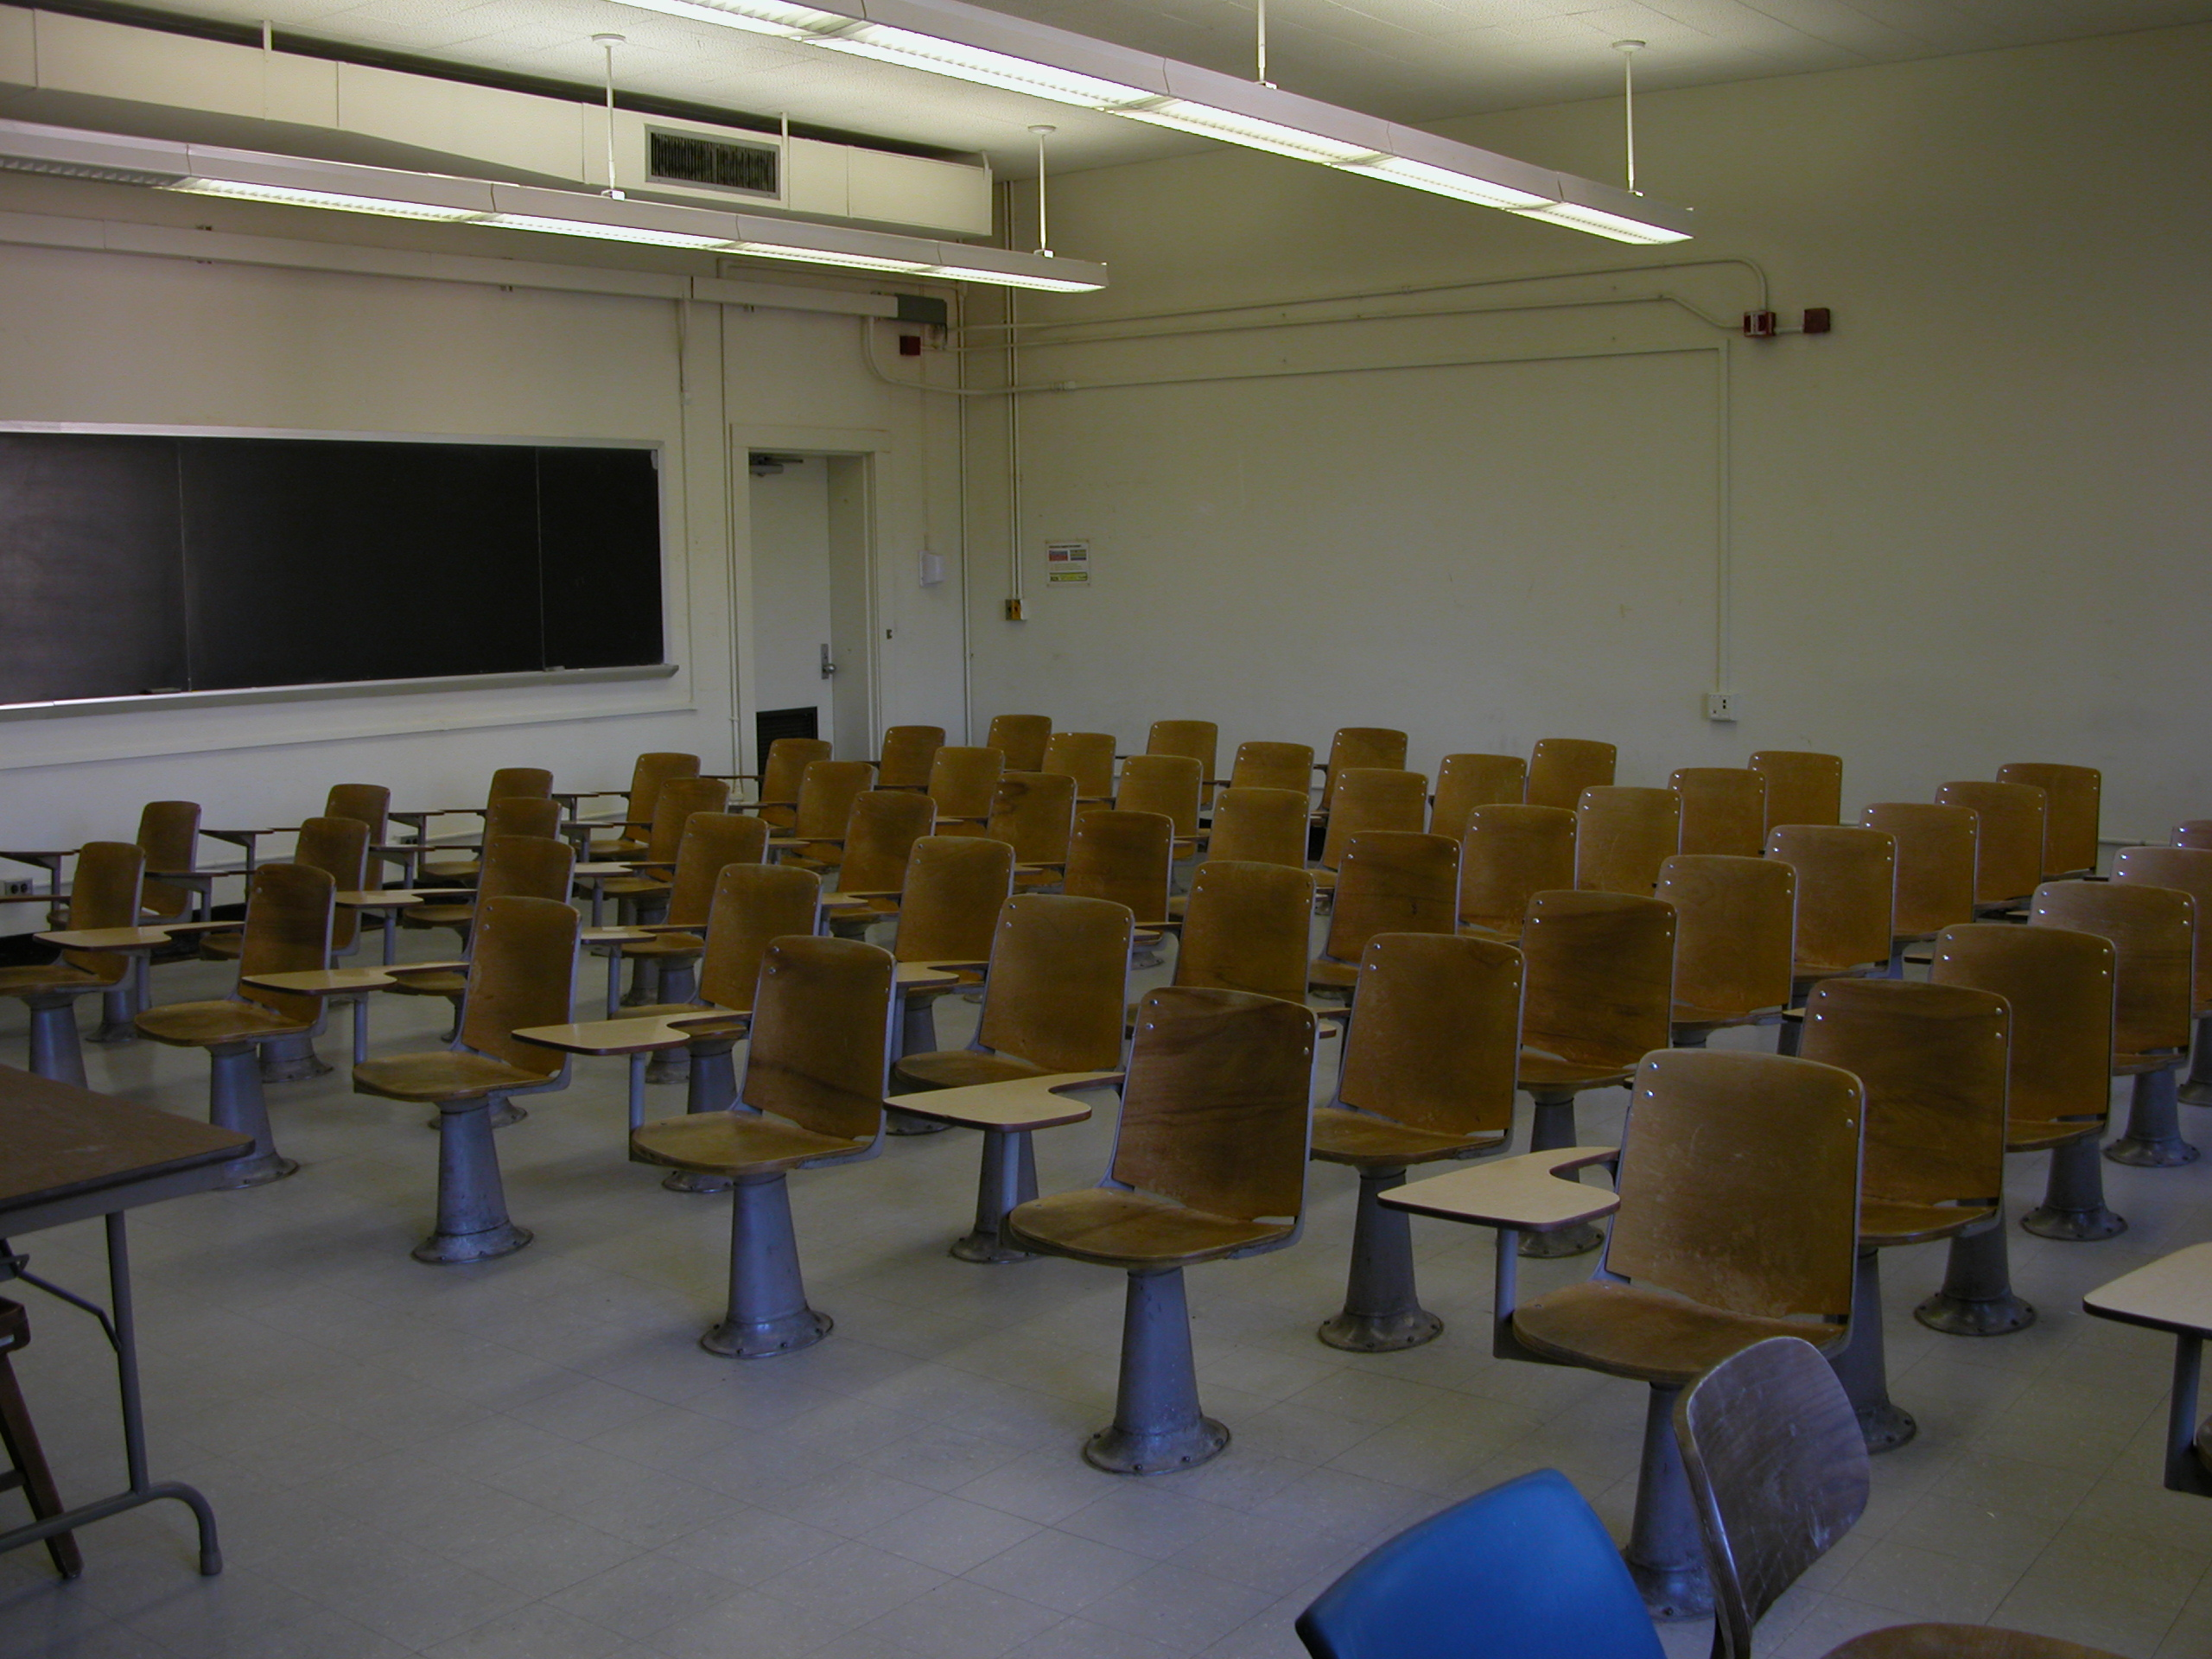
Campus Resource Exchange
Phase 2
progress update
Scope reviewed
Scenario drafted
Hosting costs researched
Illustrative classroom, not KU
This week: progress discussion
Next week: final feasibility submission
Group 4 Sultan Almheiri, Zayed Alfadli and Ghith Alhinaai 22 September 2026
Sultan 1
Notes:
Sources and status
https://github.com/duqins/ITS/blob/main/docs/reference/Project-September2026.pdf pages 5 and 7
Early progress report, not a measured 50 percent completion claim. No interviews, timing trials, implemented app or deployment claimed. Submission next week comes from the user; exact day remains to confirm. Photo by Ildar Sagdejev (Specious), UNC Chapel Hill, 2003-09-30. Source https://commons.wikimedia.org/wiki/File:2003-09-30_UNC-CH_Phillips_classroom_1.jpg . CC BY-SA 3.0 https://creativecommons.org/licenses/by-sa/3.0 . Proportional resizing only. Suggested time25seconds.

Slide 2
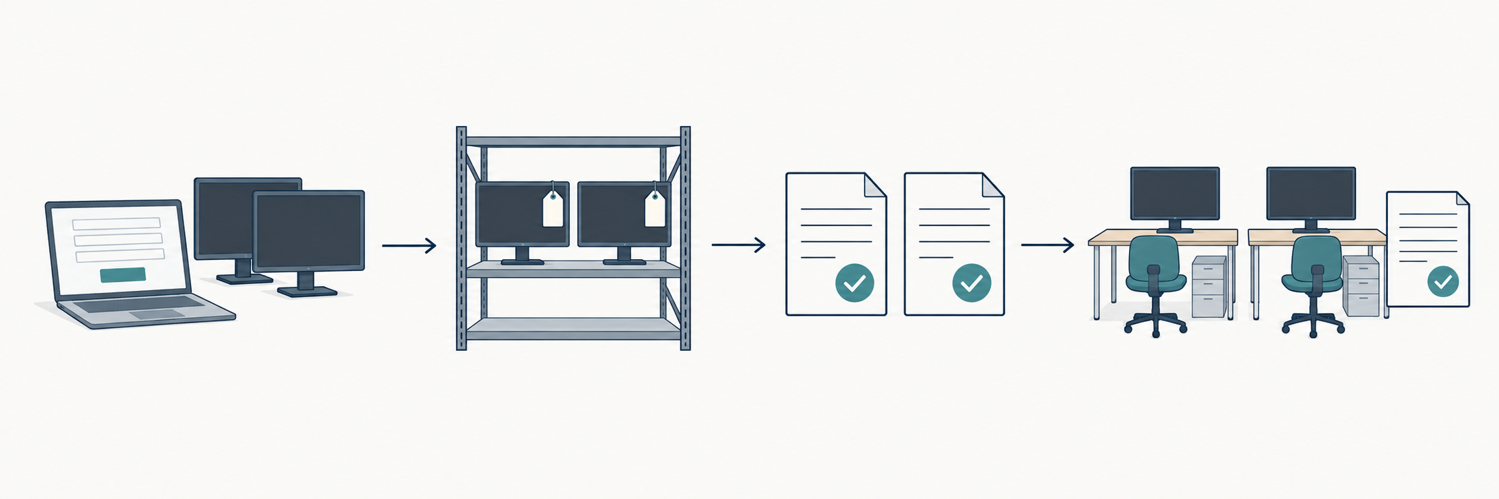
Our proposed monitor example
We are three KU students proposing a reuse tool for staff
1 Request
2 Find spares
3 Get approval
4 Record handover
Two suitable monitors
Check quantity and fit
Releasing and receiving staff
Update custody and location
Zayed 2
Notes:
Sources and status
https://github.com/duqins/ITS/blob/main/docs/phase1/sections/06-requirements-specification.md
Local Phase2 foundation proposal
Illustrative scenario, not a measured request or a confirmed KU mandate. Participating units, staff and service owner still need confirmation. Steps summarise FR07,08,10,11; any additional finance/procurement approvals depend on policy. Diagram is a conceptual image generated with the built-in image tool, not a screenshot or implemented application. Source prompt is retained with the image. Suggested time35seconds.

Slide 3
Project scope
These boundaries cover the semester project
Area | In scope | Out of scope
Campus work | Asset lists, requests, approvals and history | Live links to KU finance, purchasing or ERP systems
Asset care | Transfer, maintenance and retirement records | Vehicle scheduling or barcode and RFID hardware
Costs and reports | Cost records and sustainability reports | Purchasing and payment processing
AI help | AI suggestions, assistant and reports | Training new AI models from scratch
Access | Responsive website, hosting and deployment | Separate iPhone and Android apps
The monitor example is a small test case within this wider scope.
Zayed 3
Notes:
Sources and status
https://github.com/duqins/ITS/blob/main/docs/phase1/sections/02-project-overview.md section2.5
https://github.com/duqins/ITS/blob/main/docs/phase1/sections/06-requirements-specification.md
Condensed scope summary. In scope includes authentication and nine roles, departments, assets with photos/documents, surplus marketplace, requests, search/filtering, reservations, approvals, transfer/custody, maintenance/repair, end-of-life actions, notifications/audit, classic reports, AI classification/matching/ranking/sustainable-action suggestions/assistant/generative reporting, sustainability, local setup, hosting/deployment and documentation. ERP means university enterprise resource planning; live integration is excluded and interfaces are simulated. Recording collection/delivery remains in scope, while physical logistics/hardware is excluded. Deployment is explicitly included. Suggested time35seconds.

Slide 4
What we will compare at KU
Task | Current KU process | Our core tool | Added AI help
Find an item | Confirm search and availability | Keywords and filters | Suggest matches by meaning
Send a request | Confirm entry and routing | A form and request status | Help fill the request with user confirmation
Approve a transfer | Confirm rules and decision owners | Staff approve and record decisions | Suggestions only Staff still decide
Prepare reports | Confirm existing reports | Recorded totals and standard reports | Written summaries for staff review
We need evidence of the current system before claiming an improvement.
Zayed 4
Notes:
Sources and status
https://github.com/duqins/ITS/blob/main/docs/reference/Project-September2026.pdf page5
https://github.com/duqins/ITS/blob/main/docs/phase1/sections/06-requirements-specification.md
Current KU capabilities are unconfirmed. This is a comparison plan, not a claim that KU lacks any listed feature. Core and AI entries describe intended functionality, not implemented features. Human approvals and permissions apply to all versions. Suggested time30seconds.

Slide 5
Where AI would help
Example need: two working monitors with HDMI connections
Ordinary search | Search with AI help
Search for “monitor” Filter by connection and quantity | Describe what the monitors are needed for AI ranks suitable options
Read the item details and choose a suitable match | Check the suggested match and its explanation
Both versions keep the same rules
Access permissions, available quantity and staff approvals still apply.
Ordinary search remains available if AI fails.
Ghith 5
Notes:
Sources and status
https://github.com/duqins/ITS/blob/main/docs/phase1/sections/06-requirements-specification.md AI03-AI05,AI11,AI13
https://github.com/duqins/ITS/blob/main/docs/phase1/sections/09-classic-vs-ai.md
Proposed behaviour. Enforce eligibility and permissions before actionable matching; AI must not override compatibility, available quantity, release/receipt approvals or controlled asset state changes. Ranking quality, explanations and fallback still need a trial. Suggested time35seconds.

Slide 6
How we will check a benefit
Possible change | What we will measure | Extra work to count
One list of spare items | Search and enquiry minutes | Keeping listings accurate
Reuse item details | Repeated fields and corrections | Any extra entry into the current KU system
AI suggests a match | Useful results and time to check them | Wrong matches, retries and staff review
Same task, same outcome, all staff involved
Money saved needs extra purchases avoided, less reuse and running costs.
Working minutes and waiting time stay separate. Results are still to collect.
Ghith 6
Notes:
Sources and status
https://github.com/duqins/ITS/blob/main/docs/reference/Project-September2026.pdf page7
Phase2_Progress_Update.docx page2
These are hypotheses and a measurement plan, not demonstrated benefits. Include failed cases, sample size, active minutes of all roles, corrections, AI review, administration and duplicate entry. Use comparable input cases and record completion/errors. Count incremental avoided purchases relative to current process, subtract inspection/repair/transfer and added operation costs. Released staff time is capacity, not automatic cash savings. Suggested time35seconds.

Slide 7
Feasibility work so far
Area | Work started | Still needed
Technical | Hosting options listed | Test a suitable stack
Financial | Example hosting cost | Actual use and supported benefits
Operational | Scenario drafted | Current KU steps and staff needs
Schedule | Tasks divided | Deadline and available hours
Data and AI | Trial approach planned | Data access and model trial
Rules and ethics | Data and approval risks noted | Relevant KU rules and controls
These are draft findings. The final report needs all six checks.
Ghith 7
Notes:
Sources and status
https://github.com/duqins/ITS/blob/main/docs/reference/Project-September2026.pdf page7
Phase2_Group_Work_Plan.docx
Phase2_Progress_Update.docx
Status refers to documented planning/research, not completed feasibility validation. No actual stack experiment, interviews, current-process measurements, policy approval or implementation is claimed. Suggested time30seconds.

Slide 8
Our first hosting cost estimate
USD 6.20
Illustrative monthly
Railway hosting cost
Free option to test
Render + Neon
Free limits and idle sleep apply.
Upload storage still needs a plan.
Assumed use: 0.5 GB memory, 0.05 CPU cores, 1 GB stored, 1 GB sent.
Across the app and database. AI, upload storage and other costs still to add.
Sultan 8
Notes:
Sources and status
https://docs.railway.com/pricing
https://docs.railway.com/pricing/understanding-your-bill
https://render.com/docs/free
https://github.com/neondatabase/website/blob/main/content/faqs/free-plan-limits-and-quotas.md
Prices checked22September2026. Monthly average combined app/database resource assumptions: .5GB RAMx$10=$5; .05vCPUx$20=$1;1GBvolume x$.15=$.15;1GBpublicegress x$.05=$.05. Total$6.20. Hobby minimum$5 includes usage, so billmax(5,6.20)=6.20. Assumptions are unmeasured and not KU demand. Illustrative partial subtotal excludes AI, media storage, support, taxes and other unpriced costs. Renderfree sleeps15idleminutes and cannot persist appfiles; Neonfree database is separate. Chart data are literal calculations, not an external workbook or measured bill. Suggested time45seconds.

Slide 9
What we will finish next
Owner | Before submission next week
Sultan | Finish costs and the time plan Check workload against our available hours
Zayed | Confirm the KU process and scenario Review staff needs, rules and the brand
Ghith | Compare technology and AI choices Run a small trial if access allows
For today’s discussion
Confirm the current KU system, the service owner, evidence access
and the exact submission day.
Sultan 9
Notes:
Sources and status
https://github.com/duqins/ITS/blob/main/docs/reference/Project-September2026.pdf page7
Phase2_Group_Work_Plan.docx
Three slides each. Sultan1,8,9 total100seconds; Zayed2,3,4 total100seconds; Ghith5,6,7 total100seconds. Suggested durations allow5minutes for the team. This is a timing allocation, not a speaking guide. Brand and logo remain unconfirmed. Final report integrates six feasibility dimensions. Deployment remains in semester scope. Suggested time30seconds.

