Slide 1

Victor Azizi, Stef Smeets
2024-01-22

Slide 2
What is duqtools?
Duqtools is a tool for Dynamic Undertainty Quantification for Tokamak reactor simulations modelling
Open-source package written in Python (Apache 2.0)
Documentation: https://duqtools.readthedocs.io
Source code: https://github.com/duqtools/duqtools

Slide 3
Why duqtools?
Reduced order models need many runs
duqtools allows ensemble runs with hypercube sampling
Many outputs are difficult to inspect manually
duqtools can visualize and merge ensemble runs

Slide 4
What can duqtools do?
Set up 100s of simulation runs from a single template
Launch canonical UQ with minimal programming
Batch job submission and status tracking
Supports the Standardized Interface Data Structures (IDSs) data directory
Compare and visualize 100s of simulations in one overview
Display and merge simulation results as confidence ranges and distributions

Slide 5
Duqtools limitations
Currently only works with the MDS+ format of IMAS
Only one 'system' is implemented, JINTRAC
No automatic sensitivity analysis

Slide 6
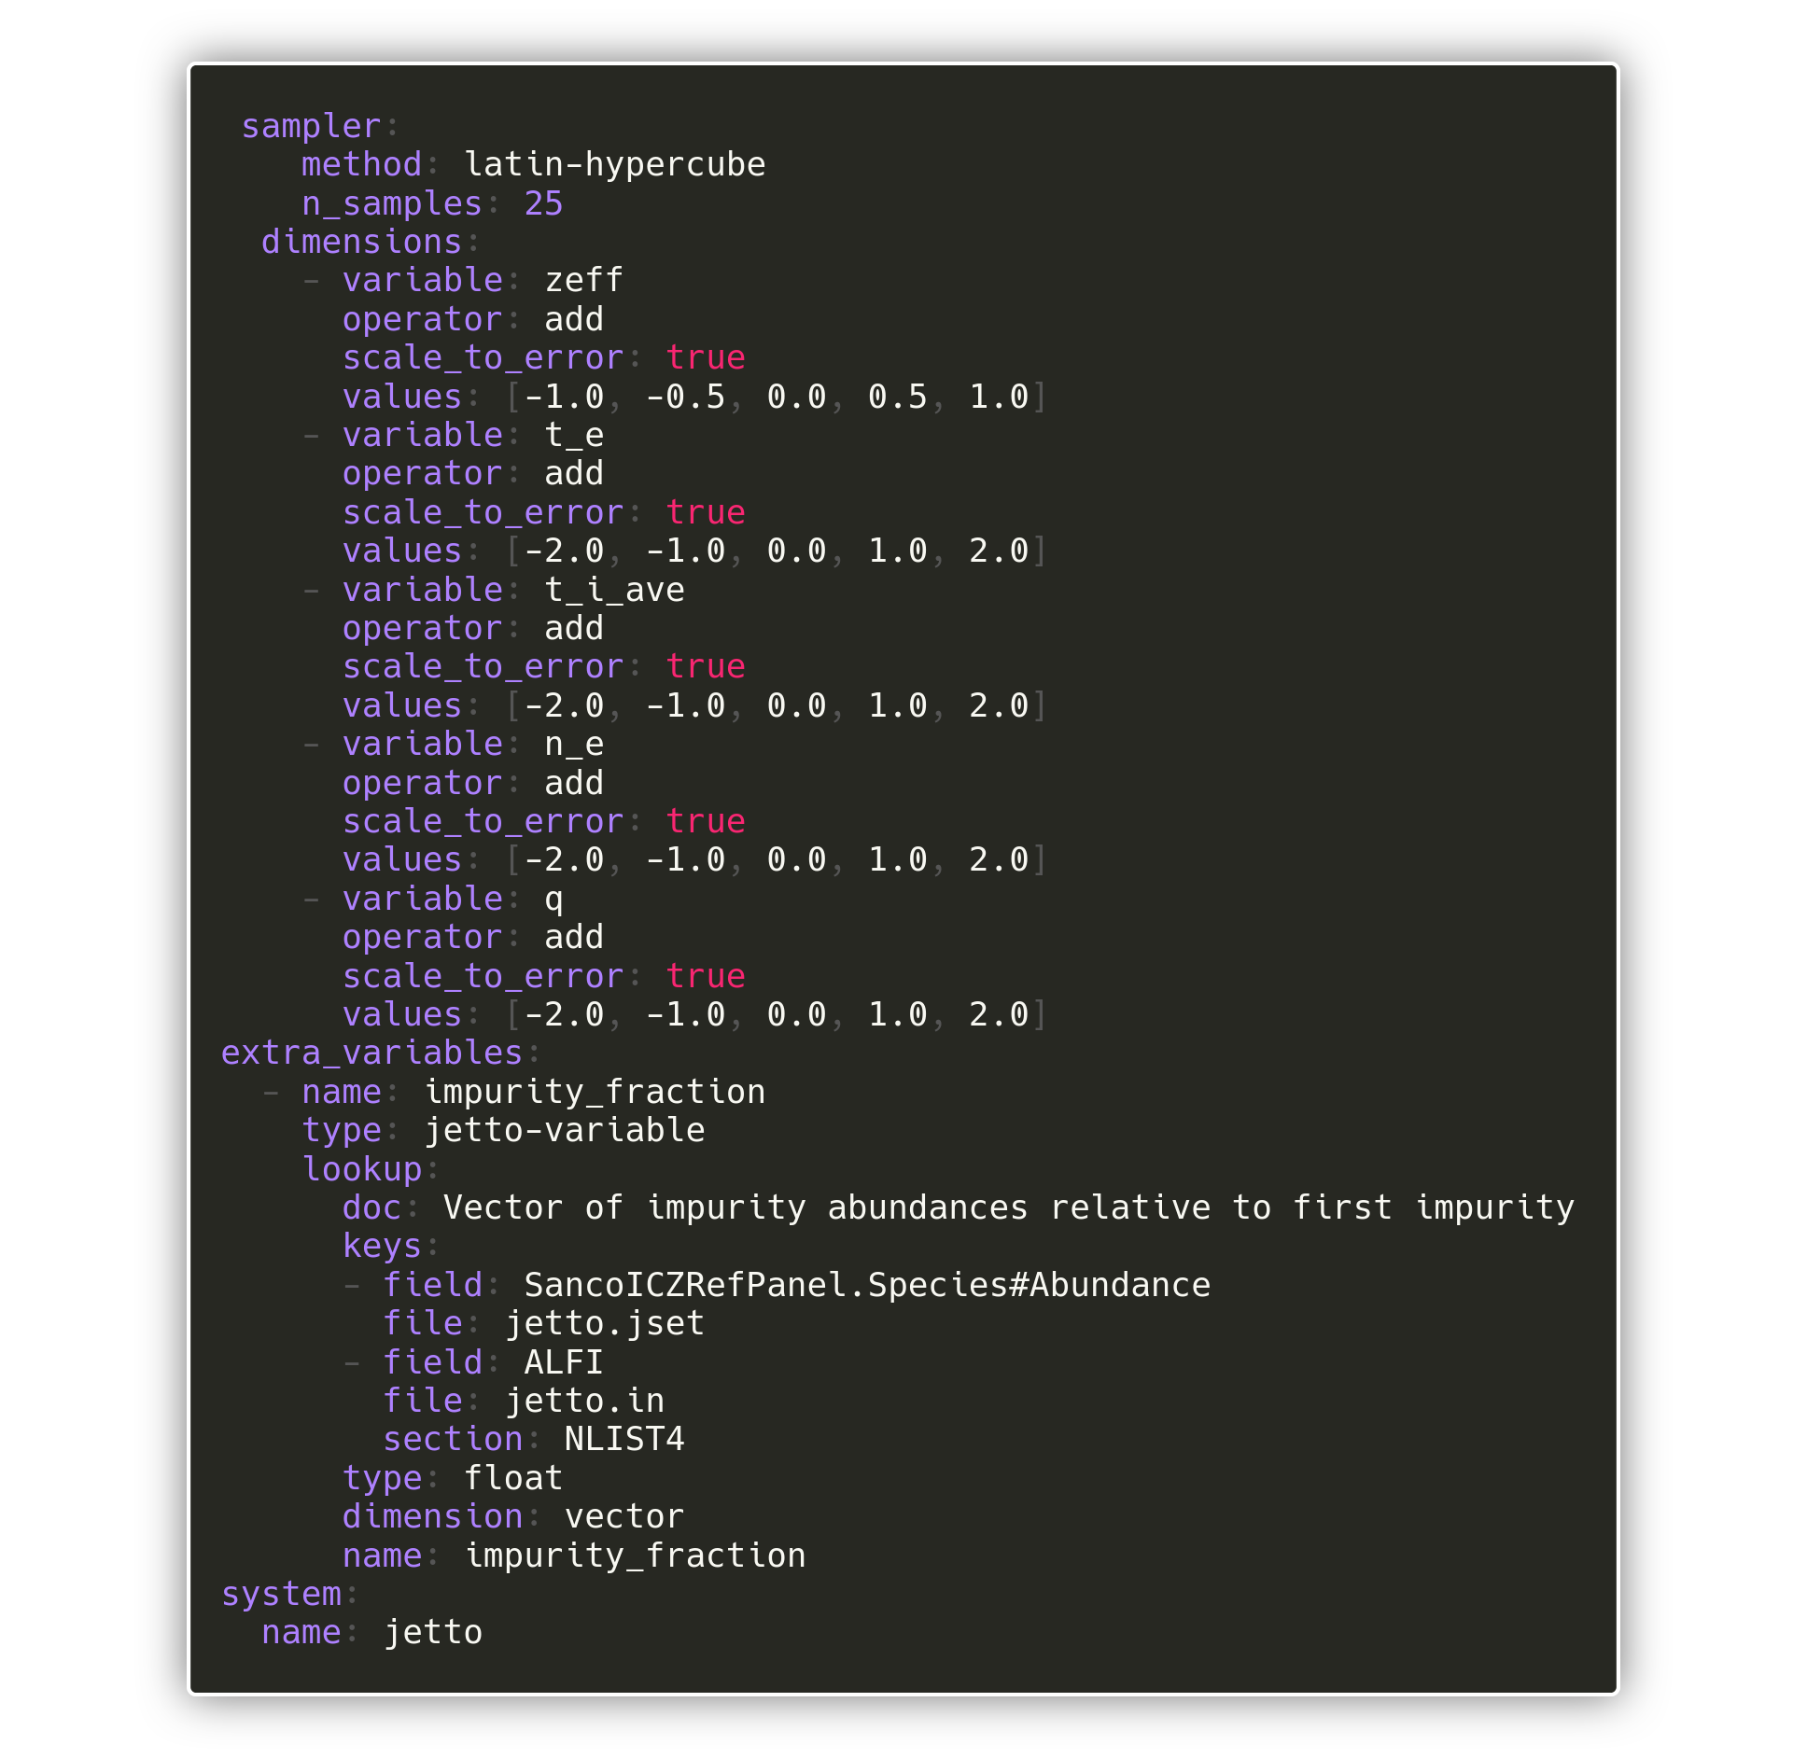
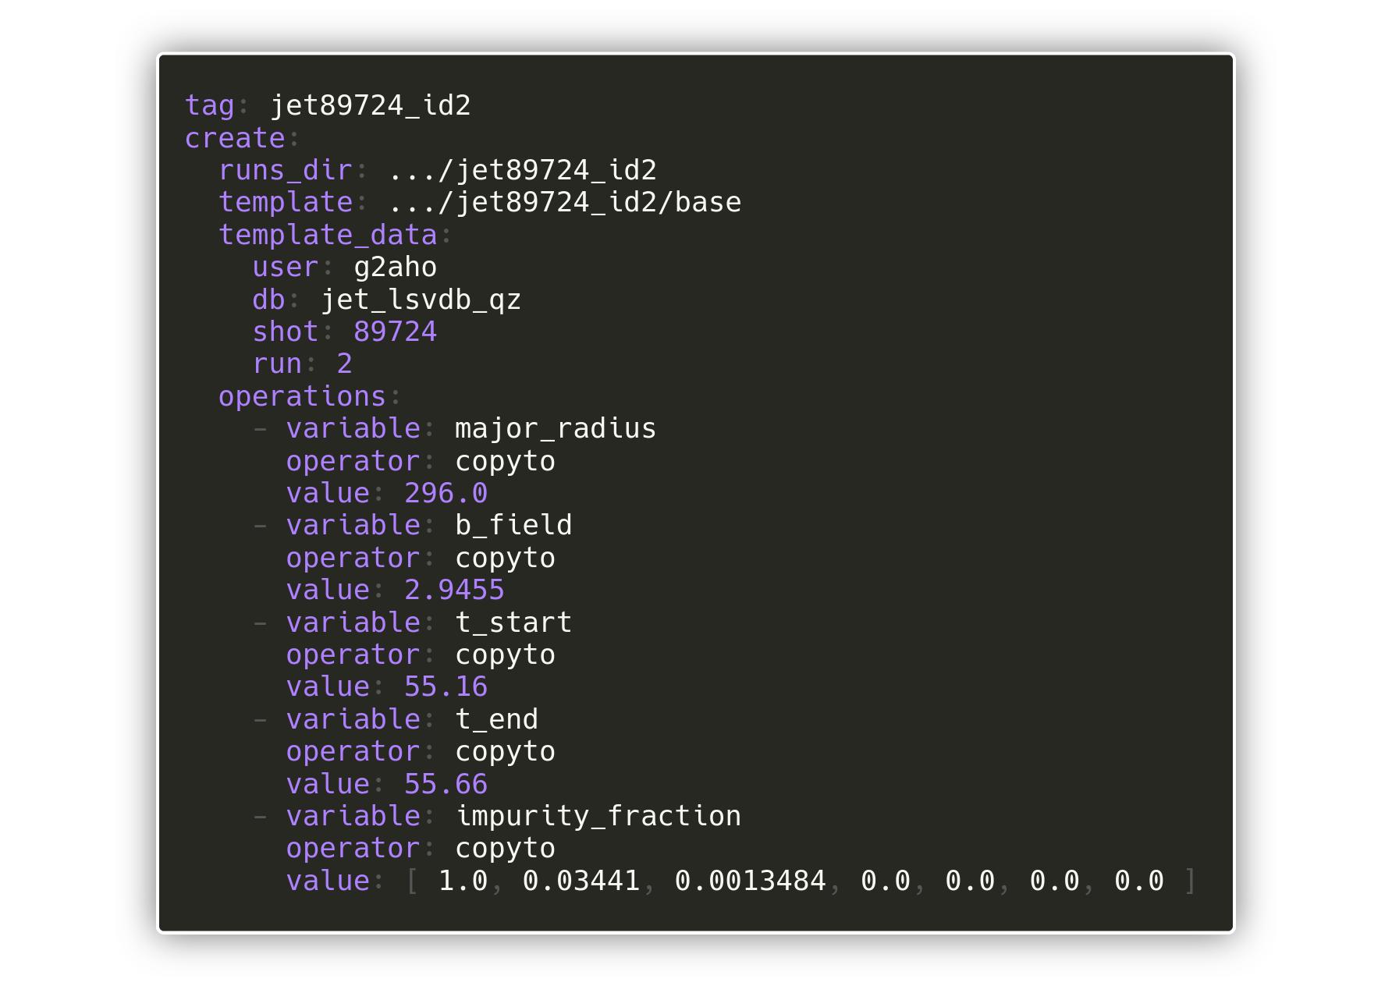
Run sampling
pre-defined UQ template
User can set up standardized sensitivity and UQ with minimal programming

Slide 7


Create, run, merge, visualize
Duqtools create
Duqtools run
Duqtools merge
Duqtools vizualize

Slide 8
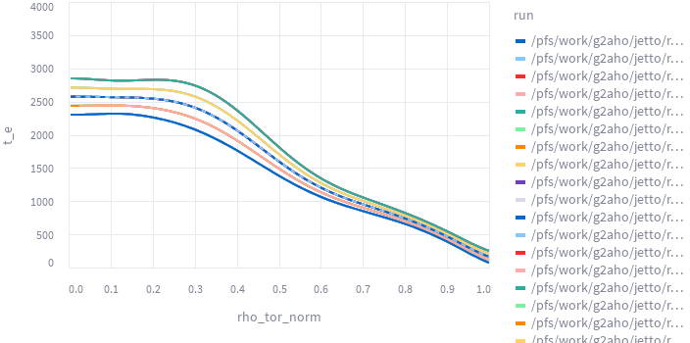
Visualization of the sampling
Using the duqtools dashboard

Slide 9
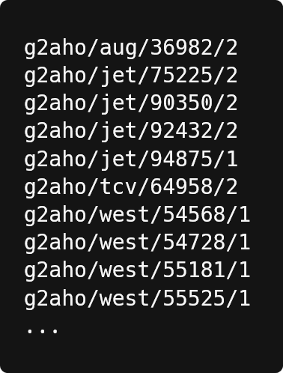
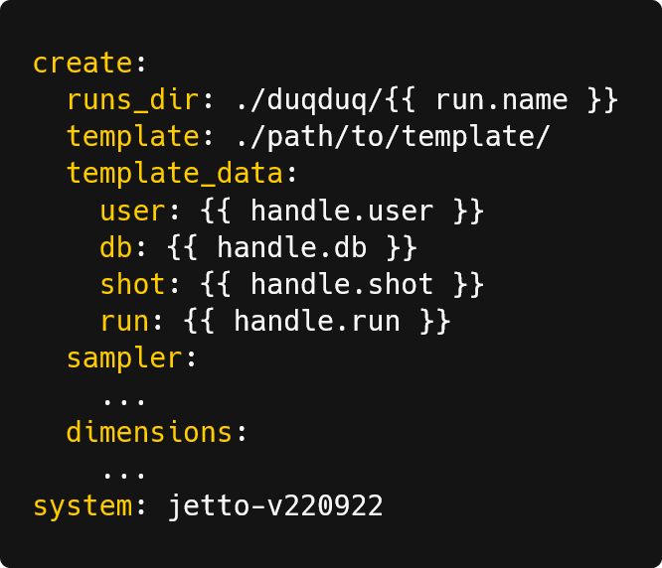
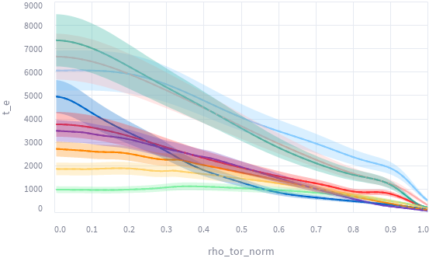
Large scale validation (duqduq)
The same as duqtools, but templated, so it can be applied to multiple input data.
List of IMAS data
Canonical UQ template
duqduq
Demo: https://duqtools.readthedocs.io/en/latest/examples/demo_lsv_run/

Slide 10
duqtools demos
Jetto UQ | https://duqtools.readthedocs.io/en/latest/examples/demo_single_run/
Large scale validation | https://duqtools.readthedocs.io/en/latest/examples/demo_lsv_run/
Docker | https://duqtools.readthedocs.io/en/latest/examples/duqtools_in_docker/
Prominence | https://duqtools.readthedocs.io/en/latest/examples/duqtools_on_prominence/

Slide 11

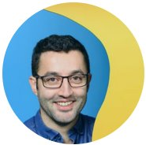
Fusion project
Development of the European fusion reactor simulation framework for experimental design, optimization, and control
“Empowering
researchers across
all disciplines
through innovative
research software”
Contact Person
Stef Smeets
Senior Research Software Engineer
s.smeets@esciencecenter.nl
Victor Azizi
Research Software Engineer
v.azizi@esciencecenter.nl

