Slide 1

2024-01-22
Stef Smeets, Victor Azizi

Slide 2
What is imas2xarray?
imas2xarray is a python library for reading and writing IMAS data in HDF5 format using xarray
Open-source package written in Python (Apache 2.0)
Documentation: https://imas2xarray.readthedocs.io
Source code: https://github.com/duqtools/imas2xarray
Pypi: https://pypi.org/project/imas2xarray

Slide 3
What can imas2xarray do?
Read and write data in HDF5 format
Modify IMAS data with minimal effort
Intuitive python API
Easy to get your data in and out thanks to xarray
Simplify data access via variable aliases
Supports the Standardized Interface Data Structures (IDSs) data directory

Slide 4

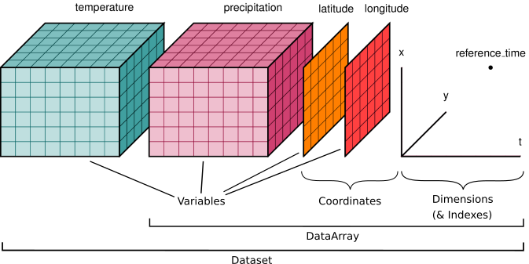
...xarray?
Python library for working with labelled multi-dimensional arrays

Slide 5
imas2xarray 🤩
Lightweight
Independent from access layer (runs on your laptop)
Fast
Can edit IDS's
Works with IDS in HDF5 format
imas2xarray 🫣
Does not use the data dictionary (yet), user specifies dimensions
Only works with IDS in HDF5 format

Slide 6
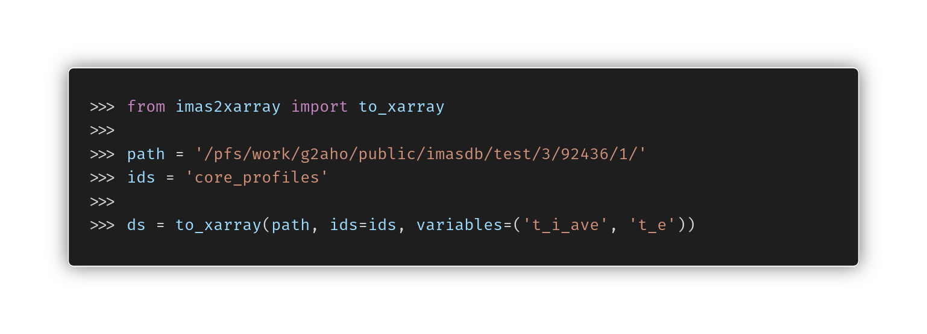
Reading data using variables

Slide 7
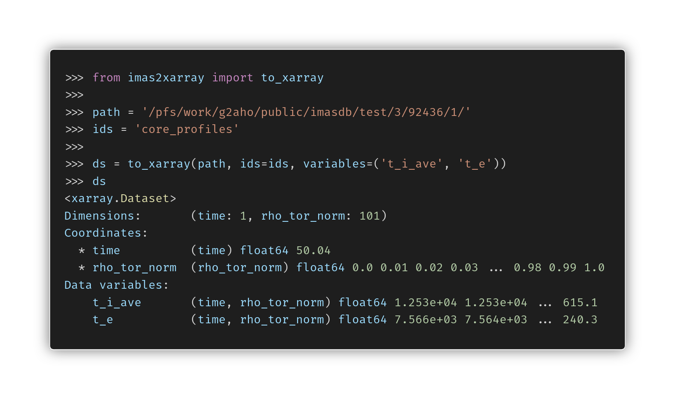

Slide 8
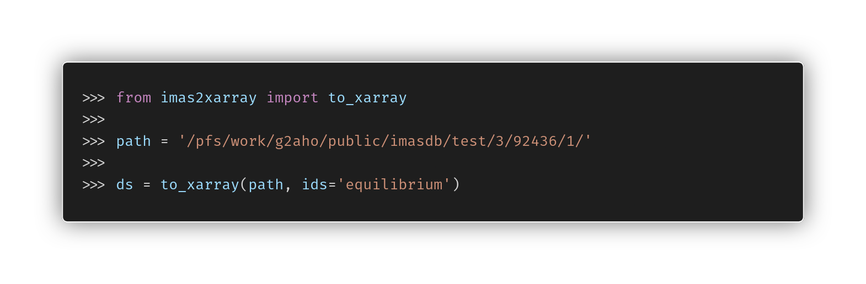
Reading all variables known to imas2xarray

Slide 9
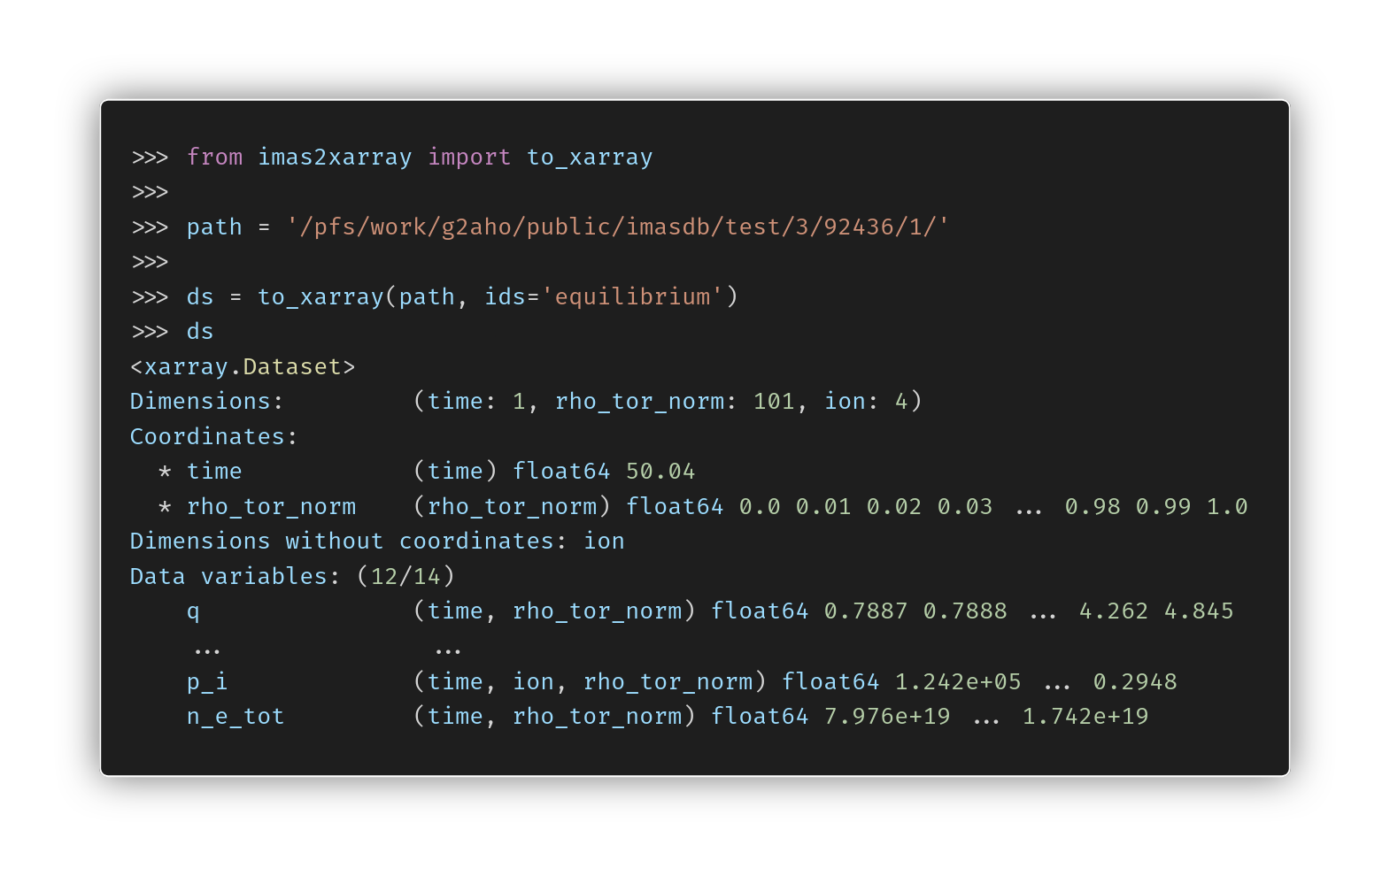

Slide 10
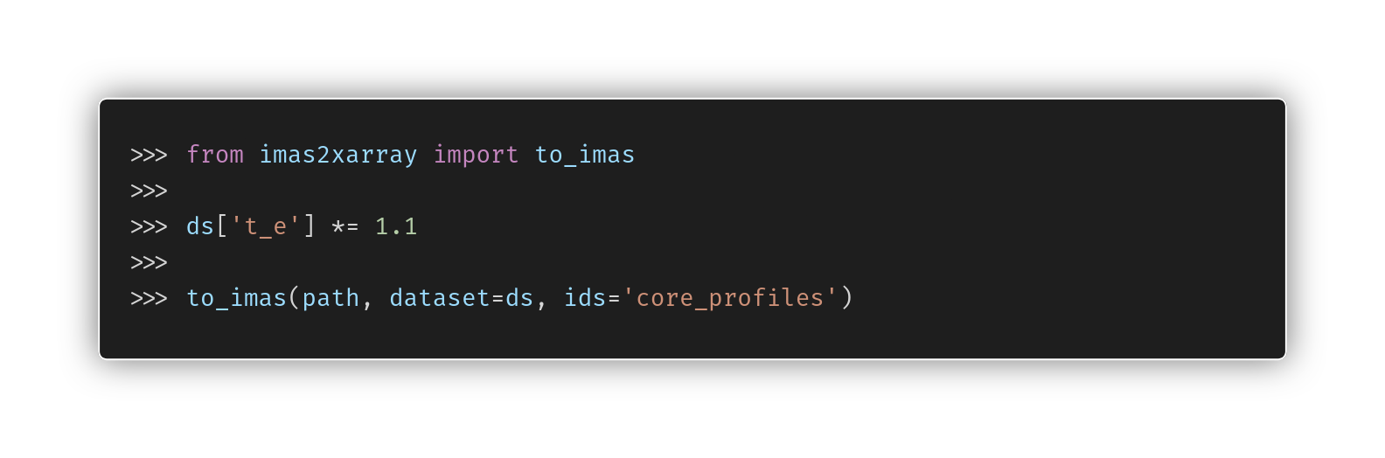
Writing data

Slide 11
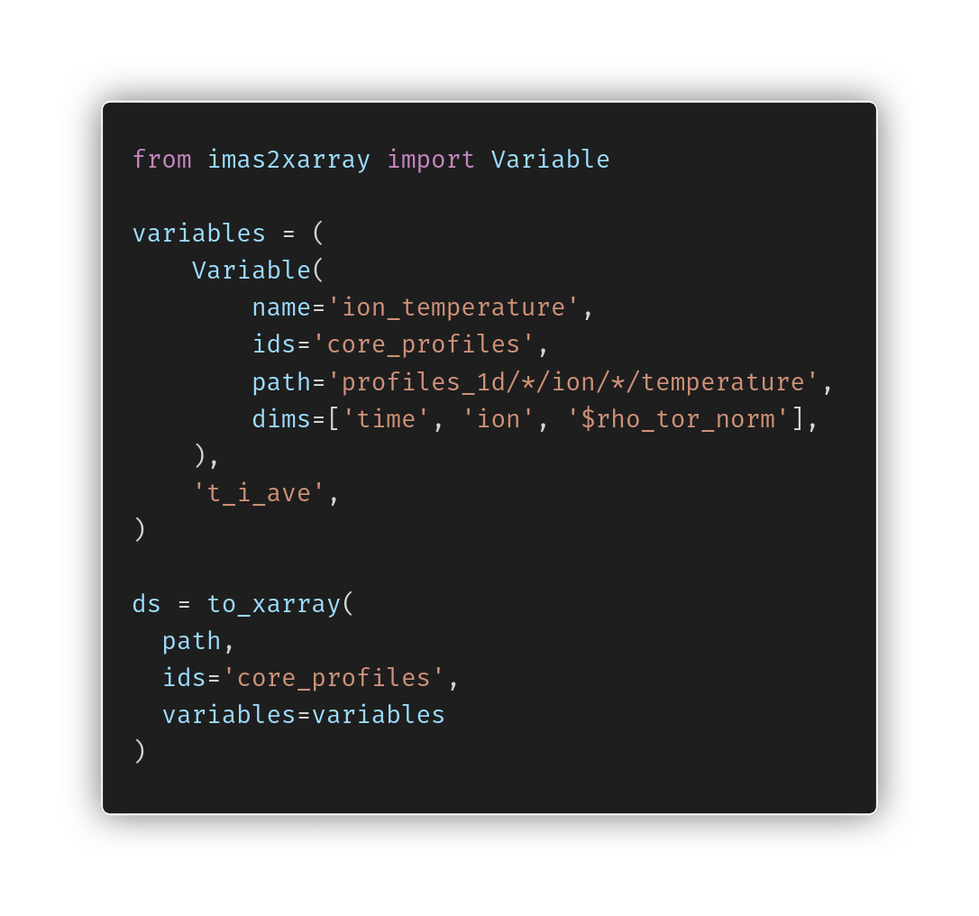
Variables
User-defined variable definitions
Alias long paths in IMAS data dictionary
Defined in code or via yaml config files
Eventually via IMAS data dictionary?
Full variable listing: https://imas2xarray.readthedocs.io/en/latest/variables/

Slide 12
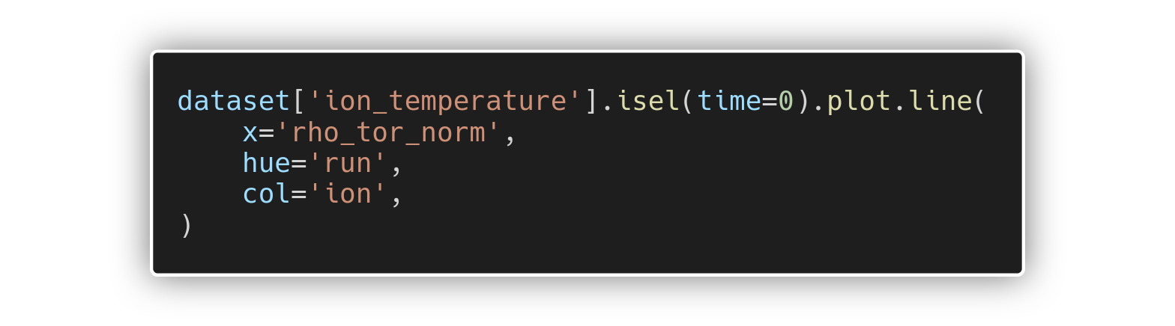
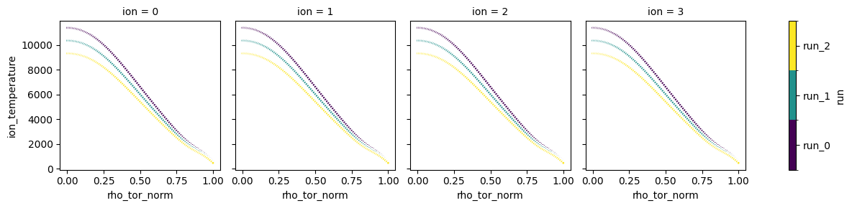
Plots
Everything available from xarray
Intuitive plotting

Slide 13
Installation
Python 3.9+
Minimal dependencies, thus easy to install in existing projects/tools
Available from pypi
pip install imas2xarray

Slide 14
imas2xarray demos
Introduction | https://imas2xarray.readthedocs.io/en/latest/notebooks/xarray/
2D data | https://imas2xarray.readthedocs.io/en/latest/notebooks/xarray-2D/
Ions | https://imas2xarray.readthedocs.io/en/latest/notebooks/xarray-ions/

Slide 15


Fusion project
“Empowering
researchers across
all disciplines
through innovative
research software”
Development of the European fusion reactor simulation framework for experimental design, optimization, and control
Contact Person
Stef Smeets
Senior Research Software Engineer
s.smeets@esciencecenter.nl
Victor Azizi
Research Software Engineer
v.azizi@esciencecenter.nl

