Slide 1

mongoose
elegant mongodb object modeling for node.js
By Duraimurugan

Slide 2
What is mongo DB
A Document Database
High Performance
High availability
Easy scalability

Slide 3
What is mongo DB ?
Document Database
Documents (objects) map nicely to programming language data types.
Embedded documents and arrays reduce need for joins.
Dynamic schema makes polymorphism easier.
High Performance
Embedding makes reads and writes fast.
Indexes can include keys from embedded documents and arrays.
Optional streaming writes (no acknowledgments).
High Availability
Replicated servers with automatic master failover.

Slide 4
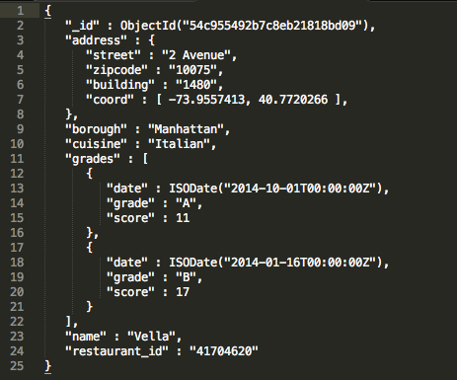
What are Document?
A record in MongoDB is a document, which is a data structure composed of field and value pairs

Slide 5
Documents restrictions on field names:
The field name _id is reserved for use as a primary key; its value must be unique in the collection, is immutable, and may be of any type other than an array.
The field names cannot start with the dollar sign ($) character.
The field names cannot contain the dot (.) character.
The field names cannot contain the null character.

Slide 6
What is Collections?
MongoDB stores documents in collections. Collections are analogous to tables in relational databases. Unlike a table, however, a collection does not require its documents to have the same schema.
In MongoDB, documents stored in a collection must have a unique _id field that acts as a primary key.

Slide 7
what is Document Format?
MongoDB stores documents on disk in the BSON serialization format. BSON is a binary representation of JSON documents, though it contains more data types than JSON.
The field name _id is reserved for use as a primary key; its value must be unique in the collection, is immutable, and may be of any type other than an array.
The field names cannot start with the dollar sign ($) character.
The field names cannot contain the dot (.) character.
The field names cannot contain the null character.

Slide 8
Document Size Limit
The maximum BSON document size is 16 megabytes.
The maximum document size helps ensure that a single document cannot use excessive amount of RAM or, during transmission, excessive amount of bandwidth. To store documents larger than the maximum size, MongoDB provides the GridFS API

Slide 9
Dot Notation
MongoDB uses the dot notation to access the elements of an array and to access the fields of an embedded document.
db.inventory.find( { 'producer.company': 'ABC123' } )

Slide 10
Doller operation
The positional $ operator identifies an element in an array to update without explicitly specifying the position of the element in the array. To project, or return, an array element from a read operation, see the $ projection operator.
Syntax: {field: {$ne: value} }
db.inventory.find( { qty: { $ne: 20 } } )

Slide 11
Query Documents
db.collection.find() method retrieves documents from a collection
An empty query document ({}) selects all documents in the collection:
db.inventory.find( {} )
Not specifying a query document to the find() is equivalent to specifying an empty query document. Therefore the following operation is equivalent to the previous operation:
db.inventory.find()

Slide 12
Specify Equality Condition
To specify equality condition, use the query document { <field>: <value> } to select all documents that contain the <field> with the specified <value>.
db.inventory.find( { type: "snacks" } )

Slide 13
Query Selectors
Name Description
$eq Matches values that are equal to a specified value.
$gt Matches values that are greater than a specified value.
$gte Matches values that are greater than or equal to a specified value.
$lt Matches values that are less than a specified value.
$lte Matches values that are less than or equal to a specified value.
$ne Matches all values that are not equal to a specified value.
$in Matches any of the values specified in an array.
$nin Matches none of the values specified in an array.

Slide 14
Logical
$or Joins query clauses with a logical OR returns all documents that match the conditions of either clause.
$and Joins query clauses with a logical AND returns all documents that match the conditions of both clauses.
$not Inverts the effect of a query expression and returns documents that do not match the query expression.
$nor Joins query clauses with a logical NOR returns all documents that fail to match both clauses.

Slide 15
Array
$all Matches arrays that contain all elements specified in the query.
$elemMatch Selects documents if element in the array field matches all the specified $elemMatch conditions.
$size Selects documents if the array field is a specified size.

Slide 16
Element
$exists Matches documents that have the specified field.
$type Selects documents if a field is of the specified type.

Slide 17
Evaluation
$mod Performs a modulo operation on the value of a field and selects documents with a specified result.
$regex Selects documents where values match a specified regular expression.
$text Performs text search.
$where Matches documents that satisfy a JavaScript expression.

Slide 18
Comparison Query Operators
$eq Matches values that are equal to a specified value.
$gt Matches values that are greater than a specified value.
$gte Matches values that are greater than or equal to a specified value.
$lt Matches values that are less than a specified value.
$lte Matches values that are less than or equal to a specified value.
$ne Matches all values that are not equal to a specified value.
$in Matches any of the values specified in an array.
$nin Matches none of the values specified in an array.

Slide 19
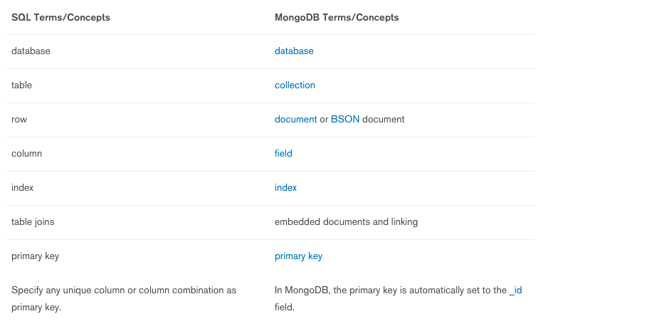
SQL vs MongoDB

Slide 20
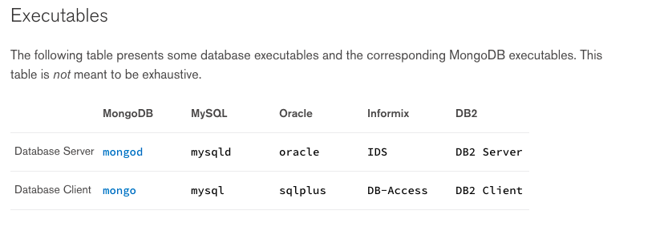
SQL vs MongoDB

Slide 21
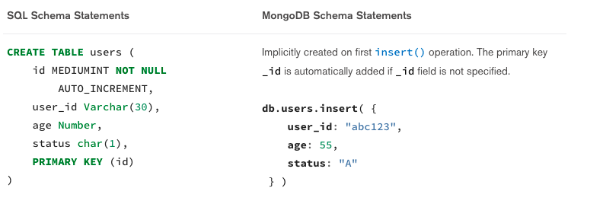
SQL vs MongoDB

Slide 22
SQL vs MongoDB

Slide 23
SQL vs MongoDB

Slide 24
Thank You

