Slide 1
OpenACC Performance Optimization
25.10.2018| J. Kraus (NVIDIA)

Slide 2
Outline
Memory coalescing
Loop optimizations

Slide 3
CSR sparse matrix storage
 | 0 | 1 | 2 | 3 | 4
0 | -2 | 1 | 0 | 0 | 0
1 | 1 | -2 | 1 | 0 | 0
2 | 0 | 1 | -2 | 1 | 0
3 | 0 | 0 | 1 | -2 | 1
4 | 0 | 0 | 0 | 1 | -2
 | 0 | 1 | 2 | 3 | 4
0 | -2 | 1
1 | 1 | -2 | 1
2 |  | 1 | -2 | 1
3 |  |  | 1 | -2 | 1
4 |  |  |  | 1 | -2
row_ptr
0 | 2 | 5 | 8 | 11 | 13
col_ptr
0 | 1 | 0 | 1 | 2 | 1 | 2 | 3 | 2 | 3 | 4 | 3 | 4
val
-2 | 1 | 1 | -2 | 1 | 1 | -2 | 1 | 1 | -2 | 1 | 1 | -2

Slide 4
Sparse Matrix Vector Product (SpMV)
42:#pragma acc parallel loop
43:for (int row=0; row<num_rows; ++row)
44:{
45: y[row] = 0.0;
46: const int row_start = row_ptr[row];
47: const int row_end = row_ptr[row+1];
48: for (int col_idx=row_start; col_idx<row_end; ++col_idx)
49: {
50: y[row] += val[col_idx] * x[ col_ptr[col_idx] ];
51: }
52:
53:}

Slide 5
SpMV on K80
pgcc -fast -acc -ta=tesla -Minfo=accel spmv.c -o spmv
main:
36, Generating copyin(col_ptr[:num_vals],row_ptr[:num_rows+1],val[:num_vals],x[:num_rows])
Generating copy(y[:num_rows])
42, Accelerator kernel generated
Generating Tesla code
43, #pragma acc loop gang, vector(128) /* blockIdx.x threadIdx.x */
48, #pragma acc loop seq
48, Complex loop carried dependence of y-> prevents parallelization
Loop carried reuse of y-> prevents parallelization
./spmv
Runtime 0.146638 s.

Slide 6
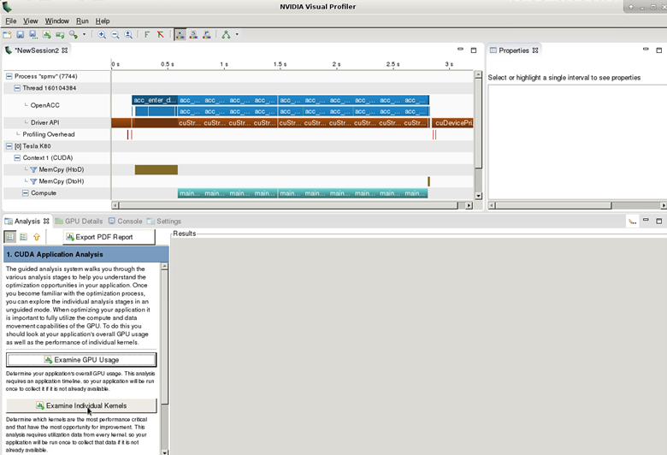
SpMV on K80

Slide 7
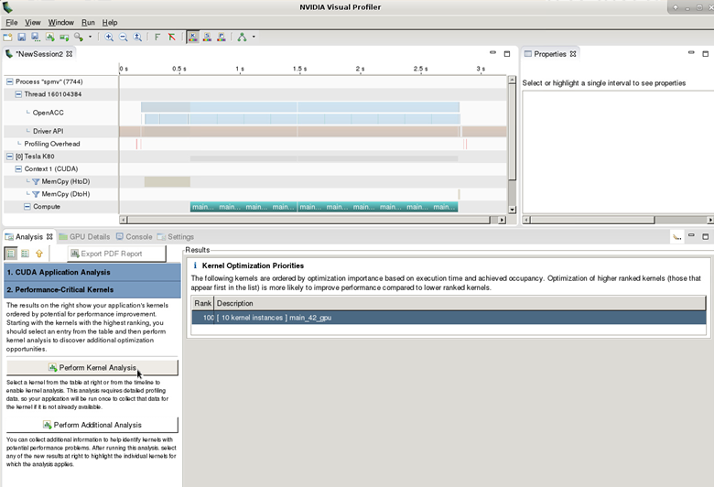
SpMV on K80

Slide 8
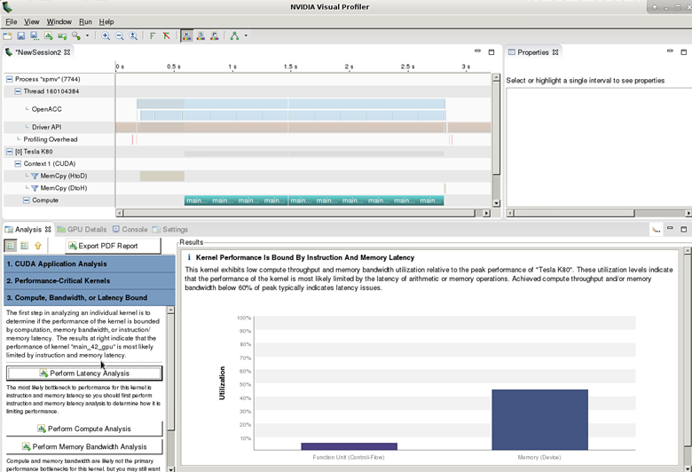
SpMV on K80

Slide 9
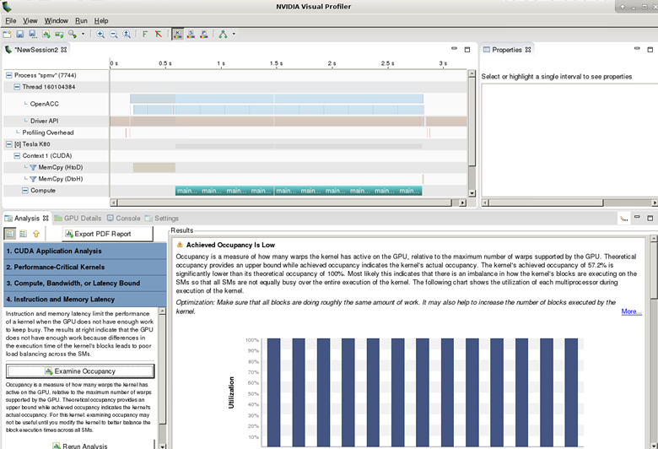
SpMV on K80

Slide 10
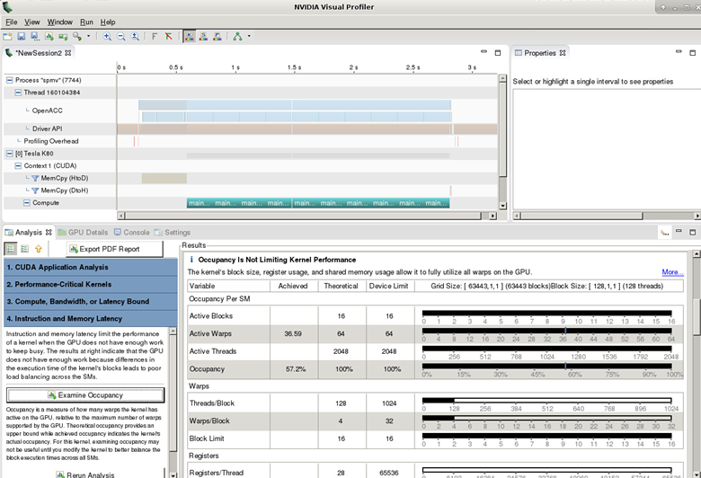
SpMV on K80

Slide 11
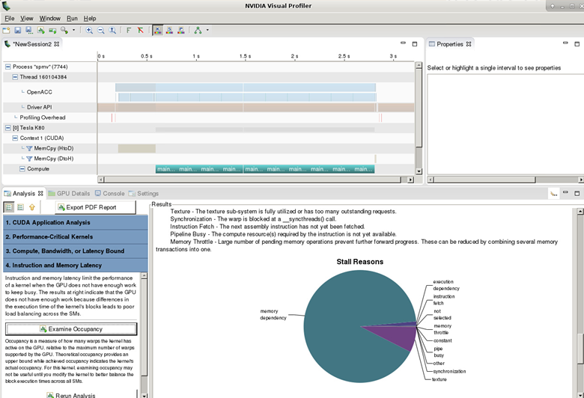
SpMV on K80

Slide 12
SpMV on K80
Disable usage of texture cache to see uncoaleseced memory accesses
pgcc -fast -acc -ta=tesla:cc30,lineinfo -Minfo=accel spmv.c -o spmv
main:
36, Generating copyin(col_ptr[:num_vals],row_ptr[:num_rows+1],val[:num_vals],x[:num_rows])
Generating copy(y[:num_rows])
42, Accelerator kernel generated
Generating Tesla code
43, #pragma acc loop gang, vector(128) /* blockIdx.x threadIdx.x */
48, #pragma acc loop seq
48, Complex loop carried dependence of y-> prevents parallelization
Loop carried reuse of y-> prevents parallelization
Better Profiling Information

Slide 13
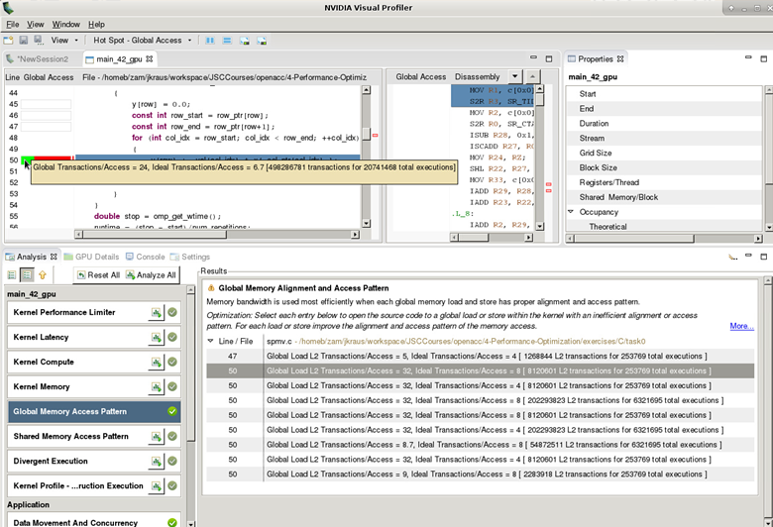
SpMV on K80

Slide 14
Memory Coalescing
Coalesced access:
A group of 32 contiguous threads („warp“) accessing adjacent words
Few transactions and high utilization
Uncoalesced access:
A warp of 32 threads accessing scattered words
Many transactions and low utilization
For best performance threadIdx.x should access contiguously
0
1
31
0
1
31
Coalesced
Uncoalesced

Slide 15
OpenACC: 3 Levels of Parallelism
Vector threads work in lockstep (SIMD/SIMT parallelism)
Workers have 1 or more vectors
Gangs have 1 or more workers and share resources (such as a cache, the SM, etc.)
Multiple gangs work independently of each other
Vector
Workers
Gang
Vector
Workers
Gang

Slide 16
CUDA Execution Model
Software
Hardware
Threads are executed by scalar processors
Scalar
Processor
Thread
Thread blocks are executed on multiprocessors
Thread blocks do not migrate
Several concurrent thread blocks can reside on one multiprocessor - limited by multiprocessor resources (shared memory and register file)
Thread
Block
Multiprocessor
...
A kernel is launched as a grid of thread blocks
Grid
Device
Blocks and grids can be multi dimensional (x,y,z)

Slide 17
CUDA Warps
A thread block consists of a groups of warps
A warp is executed physically in parallel (SIMT) on a multiprocessor
Currently all NVIDIA GPUs use a warp size of 32
32 Threads
...
=
32 Threads
32 Threads
Thread
Block
Warps
Multiprocessor

Slide 18
Mapping OpenACC to CUDA
The compiler is free to do what it wants
In general
gang: mapped to blocks (COARSE GRAIN)
worker: mapped to threads (FINE GRAIN)
vector: mapped to threads (FINE SIMD/SIMT)
Exact mapping is compiler dependent
Performance Tips
Use a vector size that is divisible by 32
Block size is num_workers * vector_length

Slide 19

OpenACC gang, worker, vector clauses
Gang, worker, vector can be added to a loop clause
Control the size using the following clauses on the parallel region
Parallel: num_gangs(n), num_workers(n), vector_length(n)
Kernels: gang(n), worker(n), vector(n)
#pragma acc parallel loop gang worker
for (int row=0; row<num_rows; ++row)
{
#pragma acc loop vector
for (int col_idx=row_start; col_idx<row_end; ++col_idx)
gang, worker, vector appear once per parallel region

Slide 20
Understanding Compiler Output
42, Accelerator kernel generated
Generating Tesla code
43, #pragma acc loop gang, vector(128) /* blockIdx.x threadIdx.x */
Compiler is reporting how it is assigning work to the device
Gang is being mapped to blockIdx.x
Vector is being mapped to threadIdx.x
Worker is not used
This application has a thread block size of 128 and launches as many blocks as necessary

Slide 21
SpMV
42:#pragma acc parallel loop
43:for (int row=0; row<num_rows; ++row)
44:{
45: y[row] = 0.0;
46: const int row_start = row_ptr[row];
47: const int row_end = row_ptr[row+1];
48: for (int col_idx=row_start; col_idx<row_end; ++col_idx)
49: {
50: y[row] += val[col_idx] * x[ col_ptr[col_idx] ];
51: }
52:
53:}
Want this loop to parallelize with vector parallelism
48, Complex loop carried dependence of y-> prevents parallelization
Loop carried reuse of y-> prevents parallelization

Slide 22
SpMV
42:#pragma acc parallel loop
43:for (int row=0; row<num_rows; ++row)
44:{
45: double y_tmp = 0.0;
46: const int row_start = row_ptr[row];
47: const int row_end = row_ptr[row+1];
48: for (int col_idx=row_start; col_idx<row_end; ++col_idx)
49: {
50: y_tmp += val[col_idx] * x[ col_ptr[col_idx] ];
51: }
52: y[row] = y_tmp;
53:}
Sum up in temporary to remove loop carried dependency

Slide 23
SpMV on K80
pgcc -fast -acc -ta=tesla -Minfo=accel spmv.c -o spmv
main:
36, Generating copyin(col_ptr[:num_vals],row_ptr[:num_rows+1],val[:num_vals],x[:num_rows])
Generating copy(y[:num_rows])
42, Accelerator kernel generated
Generating Tesla code
43, #pragma acc loop gang /* blockIdx.x */
48, #pragma acc loop vector(128) /* threadIdx.x */
50, Generating implicit reduction(+:y_tmp)
48, Loop is parallelizable
./spmv
Runtime 0.168035 s. (was 0.146638 s)

Slide 24
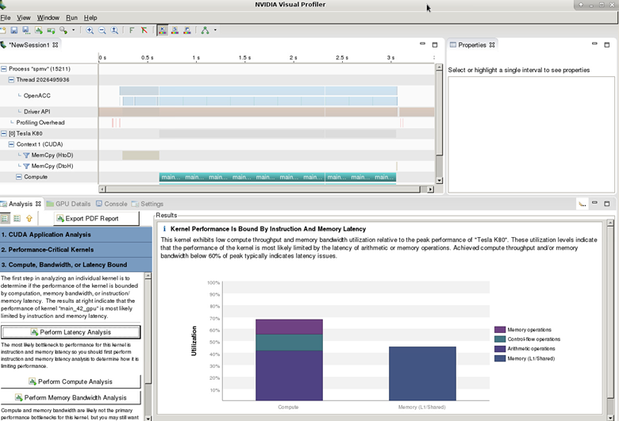
SpMV on K80

Slide 25
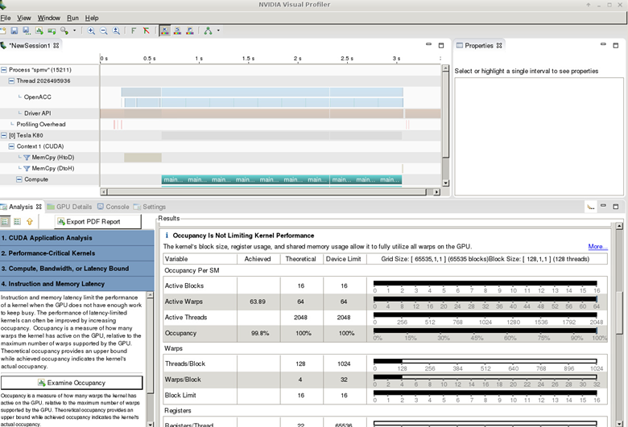
SpMV on K80

Slide 26
SpMV on K80

Slide 27
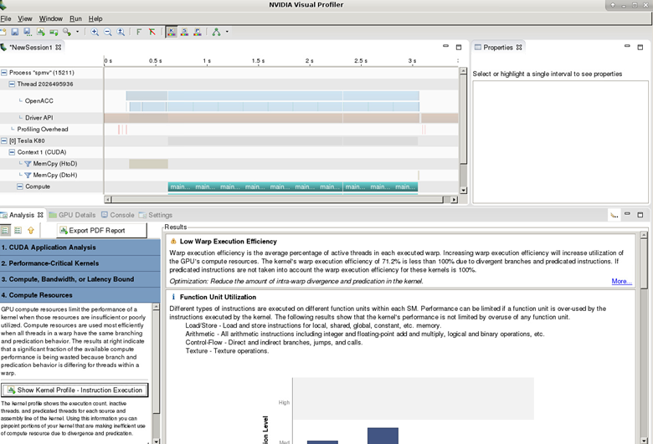
SpMV on K80

Slide 28
SpMV on K80
42:#pragma acc parallel loop
43:for (int row=0; row<num_rows; ++row)
44:{
45: double y_tmp = 0.0;
46: const int row_start = row_ptr[row];
47: const int row_end = row_ptr[row+1];
48: for (int col_idx=row_start; col_idx<row_end; ++col_idx)
49: {
50: y_tmp += val[col_idx] * x[col_ptr[col_idx]];
51: }
52: y[row] = y_tmp;
53:}
gang
vector(128)
42, Accelerator kernel generated
Generating Tesla code
43, #pragma acc loop gang /* blockIdx.x */
48, #pragma acc loop vector(128) /* threadIdx.x */
50, Generating implicit reduction(+:y_tmp)

Slide 29
Providing more information to the compiler
We know that each row of the used Matrix has only 27 elements
Using 128 threads for 27 elements does not make sense
Let‘s tell the compiler to use fewer threads for each row

Slide 30
SpMV on K80
42:#pragma acc parallel loop vector_length(32)
43:for (int row=0; row<num_rows; ++row)
44:{
45: double y_tmp = 0.0;
46: const int row_start = row_ptr[row];
47: const int row_end = row_ptr[row+1];
48: for (int col_idx=row_start; col_idx<row_end; ++col_idx)
49: {
50: y_tmp += val[col_idx] * x[col_ptr[col_idx]];
51: }
52: y[row] = y_tmp;
53:}
gang
vector(32)
42, Accelerator kernel generated
Generating Tesla code
43, #pragma acc loop gang /* blockIdx.x */
48, #pragma acc loop vector(32) /* threadIdx.x */
50, Generating implicit reduction(+:y_tmp)

Slide 31
SpMV on K80
pgcc -fast -acc -ta=tesla:gv32mode -Minfo=accel spmv.c -o spmv
main:
36, Generating copyin(col_ptr[:num_vals],row_ptr[:num_rows+1],val[:num_vals],x[:num_rows])
Generating copy(y[:num_rows])
42, Accelerator kernel generated
Generating Tesla code
43, #pragma acc loop gang /* blockIdx.x */
48, #pragma acc loop vector(32) /* threadIdx.x */
50, Generating implicit reduction(+:y_tmp)
48, Loop is parallelizable
./spmv
Runtime 0.114376 s. (was 0.168035 s)

Slide 32
Keeping the code performance portable
The device_type clause allows device specific tuning without harming performance portability
All clauses following a device_type clause only apply for the given target:
#pragma acc parallel loop device_type(NVIDIA) vector_length(32)
for (int row=0; row<num_rows; ++row)
{

Slide 33
Tasks
Task 0: Coalescing memory accesses (repeat)
Task 1: Use vector_length to improve the warp execution efficiency (repeat what was shown)
Task 2: Use the guided analysis to further improve the performance.
Hint: Add worker level parallelism to increase the block size to 128 threads (required to get full occupancy).

Slide 34
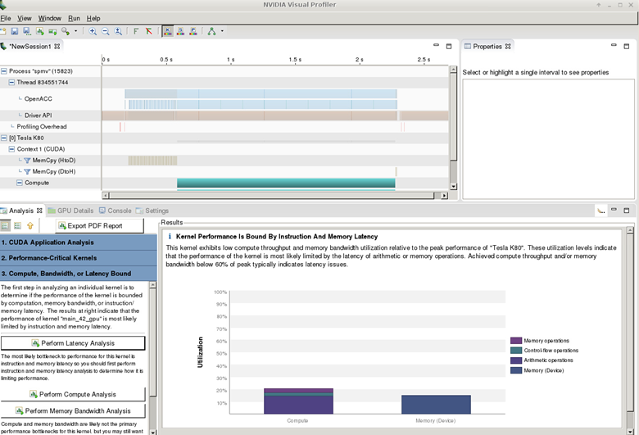
SpMV on K80

Slide 35
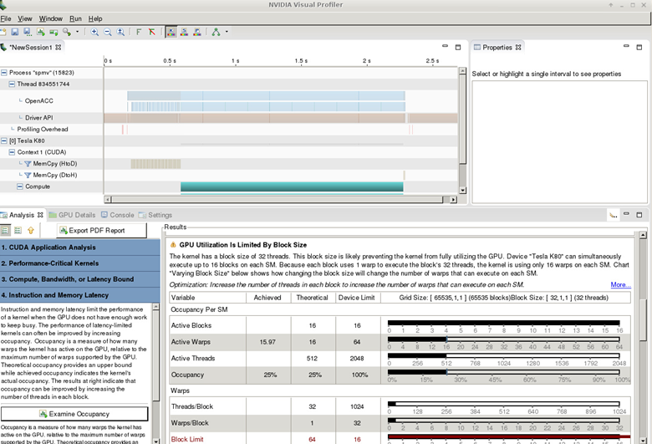
SpMV on K80

Slide 36
SpMV
42:#pragma acc parallel loop device_type(NVIDIA) gang worker vector_length(32)
43:for (int row=0; row<num_rows; ++row)
44:{
45: double y_tmp = 0.0;
46: const int row_start = row_ptr[row];
47: const int row_end = row_ptr[row+1];
48: for (int col_idx=row_start; col_idx<row_end; ++col_idx)
49: {
50: y_tmp += val[col_idx] * x[ col_ptr[col_idx] ];
51: }
52: y[row] = y_tmp;
53:}
gang, worker(4)
vector(32)
42, Accelerator kernel generated
Generating Tesla code
43, #pragma acc loop gang, worker(4) /* blockIdx.x threadIdx.y */
48, #pragma acc loop vector(32) /* threadIdx.x */
50, Generating implicit reduction(+:y_tmp)

Slide 37
Understanding Compiler Output (recap)
42, Accelerator kernel generated
Generating Tesla code
43, #pragma acc loop gang, worker(4) /* blockIdx.x threadIdx.y */
48, #pragma acc loop vector(32) /* threadIdx.x */
50, Generating implicit reduction(+:y_tmp)
Compiler is reporting how it is assigning work to the device
Gang is being mapped to blockIdx.x
Worker is being mapped to threadIdx.y
Vector is being mapped to threadIdx.x
This application has a thread block size of 4x32 and launches as many blocks as necessary

Slide 38
SpMV on K80
pgcc -fast -acc -ta=tesla:gv32mode -Minfo=accel spmv.c -o spmv
main:
36, Generating copyin(col_ptr[:num_vals],row_ptr[:num_rows+1],val[:num_vals],x[:num_rows])
Generating copy(y[:num_rows])
42, Accelerator kernel generated
Generating Tesla code
43, #pragma acc loop gang, worker(4) /* blockIdx.x threadIdx.y */
48, #pragma acc loop vector(32) /* threadIdx.x */
50, Generating implicit reduction(+:y_tmp)
48, Loop is parallelizable
./spmv
Runtime 0.040940 s. (initial was 0.146638 s)

Slide 39
Conclusions
The NVIDIA Visual Profiler can be used to identify performance bottlenecks in OpenACC Kernels
Coalescing memory accesses is important for performance
Using loop clauses allows to provide runtime information (approximate length of matrix rows) to the compiler for better performance.

