Slide 1
HPC Python
28.05.2015 – 29.05.2015
Olav Zimmermann & Jan H. Meinke

Slide 2
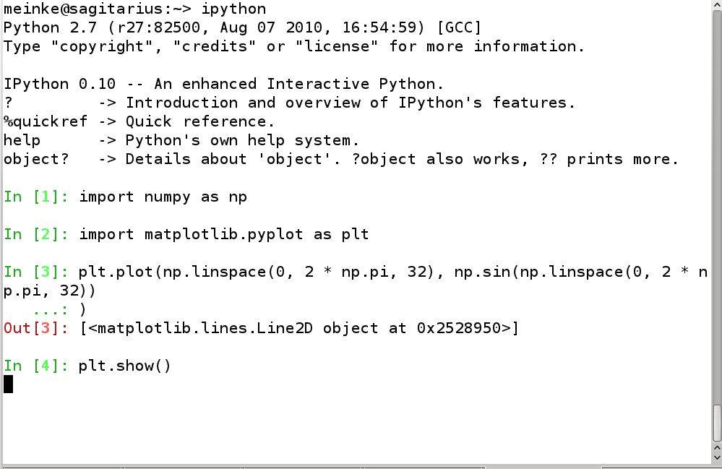
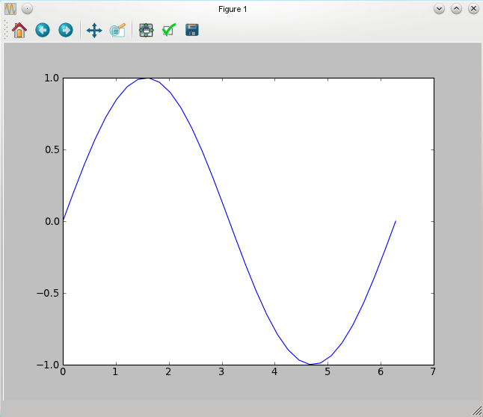
IPython
Notes:
IPython (http://ipython.org/) is an interactive Python shell with many more features than the standard shell. It offers tab completion, a namespace management, and many useful commands to develop and run interactively. It can even be used as a frontend to a cluster.

Slide 3
IPython
Start IPython by typing ipython
Useful options, e.g.,
  --pylab pulls numpy, scipy, and matplotlib into namespace. Starts threaded mode.
  --gui=(gtk|qt|wx|glut|pyglet)starts threaded mode
  -h detailed help on available options

Slide 4
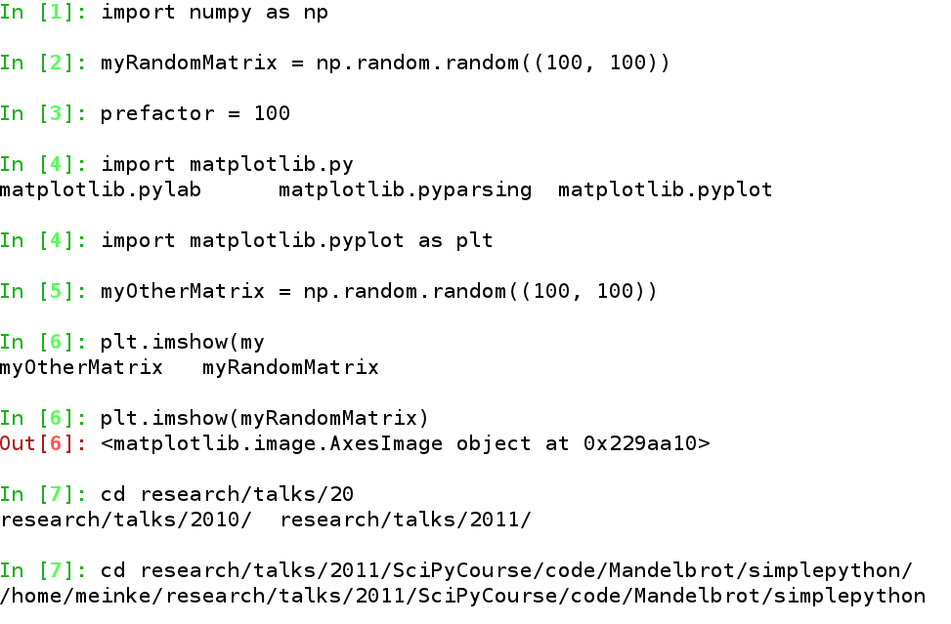
IPython – Autocompletion
Tab starts autocompletion of current input.
Hints taken from
  namespace (modules, functions, variables)
  file system
  magic commands

Slide 5
IPython – Namespace
who, whos give information about variables
>>> a = 10
>>> b = “hello”
>>> who
a b
>>>whos
Variable Type Data/Info
----------------------------
a int 10
b str hello
psearch, store, reset

Slide 6
IPython – Logging and History
Logging keeps track of all your input
  logstart starts logging.
  logon/logoff turn logging on/off
  logstate gives information about logging
history prints the input history
  history n prints last n lines
  history m n prints lines m to n-1

Slide 7
IPython – Accessing History
In [1]: import numpy as np
In [2]: np.random.random((100,100))
Out [2]:
array([[ 0.72356433, 0.63097013],
[ 0.33260908, 0.369829 ]])
In[3]: a = _ # or a = Out[2]
In[4]: Out[2].reshape(4, 1)
Out[4]:
array([[ 0.72356433],
[ 0.63097013],
[ 0.33260908],
[ 0.369829 ]])

Slide 8
IPython – Save, Edit, and Run
save filename n1 n2-n4 n8 n20-n45
edit filename/function name
  opens file in editor
  runs script after closing
  -x don't run after editing
  if function name is given
    open file containing function
    place cursor at function
run filename [args]
  run script contained in filename

Slide 9
IPython – Save, Edit, and Run
In[3]: x = np.linspace(0, 2*np.pi, 32)
In[4]: y = np.sin(x)
In[5]: plt.plot(x, y, label=”sin($\phi$)”)
Out[5]: [<matplotlib.lines.Line2D object at 0x26db190>]
In[6]: plt.legend()
Out[6]: <matplotlib.legend.Legend object at 0x26db5d0>
In[7]: plt.show()
In[8]: save plotsin.py 1-7
The following commands were written to file `plotsin.py`:
…
In[9]: edit plotsin.py
Editing... done. Executing edited code...
In[10]: run plotsin.py

Slide 10
IPython – Getting Help
Integrates Python's help()
?
??
psource
edit
lsmagic, quickref
In[2]: np.linspace?
Type: function
Base Class: <type 'function'>
String Form: <function linspace at 0xf84050>
Namespace: Interactive
File: /usr/lib64/python2.7/site-packages/numpy/core/function_base.py
Definition: np.linspace(start, stop, num=50, endpoint=True, retstep=False)
Docstring:
Return evenly spaced numbers over a specified interval
In[3]: np.linspace?? # Lists source
In[5]: psource np.linspace # Lists source
In[6]: edit np.linspace # Opens editor with cursor on def linspace
In[7]: lsmagic
Available magic functions:
%Exit %Pprint %Quit %alias %autocall %autoindent %automagic %bg
In[8]: quickref # Try for yourself

Slide 11
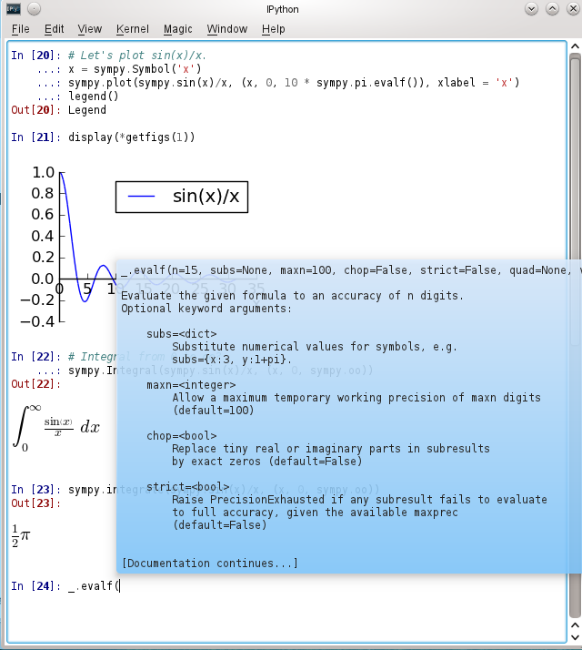
IPython QtConsole
Multi-line editing
Display plots inline
Rich representations
Tooltips

Slide 12
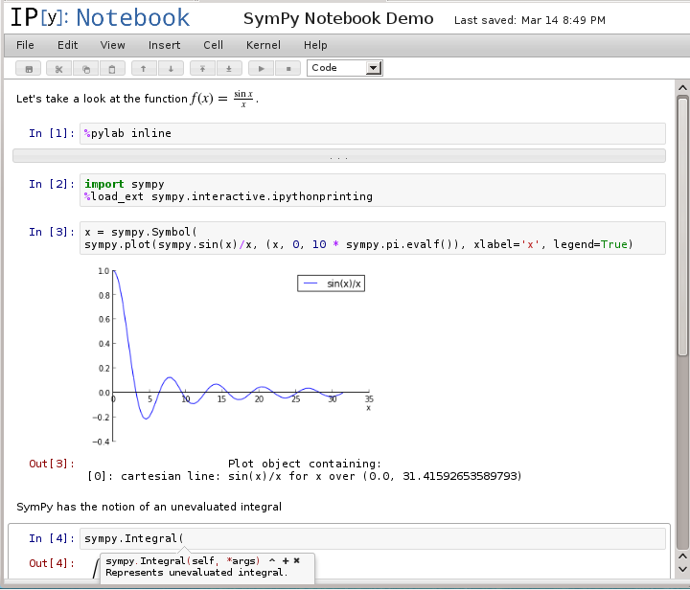
IPython Notebook
Text cells with LaTeX formatting.
Multi-line editing
Display plots inline
Rich representations
Tooltips

Slide 13
NumPy
fast numeric library for python
written in C
capabilities similar to MatLab
focus on array processing
many scientific application libraries depend on NumPy
replaces Numeric and Numarray
current version NumPy 1.8.1 (26 Mar, 2014)
further information:
  http://numpy.scipy.org
  http://www.scipy.org/Numpy_Example_List_With_Doc

Slide 14
NumPy
NumPy is mainly about:
  ndarray = n-dimensional array objects
  ufunc = fast operations on ndarrays
  some subpackages: linalg, fft, random
  for other functionalities → SciPy
to avoid confusion we will import numpy into its own namespace:
>>> import numpy as np
>>> print np.__version__
'1.8.0'

Slide 15
NumPy - ndarrays
ndarrays are:
  n-dimensional array objects
  typed (default='minimal' type at creation time or float64)
  C-contigous in memory by default (last index fastest)
  indexed starting at 0 (C-convention)
creating ndarrays:
  >>> a=np.array([[1,2,3,4],[5,6,7,8]]) # from python list
  >>> b=np.ones(5) # float64 if no dtype given!
  >>> c=np.arange(0, 2*np.pi, np.pi/180) # from generator
  >>> d=np.linspace(0,2*np.pi, 360) # dto.

Slide 16
NumPy - ndarrays
inspecting ndarrays:
  >>> a=np.array([[1,2,3],[4,5,6]])
  >>> a
  array([[1, 2, 3],
  [4, 5, 6]])
  >>> a.dtype
  dtype('int64')
  >>> a.itemsize # element size in bytes
  8
  >>> a.shape # array dimensions
  (2, 3)
  Several others, try e.g. a.ndim, a.size, a.nbytes, type(a)

Slide 17
NumPy – dtypes and casting
numpy dtypes:
  (long)float, float16...128
  (long)complex, complex64...256
  (u)int, (u)int8...128
  str, unicode
  bool (=1byte!)
  datetime64, timedelta64
  object, void
type casting:
  astype() #always copy
  asarray() #copy if type changed
related functions:
  tolist()
  fromstring()

Slide 18
NumPy – ndarrays: read access (1)
indexing:
>>> a=np.array([[1,2,3],[4,5,6],[7,8,9]])
>>> a[1,-1] # tuple indexing in 1 square bracket
6
slicing (as with normal python lists: slice=reference!):
>>> a[:,::2] # every second column
array([[1, 3],
[4, 6],
[7, 9]])
>>> a[1:3]
array([[4, 5, 6],
  [7, 8, 9]])

Slide 19
NumPy – ndarrays: read access (2)
the following access methods create copies!
fancy indexing:
>>> a=np.arange(0,77,7)
>>> a[[1,3,8]]
array([ 7, 21, 56])
masking:
>>> mask= np.array([0,1,0,1,0,0,0,0,1,0],dtype=bool)
>>> a[mask]
array([ 7, 21, 56])
using a condition:
>>> a[a%3==0]
array([ 0, 21, 42, 63])

Slide 20
NumPy – ndarrays: read access (3)
where() (creates an index array)
>>> a=np.arange(0,77,7)
>>> np.where(a%3==0)
(array([0, 3, 6, 9]),) # indices
>>> a[np.where(a%3==0)] # use for fancy indexing
array([ 0, 21, 42, 63])
  e.g. for accessing a second array of the same dimensions based on a condition on the first array

Slide 21
NumPy – ndarrays: write access
directly into cells and slices (as they are references!)
>>> a=np.array([[1,2,3],[4,5,6]])
>>> a[1,1:]=0
>>> a
array([[1, 2, 3],
[4, 0, 0]])
fill()
>>> a.fill(2.5) # same as a[:]=2.5
>>> a; a.dtype
array([[2, 2, 2],
[2, 2, 2]])
dtype('int64') # attention! type coercion!

Slide 22
NumPy – ndarrays: shape shifting (1)
transpose() or T (creates a view with swapped strides)
>>> a=np.array([[1,2,3],[4,5,6]])
>>> a.strides
(24, 8)
>>> b=a.T
>>> b[0,0]=0
>>> b; b.strides; a
array([[0, 4],
[2, 5],
[3, 6]]
(8, 24)
array([[0, 2, 3], # a view is a reference!
[4, 5, 6]]) # strides may be changed

Slide 23
NumPy – ndarrays: shape shifting (2)
flatten() flat() and ravel() (nd-array → 1d-array)
>>> a=np.array([[1,2,3],[4,5,6]])
>>> b=a.flatten() # array([1, 2, 3, 4, 5, 6]), copy of a
>>> a_it=a.flat # 1d-iterator on a
>>> sum(a.flat)
21
>>> c=a.ravel() # ravel() creates a view, i.e. reference
>>> c[0]=0; a[0]
array([0, 2, 3])
>>> a_t=a.T; # a_t is no longer contigous in memory
>>> d=a_t.ravel() # ravel() now creates a copy!
>>> d[0]=0; a_t[0]
array([1, 4]) # a_t unchanged

Slide 24
NumPy – ndarrays: shape shifting (3)
newxaxis
  a special index, that creates an axis
>>> a=np.array([1,2,3]) # 1d-array, shape=(3, )
>>> b=a[:,np.newaxis,np.newaxis]; b
array([[[1]], #3d-array, shape==(3,1,1)
[[2]],
[[3]]])
>>> c=a[np.newaxis,np.newaxis,:]; c
array([[[1, 2, 3]]]) #3d-array, shape==(1,1,3)
  w/o assignment a.shape=(1,1,3) does the same thing
squeeze()
  removes all empty dimensions
>>> b.squeeze()
array([1,2,3])

Slide 25
NumPy – ndarrays …and more functions...
some other shape functions:
reshape() (-1 = dimension to be inferred, max. one)
swapaxes() swaps two axis of the array
some other array creation functions:
zeros 0-filled array
identity square 0-filled array, main diagonal=1
asarray from list, tuple and their combinations
fromiter from iterator
fromfunction from function evaluated on array positions
diag like identity but diagonal given as vector

Slide 26
NumPy – ndarrays to and from files
loadtxt(): array from txt file:
>>> cat 'test.dat'
//// This and the next line are headers
Name income rev_q1 rev_q2 rev_q3 rev_q4
larry, 200, 0, 1.5, 2.8, 0.2
bill, 1000, 12.5, 15, 18, 33.4
steve, 5600, 128, 40, 0, 0
>>> np.loadtxt('test.dat',dtype=np.float32, skiprows=2, delimiter=',' ,usecols=[1,2,3,4,5])
array([[ 2.00000000e+02, 0.00000000e+00, 1.50000000e+00, 2.79999995e+00, 2.00000003e-01], …
  loadtxt() decompresses “.gz” files automatically

Slide 27
NumPy – ndarrays to and from files (2)
loadtxt(): nested array from txt file:
>>> cat 'test.dat'
//// This and the next line are headers
Name income rev_q1 rev_q2 rev_q3 rev_q4
larry, 200, 0, 1.5, 2.8, 0.2
bill, 1000, 12.5, 15, 18, 33.4
steve, 5600, 128, 40, 0, 0
>>> dt=np.dtype([('name','S10'),('income',np.int16),('revenue',([('q1',np.float32),('q2',np.float32),('q3',np.float32),('q4',np.float32)]))])
>>> np.loadtxt('test.dat',dtype=dt, skiprows=2,delimiter=',')
array([('larry', 200, (0.0, 1.5, 2.799999952316284, 0.20000000298023224)),.....
dtype=[('name', '|S10'), ('income', '<i2'), ('revenue', [('q1', '<f4'), ('q2', '<f4'), ('q3', '<f4'), ('q4', '<f4')])])

Slide 28
NumPy – ndarrays to and from files (2)
savetxt(): save array to txt file:
>>> a=np.arange(0,100,0.5)
>>> a.reshape(-1,5) # reshaping into 5 columns
>>> np.savetxt("newdat.txt",newdat,fmt="%5.1f",delimiter=",")
>>> cat “newdat.txt”
0.0, 0.5, 1.0, 1.5, 2.0
2.5, 3.0, 3.5, 4.0, 4.5
5.0, 5.5, 6.0, 6.5, 7.0
7.5, 8.0, 8.5, 9.0, 9.5 …
some other file I/O functions in numpy:
fromfile, tofile binary or text format
save, load binary numpy “npy”format
savez, load binary numpy “npz”-container format
genfromtxt like loadtxt, w. checks and more options

Slide 29
NumPy – working with ndarrays - ufuncs
universal functions (=ufuncs) process arrays element-wise, i.e. they are vectorized wrappers for scalar functions
about 80 ufuncs available:
  add, sub...,power, log, log2, exp, exp2, sign, conj...
  trigonometric, bitwise, comparison and logic functions
  maximum, minimum,.....

Slide 30
NumPy – ufuncs: broadcasting
to work with 2 or more arrays that have non-identical dimensions ufuncs use broadcasting:
  the output shape is the maximum shape for each of the dimensions ocurring in the inputs
  all arrays are augmented to the output dimension by adding single valued dimensions
  all input dimensions are either 1 or output size
  values are repeated from the values of axis shape>1
>>> a1=np.array([[4.,2.,6.],[1.,2.,3.]])
>>> a2=np.array([1.,5.,3.]) # will be broadcasted to 2d-array
array([1.,5.,3.],[1.,5.,3.])
>>> np.maximum(a1,a2)
array([[ 4., 5., 6.],
[ 1., 5., 3.]])

Slide 31
NumPy – working with ndarrays - ufuncs
ufuncs support the following 4 methods:
  op.reduce() apply ufunc along one axis (dim-=1)
  op.accumulate() same with intermediate results
  op.reduceat() reduce on specific slices
  op.outer() combinatoric application of op.
>>> a=np.array([[1.,2.,3.],[4.,5.,6.]])
>>> np.add.reduce(a)
array([ 5., 7., 9.])
>>> np.add.reduce(a,axis=1)
array([ 6., 15.])
>>> np.add.accumulate(a, axis=1)
array([[ 1., 3., 6.],
[ 4., 9., 15.]])

Slide 32
NumPy – other reduction functions
work along one specified axis and reduce one dimension
if axis=None they work over the entire array
sum(), prod(), min(), max(), ptp(), argmin(), argmax(),
any(), all(), mean(), std(), var()
>>> a=np.array([[1.,12.,2],[8.,3.,5.]])
>>> a.ptp() # peaktopeak=max-min, entire array
11.0
>>> a.ptp(axis=0)
array([ 7., 9., 3.])

Slide 33
NumPy – vectorize
vectorize():
  creates vectorized wrapper for scalar functions
  works even if functions contain iterations etc.
  >>> a=np.arange(50)
  >>> def dividable_by_3_or_7(x):
  ... if (x%3==0) or (x%7==0):
  ... return True
  ... return False
  >>> v_dividable_by_3_or_7=np.vectorize(dividable_by_3_or_7)
  >>> a[v_dividable_by_3_or_7(a)]
  array([ 0, 3, 6, 7, 9, 12, 14, 15, 18])

Slide 34
NumPy – complex
numpy supports arrays with type complex
  all ndarrays have methods real() and imag()
  conj() return the complex conjugate, element-wise
  angle() return the angle of the complex argument
  values are repeated from the values of axis shape>1
>>> a = np.array([1+1j, 2, 3-2j])
>>> a.conj()
array([ 1.-1.j, 2.-0.j, 3.+2.j])
>>> np.angle(a,deg=1) # default: radian
array([ 45. , 0. , -33.69006753])

Slide 35
NumPy – random data
package numpy.random:
  Mersenne Twister random generator
  rand , randn, randint etc. create ndarrays
  ca. 30 different random number distributions
  shuffle(): in-place shuffling of a sequence (1d)
  permutation(): permuted copy of sequence or range (1d)
>>> a=np.random.randn(10000000); a # from normal distr.
array([-0.77242906, 0.7029468 , -0.86639567, ..., 0.88509133,
      0.32113341, -1.8182 ])
>>> a.mean(); a.std()
2.1424424256423229e-05
0.99968935832287886

Slide 36
NumPy – other functions
vector functions:
  dot, vdot, inner, outer, cross, kron, tensordot
many other useful functions:
  memmap, mgrid, extract, sort, argsort, choose,
many other math functions:
  http://docs.scipy.org/doc/numpy/reference/routines.math.html
packages for:
  linear algebra: np.linalg (decompositions, eigenvalues...)
  Fast Fourier Transform: np.fft
  random numbers: np.random

Slide 37
NumPy – misc.
other features
  support for arrays containing missing values
  many routines have efficient in-place variants
pitfalls
  slices are references
  fancy indexing creates copy
  some functions return either a view or a copy depending on whether the array is contiguous or not, e.g. ravel()
  automatic type casting without warning

Slide 38

Mandelbrot Set (Apfelmännchen)
Notes:
The Mandelbrot set. Image taken from Wikimedia Commons created by WolfgangBeyer.

Slide 39
Mandelbrot Set (Apfelmännchen)
Set of points for which z(i+1)=z(i)*z(i)+c does not diverge
z and c are complex numbers
z=zr+i*zi, where i=sqrt(-1)
Series diverges if |z| > 2
z^{i}
z
z^{r}

Slide 40
Mandelbrot – The Algorithm
for c in PointInComplexPlane:
  z=0
  for i in range(maximumNumberOfIterations):
    z=z*z+c
    if abs(z) > 2:
    iter[c] = i
    break

Slide 41
Complex Numbers in Python
Native to Python
Expressed as z = 1.2 + 3.14j
(Engineers use j instead of i for )
Math functions work
abs(z) returns |z|

Slide 42
Exercise: Mandelbrot Set in Python
Write a program to determine the Mandelbrot set
Visualize the Mandelbrot set using imshow von matplotlib

Slide 43
Exercise: Using NDArrays
Each point is independent
Use NDArrays for PointInComplexPlane, z, and iter
Visualize Mandelbrot set using matplotlib
Is the NDArray implementation faster?
(Use %timeit or add timing statements to your code)

Slide 44
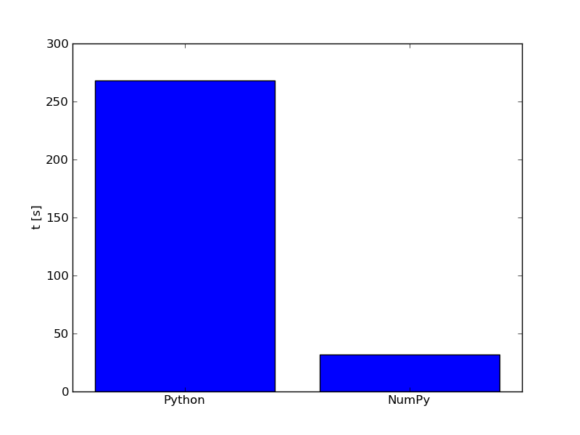
Speed Comparison 1

Slide 45
SciPy overview

Slide 46
SciPy
comprehensive package for scientific computation
import scipy;help(scipy) gives >87000 lines!
builds on NumPy:
  imports all NumPy functionality into scipy namespace
  SciPy functions use the same broadcasting machinery
can be linked to high performance math libraries e.g. Intel MKL
17 task-specific subpackages:
  cluster, constants, fftpack, integrate, interpolate, io,
  linalg, misc, ndimage, odr, optimize, signal, sparse, spatial, special, stats, (weave)
  Many functions are wrappers to C/Fortran libs

Slide 47
SciPy – integration
package scipy.integrate
quad(): general purpose integration for integrating over a function
>>> from scipy import integrate
>>> integrate.quad(lambda x: sp.sin(x),0,sp.pi*2.)
(2.221501482512777e-16, 4.3998892617845996e-14)
also available: double and triple integration, Gaussian quadrature and Romberg
integration is also possible from/to infinity
odeint(), ode(): ordinary differential eqs (lsoda...)

Slide 48
SciPy – optimization, root finding, fitting
package scipy.optimize
contains range of different optimizers:
  general purpose: minimize, minimize_scalar, leastsq
    unconstrained and constrained, uni- and multivariate
  global: brute, basinhopping, new: differential_evolution
  curve_fit(): non-linear fitting (Levenberg-Marquardt)
  root finding: newton, broyden, newton_krylov, anderson
  New: linear programming: linprog (simplex)

Slide 49
SciPy – linear algebra
package scipy.linalg
(mirror of numpy linalg + more)
basic functions:
  inv, solve, det, norm, lstsq
decompositions:
  eig, svd, LU, QR, Cholesky, Schur
matrix functions:
  expm, logm, sinm, sinhm, cosm, coshm …
special matrices:
  block_diag, hadamard, hilbert …

Slide 50
SciPy – interpolation and signal processing
package scipy.interpolation
  1D and 2D spline interpolation
  1D and 2D radial basis function interpolation
  nD: linear and Nearest Neighbor-interpolation
package scipy.signal
  1D and 2D B-spline interpolation
  filters: correlate, convolve, median, Wiener
  windowing, peak finding, spectral analysis

Slide 51
SciPy – other packages
spatial
  KDtree = nearest neighbor search
  Delaunay triangulation, Voronoi diagrams
  ~20 different distance measures (spatial.distance)
stats
  very large package
  ca. 100 continuous and discrete distributions
  >20 test functions (T-test, Kolmogorov, Kruskal, etc.)
  contingency table function, general linear models

Slide 52
SciPy – other packages
io
  reading and writing of files in several formats:
  MATLAB, wav (sound), arff (WEKA), netcdf, Matrix Market
weave (deprecated: use Cython!)
  C/C++ in python:
  inline: use C within python
  blitz: convert numpy expressions to C++
other packages: cluster, sparse, fftpack, odr, constants, ndimage

Slide 53
SciPy – other packages
misc
  factorial functions
  derivative (numeric!)
  lena (test picture)
special
  over 300 special functions
  Bessel, Error function, Elliptic functions and integrals, Beta, Gamma, orthgoal polynomial functions,
  Legendre, Hypergeometric, spheroidal wave functions
  ….you name it ...

Slide 54
NumPy/SciPy/mpi4py – outlook
NumPy 1.9
  ufuncs will work with sparse matrices
  linspace output can be specified w. dtype
  cross() broadcasting bug fixed
  GIL released for fancy indexing, np.where and random
SciPy 0.15/0.16
  new optimizers: LP, differential evolution
  weave deprecated (use cython!)
  Cython wrappers for BLAS and LAPACK
Mpi4py 2.0 (still not there...)
  MPI-3 features, e.g. non-blocking collectives

Slide 55
mpi4py overview

Slide 56
mpi4py
object-oriented MPI wrapper for python (mpi4py.scipy.org)
supports almost all features of MPI-2:
  communicators and virtual topologies
  point to point communication: (non)-blocking, persistent
  collective communication: including MPI reductions
  one sided communication (remote memory access)
  dynamic process management (e.g. client/server)
  MPI-I/O
  most functions have variants supporting generic python objects (exception: irecv() )
currently not implemented are:
  alltoallw() and reduce_scatter()

Slide 57
Mpi4py – point to point communication
# adapted from the mpi4py tutorial
from mpi4py import MPI
import numpy as np
comm = MPI.COMM_WORLD
rank = comm.Get_rank()
# uppercase Send/Recv=automatic MPI datatype discovery
if rank == 0:
data = numpy.arange(100, dtype=numpy.float64)
comm.Send(data, dest=1, tag=13)
elif rank == 1:
data = numpy.empty(100, dtype=numpy.float64)
comm.Recv(data, source=0, tag=13)

Slide 58
Mpi4py – collective communication
from mpi4py import MPI
comm = MPI.COMM_WORLD
size = comm.Get_size()
rank=comm.Get_rank()
data=(rank+1)**2
print "before gather, data on\
rank %d is: "%rank,data
comm.Barrier()
data=comm.gather(data,root=0)
if rank==0:
for i in range(size):
assert data[i]==(i+1)**2
else:
assert data is None
print "data on rank: %d is: "%rank,data
Output:
before gather, data on rank 3 is:16 before gather, data on rank 0 is: 1 before gather, data on rank 1 is: 4 before gather, data on rank 2 is: 9
data on rank: 1 is: None
data on rank: 3 is: None
data on rank: 2 is: None
data on rank: 0 is: [1, 4, 9, 16]

Slide 59
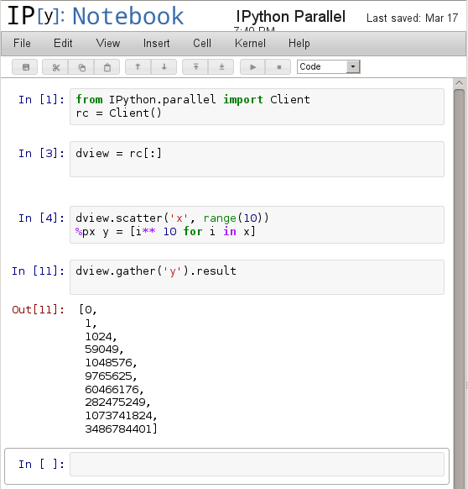
Parallel Programming w/ IPython
Manage clusters via Dashboard
Include local and remote resources
Resource allocation may vary with time
Plays nicely with MPI

Slide 60
IPython Parallel: Architecture
Hub + Scheduler form Controler
Engines are Python instances
DirectView
Load-balanced View
Hub
IPEngines

Slide 61
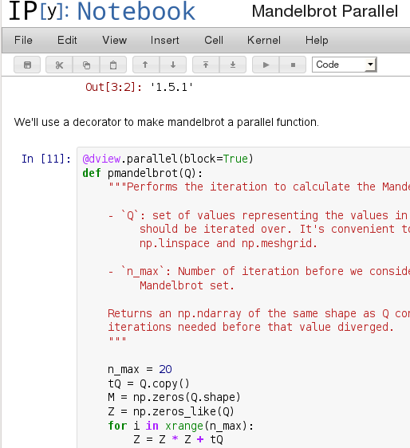
IPython Parallel: Easy Parallelism
@view.parallel decorator
%px magic
Can only manipulate copies of
passed arrays.

Slide 62
Blockwise Matrix-Matrix Multiplication
=

Slide 63
Blockwise Matrix-Matrix Multiplication
=

Slide 64
Blockwise Matrix-Matrix Multiplication
=

Slide 65
Blockwise Matrix-Matrix Multiplication
=

Slide 66
Blockwise Matrix-Matrix Multiplication
=

Slide 67
Blockwise Matrix-Matrix Multiplication
=
Thread block loops over blocks in blue and yellow matrix:
Calculate upper left corner
Load data into shared memory
Do calculation (one thread is still responsible for an element)
Add partial sum to result

Slide 68
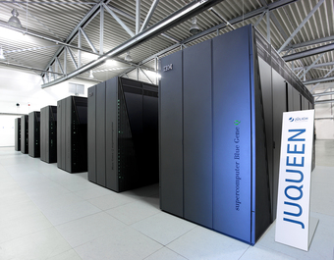
Python on JUQUEEN

Slide 69
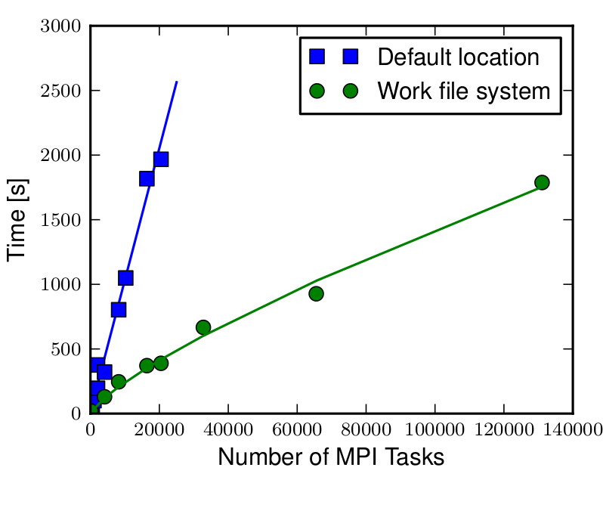
Python on JUGEEN

Slide 70
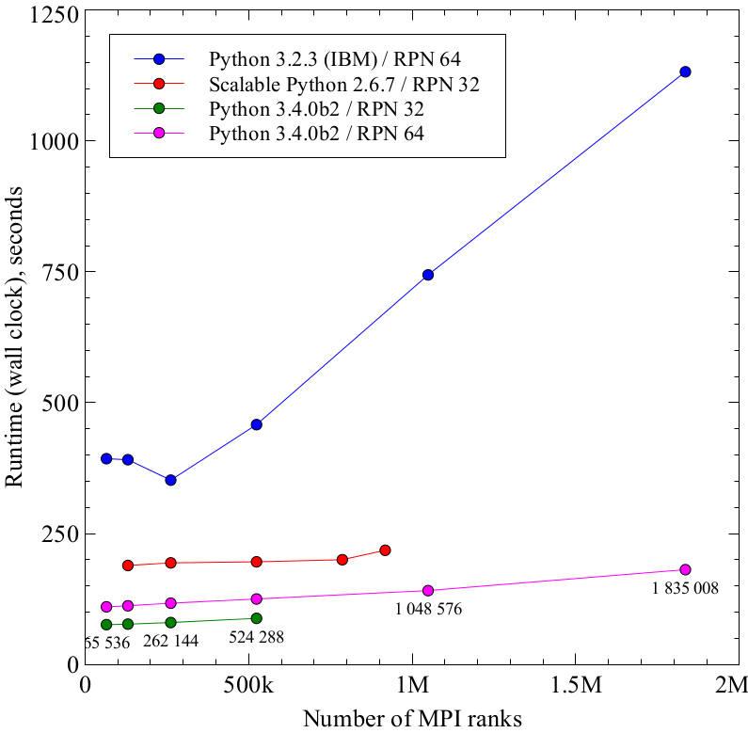
Python on JUQUEEN
Figure by Yury Zaitsev

Slide 71
misc
bindings to HPC libs (e.g. those on JUROPA):
  petsc4py : https://bitbucket.org/petsc/petsc4py
    includes interfaces to ScalaPack, Mumps, hypre, sundials, sprng, parmetis etc.
  ScalaPack: https://github.com/jrs65/scalapy
  Arpack: see scipy.sparse.linalg
  MUMPS: https://pypi.python.org/pypi/PyMUMPS
  Elemental: (no longer :-( )
  ELPA: not available
  CPMD, CP2k et al: http://elcorto.bitbucket.org/pwtools/
  for much more:
    Look on PyPI, github, google code or bitbucket !!

Slide 72
data analysis
will be detailed in November course
  high performance I/O:
    netCDF, HDF5, MPI I/O with mpi4py (PyTables et al.)
  visualization
    matplotlib, mayavi, ...
  analysis and machine learning
    PANDAS
    scikit learn
  there are many packages for: image analysis, signal analysis, DNA sequence analysis, text/speech analysis
  Look on PyPI, github, google code or bitbucket !!

Slide 73
References
book:
  H.P.Langtangen: A Primer on Scientific Programming with Python
numpy, scipy:
  online documentation
  presentations from Enthought
matplotlib, MayaVi:
  online documentation
High Performance Python (Cython et al.)
  online documentation
python conferences and proceedings:
  SciPy http://conference.scipy.org(/proceedings.html)
  EuroScipy

Slide 74
making the world a better place
immediately after the course:
  please email your complaints, wishes and suggestions
  spread the word (if you liked it)
later:
  teach others
  contribute to the scientific packages
  fill in the feedback form (internal participants only)

