Slide 1
HPC Python
13.06.2016 – 14.06.2016
Olav Zimmermann & Jan H. Meinke

Slide 2
Making Things Faster
numba
C
Cython
mpi4py
Fortran
ShedSkin
PyOpenCL
C++
numexpr
PyCUDA
PyPy
Boost.Python

Slide 3
Profiling
First measure then optimize
cProfile (function level)
python -m cProfile -o Mandelbrot.py.profile Mandelbrot.py
RunSnakeRun
line_profiler (line by line)

Slide 4
Making Things Faster
numba
C
Cython
mpi4py
Fortran
ShedSkin
PyOpenCL
C++
numexpr
PyCUDA
PyPy
Boost.Python

Slide 5
Numexpr
import numexpr as ne
>>> a = np.random.random(1e6)
>>> b = np.random.random(1e6)
>>> c = np.random.random(1e6)
>>> %timeit ne.evaluate('
… 2 * a ** 3 + 3 * a ** 2 * b
… + a * b ** 2 + b ** 3 + c')
100 loops, best of 3: 10.4 ms per loop
>>> %timeit 2 * a ** 3 + 3 * a ** 2 * b
… + a * b ** 2 + b ** 3 + c
1 loops, best of 3: 224 ms per loop
Avoid temporary variables
Just-in-time compilation
Multi-threaded
https://github.com/pydata/numexpr

Slide 6
Numba
Just-in-time compiler (uses llvm)
NumPy-aware
Very fast
from numba import autojit
import numpy as np
@autojit
def mandel(x, y, max_iters):
i = 0
c = complex(x,y)
z = 0.0j
for i in range(max_iters):
z = z*z + c
if (z.real*z.real + z.imag*z.imag) >= 4:
return i
return 255
@autojit
def create_fractal(...):
...
http://numba.pydata.org/

Slide 7
Making Things Faster
numba
C
Cython
mpi4py
Fortran
ShedSkin
PyOpenCL
C++
numexpr
PyCUDA
PyPy
Boost.Python

Slide 8
Cython
“Cython is a language that makes writing C extensions for the Python language as easy as Python itself”

Slide 9
Cython
Python syntax
Variable definitions
Compiled extensions
Support for NumPy
def dot(v, w):
if len(v) == len(w) and len(v) > 0:
res = v[0] * w[0]
for i in range(1, len(v)):
res += v[i] * w[i]
return res
http://cython.org/
dot.pyx

Slide 10
Cython – Compiling
At runtime
Import pyximport
Call pyximport.install()
.pyx treated the same as .py
import pyximport
pyximport.install()
from dot import dot
a = [1, 2, 3, 4]
b = [4, 3, 2, 1]
print dot(a, b)

Slide 11
Cython – Compiling
Using distutils
Write a simple setup.py script:
python setup.py build_ext --inplace
from distutils.core import setup
from distutils.extension import Extension
from Cython.Distutils import build_ext
ext_modules = [Extension("dot", ["dot.pyx"])]
setup( name = 'Dot product',
cmdclass = {'build_ext': build_ext},
ext_modules = ext_modules)

Slide 12
Exercise: Speed Comparison
Use IPython's %timeit to compare a pure python function with the compiled version
Define function in IPython
Multiply two lists with at least 1000 elements
Load the module and time it as well.
def dot(v, w):
if len(v) == len(w) and len(v) > 0:
res = v[0] * w[0]
for i in range(1, len(v)):
res += v[i] * w[i]
return res
%load_ext Cython
Notes:
I got a factor of 2.3!

Slide 13
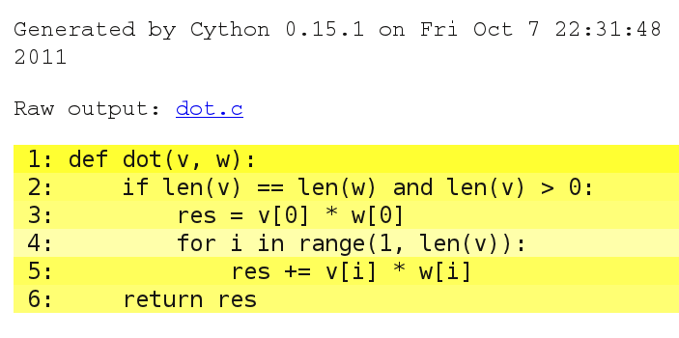
Cython Annotations
Notes:
Line 4 is a lighter color. This means cython was able to convert part of the code into pure C. In this case it's the loop.
If we want to keep this function as general as it is there's not much else we can do. But if we know, for example, that all the elements in v and w are integers, we can use ndarrays and let the function know about it.

Slide 14
Exercise: Speed Comparison
Use IPython's %timeit to compare the time dot needs for lists and ndarrays
→ it's slower with ndarrays
Notes:
I got a factor of 2.3!

Slide 15
Cython – Adding Types
import numpy as np
cimport numpy as np
def dot(np.ndarray[np.int_t, ndim = 1] v,
np.ndarray[np.int_t, ndim = 1] w):
cdef int res
cdef int i
if len(v) == len(w) and len(v) > 0:
res = v[0] * w[0]
for i in range(1, len(v)):
res += v[i] * w[i]
return res

Slide 16
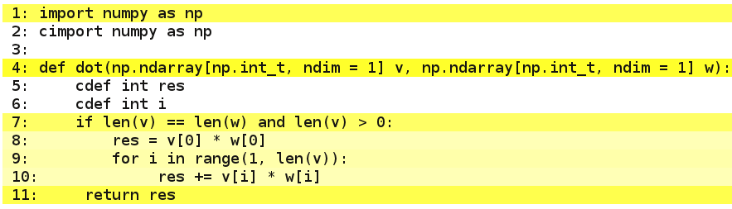
Cython – Adding Types

Slide 17
Cython – Adding Types
import numpy as np
cimport numpy as np
def dot(np.ndarray[np.int_t, ndim = 1] v,
np.ndarray[np.int_t, ndim = 1] w):
cdef int res
cdef int i
cdef int n
n = len(v)
if len(v) == len(w) and len(v) > 0:
res = v[0] * w[0]
for i in range(1, n):
res += v[i] * w[i]
return res

Slide 18
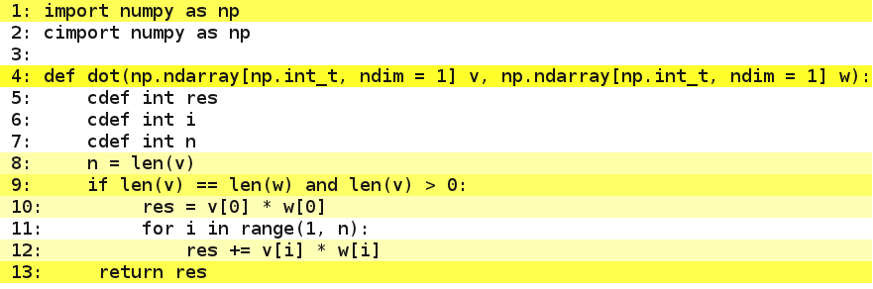
Cython – Adding Types

Slide 19
Cython – Turning Off Checks
import numpy as np
cimport numpy as np
cimport cython
@cython.boundscheck(False)
def dot(np.ndarray[np.int_t, ndim = 1] v,
np.ndarray[np.int_t, ndim = 1] w):
cdef int res, i, n
n = len(v)
if len(v) == len(w) and len(v) > 0:
res = v[0] * w[0]
for i in range(1, n):
res += v[i] * w[i]
return res

Slide 20
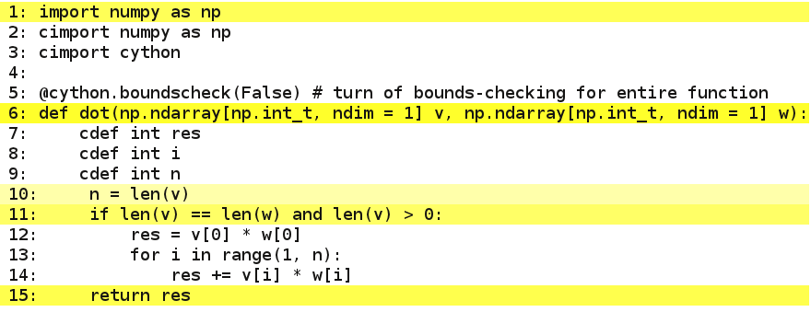
Cython – Turning Off Checks

Slide 21
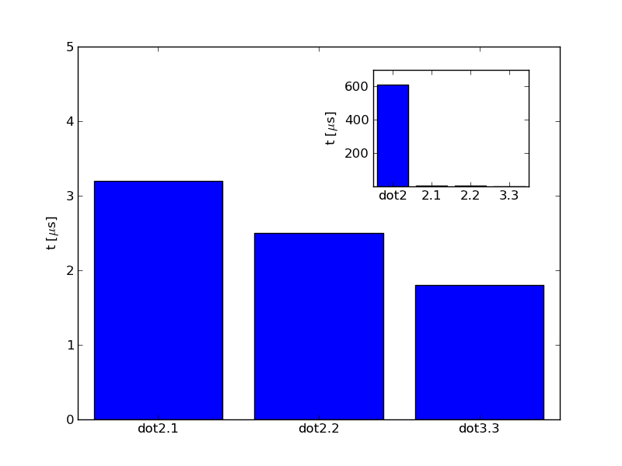
dot2 – Timing Comparison
Notes:
1.8 us (np.array, 1000, no boundscheck), dot2.3
2.5 us (np.array, 1000, all cdef), dot2.2
3.2 us (np.array, 1000, cdef v,w,res, i len(v) in loop), dot2.1
610 us (np.array, 1000, no typing), dot2

Slide 22
Exercise: Speedup Mandelbrot w/ Cython
Use Cython to speed up your implementation of Mandelbrot
How much speedup do you achieve?
You can start with Mandelbrot.pyx in ~scpy/2014/HPCPy/code/Mandelbrot/cython/
Split complex math into real and imaginary part
Does that improve things?

Slide 23
Making Things Faster
numba
C
Cython
mpi4py
Fortran
ShedSkin
PyOpenCL
C++
numexpr
PyCUDA
PyPy
Boost.Python
Notes:
Cython produces very efficient code but maybe you already have an implementation in C, C++ or Fortran available. Cython can help there, too. You can use Cython to create bindings to the compiled code that are then called from within Python

Slide 24
Python Bindings to C with Cython
Cython can call any C function
Create thin wrapper that's called from Python
cdef extern from "math.h":
# List all the functions you want to import
double sin(double)
double cos(double)
def csin(double x):
return sin(x)
def sin2cos2(double x):
return sin(x) * sin(x) + cos(x) * cos(x)

Slide 25
Exercise: Wrapping C with Cython
Wrap the Mandelbrot routines in ~scpy/2016/HPCPy/code/Mandelbrot/c
Is the result faster than your Numba code?

Slide 26
Making Things Faster
numba
C
Cython
mpi4py
Fortran
ShedSkin
PyOpenCL
C++
numexpr
PyCUDA
PyPy
Boost.Python

Slide 27
Python Bindings to C++ with Cython
Cython knows about classes and namespaces
Import public member variables and functions

Slide 28
Python Bindings to C++ with Cython
#include <vector>
class Point3D {
public:
Point3D(const double x, const double y, const double z);
Point3D(const std::vector<double> r);
void translate(const double dx, const double dy,
const double z);
void translate(const std::vector<double> dr);
const std::vector<double> coordinates();
private:
double _x, _y, _z;
};

Slide 29
Import
Import class and members (note cppclass keyword)
A number of standard containers are already wrapped. Import with:
from libcpp.vector cimport vector
cdef import from "point3d.h":
cpdef cppclass Point3D:
Point3D(double x, double y, double z)
void translate(double dx, double dy, double dz)
vector[double] coordinates()
from libcpp.vector cimport vector

Slide 30
Definition and Constructors
Define wrapper class
self.thisptr keeps reference to C++ object
cdef class PyPoint3D:
cdef Point3D *thisptr
def __cinit__(self, double x, double y, double z):
self.thisptr = new Point3D(x, y, z)
def __dealloc__(self):
del self.thisptr

Slide 31
Wrapper functions
Create wrapper around function calls
def translate(self, double dx, double dy, double dz):
self.thisptr.translate(dx, dy, dz)
def coordinates(self):
cdef vector[double] r = self.thisptr.coordinates()
return (r[0], r[1], r[2])

Slide 32
Setup.py
Specify language (c++) in setup.py
setup(ext_modules=[Extension(
"pypoint3d", # name of extension
["point.pyx", "point3d.cpp"], # our Cython source
language="c++")])

Slide 33
Exercise: Wrapping C++ with Cython
Wrap the Mandelbrot class in Mandelbrot/cplusplus
Build with python setup.py build_ext --inplace
Run main.py
Is the result faster than your Numba code?

Slide 34
Making Things Faster
numba
C
Cython
mpi4py
Fortran
ShedSkin
PyOpenCL
C++
numexpr
PyCUDA
PyPy
Boost.Python

Slide 35
Python Bindings to Fortran with f2py
f2py is part of NumPy
Very easy to use
Given a fortran module in the file mandelbrot.f90 use
f2py -c mandelbrot.f90 -m mandelbrot_f
cp ~scpy/2016/HPCPy/code/Mandelbrot/fortran

Slide 36
Exercise: Wrapping a Fortran Module with f2py
Wrap the module mandelbrot in mandelbrot.f90
Run main.py
Is the result faster than your Cython code?

Slide 37
Making Things Faster
numba
C
Cython
mpi4py
Fortran
ShedSkin
PyOpenCL
C++
numexpr
PyCUDA
PyPy
Boost.Python

Slide 38
Parallel Programming and Cython
prange (Cython >= 0.15)
mpi4py
IPython Parallel

Slide 39
Making Things Faster
numba
C
Cython
mpi4py
Fortran
ShedSkin
PyOpenCL
C++
numexpr
PyCUDA
PyPy
Boost.Python

Slide 40
GPU Programming with Python
PyCUDA
PyOpenCL
GPUArrays (PyCUDA)/ Array(PyOpenCL)
Elementwise kernels
Numba

Slide 41
Low Latency or High Throughput?
CPU
  Optimized for low-latency access to cached data sets
  Control logic for out-of-order and speculative execution
GPU
  Optimized for data-parallel, throughput computation
  Architecture tolerant of memory latency
  More transistors dedicated to computation
Control
ALU
ALU
ALU
ALU
Cache
DRAM
DRAM
© NVIDIA Corporation 2010

Slide 42
PyCUDA
Developed by Andreas Klöckner http://mathema.tician.de/software/pycuda
Full access to CUDA
Elementwise kernels
Custom reductions
GPUArrays

Slide 43
GPUArrays
NumPy NDArray lookalike
Live on the GPU
Operations are performed on GPU
cumath provides mathematical functions, e.g, sin, cos, and exp.

Slide 44
GPUArrays – Preparations
Initialize CUDA
Construct GPUArray
import pycuda.autoinit
import pycuda.gpuarray as gpuarray
import pycuda.driver as cuda
import numpy as np
a = np.random.random(1000).astype(np.float32)
b = np.random.random(1000).astype(np.float32)
a_gpu = gpuarray.to_gpu(a)
b_gpu = gpuarray.to_gpu(b)

Slide 45
GPUArrays – Usage
Use them like NDArrays
Efficient reductions, e.g., gpuarray.sum
Copy data back from GPU
or
s = gpuarray.sum(a_gpu * b_gpu) # executed on the GPU
c_gpu = a_gpu * b_gpu
c = c_gpu.get()
c_firstfive = c_gpu[:5]

Slide 46
GPUArrays – Usage
Fancy indexing and filters not supported, but
More details at http://documen.tician.de/pycuda/array.html
ones_gpu = gpuarray.zeros_like(c_gpu) + 1.0
c_gpu = gpuarray.if_positive(c_gpu <= 0.5 * ones_gpu, c_gpu, ones_gpu)

Slide 47
Exercise: Mandelbrot with GPUArrays
Implement the calculation of the Mandelbrot set using GPUArrays
Start with NumPy implementation
export PYTHONPATH=~meinke/.local/lib64/python2.7/site-packages:$PYTHONPATH

Slide 48
Elementwise Kernels
Multi-element expressions create temporaries
Elementwise kernels avoid that
Calculate :
or as
r_gpu = (x_gpu + y_gpu) ** 2
from pycuda.elementwise import ElementwiseKernel
xplusysquare = ElementwiseKernel(
"float* x, float* y, float* z",
"z[i] = x[i] * x[i] + 2 * x[i] * y[i] + y[i] * y[i]",
"xplusy_square")
r2_gpu = gpuarray.empty_like(x_gpu)
xplusysquare(x_gpu, y_gpu, r2_gpu)

Slide 49
Elementwise Kernels
preamble is import keyword argument:
“preamble specifies some source code that is included before the elementwise kernel specification. You may use this to include other files and/or define functions that are used by operation.” (Documentation)

Slide 50
Exercise: Mandelbrot with ElementwiseKernel
Implement the calculation of the Mandelbrot set using ElementwiseKernel
Hints:
  Include pycuda-complex.hpp using preamble
  Use pycuda::complex<float> (or double) as data type
  ElementwiseKernels can have more than one line
from pycuda.elementwise import ElementwiseKernel
xplusysquare = ElementwiseKernel(
"float* x, float* y, float* z",
"z[i] = x[i] * x[i] + 2 * x[i] * y[i] + y[i] * y[i]",
"xplusy_square")
r2_gpu = gpuarray.empty_like(x_gpu)
xplusysquare(x_gpu, y_gpu, r2_gpu)

Slide 51
Solution: Mandelbrot with ElementwiseKernel
complex_gpu = ElementwiseKernel(
"pycuda::complex<float> *z, pycuda::complex<float> *q, int *iteration, int maxiter",
”””for (int n=0; n < maxiter; n++) {
z[i] = (z[i]*z[i])+q[i];
if (abs(z[i]) > 2.0f) {
iteration[i]=n;
z[i] = pycuda::complex<float>();
q[i] = pycuda::complex<float>();
}
}
”””, "complex5",
preamble="#include <pycuda-complex.hpp>",)

Slide 52
Numba
import numpy as np
from numbapro import jit
from numbapro import cuda
@jit(argtypes=[f4[:,:], f4[:,:], f4[:,:]], target='gpu')
def cu_square_matrix_mul(A, B, C):
sA = cuda.shared.array(shape=(tpb, tpb),
dtype=f4)
…
tx = cuda.threadIdx.x
…
x = tx + bx * bw
y = ty + by * bh
acc = 0.
for i in range(bpg):
if x < n and y < n:
sA[ty, tx] = A[y, tx + i * tpb]
sB[ty, tx] = B[ty + i * tpb, x]
cuda.syncthreads()
…
CUDA uses llvm
Numba uses llvm
→ Use Numba to generate GPU code
See http://docs.continuum.io/numbaprofor more

Slide 53
Numba on JUDGE
Get an interactive node by adding -I -X to your msub command
module load python cuda/5.5 GCC
export PYTHONPATH=~meinke/.local/lib64/python2.7/site-packages:$PYTHONPATH
export NUMBAPRO_CUDALIB=/usr/local/cuda/cuda-5.5/nvvm/lib64
export NUMBAPRO_LIBDEVICE=/usr/local/cuda/cuda-5.5/nvvm/libdevice

