Slide 1
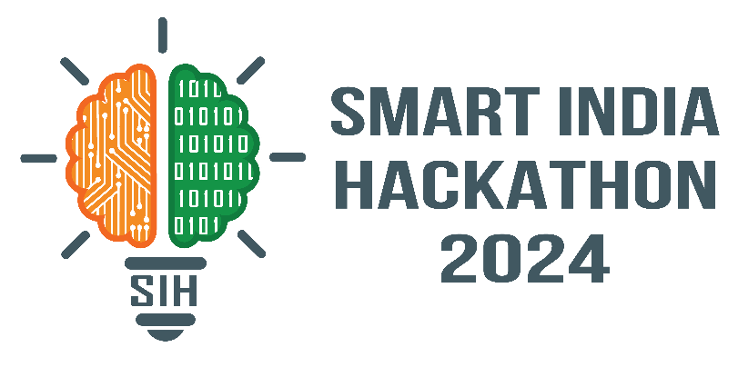
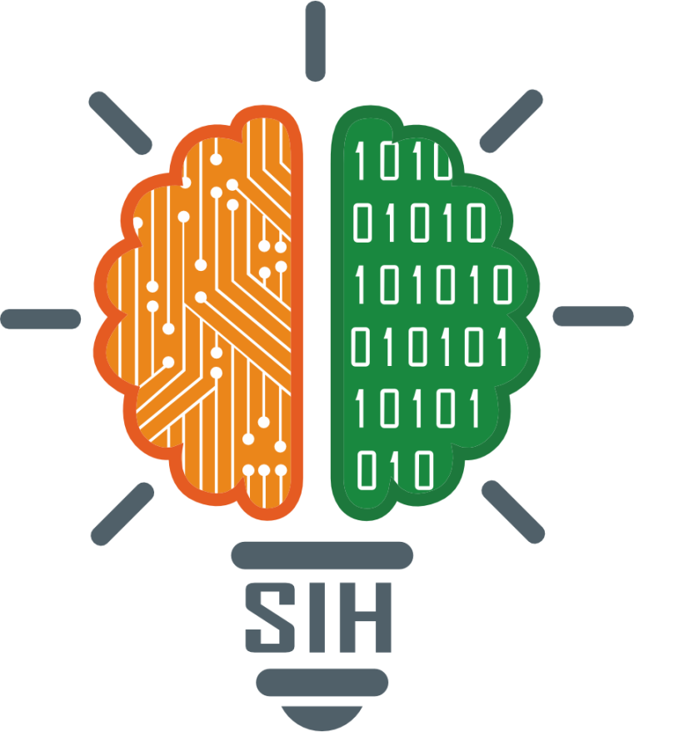
SMART INDIA HACKATHON 2024
TITLE PAGE
Problem Statement ID –SIH1527
Problem Statement Title-Enhancing body detection in CSSR operation using advanced technology
Theme-Disaster Management
PS Category- Hardware
Team ID-
Team Name (Registered on portal)-GigaMinds

Slide 2
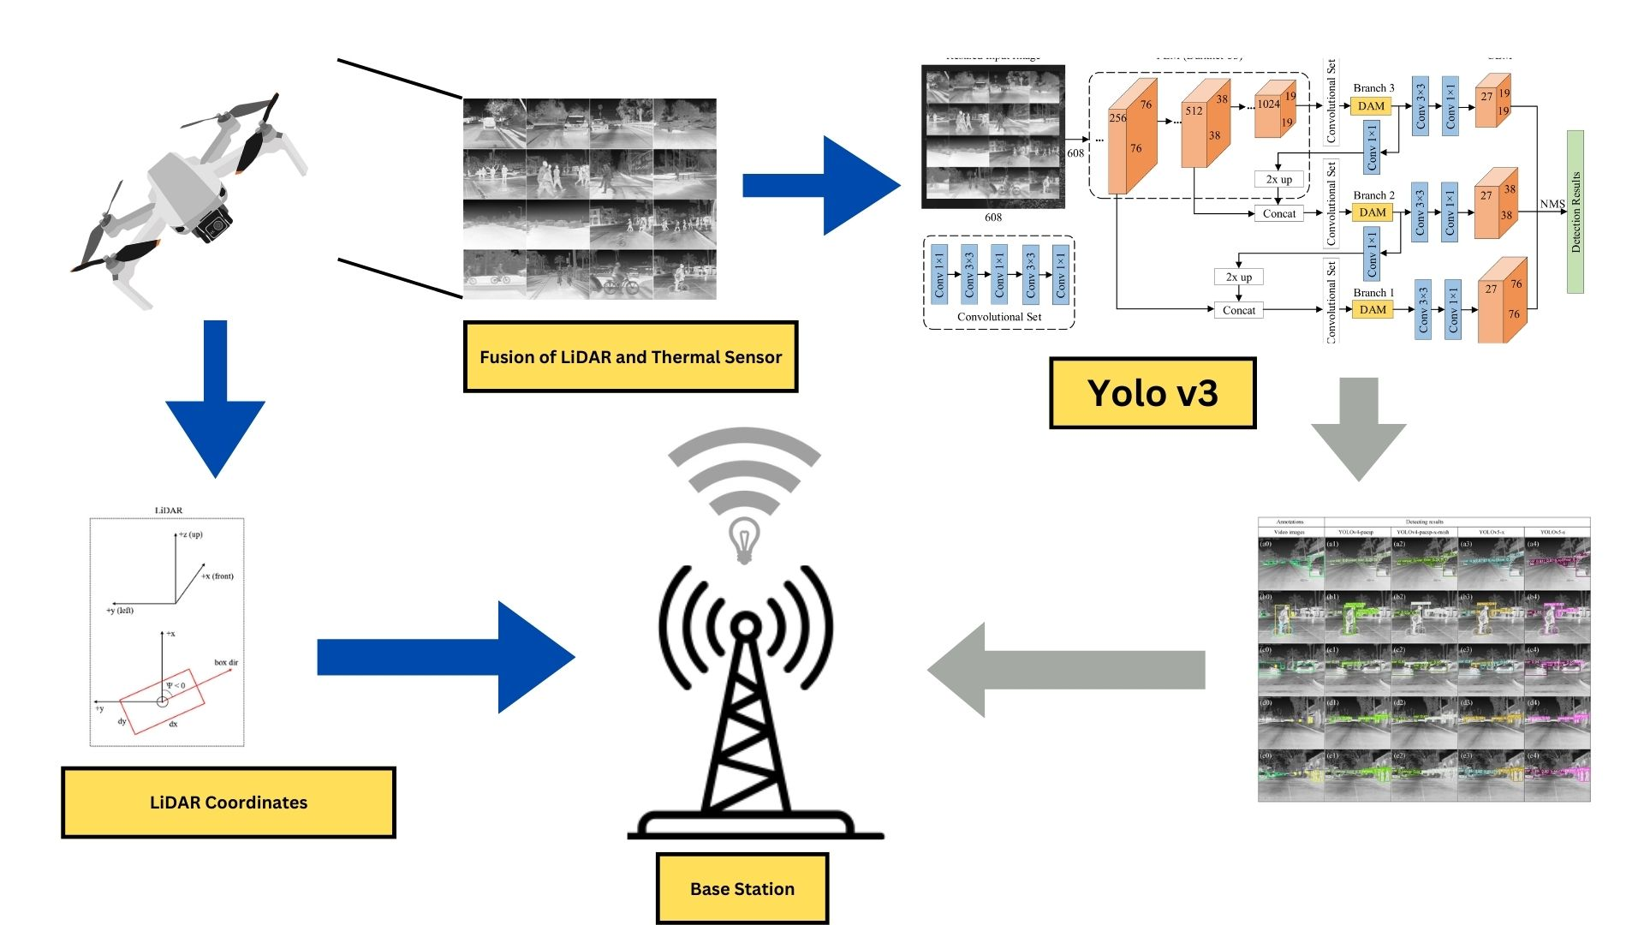
IDEA TITLE
GigaMinds
Problem
Disasters serve as an eye-opener as they are unstoppable and exceptional events which are either natural or manmade, such as earthquakes, wildfires, floods and terrorist attacks etc. These natural catastrophes many a times serve as a hats down chink in the armor as they lead to a massive death toll either because of people being stuck in the debris or due to no help received on time. One of the major challenges faced by the rescue and search teams during a massive disaster is the actual search of survivors and victims at the earliest and also reaching out to far off areas to make sure people are not stuck under the debris.
Solution
The solution presented is an autonomous drone using the YOLO v3 algorithm for real-time human detection in disasters, which alerts rescue teams to the victims' precise locations, enhancing search and rescue efficiency

Slide 3
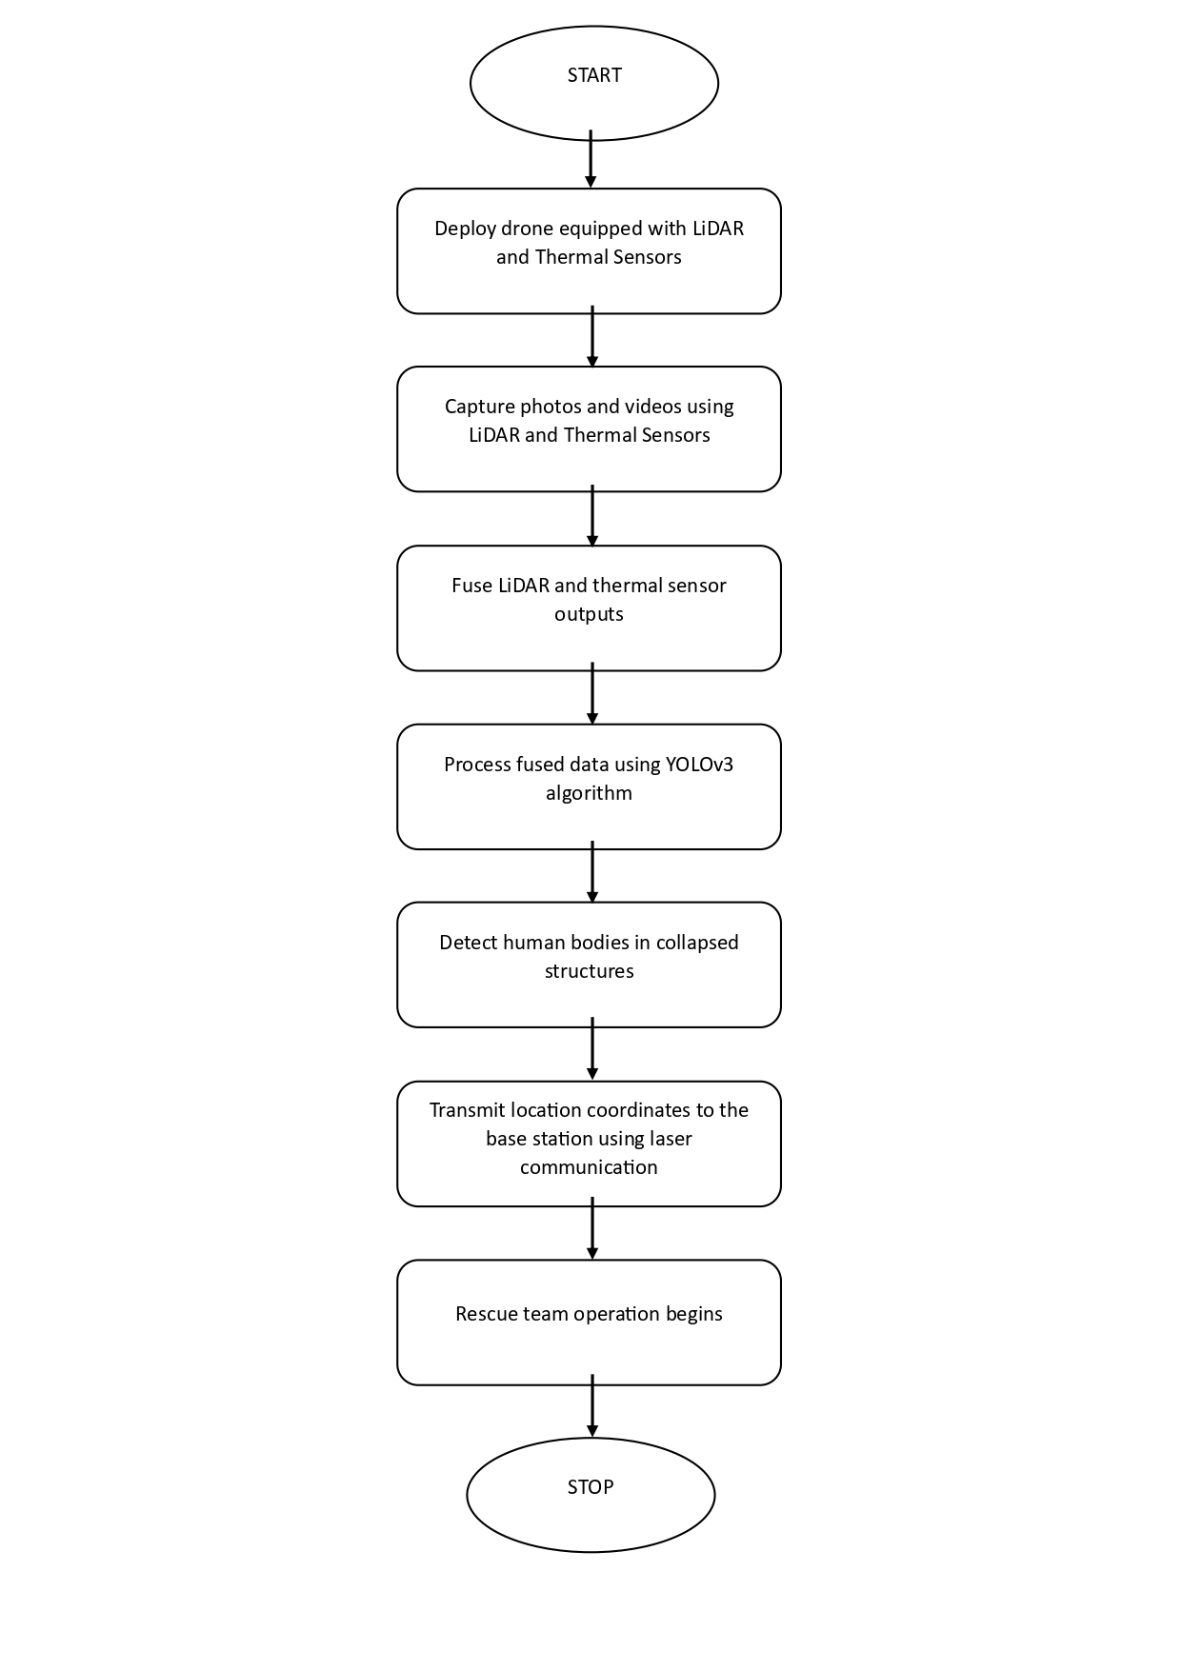
TECHNICAL APPROACH
GigaMinds
REQUIRMENTS
Hardware
Drone
FLIR LEPTON (Thermal Sensors)
Laser Communication channel(LiFi)
VL53LOX (Lidar Sensor)
Software
YOLO v3 (Algorithm)
OpenCV

Slide 4
FEASIBILITY AND VIABILITY
GigaMinds
Feasibility
Technical Feasibility:
Hardware Readiness: Drones, cameras, and FLIR Lepton sensors are easily integrated.
YOLOv3 Algorithm: Effective real-time detection on edge devices like NVIDIA Jetson Nano.
Autonomous Navigation: Reliable via GPS and obstacle detection.
Real-Time Processing: Supported by edge computing and GPUs.
Operational Feasibility:
Terrain Deployment: Effective in varied terrains (urban, forests, mountains).
All-Weather Operations: Functions in all weather using visual and thermal imaging.
Scalability: Deploy multiple drones for large disaster areas.
Cost Feasibility:
Implementation: Manageable initial investment, considering life-saving potential.
Maintenance: Low operating costs with reusability.
Viability
Market Viability:
Demand: Growing need for search and rescue tech.
Adoption: Increased use by rescue teams, governments, and NGOs.
Multi-Use: Applicable to surveillance, environmental monitoring, and more.
Regulatory Viability:
Airspace Regulations: Supportive frameworks for emergency drone use.
Data Privacy: Focus on life-saving, with appropriate protocols.
Social Viability:
Public Acceptance: Supported for humanitarian efforts.
Ethical Considerations: Positive societal and ethical alignment.
Economic Viability:
Cost-Benefit: Justified by potential life-saving and resource savings.
Funding: Available from grants and disaster management funds.

Slide 5
IMPACT AND BENEFITS
GigaMinds
Impact
Faster Response Times: Rapid identification and localization of survivors accelerates rescue operations, improving survival chances.
Improved Coverage: Drones access remote or hazardous areas, ensuring no survivors are overlooked.
Accurate Detection: YOLOv3 provides precise real-time detection and tracking, crucial for urgent rescue efforts.
Reduced Risk to Rescuers: Real-time information minimizes the need for rescuers to enter dangerous areas blindly.
Benefits
Increased Survival Rates: Quick detection and alerts enhance the likelihood of timely rescues.
24/7 Operation: Drones with thermal sensors and YOLOv3 operate continuously, even in low-light conditions.
Cost-Effective: Automation reduces the need for large human teams, saving resources and time.
Scalable Deployment: Multiple drones can cover large areas, enabling coordinated, efficient search operations.
Real-Time Data Transmission: Immediate video feeds and GPS data enhance strategic planning and response.
Versatility: Effective in various disasters, whether natural or man-made.
Better Resource Allocation: Precise survivor location allows focused and efficient use of rescue resources.

Slide 6
RESEARCH AND REFERENCES
GigaMinds
https://onlinelibrary.wiley.com/doi/10.1155/2023/5419384
https://www.mdpi.com/1424-8220/24/3/922
Smith, J., & Brown, L. (2020). "Advances in Machine Learning for Object Detection: A Survey." Journal of Computer Vision, 58(3), 123-145.
Lee, C., & Wang, H. (2021). "Deep Learning Approaches to Real-Time Body Detection in Complex Environments." IEEE Transactions on Pattern Analysis and Machine Intelligence, 43(7), 1987-2001.
Zhang, Y., & Liu, X. (2019). "Integration of Computer Vision and Sensor Systems for Enhanced Object Detection." International Journal of Computer Vision, 128(2), 345-362.
Johnson, K., & Green, M. (2022). "Case Studies on the Implementation of Advanced Body Detection Technologies in Construction Sites." Construction Safety Journal, 34(1), 45-59.
Turner, P., & Edwards, R. (2023). "Challenges and Solutions in Real-Time Body Detection for Construction Site Safety." Proceedings of the International Conference on Construction Safety, 12, 67-80.

