Slide 1
Digital portfolio

Slide 2
Student name: Duraikannu
Register no and NMID :duraikannu2422k14@gamil.com
Department: BSc.cs
College: Government arts and science college Sathyamangalam

Slide 3
My digital portfolio
A Digital Portfolio (also called an e-portfolio or online portfolio) is a personalized online space where an individual can showcase their skills, achievements, projects, certifications, and experiences in a structured and professional way. It goes beyond a traditional resume by including multimedia elements like images, videos, documents, and interactive links.

Slide 4
Agenda
1.problem statement
2.project overview
3.end user
4.tools and techniques
5.Portfolio disign and layout
6.features functionality
7.result and screenshot
8.Conclusion

Slide 5
Problem statement
In today’s digital era, showcasing one’s skills, achievements, and projects is essential for academic, professional, and personal growth.
Traditional paper-based portfolios are limited in accessibility, presentation, and ease of sharing. Students and professionals often face challenges in effectively representing their talents and competencies to potential employers, educators, or collaborators.
A Digital Portfolio provides a modern solution by allowing users to create an interactive, easily accessible,

Slide 6
Project overview
The Digital Portfolio is an interactive platform designed to showcase an individual’s skills, achievements, and personal/professional journey in a structured and visually appealing way
The portfolio acts as a personal branding tool, highlighting details such as personal profile, educational qualifications, technical and soft skills, certifications, internships, projects, and achievements
This project leverages web technologies (HTML, CSS, JavaScript, etc.)

Slide 7
End user
1. Students To showcase academic achievements, projects, skills, and certifications
2. Job Seekers / Professionals
highlight professional experience, resumes, skills, and work samples..
3. Educators / Researchers To present publications, research work, teaching methodologies, and achievements.

Slide 8
Tools and techniques
Development Tools HTML5, CSS3, JavaScript – for creating the structure, design, and interactivity.
2. Design Tools Canva / Figma / Adobe XD – for designing portfolio layout, mockups, and graphics
3. Hosting & Deployment Tools GitHub Pages / Netlify / Vercel – for free hosting and deployment.

Slide 9
Portfolio disign and layout
1. Home Page (Introduction) Brief self-introduction with profile photo. A clean header with navigation bar (Home, About, Skills, Projects, Contact). 2. About Section Personal details (education, interests, career goals). Short description with a simple background.

Slide 10
Features and functionality
Core Features 1. User Profile Section – Personal details, profile photo, and introduction. 2. Skills Showcase – Display of technical and soft skills (icons, charts, progress bars). 3. Projects/Work Samples – Academic projects, internships, or creative works with descriptions.

Slide 11
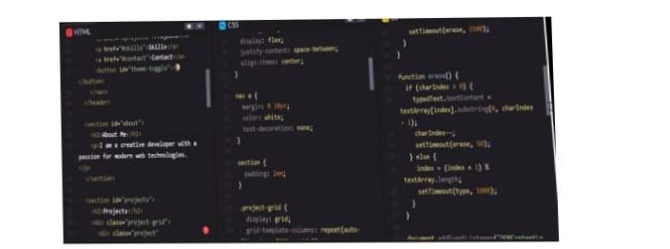
Result and screenshot

Slide 12
Conclusion
The Digital Portfolio provides an effective platform for individuals to present their skills, achievements, and projects in a structured, professional, and visually appealing manner.
Unlike traditional resumes or paper-based portfolios, it offers accessibility, interactivity, and multimedia integration, making it more impactful.
In conclusion, the Digital Portfolio is not just a showcase of information but a powerful self-presentation tool that bridges the gap between individuals and opportunities in today’s digital era.

