Slide 1
INTERNET OF THING Smart water system

Slide 2
Project definition
: The project involves implementing IoT sensors to monitor water consumption in public places such as parks and gardens. The objective is to promote water conservation by making real-time water consumption data publicly available. This project includes defining objectives, designing the IoT sensor system, developing the data-sharing platform, and integrating them using IoT technology and Python.

Slide 3
Design thinking
Project Objectives: Define objectives such as real-time water consumption monitoring, public awareness, water conservation, and sustainable resource management. IoT Sensor Design: Plan the design and deployment of IoT sensors to monitor water consumption in public places. Real-Time Transit Information Platform: Design a mobile app interface that displays real-time parking availability to users. Integration Approach: Determine how IoT sensors will send data to the data-sharing platform.

Slide 5
Project objectives introduction:
The activity of movement and control of water resources to minimize the damage to property and life and also to maximize the efficient beneficial use is known as water management. If the management of water is good in dams and levees it reduces the risk of harm caused due to flooding.

Slide 6
Water management
Planning, developing, and managing water resources in terms of both water quantity and quality across all water applications is known as water resources management (WRM). Water management is a process of developing, optimizing and planning of water resources via many practices which are defined by many policies and regulations

Slide 7
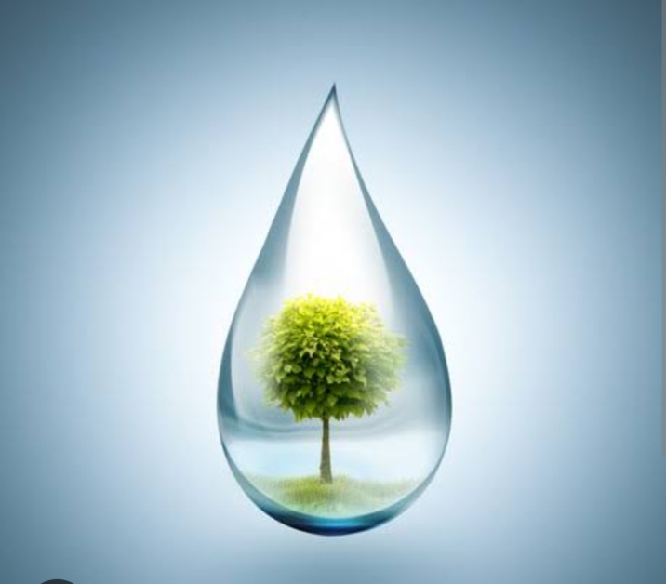
Water management

Slide 8
Water conservation and methods
Water Conservation Methods With a well-planned system, water is supplied to many places regularly in a city.
This is generally planned by civic authorities in a city. But many times we observe that some amount of water is wasted through leakage of pipe and many other reasons.
As we know that proper water management is necessary for the conservation of water. Thus, it is important for civic authorities to take care of these issues while supplying water to our homes

Slide 9
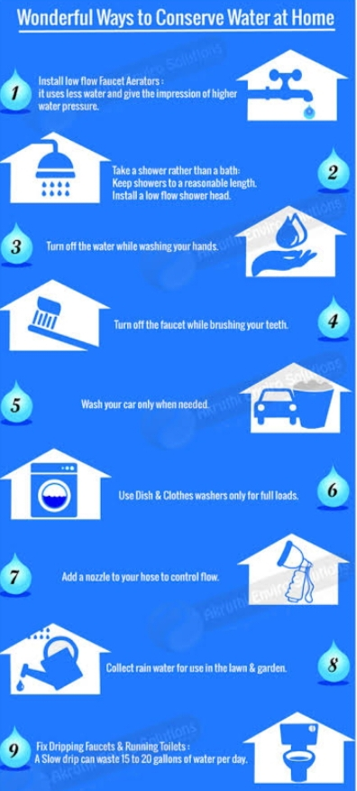
Water conservation ways at home

Slide 10
Agriculture based water conservation
We usually observe that most of the rainwater gets wasted although it is one of the most precious natural resources.
This rainwater can be used to recharge the groundwater levels by a technique known as rainwater harvesting.
Farmers can play an important role in water management by using a water conservation method for irrigation known as drip irrigation.
In this technique, plants are watered using narrow tubes and this water is directly delivered at the base of the plant.

Slide 11
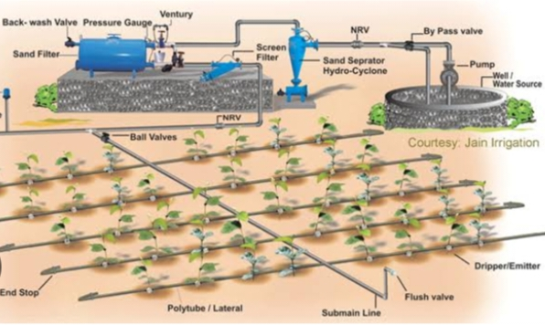
Diagram For agriculture water conservation

Slide 12
2.IOT sensor design
Sensors: IoT sensors are used to measure various parameters of water quality, such as pH, temperature, dissolved oxygen, and the presence of chemicals and microorganisms.
These sensors can be placed in rivers, lakes, and other bodies of water, and they can transmit data in real-time to a central monitoring system.

Slide 13
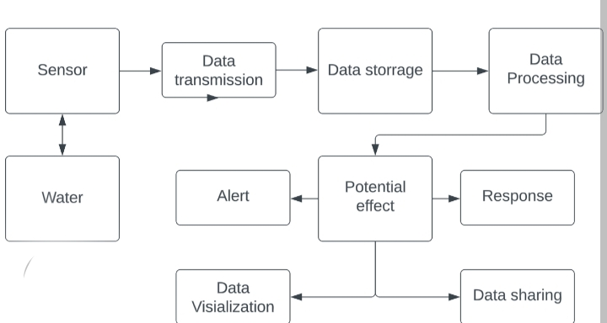
IOT sensor

Slide 14
3.Real time parking
It allows users to find and reserve the chosen parking spot.
Additionally, the app can navigate the driver to the booked place. This parking service app tends to provide a flexible payment system.
So, the users usually can pay by credit card or in cash

Slide 15
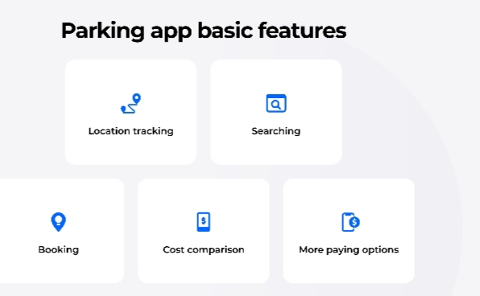
Parking app basic features

Slide 16
4.IOT sensor of data sharing
In a nutshell, IoT works like this:
Devices have hardware, like sensors, that collect data.
The data collected by the sensors is then shared via the cloud and integrated with software.
The software then analyzes and transmits the data to users via an app or website.

Slide 17
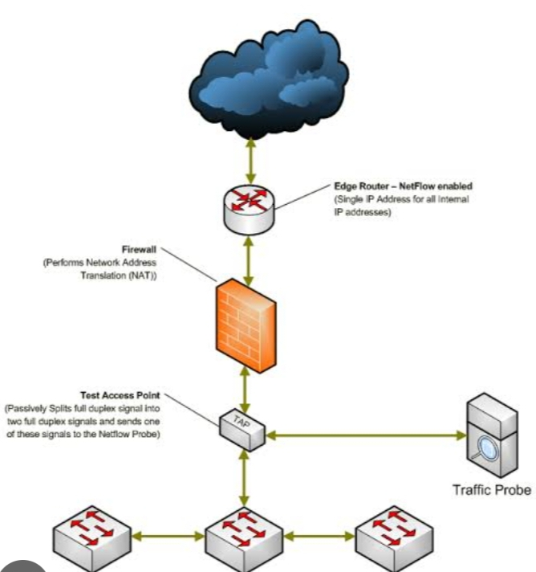
IOT sensor of data diagram

Slide 18
THANK YOU

