Slide 1

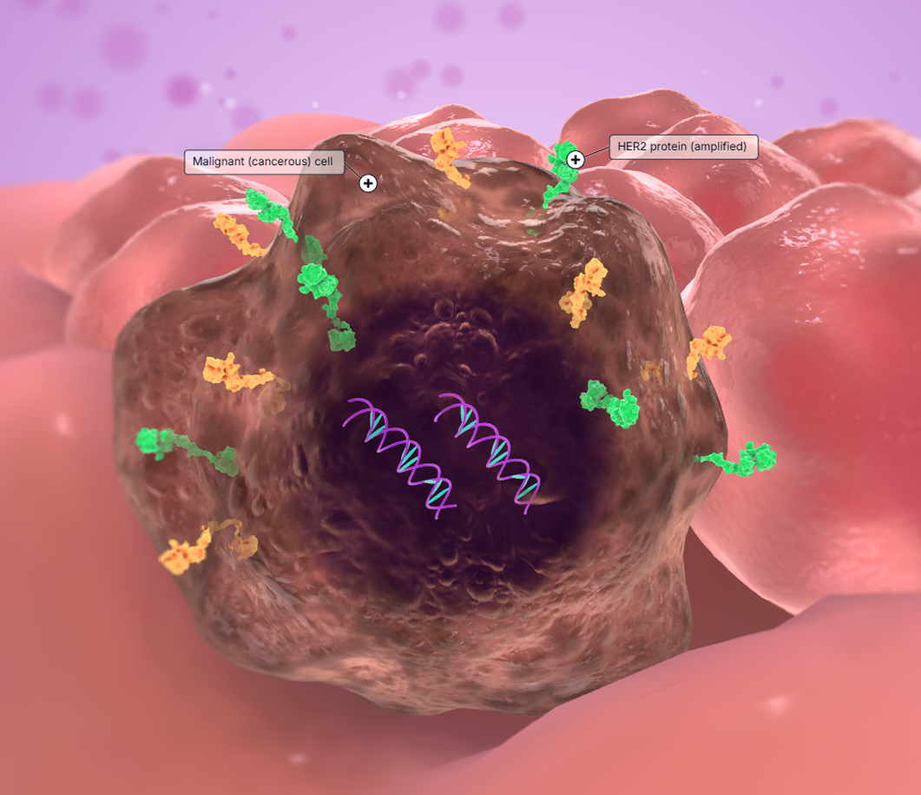
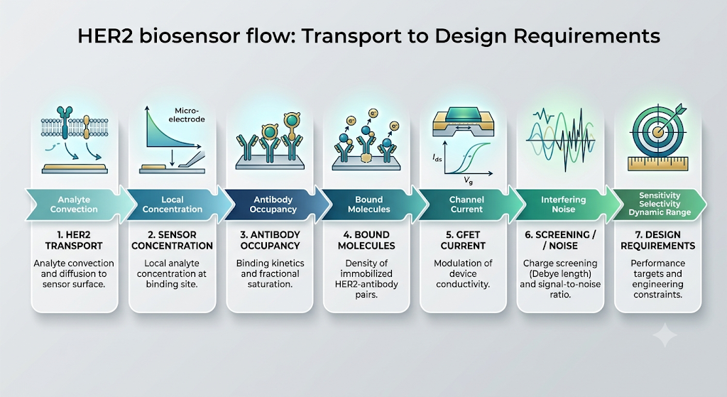
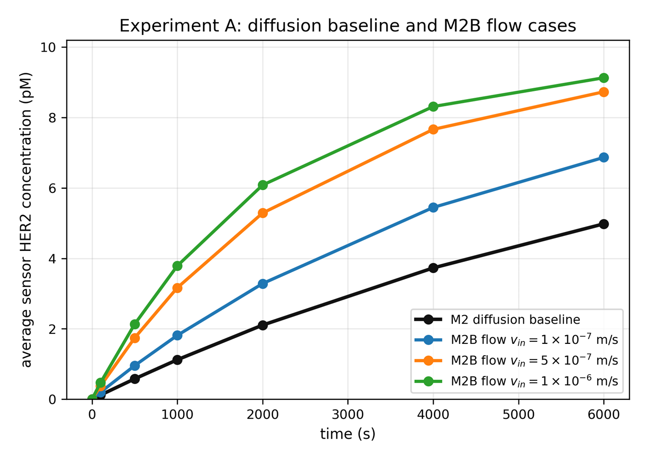
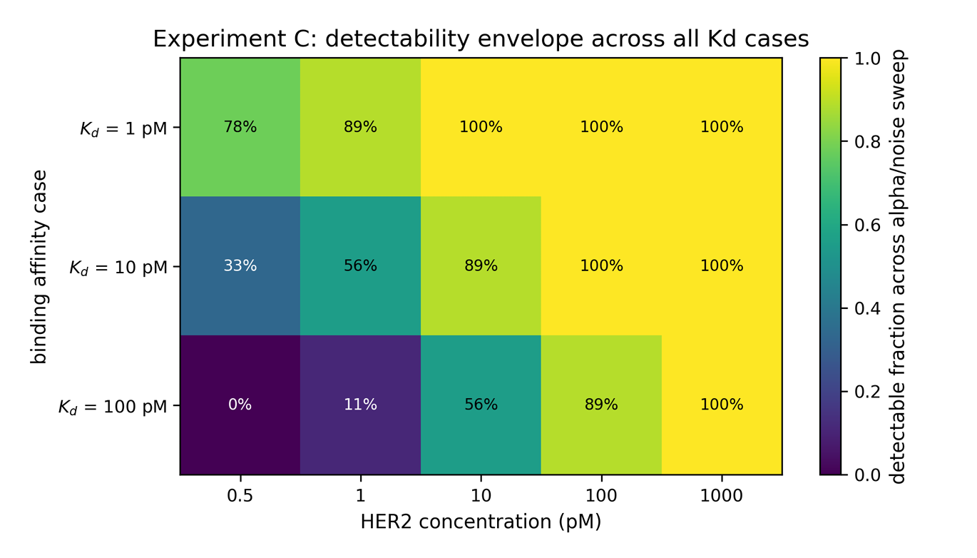
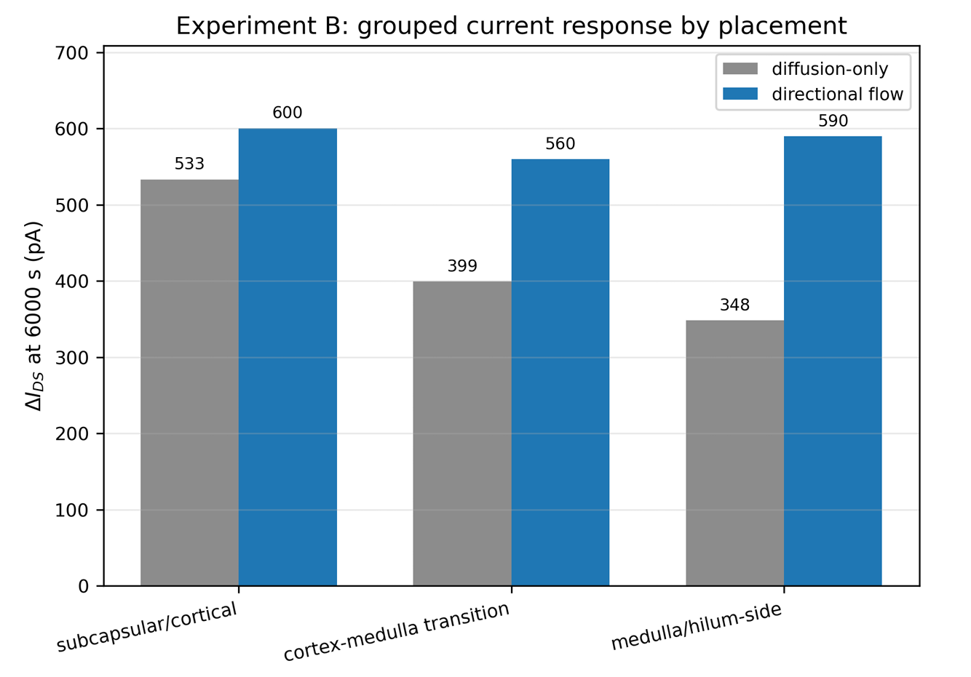
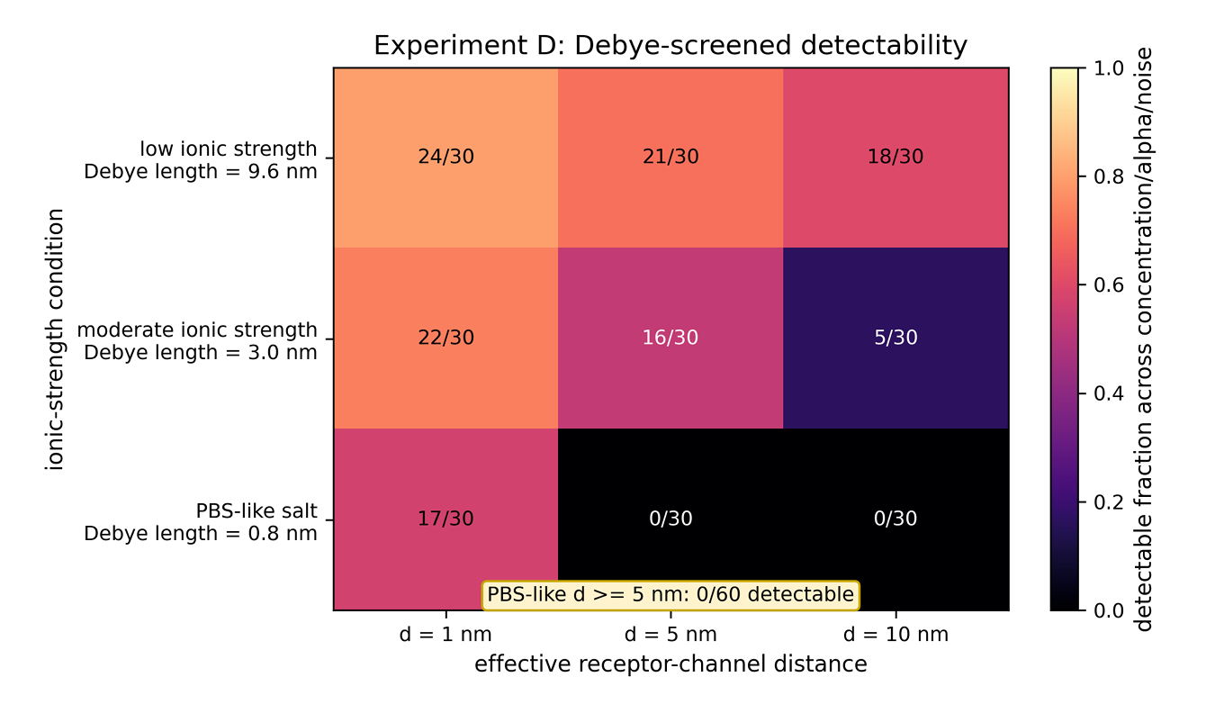
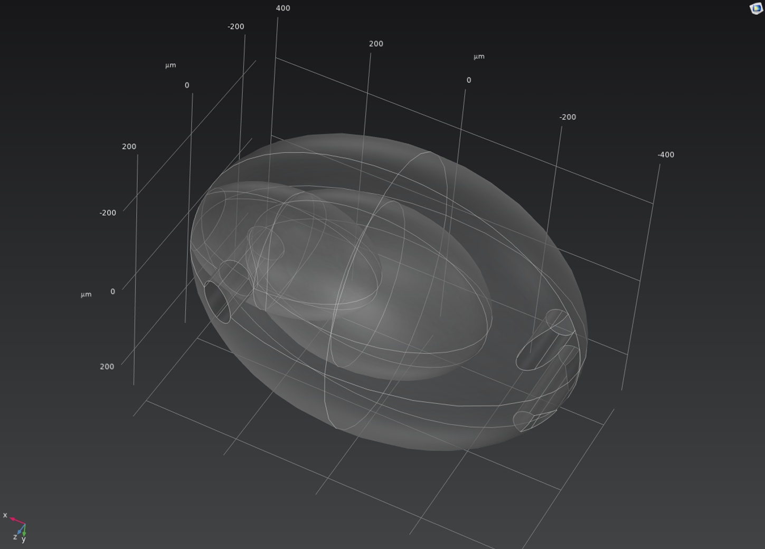
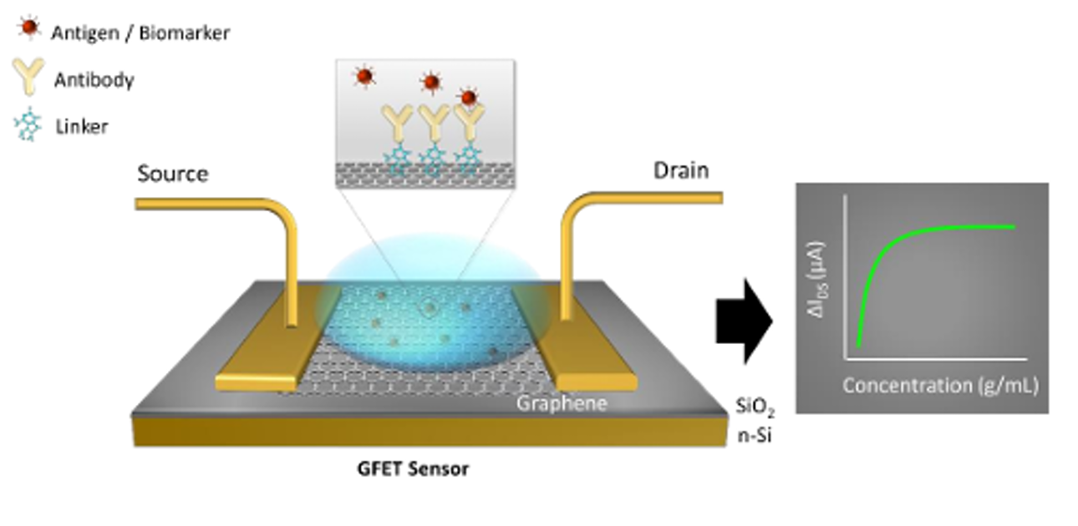
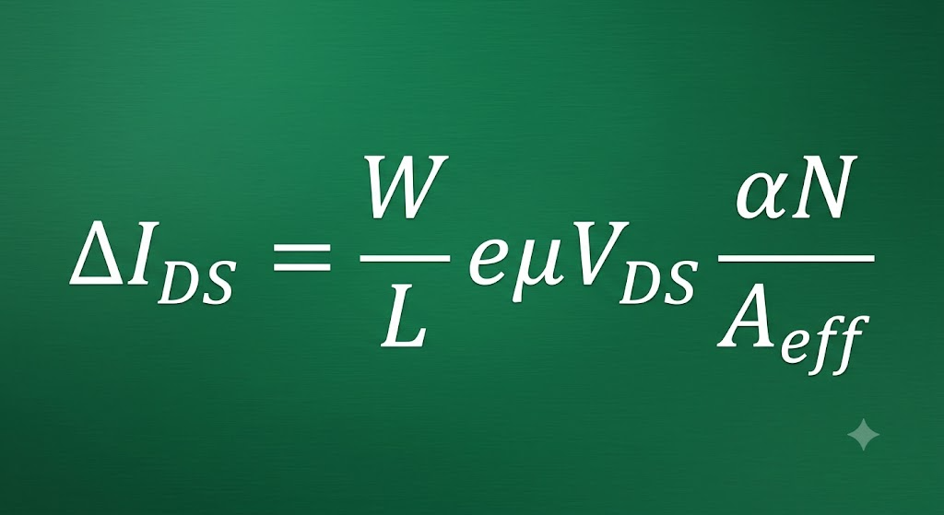
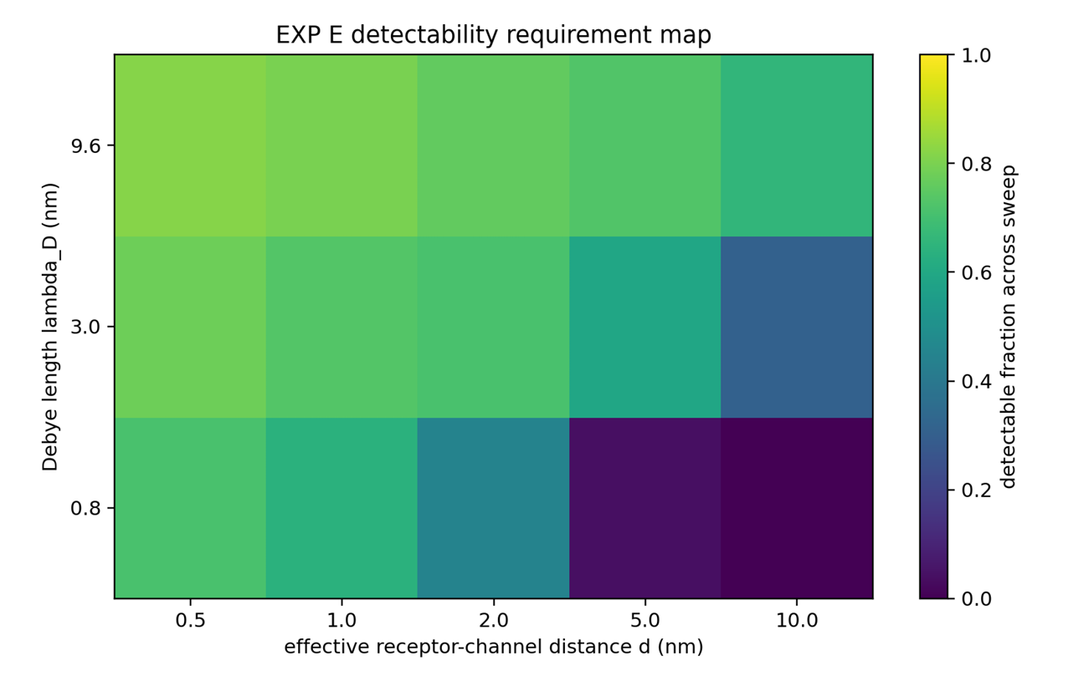
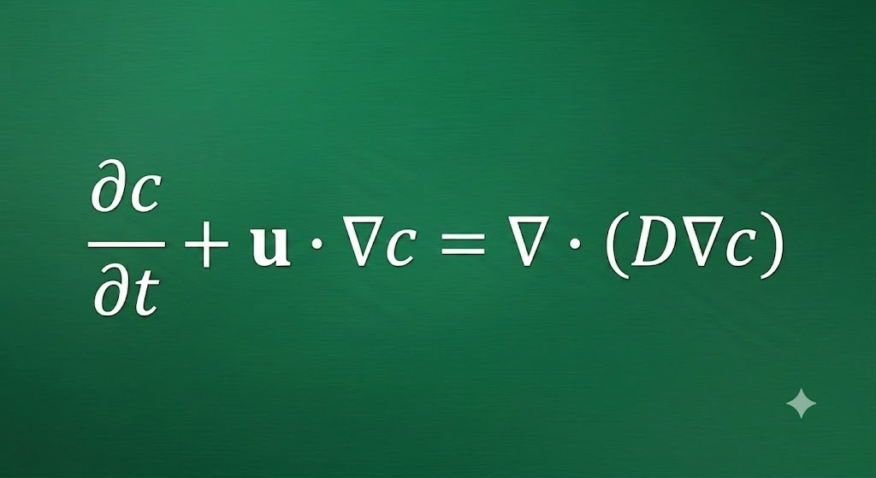

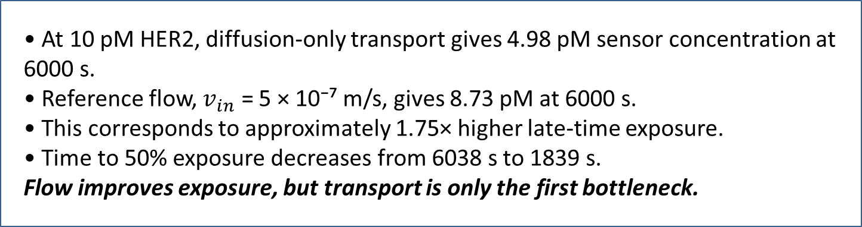
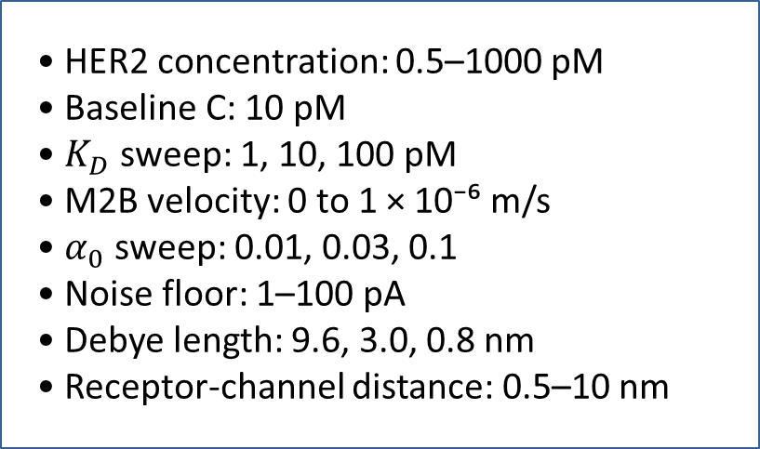
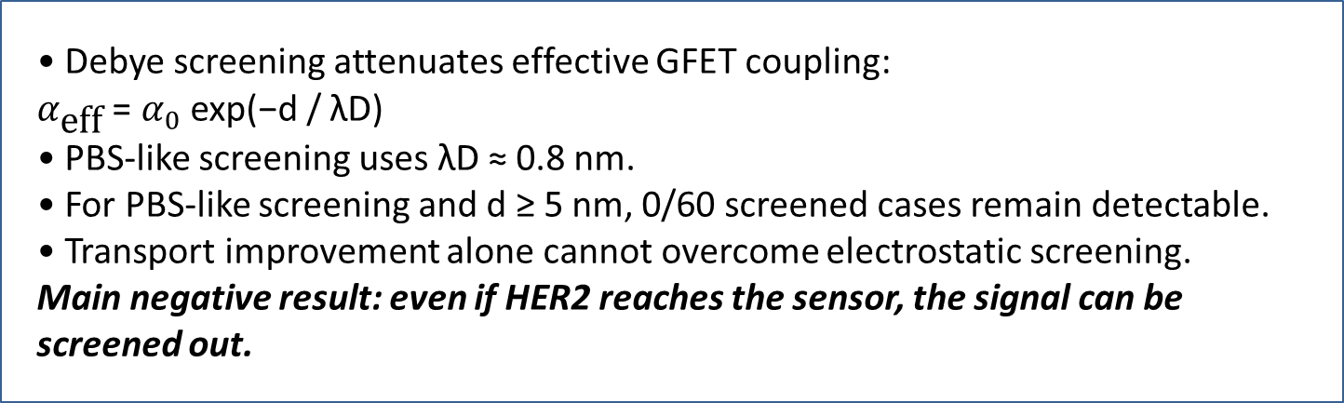
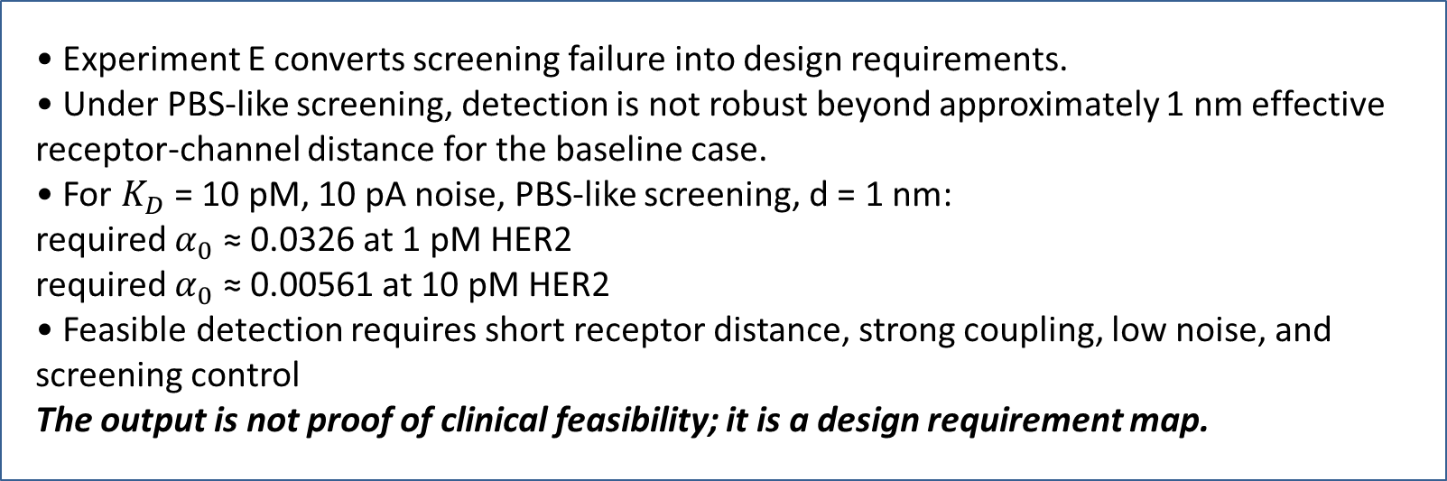
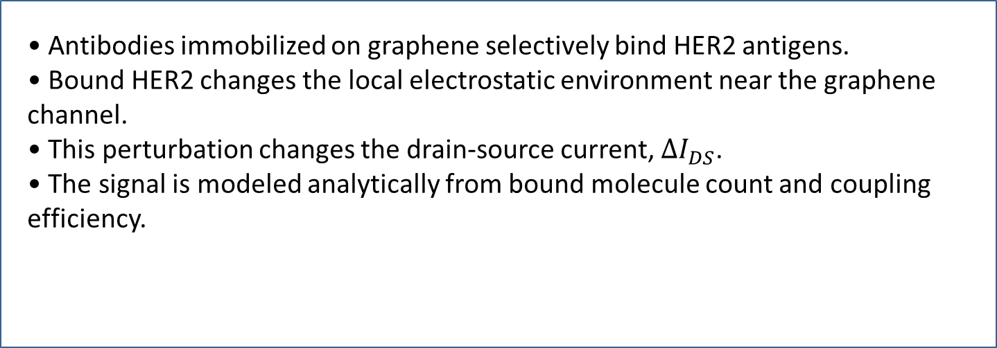
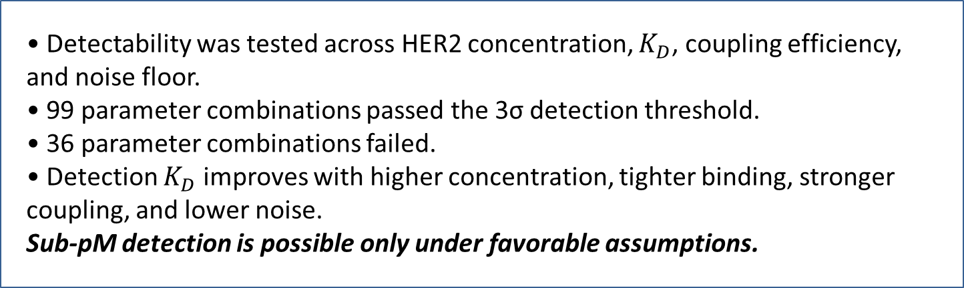
In-body Antigen Detection via Antibodies on a Transistor
Simulation-Based Feasibility Study of a GFET-HER2 Biosensor
Duran Kaan Altın - Advisors: Professor Tuna Tuğcu, Professor Kutlu Ülgen - Boğaziçi University, CMPE 492
Simulation Pipeline
Result 1 - Directional Flow Improves Exposure
Result 3 - Detection Is Not Universal
Problem and Biological Motivation
• M1: HER2-antibody binding kinetics. • M2: diffusion-only COMSOL transport baseline. • M2B: partially anatomical prescribed-flow convection-diffusion extension. • M3/M4: surface binding, bound molecule count, GFET current, LOD. • Experiments C–E: detectability, Debye screening, and design requirements.
M2B is a partially anatomical prescribed-velocity extension, not a full anatomical lymph-node model.
• At 10 pM HER2, diffusion-only transport gives 4.98 pM sensor concentration at 6000 s. • Reference flow, $v_{in}$ = 5 × 10⁻⁷ m/s, gives 8.73 pM at 6000 s. • This corresponds to approximately 1.75× higher late-time exposure. • Time to 50% exposure decreases from 6038 s to 1839 s.
Flow improves exposure, but transport is only the first bottleneck.
• Detectability was tested across HER2 concentration, $K_{D}$, coupling efficiency, and noise floor. • 99 parameter combinations passed the 3σ detection threshold. • 36 parameter combinations failed. • Detection $K_{D}$ improves with higher concentration, tighter binding, stronger coupling, and lower noise.
Sub-pM detection is possible only under favorable assumptions.
• HER2 is a clinically important breast cancer biomarker.
• Tumor-derived molecules can move through lymphatic pathways toward regional lymph nodes.
• A sensor cannot detect HER2 until molecules reach the sensing surface.
• Therefore, transport, sensor placement, and local exposure are part of the detection problem.
Result 4 - Physiological Screening Suppresses the Signal
GFET-Based HER2 Detection Principle
Result 2 - Sensor Placement Matters
• Debye screening attenuates effective GFET coupling: $α_{\text{eff}}$ = $α_{0}$ exp(−d / λD) • PBS-like screening uses λD ≈ 0.8 nm. • For PBS-like screening and d ≥ 5 nm, 0/60 screened cases remain detectable. • Transport improvement alone cannot overcome electrostatic screening.
Main negative result: even if HER2 reaches the sensor, the signal can be screened out.
• Antibodies immobilized on graphene selectively bind HER2 antigens. • Bound HER2 changes the local electrostatic environment near the graphene channel. • This perturbation changes the drain-source current, $ΔI_{DS}$. • The signal is modeled analytically from bound molecule count and coupling efficiency.
Lymph-Node-Inspired Transport Model
• Three sensor regions were evaluated: subcapsular/cortical, cortex-medulla transition, and medulla/hilum-side. • Subcapsular/cortical placement gives the strongest response under reference flow. • Current response at 6000 s increases under directional flow for all tested placements. • Placement affects response timing and pathway exposure.
Placement sweep is post-processed over the transport model, not a full remeshed COMSOL relocation study.
Own COMSOL work
• Outer region approximates cortex/capsule. • Inner region approximates medulla. • M2 baseline isolates heterogeneous diffusion. • M2B adds directional prescribed flow with afferent inlet regions and a hilum-side outlet. • The goal is to estimate HER2 exposure at the GFET sensing region.
Convection-diffusion transport in M2B:
Key Parameters
Main Engineering Conclusion
Limitations & Future Work
Result 5 - Feasibility Requires Strict Design Conditions
• HER2 concentration: 0.5–1000 pM
• Baseline C: 10 pM
• $K_{D}$ sweep: 1, 10, 100 pM
• M2B velocity: 0 to 1 × 10⁻⁶ m/s
• $α_{0}$ sweep: 0.01, 0.03, 0.1
• Noise floor: 1–100 pA
• Debye length: 9.6, 3.0, 0.8 nm
• Receptor-channel distance: 0.5–10 nm
• Directional flow increases HER2 exposure at the sensing region.
• Sensor placement affects response timing and current response.
• Detectability is conditional, not guaranteed.
• Under physiological-like screening, receptor-channel distance and electronics noise dominate feasibility.
• A feasible GFET-HER2 design requires short receptor distance, strong coupling, low noise, favorable binding, and screening mitigation.
Transport can be improved; electrical detectability remains the hard constraint.
• Simulation-only study; no fabricated GFET or clinical validation.
• M2B uses prescribed velocity, not validated Darcy/Brinkman lymph flow.
• GFET response and Debye screening are analytical feasibility models.
• Future work: experimental binding validation, low-noise readout, shorter receptor-channel distance, and improved flow/electrostatic modeling.
• Experiment E converts screening failure into design requirements. • Under PBS-like screening, detection is not robust beyond approximately 1 nm effective receptor-channel distance for the baseline case. • For $K_{D}$ = 10 pM, 10 pA noise, PBS-like screening, d = 1 nm: required $α_{0}$ ≈ 0.0326 at 1 pM HER2 required $α_{0}$ ≈ 0.00561 at 10 pM HER2 • Feasible detection requires short receptor distance, strong coupling, low noise, and screening control
The output is not proof of clinical feasibility; it is a design requirement map.
References

