Slide 1
3 Simple Raspberry Pi Sense HAT Projects for Kids and Families
By Les Pounder published May 03, 2020
https://www.tomshardware.com/how-to/raspberry-pi-sense-hat-projects-for-kids
Prepared by: Dr. Your-name

Slide 2
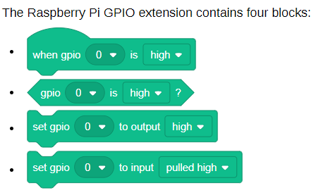

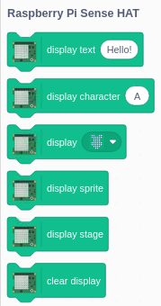
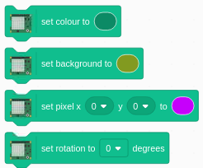
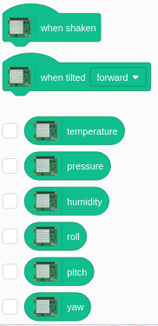
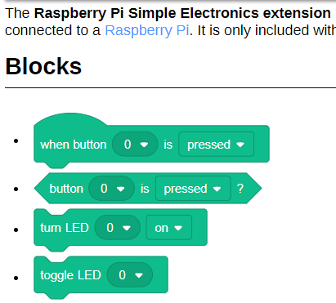
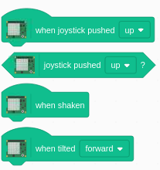
The Raspberry Pi Sense HAT extension contains 22 blocks:
GPIO:
Electronics

Slide 3
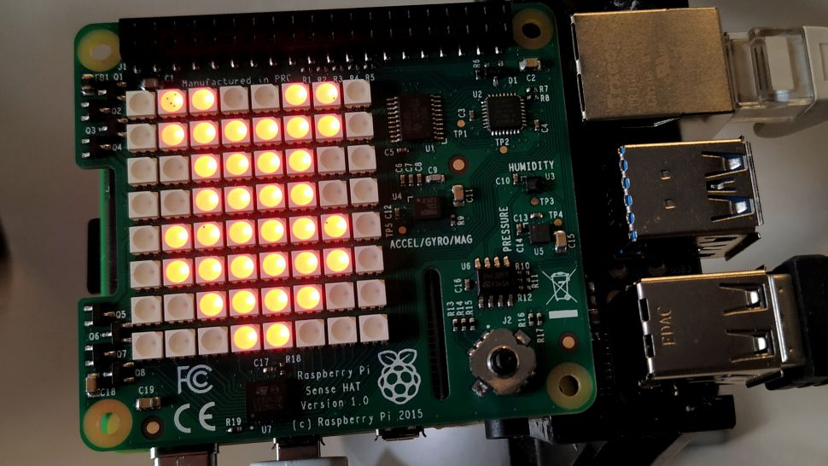
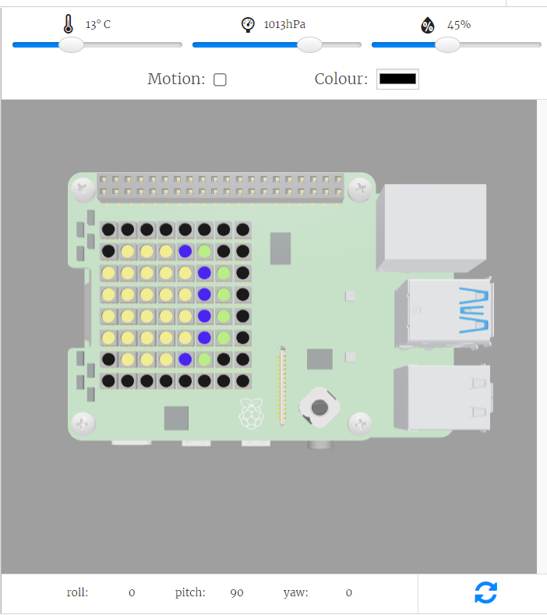
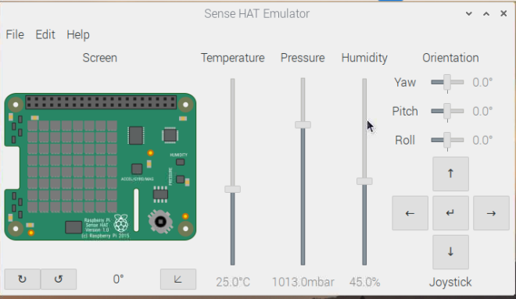
Pre-Configuration
Hands-on physical computing projects
Setting Up the Raspberry Pi Sense HAT and Scratch 3
Attach the Sense HAT
Enable I2C in raspi-config (optinal)
Install Scratch 3
Install the Sense HAT Scratch 3 extension
Note:
You can only try this project on the Raspberry Pi device
The emulator
One on https://trinket.io/sense-hat works only with Python, not Scratch
Another, Scratch first and add SenseHat, then Emulator will pop up.
https://youtu.be/rDA1xkpt7wo [2:51]
https://youtu.be/B36czuDW-Sg [2:23, my]

Slide 4
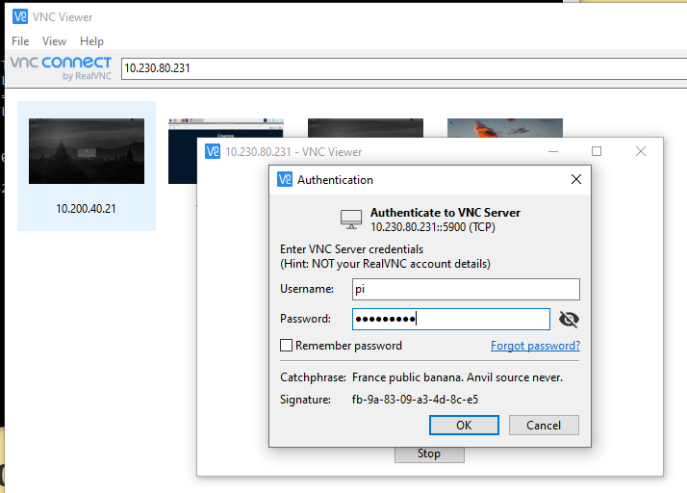
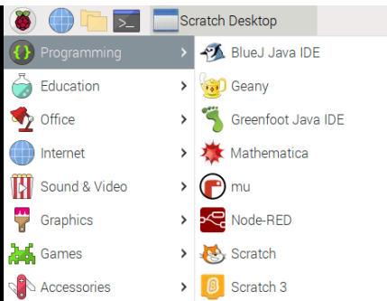


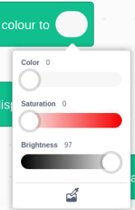



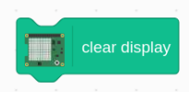
P-01: Scrolling “Hello World” App with Raspberry Pi Sense HAT (step-0 warm-up)
0.a connect to the same wireless (or wired) network
ping -4 pi0xx (e.g. pi002, see the label on the side)
0.b write down the IP address (e.g., 192.168.0.101)
0.c use VNC viewer to have a monitor-less/Headless login
user-name: pi, password: raspberry
0.d click R-Pi-icon -> Programming -> Scratch 3
0.e run Scratch 3 -> add SenseHAT extension
0.f Testing: Drag the “display text Hello!” first.
0.g: Cool!

Slide 5

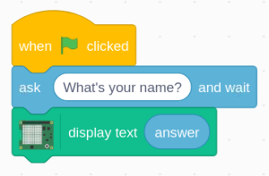
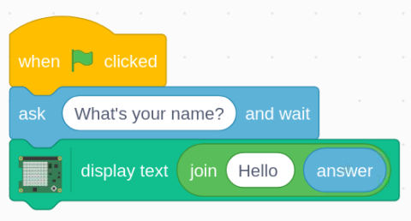
P-01: Scrolling “Hello World” App with Raspberry Pi Sense HAT
Drag “When Green Flag is clicked” from the Events section into the coding area.
Drag the “What is your Name” block from “Sensing” and connect it under the previous block.
Connect the “Display Text” block from the Sense HAT section to the “what is your name” block.
Test
We want to say hello to the user, but we also want to call them by their name.
Find the “join apple banana” block under Operators and drag it over to replace the word “hello” in display text.

Slide 6
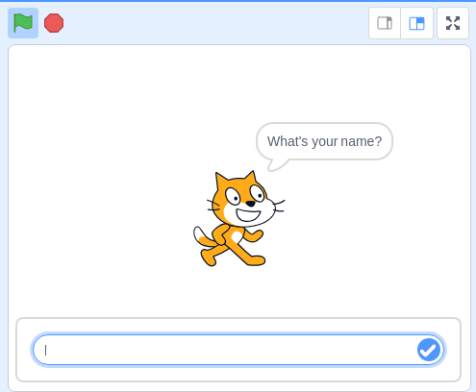
Scrolling “Hello World” App (cont’d)
Change “apple” to “Hello " (the space after Hello is important!).
Drag the “answer” block from Sensing and drop it on top of the “banana” section of the join block.
By doing this the answer to the question “What’s your name?” is saved as a variable called “answer” which is then used to greet the user by their name.
Click on the Green Flag icon, just above the stage and the sprite will ask your name.
Enter your name and watch as your Sense HAT greets you by name.

Slide 7
Scrolling “Hello World” App with Raspberry Pi Sense HAT
Done Project-01.
Fun and Interesting!

Slide 8
Done Project-01.
Fun and Interesting!
Let’s Try More …
Temperature sensor

Slide 9

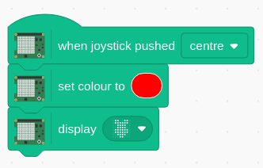
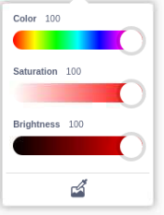

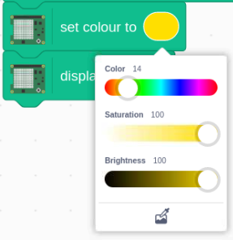
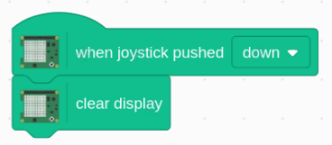
P-02: Joystick Input, Temperature Reading with Raspberry Pi Sense HAT
The test project uses the “When joystick pushed up” block found in the “Sense HAT” section.
Drag the “When joystick pushed up” block from the “Sense HAT” section into the coding area then change the direction to push the joystick from up to centre.
Add the “set color to” block, also from the “Sense HAT” section. Then change the color to something interesting (e.g., Red).
Connect the “Display...” block to the previous block. The default image is some pixel art of the Pi logo.
test by pressing the joystick centre

Slide 10

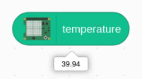
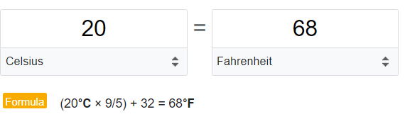
A more complex project. This project will check the temperature
Click the temperature block (i.e., report-block) to have reading
Why only 39.94?
Sensor Problem/Mal-function? Or
Locality/Region/Country Issue?
Observation:
In U.K, the temperature unit is based on degree C (i.e., Celsius)
In addition, made in USA?, no, made in UK
In U.S? degree F (Fahrenheit)
Other examples?
Pound vs. Kilogram
Inch vs. centimeter
Big Deal? Yes, it is.

Slide 11

Side-Note:
8.4.4 Robot Missions to Mars
NASA designed the $125 million Mars Climate Orbiter to facilitate communications between Earth and automated probes on the surface of Mars, including the Mars Polar Lander. Ironically, the spacecraft was lost because of a miscommunication between two support teams on Earth.
The Lockheed Martin flight operations team in Colorado designed its software to use English units. Its program output thrust in terms of foot-pounds. The navigation team at the Jet Propulsion Laboratory in California designed its software to use metric units. Its program expected thrust to be input in terms of newtons. One foot-pound equals 4.45 newtons. On September 23, 1999, the Mars Climate Orbiter neared the Red Planet.
When it was time for the spacecraft to fire its engine to enter orbit, the Colorado team supplied thrust information to the California team, which relayed it to the spacecraft. Because of the units mismatch, the navigation team specified 4.45 times too much thrust. The spacecraft flew too close to the surface of Mars and burned up in its atmosphere.
Pearson Publisher

Slide 12

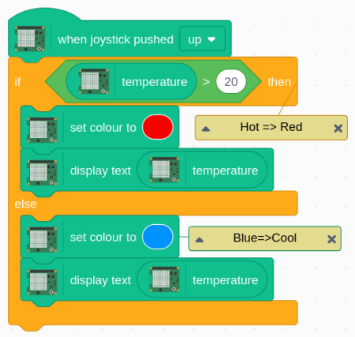

A more complex project. This project will check the temperature
Using the onboard temperature sensor of the Sense HAT. It will save the temperature to a variable, , then compare that variable to see if it is greater than 20 degrees Celsius. If so, then the text scrolling across the Sense HAT will be in Red. If below 20C then it will be Blue.
Drag the “When joystick pushed up” into the coding area.
Add the "If, then, else” block and connect it to the previous block.
Drag “_ > 50” and place it inside the blank shape between “if and then,”
Drag the “temperature” variable block and place it over the first blank of “_ > 50” and then change the 50 to 20

Slide 13
A more complex project. This project will check the temperature
5. Complete the rest of the code.
6. Test and Debug, if any.
* make sure the blue-text will be displayed too.
7. Something is not quite right!
Why?
We are in Your-City, not UK, so …

Slide 14
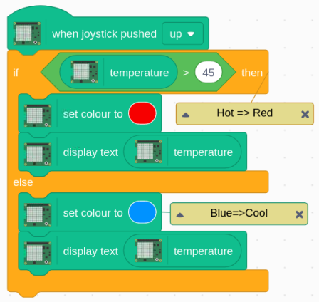
Applications in life?
Alarm, Gauge (Red/Blue/Green/?) or
Colored-Coded
Fire?
Sound the Alarm or …
Notification (text, email, …)?

Slide 15
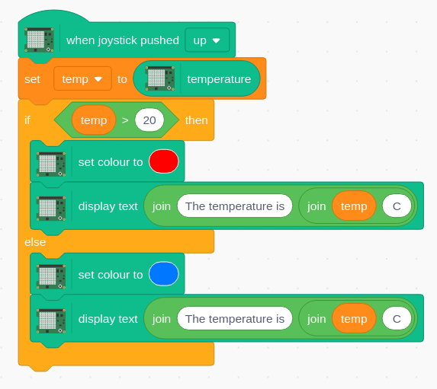
Author’s original code. I like to keep it simple for beginners.

Slide 16
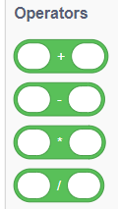


Challenge for you, not homework! Conversion between temperature units (C vs. F)
Formula: degree_C x 9/5 +32 => degree_F
(0°C × 9/5) + 32 = 32°F
https://www.google.com/search?q=celsius+to+fahrenheit&rlz=1C1GCEU_enUS861US861&oq=celsi&aqs=chrome.0.35i39j69i57j0i131i433i512l2j46i131i199i433i465i512j0i433i512l3j0i131i433l2.3319j0j15&sourceid=chrome&ie=UTF-8

Slide 17
I just shared partial teaching materials. Please refer to [1] below to develop more Hands-on projects or activities to meet your needs.
Reference:
[1] 3 Simple Raspberry Pi Sense HAT Projects for Kids and Families, By Les Pounder published May 03, 2020,
https://www.tomshardware.com/how-to/raspberry-pi-sense-hat-projects-for-kids

Slide 18

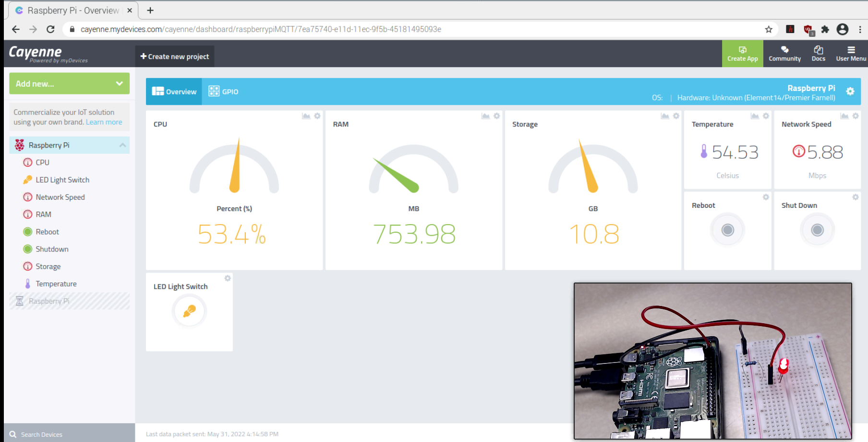
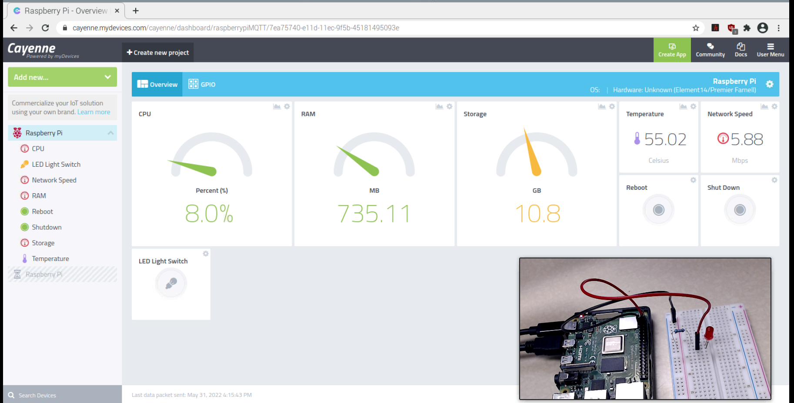
IoT application: Put them all together!
(Scratch, Raspberry Pi, IoT-Things, …)
Cayenne IoT (Internet of Things) Platform
That is all for Workshop-1.
https://youtu.be/ovthX9QlVF8?t=7 [4m:03s]

Slide 19
Day 4
Q & A?
What’s Next?
Go and Innovate!
Tomorrow’s Innovators start Today!

