Slide 1

Open electronic signature software
Author: Jakub Ďuraš
Tutor: RNDr. Viliam Kačala

Slide 2
SIGNATURE USABILITY & SECURITY
PROBLEM
Handwritten signatures still the norm despite issues with:
electronic communication
forgery
ability to change content, date & time
MOTIVATION
Changes in the legal status around the world (e.g. eIDAS).
Possibilities of cryptography.

Slide 3
GENERAL OBJECTIVES
Explore the principles and global legal status of electronic signatures.
Propose and develop open-source, cross-platform, and user-friendly platform for electronic document signing.
Provide information and way to create signatures compliant with eIDAS Regulation (Regulation No 910⁄2014 ).

Slide 4
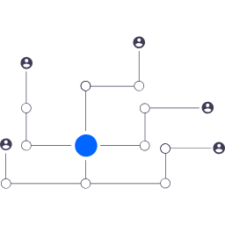

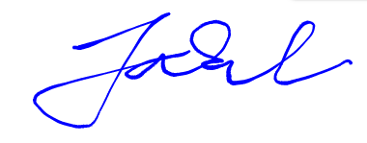
DIFFERENT TYPES
IMAGE
STANDARDIZED
PUB-KEY & CERTIFICATE
EXPERIMENTAL
Notes:
Experimental veci cim menej sa tomu venovat.

Slide 5
SOFTWARE
Signing Backend - eIDAS DSS
JAVA - DSS EU framework
LGPL v2.1 license
PLATFORM
Electron, MIT
STD
Signing Backend - Image
Go - unipdf library
AGPL v3 license
I/O
Signing Backend - Contributed
Any language, library, framework
Any license

Slide 6
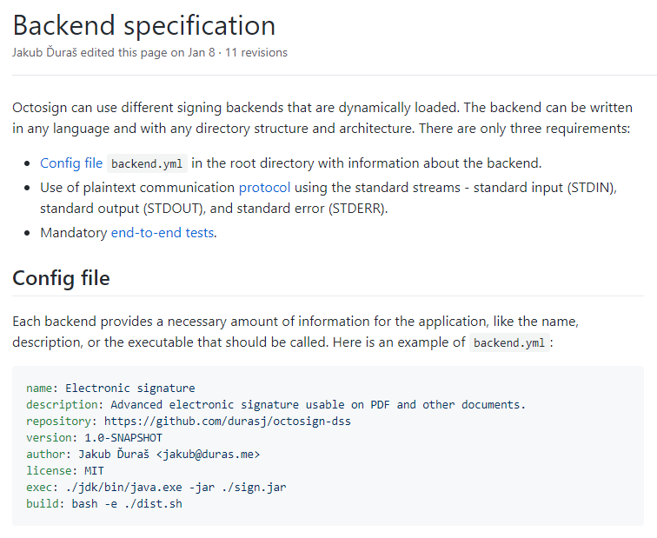
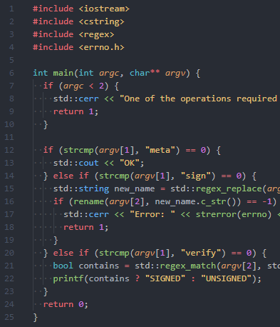
ENGINEERING FOR OPEN SOURCE
Notes:
Another slide: Quickly go over testing pyramid / V-model - adjusted for open source, electron app - mention it’s running in the CI.
Explain how simple backend creation is - show quick start in C, specification, LOC for bundled backends.

Slide 7
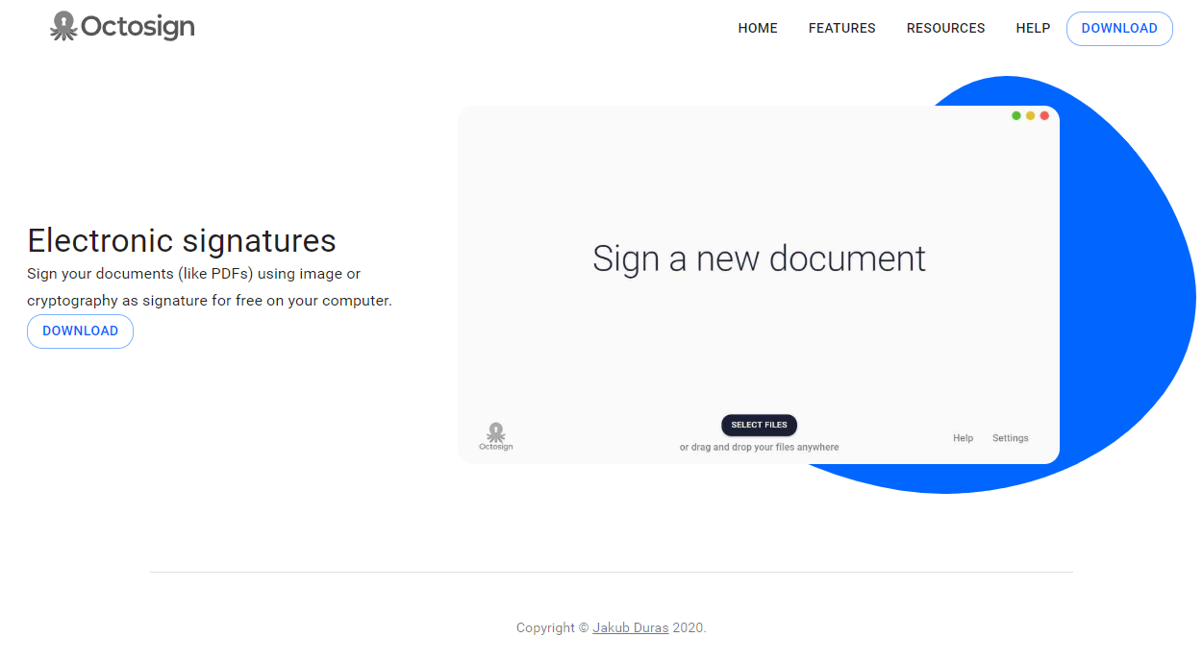
INFORMATION AND COMMUNITY
Notes:
Another slide: World map with status
Website with multilingual info
Content is editable by the community
Translation for the software by the community

Slide 8
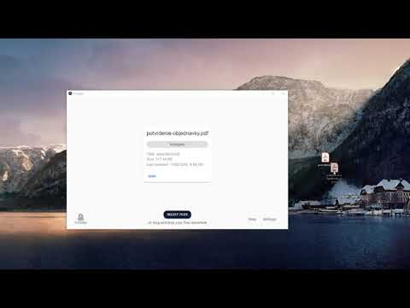

Slide 9
Thank you for your attention
www.octosign.com
thesis.science.upjs.sk/~jduras

