Slide 1
Phase 2 smart traffic management
.

Slide 2
Content
component used in our project
IR SENSOR

Slide 3
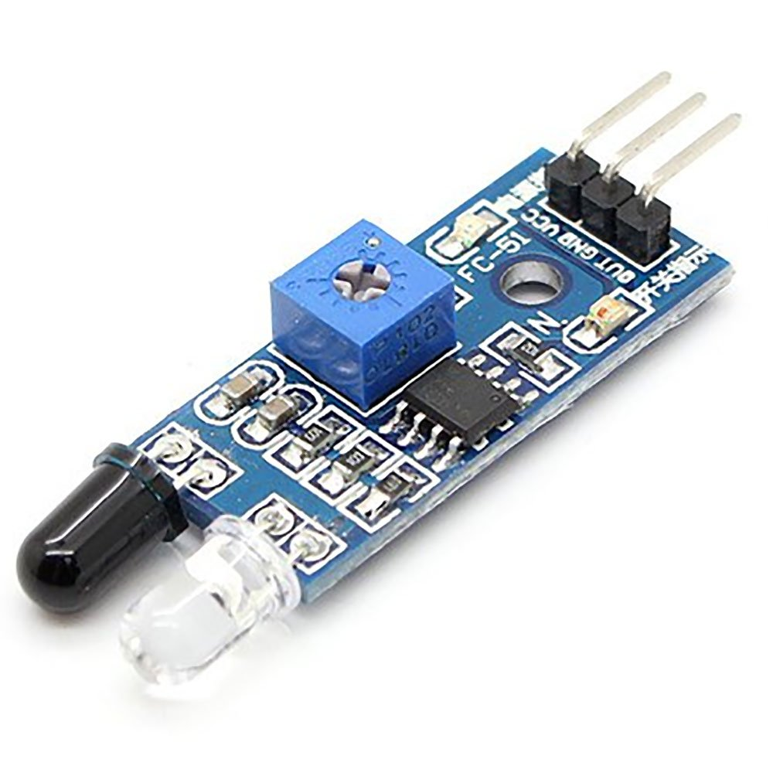
IR SENSOR

Slide 4
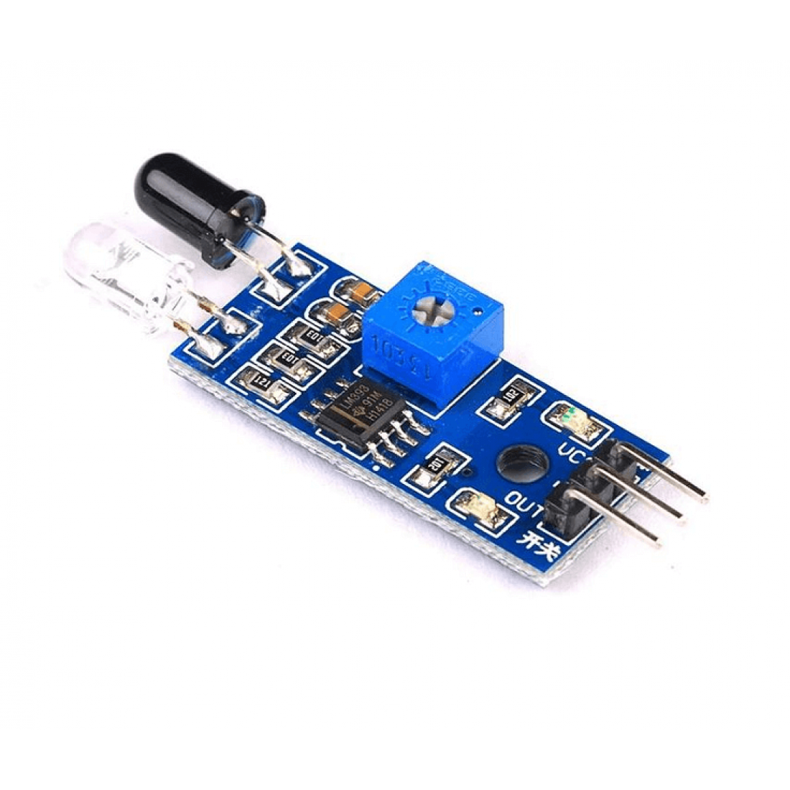
What is the IR sensor?
IR sensors are now widely used in motion detectors, which are used in building services to switch on lamps or in alarm systems to detect unwelcome guests. In a defined angle range, the sensor elements detect the heat radiation (infrared radiation) that changes over time and space due to the movement of people.

Slide 5
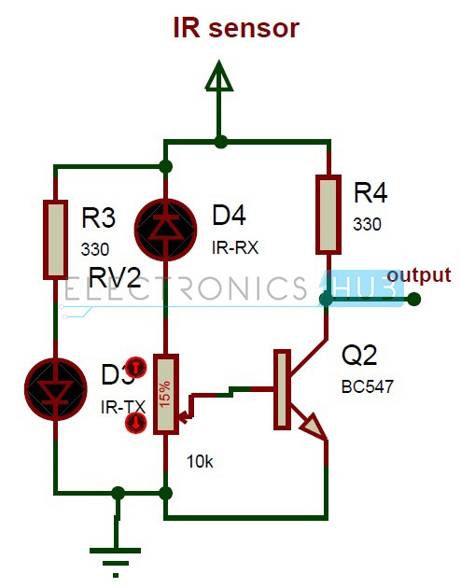
IR SENSOR IN SMART TRAFFIC MANAGEMENT
Infrared sensors (IR sensors) are used to do this. The density of the vehicles that are fixed in the lanes within a set distance is measured using IR sensors. All of the sensors are connected to the microprocessor, which regulates the traffic signal system based on the density that the sensors detect.

Slide 6
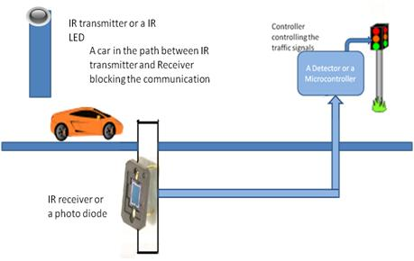
How ir sensor control traffic signal?
At traffic junction IR sensors are fitted at every side of the junction and sense the number of passing vehicle to each side of junction and interfaced to the arduino. After receiving the input from sensors we know the density of traffic at each side of junction change the traffic light as per the need.

Slide 7
Benefits of using ir sensor
Infrared sensors can detect infrared light from large distances over a wide area
No interference with electrical devices
Infrared technology is simple and extremely cheap
The shield is simple
No licenses are required.

Slide 8


