Slide 1

7COM1079-2022 Student Group No: a_group129 Names of Student Attendees: Pratyush Garg,
Mohamad AvesHanif Cutleriwala,
Chandra shekar Ballankala,
Mudassir Mohammad,
Venkata Naga Durga Akhila Tavva.
Group Id: a_group129 Name of Student Presenting: Pratyush Garg
Data Analysis – Tutorial Presentation for Feedback Date: 12/12/22
1

Slide 2
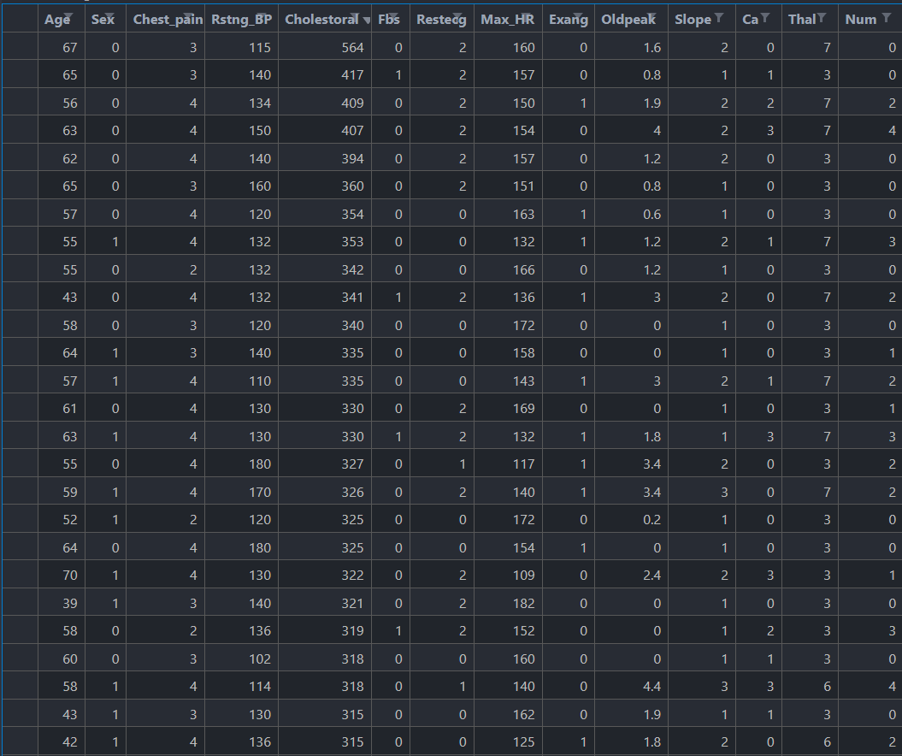
We are using the dataset https://data.world/uci/heart-disease to answer our
Research question “ Is there a difference in the mean Cholesterol level in Cleveland between Male and Female population? ”
Independent Variable: Sex – 1 (Male)
0 (Female)
Dependent Variable : Cholesterol Level
Total number of Rows 303 and Columns 17

Slide 3
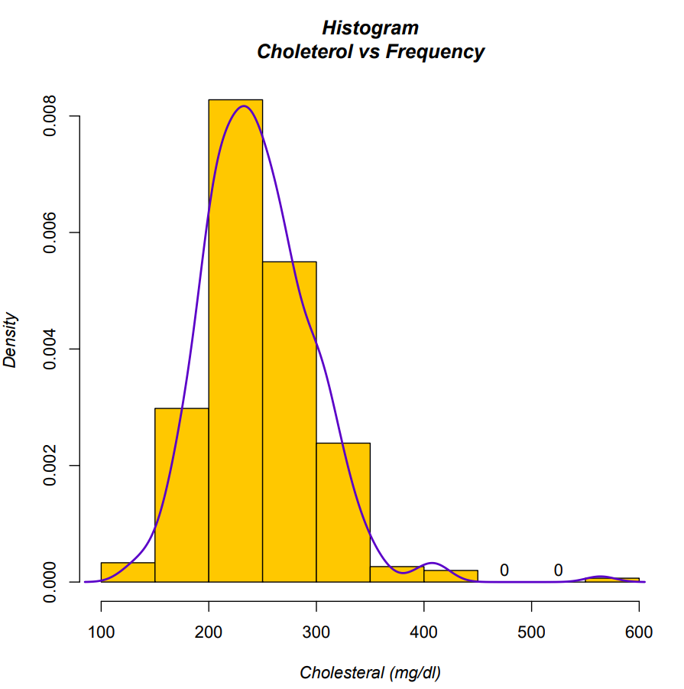
Here is a Histogram showing the frequencies of our dependent variable to include the normal curve overlay.
Our RQ asks about differences in means/ medians
1. The normal curve overlay follows the contours of the underlying data, so we use the parametric test: t-test.
3

Slide 4
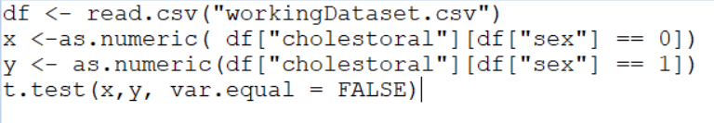
R Script and Results– The Analysis
4
Test statistic (t) : -82.308
p-value < 2.2e-16
The result is significant
I reject the null hypothesis
Notes:
4

