Slide 1



ELECTRIC VEHICLE

Slide 2

Learning Objectives :
Predict EV Range from battery, motor, weight, and charging stations.
Predict EV Sales from vehicle specs, incentives, and market features.
Predict EV Price from battery, motor, weight, brand, and incentives.
Develop a user-friendly Streamlit dashboard with visualizations.
Integrate chatbot for EV guidance.
GOAL
Source :
www.freepik.com/

Slide 3

Tools and Technology used
Programming Language: Python
Libraries: Streamlit, scikit-learn, joblib, pandas, numpy, plotly
IDE: VS Code / Jupyter Notebook

Slide 4
Methodology
1. Data Collection: EV dataset with features like Battery, Motor Power, Weight, Charging Stations, Sales, Price, Incentives.
2. Data Preprocessing: Clean missing values, normalize feature names.
3. Model Training: Train Linear Regression / Random Forest models for Range, Sales, and Price.
4. Dashboard Development: Create Streamlit app with tabs for Prediction, Visualization, and Chatbot.
5. Testing & Deployment: Test predictions and interactions, save trained models.

Slide 5
Problem Statement:
EV adaption is growing rapidly ,but predicting key metrics like Range,Sales,and Price is challenging
Manual analysis is slow and prone to errors
A data-driven solution using ML and web dashboards can provide accurate predictions
Helps EV manufacturers,policymakers,and customers make informed decisions.

Slide 6
Solution:
Build a profession dashboard that predicts range,sales, and price from EV specs
Input Sliders: Battery Capacity, Motor Power, Weight, Charging Stations, Efficiency.
Real-time Predictions: Displays EV Range, Sales, and Price.
Visualizations: visualizes using metrics and bar charts
Professional Dashboard Design: Clean layout with tabs for predictions and chatbot.
Chatbot Integration: Answers basic EV-related questions interactively.

Slide 7
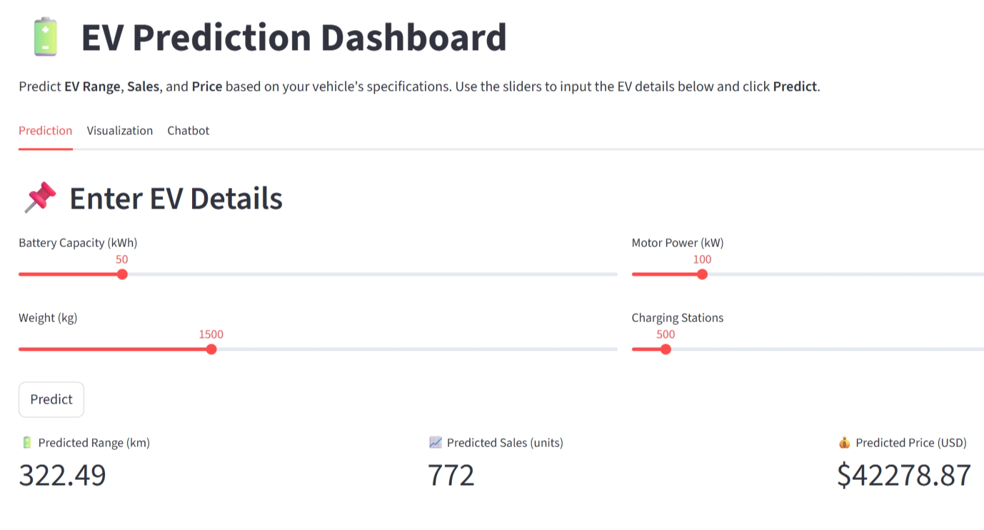
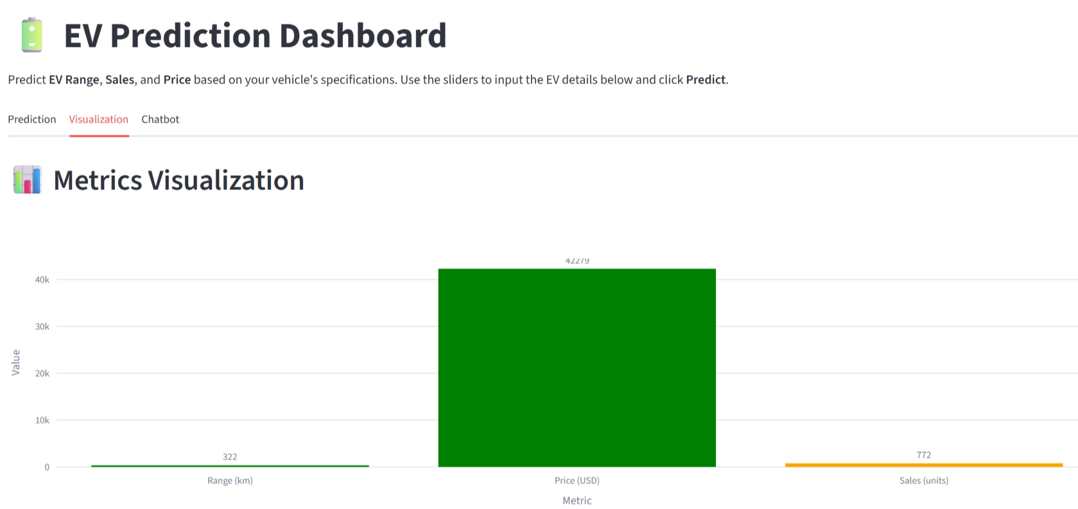
Screenshot of Output:

Slide 8
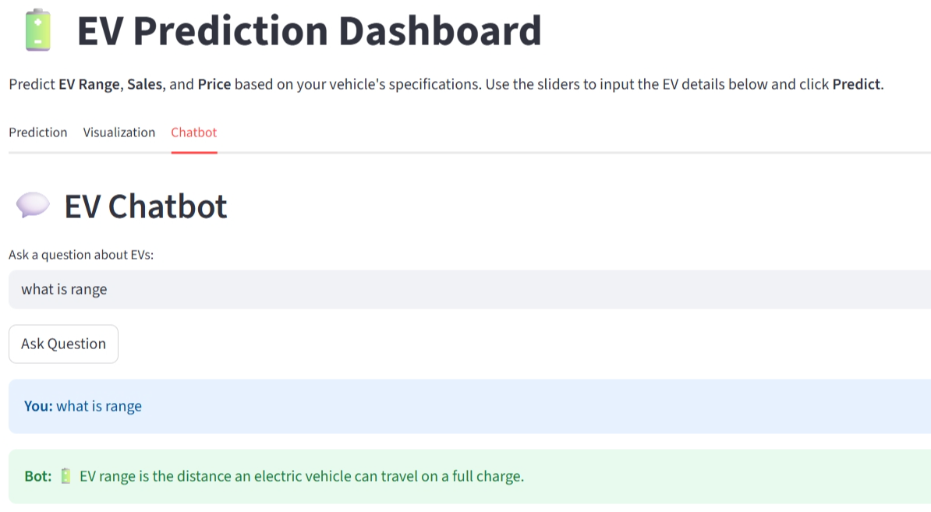
Screenshot of Output:

Slide 9
Conclusion:
Developed a user-friendly EV Prediction Dashboard.
Predicted EV Range, Sales, Price efficiently.
Provided visual insights and chatbot support.
Can assist decision-makers and consumers.

Slide 10
THANK YOU

