Slide 1
School Management System
CAPSTONE PROJECT By:
N. Chenchu Teja [192111553]
P. R. Durga Prasad [192111568]

Slide 2
Objective
Main Objective:
To automate the management of student and staff records, exams, grading, and other school operations to enhance efficiency, accuracy, and accessibility.
Specific Objectives:
Streamline student registration and teacher management.
Automate attendance tracking and fee management.
Simplify class scheduling and report card generation.

Slide 3
Introduction
Schools often rely on manual processes to manage essential operations, such as student records, staff information, attendance, and grading. These traditional methods are time-consuming and prone to errors, leading to inefficiencies.
The "School Management System" developed using C++ aims to automate core administrative tasks like student registration, teacher management, and class scheduling. By integrating these functions into one platform, it enhances operational efficiency and accuracy.
This system focuses on automating key modules to streamline school management and lays the groundwork for future enhancements such as mobile app integration.

Slide 4
Literature Survey
Existing Systems: Most existing school management systems are either manual or use outdated software, which lacks integration and scalability. These systems often require significant manual intervention, leading to errors and inefficiencies.
Research Insights: Studies show that automated systems can reduce administrative workload by up to 40% and improve accuracy in record-keeping and grading. However, many available solutions are cost-prohibitive or too complex for smaller schools.
Relevance of the Proposed System: The proposed system is tailored to address these gaps by offering a cost-effective, user-friendly solution using C++ that simplifies operations while maintaining flexibility for future upgrades.

Slide 5
System Overview Modules Used
Student Registration
Teacher Management
Class Scheduling
Attendance System
Grading System
Fee Management
Report Cards

Slide 6
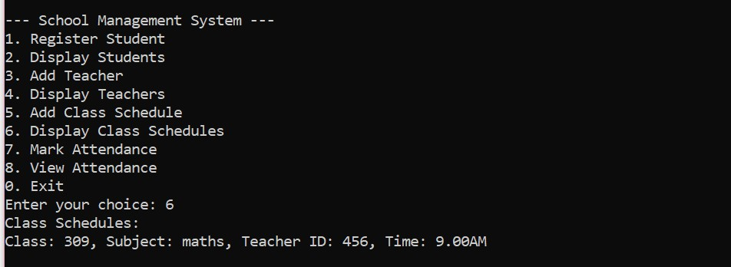
Output and Results
Outputs of each module:
Student Registration:
.

Slide 7
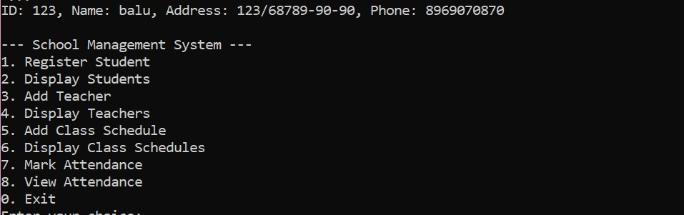
2.Display Students:

Slide 8
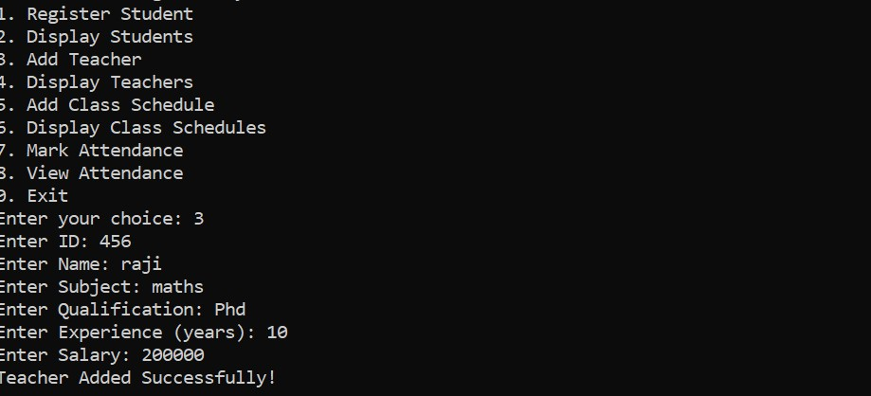
3.Add Teacher

Slide 9
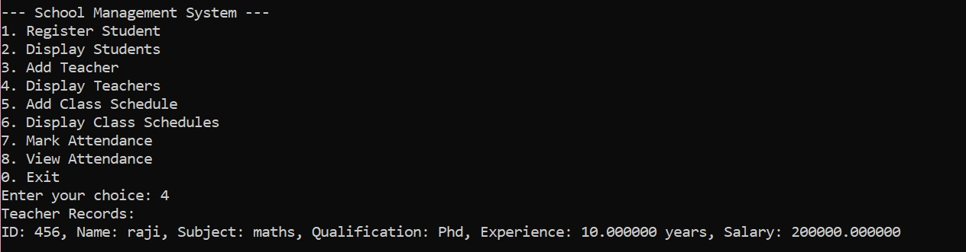
4.Display Teacher

Slide 10
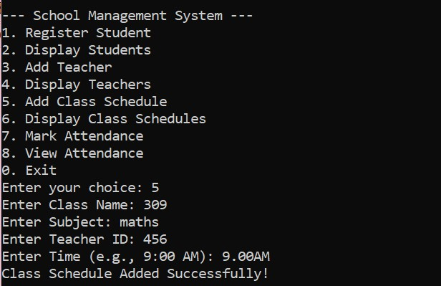
5.Add Class Schedules

Slide 11
6.Display Class Schedule

Slide 12
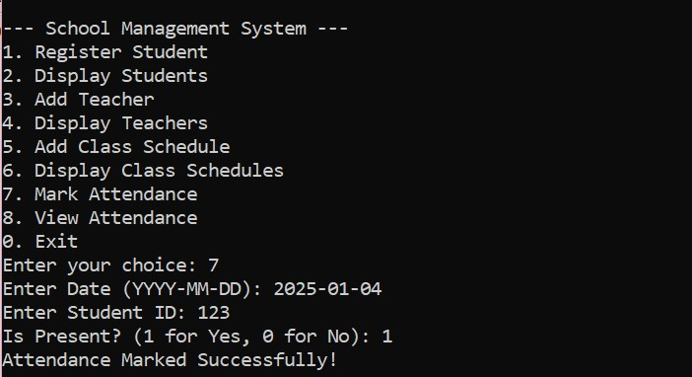
7.Mark Attendance

Slide 13
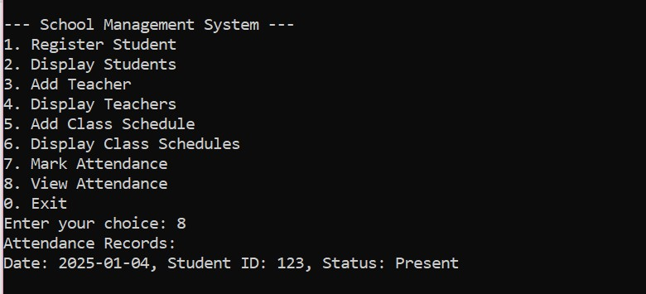
8.View Attendance

Slide 14
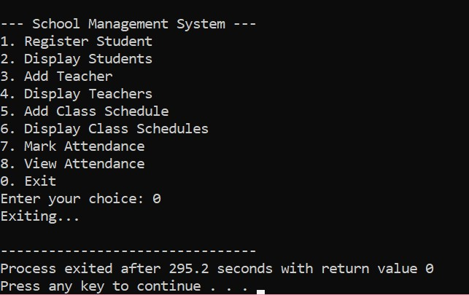
9.Exit

Slide 15
Challenges Faced
Technical Challenges:
- Integrating multiple modules.
- Handling file-based storage effectively.
Solutions Adopted:
- Modular programming and testing.

Slide 16
Future Scope
Enhancements:
- Integration with mobile apps.
- AI-based grading and prediction systems.
Scalability:
- Expansion to support multiple schools.

Slide 17
Conclusion
The "School Management System" demonstrates the potential to revolutionize traditional school administration by automating critical processes. Developed using C++, the system addresses inefficiencies in manual workflows and ensures accuracy, scalability, and ease of use. By integrating multiple modules into one platform, it simplifies operations and saves time for both staff and administrators.
This project lays the groundwork for future advancements, such as mobile application support and AI-driven analytics, making it a versatile and scalable solution for educational institutions.

Slide 18
References
Brown, T., and Smith, J. (2021). "AI in Education: Transforming School Management Systems." Journal of Educational Technology, 15(3), 215-230.
Clark, R., and Taylor, M. (2018). "Cloud-Based Solutions for Modern Educational Institutions." International Conference on Education Management Systems, 89-102.
Johnson, L., and White, P. (2017). "Data-Driven Decision Making in Schools." Educational Research Review, 22(4), 321-340.
Kumar, S., and Gupta, R. (2020). "Scalable School Management Systems: A Framework for the Future." Proceedings of the Global Education Summit, 54-68.
Lee, D., and Thompson, H. (2019). "Integrating Analytics into Educational Administration." Journal of Modern Education Systems, 9(1), 45-59.

Slide 19
THANKYOU

