Slide 1

AI Tourism Guide(Travel Buddy)
BY
Durga prasad

Slide 2
Topics
INTRODUCTION TO CHATBOT
TYPES OF CHATBOTS AND USES
DIFFERENCE BETWEEN CHATBOTS AND VIRTUAL ASSISTANT (VS)
INTORDUCING TRAVEL BUDDY(AI TOURISM GUIDE )
5. TRAVEL BUDDY(Chat Bot)
6. CODE EXPLINATION
7. REAL TIME DEVELOPMENT (Tourism Guide)

Slide 3
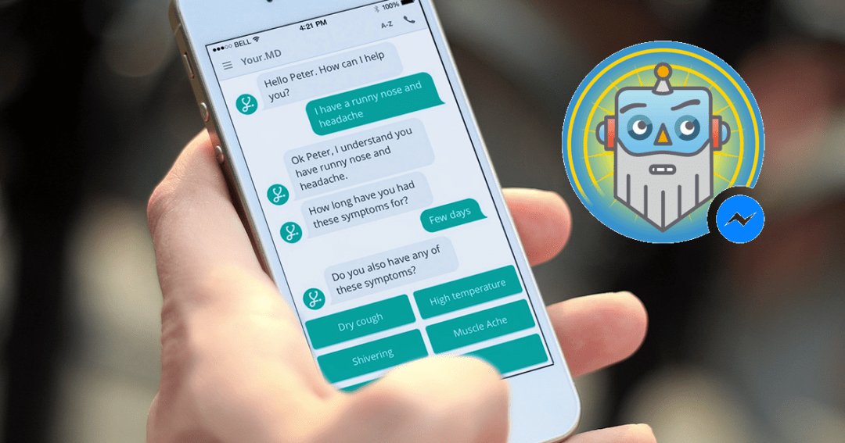
ABOUT CHATBOT
A chat bot is a computer program designed to simulate
conversation with human users, Especially over the internet.
They use AI technologies Such as NLP to understand and respond to user queries and commands.
Chat bots can found in various applications such as :
1. Customer services
2. Virtual assistants
3. Gaming and more

Slide 4
TYPES OF CHATBOTS AND USES
There are mainly three types of chatbots used in technologies :
Rule based chatbots
AI- powered chatbots
Hybrid chat bots

Slide 5
RULE BASED CHATBOT:
These chatbots operate on a set of predefined rules and decision trees. They respond to specific commands or keywords and follow scripted paths. Rule-based chatbots are effective for handling simple queries and tasks with predictable outcomes.
Example: Customer service bots that provide answers to frequently asked questions (FAQs) or guide users through predefined processes.

Slide 6
ADVANTAGES OF RULE BASED CHATBOT:
Clear Logic and Control: Rule-based chatbots operate on explicit rules and decision trees, making their behavior predictable and easier to understand from a developer's perspective.
Customization: Developers have full control over the rules and responses of the chatbot, allowing for customization tailored to specific business needs or user requirements.
3. Fast Response Time: Since responses are based on predefined rules, rule-based chatbots can provide quick responses without the need for complex computations or training data.
4. Security: Rule-based systems can be designed to ensure that sensitive information is handled securely and that users' privacy is protected, as they do not typically involve storing or processing large amounts of data.

Slide 7
5. Cost-Effective: Implementing and maintaining a rule-based chatbot can be cost-effective compared to more complex AI systems that require extensive training data and computational resources.
6. Domain-Specific Expertise: They excel in scenarios where the domain and user queries are well-defined, allowing the chatbot to provide accurate and relevant information consistently.
Disadvantages OF RULE BASED CHATBOT:
Limited Flexibility: Rule-based chatbots cannot learn or adapt beyond their predefined rules. They struggle with handling unexpected or complex user queries that fall outside their programmed scenarios.
Maintenance Challenges: As the number of rules increases or as the chatbot's complexity grows, maintaining and updating rules becomes cumbersome and error-prone.

Slide 8
Scalability Issues: Scaling a rule-based chatbot to handle a wide range of tasks or a large user base can be challenging. Each new rule needs to be carefully crafted and integrated, potentially leading to conflicts or unintended behaviors.
Natural Language Understanding: They typically rely on keyword matching or simple pattern recognition, making them less effective at understanding the nuances of natural language and conversational context.
Dependency on Data Quality: Rule-based chatbots heavily depend on the quality and completeness of the rules and data used to train them. Incomplete or biased data can lead to inaccuracies or poor performance.

Slide 9
AI- POWERED CHATBOT:
AI-powered chatbots utilize artificial intelligence techniques such as machine learning (ML) and natural language processing (NLP) to simulate human-like conversations and provide intelligent responses to users.
AI-powered chatbots use machine learning and natural language processing (NLP) algorithms to understand and generate responses. They can handle more complex queries and improve over time through continuous learning from interactions.
Example: Google Assistant, Amazon Alexa, Microsoft Cortana , ChatGPT and more are available.

Slide 10
ADVANTAGES OF AI-POWERED CHATBOT:
24/7 Availability: AI-powered chatbots can operate round the clock without breaks, providing instant responses to user queries and enhancing customer service availability.
Scalability: They can handle a large volume of inquiries simultaneously, making them scalable for businesses with varying levels of customer interaction.
Consistency: AI chatbots provide consistent responses based on predefined algorithms and data, ensuring users receive uniform information and service quality.
Efficiency: They can automate repetitive tasks and inquiries, freeing up human agents for more complex or personalized interactions, thereby improving operational efficiency.
Cost Savings: By automating customer support and other tasks, businesses can reduce labor costs associated with customer service operations.

Slide 11
Disadvantages OF AI-POWERED CHATBOT:
Complexity in Development: Developing and deploying effective AI chatbots requires significant expertise in artificial intelligence, natural language processing, and machine learning, which can be complex and costly.
Lack of Context Understanding: While AI chatbots can understand and respond based on programmed rules and algorithms, they may struggle with understanding nuanced contexts or emotions in user queries.
Security and Privacy Concerns: Handling sensitive information through AI chatbots requires robust security measures to protect user data from breaches and unauthorized access.
Dependency on Data Quality: The accuracy and effectiveness of AI chatbots heavily depend on the quality and relevance of the data used for training and ongoing learning.

Slide 12
HYBRID CHATBOT:
A hybrid chatbot typically refers to a chatbot that combines elements of both rule-based and machine learning approaches. Rule-based systems follow predefined rules to generate responses based on keywords or patterns, while machine learning models (chat gpt) learn from data to generate responses based on context and understanding.
Hybrid chatbots represent a powerful approach to building intelligent conversational agents that can handle diverse user queries effectively while continuously improving through machine learning capabilities.
Example: Customer Support, Healthcare Assistance, Financial Services, E-commerce
Etc.

Slide 13
ADVANTAGES OF Hybrid chatbot :
Flexibility: Hybrid chatbots can leverage both rule-based and machine learning approaches, allowing them to handle a wider range of queries and contexts effectively.
Accuracy: By combining rule-based logic with machine learning models, hybrid chatbots can provide more accurate responses, especially in complex or ambiguous situations.
Personalization: Machine learning models in hybrid chatbots can learn from interactions, enabling them to personalize responses based on user history and preferences.
Scalability: They can handle large volumes of queries efficiently, as the rule-based part can manage common queries quickly, while machine learning models can handle more unique or evolving queries.

Slide 14
Disadvantages OF Hybrid chatbot:
Complexity: Developing and maintaining a hybrid chatbot can be more complex compared to purely rule-based or purely machine learning-based systems.
Integration Challenges: Integrating different components (rules and ML models) into a cohesive system requires careful planning and development.
Performance Variability: The performance of hybrid chatbots can vary depending on the quality of the rules and the data used to train the machine learning models.
Dependency on Training Data: Machine learning models in hybrid chatbots require sufficient and relevant training data to perform well, which can be a limitation in some domains.

Slide 15
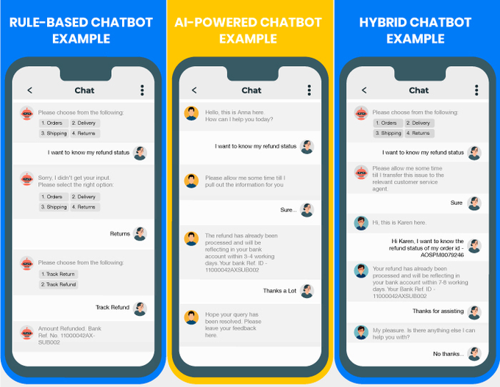

Slide 16
Chatbot vs Virtual Assistent
CHATBOT
VIRTUAL ASSISTANT
Automated Response: It operates based on predefined rules and algorithms to respond to user inputs.
Task-Oriented: Chatbots are often task-oriented, focusing on specific functions such as answering FAQs, providing information, processing orders, or booking appointments.
Limited Understanding: Chatbots typically have limited understanding of context and emotions.
Examples: Customer service chatbots, chat assistants embedded in websites or messaging platforms, transactional bots for banking or e-commerce tasks.
Enhanced Functionality: A virtual assistant, also known as a virtual assistant or intelligent assistant, goes beyond basic responses.
Contextual Awareness: Unlike chatbots, virtual assistants can understand context, learn from interactions, and provide more personalized responses over time.
Multifunctional: Virtual assistants can perform a wide range of tasks beyond basic information retrieval, such as scheduling appointments, making recommendations, managing tasks, and interfacing with other applications or services.

Slide 17

Travel Buddy AI(tourism guide):
A tourism guide chatbot is designed to assist travelers by providing information, recommendations, and support related to travel destinations, activities, accommodations, and more. Here are some key features :
Destination Information
Travel Planning Assistance
Transportation Information
Interactive Map Integration
Real-Time Updates and Notifications
Feedback and Reviews

Slide 18
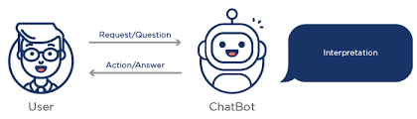
AI Buddy:
Data Loading and
preprocessing
Tokenization and Vectorization
Model Archietucture
Training and saving the model
User Interface Function
Usage (Testing)

Slide 19
Data Loading and preprocessing:
The conversational data from a CSV file into a Pandas Data Frame.
we clean the text data, convert it to lowercase, and remove non-alphabetical characters. We also convert the cleaned text columns into lists.
Training and saving the model :
Train the model using the preprocessed and vectorized data. Use a validation split to monitor the model's performance on unseen data during training.
Save the model using the .keras extension.

Slide 20
MODEL ARCHITUCTURE:
This step focuses on defining the neural network model, including the encoder and decoder components.
This architecture is designed to handle sequence-to-sequence tasks effectively, learning to map input sequences to corresponding output sequences.
Training and saving the model:
This step focuses on converting the preprocessed text data into a format that can be fed into the neural network.
This involves tokenizing the text (i.e., converting words into sequences of integers) and padding the sequences to ensure they all have the same length.

Slide 21
working code :
import numpy as np
import pandas as pd
import tensorflow as tf
from tensorflow.keras.models import Model
from tensorflow.keras.layers import Input, LSTM, Dense, Embedding
import re
import matplotlib.pyplot as plt
# Define parameters
batch_size = 64
epochs = 100
latent_dim = 256
# Path to the CSV file on disk
csv_file_path = 'C:/ML/tourism.csv'
# Read CSV file with specified encoding
df = pd.read_csv(csv_file_path, encoding='latin1')
# Assuming the columns are named differently, adjust accordingly
input_column_name = 'Q' # Adjust this if the column name is different
target_column_name = 'A' # Adjust this if the column name is different

Slide 22
# Preprocess the input and target texts
df[input_column_name] = df[input_column_name].apply(lambda x: re.sub(r'[^\w\s]', '', str(x).lower()))
df[target_column_name] = df[target_column_name].apply(lambda x: re.sub(r'[^\w\s]', '', str(x).lower()))
# Convert dataframe columns to lists
input_texts = df[input_column_name].tolist()
target_texts = df[target_column_name].tolist()
# Vectorize the data
input_tokenizer = tf.keras.preprocessing.text.Tokenizer()
input_tokenizer.fit_on_texts(input_texts)
input_sequences = input_tokenizer.texts_to_sequences(input_texts)
input_maxlen = max(len(seq) for seq in input_sequences)
input_vocab_size = len(input_tokenizer.word_index) + 1
target_tokenizer = tf.keras.preprocessing.text.Tokenizer()
target_tokenizer.fit_on_texts(target_texts)
target_texts = ['<start> ' + text + ' <end>' for text in target_texts] # Add <start> and <end> tokens
target_sequences = target_tokenizer.texts_to_sequences(target_texts)
target_maxlen = max(len(seq) for seq in target_sequences)
target_vocab_size = len(target_tokenizer.word_index) + 1
encoder_input_data = tf.keras.preprocessing.sequence.pad_sequences(input_sequences, maxlen=input_maxlen, padding='post')
decoder_input_data = tf.keras.preprocessing.sequence.pad_sequences(target_sequences, maxlen=target_maxlen, padding='post')
decoder_target_data = np.zeros((len(target_sequences), target_maxlen, target_vocab_size), dtype='float32')
for i, seqs in enumerate(target_sequences):
for j, seq in enumerate(seqs):
decoder_target_data[i, j, seq] = 1.0

Slide 23
# Define an input sequence and process it.
encoder_inputs = Input(shape=(None,))
encoder_embedding = Embedding(input_vocab_size, latent_dim, mask_zero=True)(encoder_inputs)
encoder_lstm = LSTM(latent_dim, return_state=True)
encoder_outputs, state_h, state_c = encoder_lstm(encoder_embedding)
encoder_states = [state_h, state_c]
# Set up the decoder, using `encoder_states` as initial state.
decoder_inputs = Input(shape=(None,))
decoder_embedding = Embedding(target_vocab_size, latent_dim, mask_zero=True)(decoder_inputs)
decoder_lstm = LSTM(latent_dim, return_sequences=True, return_state=True)
decoder_outputs, _, _ = decoder_lstm(decoder_embedding, initial_state=encoder_states)
decoder_dense = Dense(target_vocab_size, activation='softmax')
decoder_outputs = decoder_dense(decoder_outputs)
# Define the model that will turn
# `encoder_input_data` & `decoder_input_data` into `decoder_target_data`
model = Model([encoder_inputs, decoder_inputs], decoder_outputs)
# Compile & run training
model.compile(optimizer='adam', loss='categorical_crossentropy', metrics=['accuracy'])
# Train the model
history = model.fit([encoder_input_data, decoder_input_data], decoder_target_data,
batch_size=batch_size,
epochs=epochs,
validation_split=0.2)
# Save model with .keras extension instead of .h5
model.save('chatbot_model.keras')

Slide 24
# Extract training loss, validation loss, training accuracy, and validation accuracy
training_loss = history.history['loss']
validation_loss = history.history['val_loss']
training_acc = history.history['accuracy']
validation_acc = history.history['val_accuracy'] # Note the key name here
# Plot training and validation loss and accuracy
plt.figure(figsize=(10, 5))
# Plot Loss
plt.subplot(1, 2, 1)
plt.plot(training_loss, label='Training Loss')
plt.plot(validation_loss, label='Validation Loss')
plt.xlabel('Epochs')
plt.ylabel('Loss')
plt.title('Training and Validation Loss')
plt.legend()
# Plot Accuracy
plt.subplot(1, 2, 2)
plt.plot(training_acc, label='Training Accuracy')
plt.plot(validation_acc, label='Validation Accuracy')
plt.xlabel('Epochs')
plt.ylabel('Accuracy')
plt.title('Training and Validation Accuracy')
plt.legend()
plt.tight_layout()
plt.show()
# Load the trained model
model = tf.keras.models.load_model('chatbot_model.keras')

Slide 25
# Define a function to directly return the target text
def respond_to_input(input_text):
# Convert user input to lowercase and remove symbols
input_text = re.sub(r'[^a-zA-Z\s]', '', input_text.lower())
# Check if the input exists in the dataset
if input_text in input_texts:
# Get the index of the input_text in input_texts
input_index = input_texts.index(input_text)
# Retrieve the corresponding target_text from target_texts
target_text = target_texts[input_index]
# Remove '<start>' and '<end>' tokens from target_text
target_text = ' '.join(target_text.split()[1:-1])
return target_text
else:
return "Sorry, I don't understand."

Slide 26
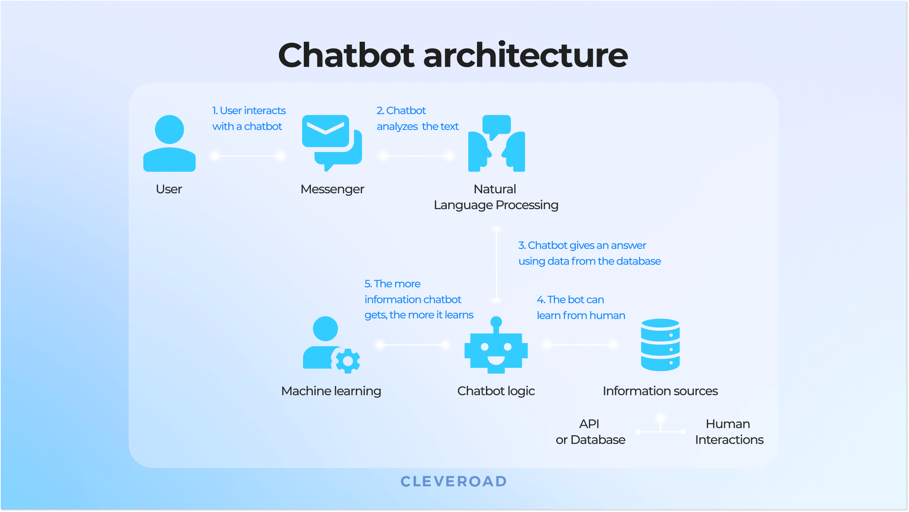
REAL TIME DEVELOPMENT OF CHATBOT(tourism guide)

Slide 27
Tensorflow and keras(Backbone)
Tensor flow is an open-source machine learning framework developed by the Google Brain team. It provides a comprehensive ecosystem for developing, training, and deploying machine learning models, particularly deep learning models.
TensorFlow supports a wide range of machine learning and deep learning algorithms, including neural networks, linear models, and clustering.
TensorFlow is used for various tasks, including image and speech recognition, natural language processing, and time series analysis. It's suitable for research as well as production-grade applications.
Keras is a high-level neural networks API, originally developed as an independent project, and now part of TensorFlow. Keras provides a user-friendly interface to define and train neural network models. It abstracts the complexity of TensorFlow operations, making it easier to build and experiment with neural networks.

Slide 28
Keras provides high-level abstractions for building and training neural networks, simplifying tasks like defining layers (Input, Embedding, LSTM, Dense), creating the model (Model), and training it (compile, fit). These functions are essential for setting up the sequence-to-sequence model for the chatbot and managing its training and inference processes.

Slide 29


