Slide 1

Name :durga dharshini registernumber:2422k0247 nm ID:asbru172422k0247 degree:bsc(computer science) college name : Sri Vasavi college (self finance wing) university : Bharathiyar university

Slide 2

INTERACTIVE DIGITAL PORTFOLIO USING FRONT END WEB DEVELOPMENT

Slide 3


Agenda Overview
Problem statement
Portfolio design and layout
01
05
Project overview
Festures and functionality
02
06
End users
Results and screenshot
03
07
Tools and thechnologies
Conclusion
04
08

Slide 4

problem statement
Studentsoften struggletopresent their achievements effectively.
Traditional resumes lack visual appeal and detailed project showcase.
A portfolio bridges the gap between skills and opportunities.

Slide 5
A digital portfolio designed to present academic, technical, and creative skills.
Project overview
Serves as a central platform to highlight projects, internships, and certifications.
Focused on simplicity, clarity, and professional presentation.

Slide 6

end user
Students: Display academic records & skills.
Faculty/Guides: Monitor student progress.
Recruiters: Identify capable candidates.
Organizations/Institutions: Keep a database of talent.

Slide 7
tools and thechnologies
Design & Layout: Canva, Figma, Photoshop.
Development: HTML, CSS, Bootstrap, JavaScript.
Database (if dynamic): MySQL / Firebase.
Presentation: MS PowerPoint / Google S lides.

Slide 8

Portfolio design and layout
Sections included:
Profile / About Me
Education & Skills
Projects & Certifications
Achievements & Activities
Contact Information
Layout designed for easy navigation and readability.

Slide 9
Professional and modern interface.
features
Resume / CV download option.
And
Separate sections for academics and projects.
functionality
Interactive links to GitHub / LinkedIn.
Mobile-friendly design.

Slide 10
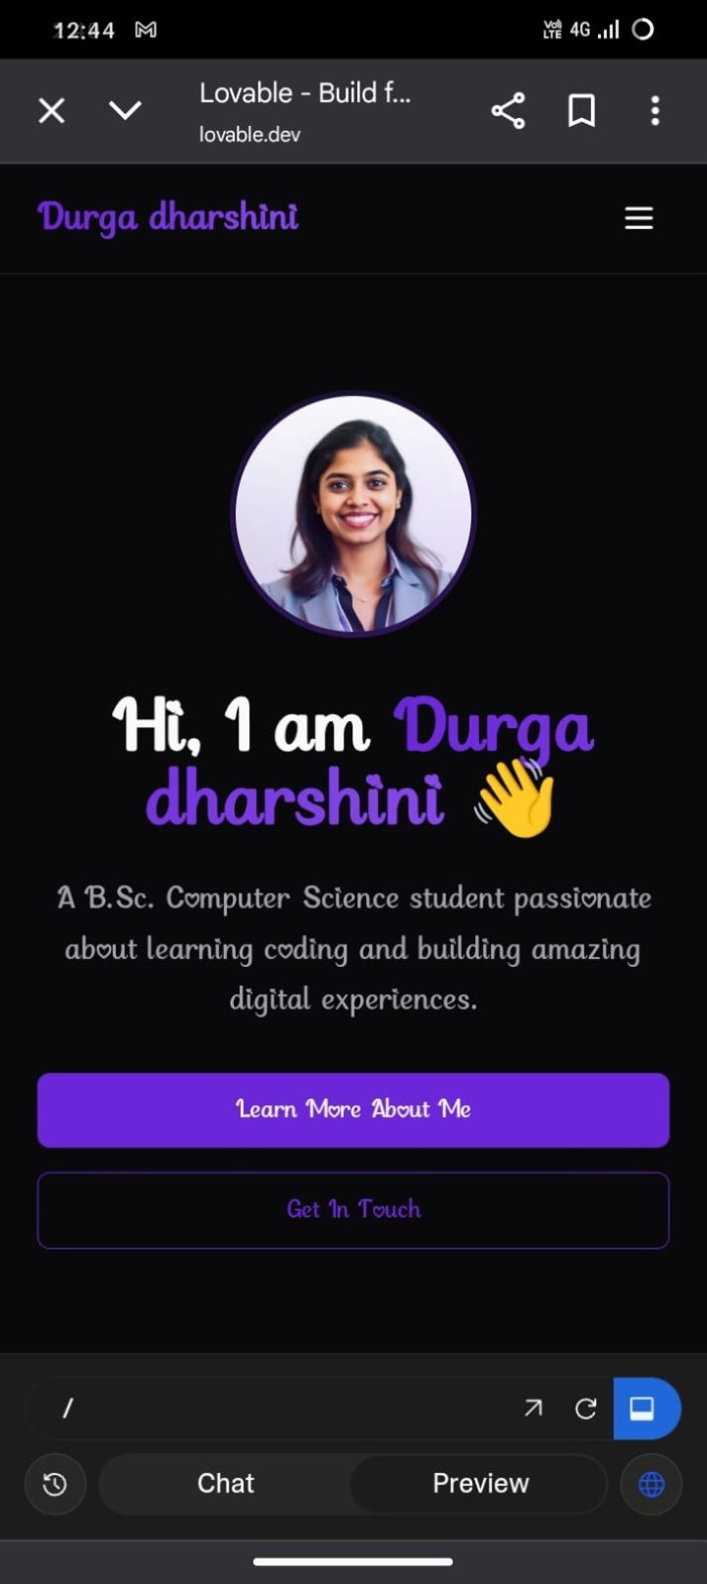
Results and screenshot

Slide 11
conclusion
A portfolio creates a professional digital identity for students.
It helps in career opportunities, higher studies, and networking.
Easy to maintain, update, and share anyt ime.

Slide 12
Thank You

