Slide 1
Why RAG?
Retrieval-Augmented Generation
Solving the limitations of Large Language Models

Slide 2
The Problem with LLMs
LLMs are powerful but suffer from:
• Hallucinations
• Knowledge cutoff
• Lack of domain-specific knowledge
• No access to private documents

Slide 3
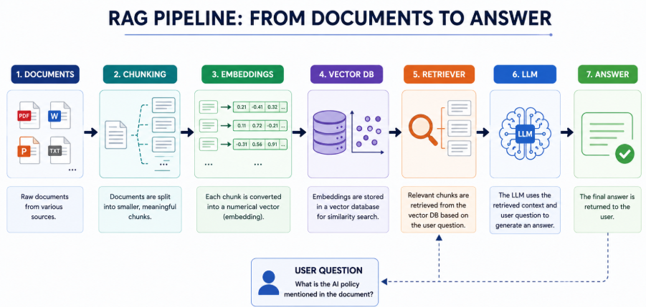
RAG Architecture

Slide 4
Step 1: Document Loading
Load PDFs, Word documents, websites, policies, regulations, and manuals.
Code
from google.colab import files
uploaded = files.upload()
pdf_file = list(uploaded.keys())[0]
print("Uploaded:", pdf_file)

Slide 5
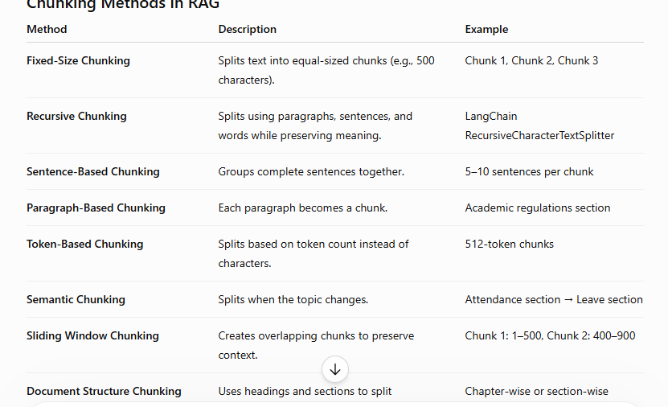
Step 2: Text Chunking

Slide 6
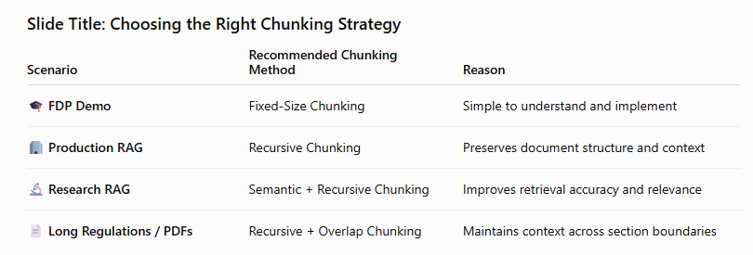
There is no single best chunking method. The choice depends on the application, document type, and retrieval requirements.

Slide 7
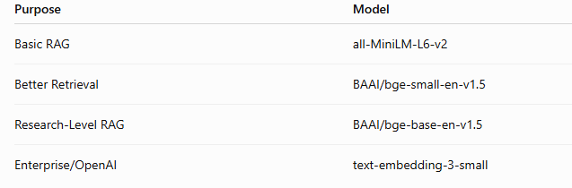
Step 3: Embeddings
Convert text into vectors using embedding models.

Slide 8
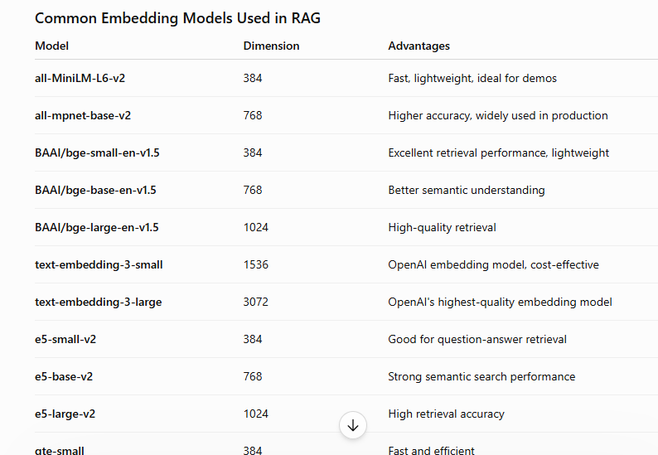

Slide 9
Chunk 1: Students must maintain 75% attendance.
Chunk 2: Minimum attendance required is 75%.
Chunk 3: Faculty are entitled to vacation leave.
Embedding Model (all-MiniLM-L6-v2)
Chunk 1 → [0.23, -0.45, 0.67, ...]
Chunk 2 → [0.25, -0.42, 0.70, ...]
Chunk 3 → [0.91, 0.12, -0.34, ...]

Slide 10
Step 4: Vector Database
Document Chunks
↓
Embeddings
↓
┌───────────────────┐
│ Vector Database │
└───────────────────┘
↓
FAISS | ChromaDB | Pinecone | Weaviate

Slide 11
Vector Database | Type | Best For
FAISS | Local | Learning, Research
ChromaDB | Local | RAG Applications
Pinecone | Cloud | Production Systems
Weaviate | Cloud/Open Source | Enterprise AI Search
Traditional Database Vector Database
Stores Records Stores Meanings
Ex: "Attendance Requirement"
≈
"Minimum Attendance Percentage"
vector Database store embeddings and help RAG systems retrieve semantically relevant information instead of relying on exact keyword matching.

Slide 12
Step 5: Retrieval
Retrieve the most relevant chunks using similarity search. Retrieval Methods
• Keyword Search (BM25)
• Semantic Search (Embeddings)
• Hybrid Search (BM25 + Semantic)
• Similarity Search (FAISS)
• MMR Retrieval – Maximum MarginaL Relevance
• Multi-Query Retrieval
Most Modern RAG Systems:
Hybrid Search + Similarity Search

Slide 13
Step 6: Prompt Augmentation
Combine user query with retrieved context before sending to LLM.
Context:
Students must maintain a minimum attendance of 75%.
Question:
What is the attendance requirement?

Slide 14
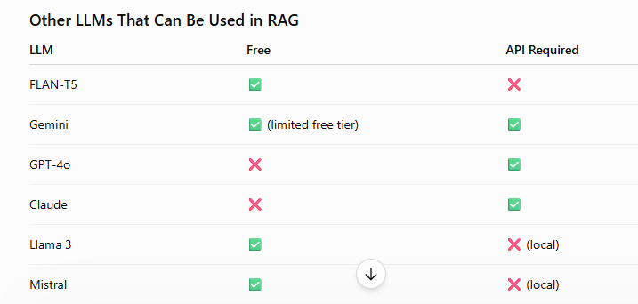
Step 7: Answer Generation
LLM generates an answer grounded in retrieved documents.

Slide 15
RAG Example – University Regulations
Question: What is the minimum attendance requirement?
Retriever fetches regulation document.
LLM answers using actual policy.

Slide 16
Benefits of RAG
• Reduced hallucinations
• Access to private knowledge
• Up-to-date information
• No model retraining required

Slide 17
RAG vs Fine-Tuning
Fine-Tuning changes model weights.
RAG keeps model unchanged and updates knowledge through documents.

Slide 18
Educational Applications
Student handbook chatbot
Research assistant
Policy assistant
Question bank assistant

Slide 19
Industrial Applications
Customer support
Legal document search
Healthcare knowledge assistant
Enterprise search

Slide 20
Challenges in RAG
Chunking quality
Embedding quality
Retrieval accuracy
Context window limitations

Slide 21
Advanced RAG
Hybrid Search
BM25 + Semantic Search
Re-ranking
Multi-query Retrieval

Slide 22
Key Takeaways
RAG enables trustworthy, document-grounded AI systems without retraining LLMs.

