Slide 1
AI-Driven Collections Framework
Harnessing Agentic AI for Scalable, Ethical, and Optimized Debt Resolution at Geldium

Slide 2
System Architecture and Workflow
Customer Data Input: Repayment history, credit score, income, customer interactions
Decision Logic Engine: AI model predicts risk and suggests actions
Action Module: Sends personalized reminders, plans, or escalations
Learning Loop: Continuously refines decisions based on outcomes
Notes:
Prompts to try:
Generate a simple outline for an AI collections system workflow, including inputs, decision logic, action triggers, and learning loop.
List 3–5 key customer attributes that would be most predictive for collections decision-making, and explain why each one matters.
Suggest examples of business rules and AI-driven actions the system could use at different risk levels (e.g., low, medium, high risk).
Create a rough sketch or step-by-step description of how customer data flows through the system from intake to action.

Slide 3
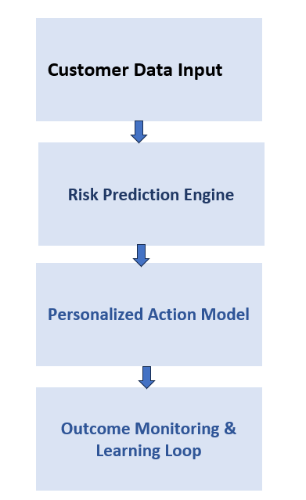
End-to-End Process Visualization

Slide 4
Strategic Role of Agentic AI in Collections
Autonomous AI: Predicting risk, sending reminders, adapting messages, learning from data
Human Oversight: Approving payment plans, reviewing edge cases, handling disputes, auditing fairness
Notes:
Prompts to try:
Explain how agentic AI could automate financial collections while keeping humans in critical decision points.
List 3–5 examples of collection actions, and classify each as best suited for full automation or requiring human oversight, with a brief reason why.

Slide 5
Responsible AI Governance Framework
Fairness Checks: Detect and mitigate bias across segments
Explainability: Clear, understandable decisions for customers
Compliance: Meets regulatory standards like GDPR, ECOA
Human-in-the-Loop: Agents involved in critical decisions
Notes:
Prompts to try:
List key fairness, transparency, and compliance practices to build into an AI-powered credit collections system.
Suggest specific ways to monitor and audit the system over time to ensure it stays fair, compliant, and effective.

Slide 6
Projected Business and Customer Impact
Business KPIs: Lower delinquency (↓25%), cost savings, better recovery rates, scalable ops
Customer Outcomes: Personalized plans, increased trust, fairness, transparent process
Notes:
Prompts to try:
Suggest KPIs for an AI-powered collections strategy that balances business outcomes with customer fairness.
Describe 2–3 ways an AI collections system could improve both operational efficiency and customer experience.

Slide 7
Thank You

