Slide 1
What’s Cooking – A Kaggle competition
Capstone Project for
Foundations of Data Science on SpringBoard.com.
Prepared by: Mallesh Sunkara
Date: 01/13/2016

Slide 2
Introduction
A cuisine can tell a lot about a country’s culture. While tasting different cuisines is fun, I believe it is also interesting to understand the diversity and spread of ingredients.
Based on the datasets provided on Kaggle here, we will build several machine learning models and discuss the merits of each of them.
Based on the understanding, we shall try to predict the type of cuisine for a set of unknown recipes.

Slide 3
Dataset
The Dataset available to us is from Yummly, with a list of recipes and the cuisines they belong to.
A cursory glance at the dataset reveals that there are 39774 recipes in the dataset (Sounds like a lot!!)
One interesting point to know how the recipes are spread across different cuisines, this might indicate a rich culinary history of the cuisine or may be that our dataset is biased.

Slide 4
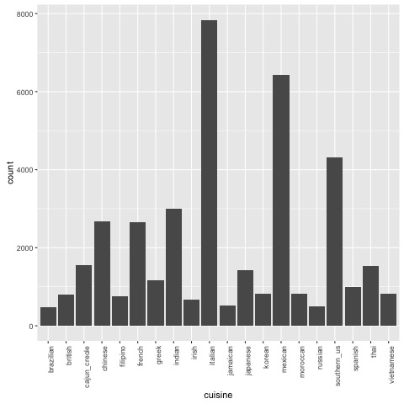
Recipes Vs Cuisines
This grpah indicates that we have a lot of Italian recipes followed by Mexican and then Southern_us.
I would have expected to see more recipes in some of the other cuisines, but probably not all are famous!

Slide 5
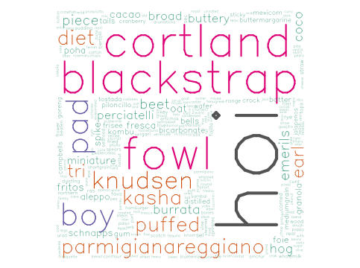
Word Count analysis – Least common Terms:
Words that least appear in the word cloud:

Slide 6
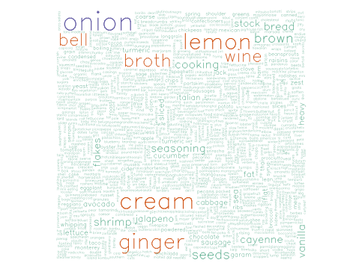
Word Count analysis – Most common Terms:
Words that appear frequently in the word cloud:

Slide 7
Data Cleansing
Based on the word clouds, we can come up with a list of words that we can eliminate from our list of ingredients. For e.g., words like cortland, schnapps probably are company names and not really and ingredient.
We can also consider only those ingredients that appear more than 3 times in the dataset. This way we can eliminate all the one-off company named ingredients. However there is a risk of losing a unique ingredient that would have helped us classify a cuisine.

Slide 8
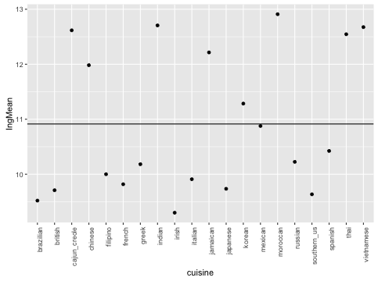
Feature Engineering – Number of Ingredients
Lets look at the average number of ingredients used in each cuisine:

Slide 9
Feature Engineering – cntd..
From the previous graph, we can conclude that the cuisines do have some kind of correlation with the number of ingredients.
A set of cuisines have high number of ingredients like Moroccan, Indian etc. where as a set of cuisines like Irish and Brazilian have lesser number of ingredients.
This indicates that probably the number of ingredients in a dish might help in predicting the cuisine.

Slide 10
Model building - Decision Trees
After adding the features, we applied a basic decision tree algorithm on the training data set.
When this model was used to predict the cuisines in the test set, we got a success of 0.40185/~40%
The code and Output file can be found here.

Slide 11
Model building – Random Forests
Considering the poor prediction ration from Decision Trees, we used a more advanced ML algorithm called Random Forests which assigns random features to a sample and there on building a model. Random forests are known to address the Overfitting problems with other decision trees.
The Model built with random Forests produced a success ratio of 0.47 when applied in the test data. Not quite an improvement we are looking for.
The code for Random Forests and output file are available here.

Slide 12
Model building – SVM
Support Vector Machines is another algorithm that is generally memory intensive, but known for high accuracy.
The model built using SVM had produces a result of 0.73592/73%. This is quite an improvement over our initial models.
The code for SVM and output file are available here.

Slide 13
Model building – Gradient Boosting
Even though we achieved a high success ration with SVMs, we attempted to improve the prediction rate by using a gradient boosting model. This model requires a bit of data massaging due to its limitations, but known to produce better results.
The success ratio using the gradient boosting is at 0.76368/76%. This is only a slight improvement over the SVMs.
The code for Gradient Boosting and output file are available here.

Slide 14
Further Analysis
A few more features can be added to the model to improve the performance. For .e.g., if we can classify the ingredients into Dairy, meat, vegan Etc. that would add a new distinction to the prediction algorithms.
This analysis can further be extended to identify the similar recipes and suggest a dish based on a customer’s previous likes and dislikes.
Also, if we dig deeper, it is possible to chart out the evolution of cuisines based on the ingredients used.

Slide 15
Thank You

