Slide 1
AWS Core Architecture & Security

Slide 2
AWS Global Infrastructure
Learning Objectives
Understand the hierarchy: Regions -> AZs -> Edge Locations
Make informed decisions about region selection
Understand the global reach and resilience of AWS

Slide 3
AWS Global Infrastructure
🌍 1. Regions: Geographic areas with multiple AZs
38 regions worldwide
Each region is completely isolated
Designed for high availability, fault isolation, data residency.
Data doesn't leave a region unless you explicitly move it
Examples: us-east-1, eu-west-1, ap-southeast-1
🏢 2. Availability Zones (AZs): Isolated data centers
2-6 AZs per region
Connected via low-latency links, high-throughput, redundant fiber networks.
Physically separated for resilience
Isolated infrastructure with distance from 50-100km apart
Carefully engineered to be away from natural calamity like flood, lightning, tornado, etc.
Example: us-east-1a, us-east-1b, us-east-1c
📍 3. Edge Locations / CDN (Content Delivery Network) endpoints for CloudFront
400+ edge locations globally
Cache content closer to users
Reduce latency for end users
Separate from Regions and AZs

Slide 4
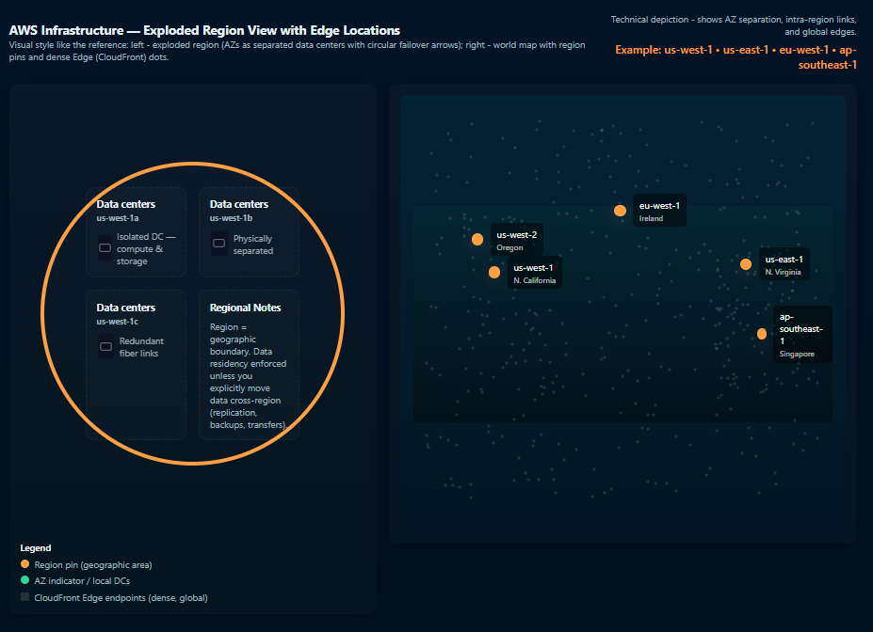
Cont..

Slide 5
Choosing the Right Region
The 4 Cs of Region Selection: Consider all factors for optimal selection
1️⃣ Compliance & Data Sovereignty
GDPR requires EU data to stay in EU
Healthcare data regulations (HIPAA)
Government requirements
2️⃣ Cost
Pricing varies by region (up to 30% difference)
Example: us-east-1 is typically cheapest
Quick Check: Do pricing comparison for EC2 instances in North Virginia vs Mumbai
3️⃣ Closeness (Latency)
Rule of thumb: ~1ms per 100km
Demo: Ping different regions from your location
Use case: Gaming needs <50ms latency
4️⃣ Capacity (Service Availability)
Not all services available in all regions
New services launch in us-east-1 first
Check AWS Regional Services list

Slide 6
Knowledge Check
Visit: https://aws.amazon.com/about-aws/global-infrastructure/
Identify the closest AWS Regions to your geography.
List the number of Availability Zones (AZs) in each selected Region.
Discussion Questions
Why do some Regions have more AZs than others?
Ans: - Customer Demand -> you would need more workload to be running on us-east-1, more infra
Cost low -> more customer demand
2. Choose Primary & Secondary Regions - Justify Your Choice
Scenario:
You are deploying an e-commerce application with the following constraints:
Customer distribution:
  60% Europe
  30% US
  10% Asia
Compliance: Must comply with GDPR
Company size: Budget-conscious startup
Services required: EC2, RDS, S3, Lambda (but we will include cloudfront for CDN as well)

Slide 7
Region Selection Examples
✅ Good Region Choices
1. E-commerce platform - Majority EU customers
Recommended: eu-west-1 (Ireland) or eu-central-1 (Frankfurt)
Meets GDPR data residency requirements
Low latency to European users
Mature regions with 3+ AZs
2. Global Gaming / Realtime App
Recommended: Nearest Region to users
Prioritize latency over everything else
Regions like ap-southeast-1, us-west-2, eu-west-2 depending on geography
Essential for real-time responsiveness
3. Startup - Cost-Sensitive Workloads
Recommended: us-east-1
Typically, the lowest-cost AWS region
Largest availability of services
Strong ecosystem / best pricing for EC2, S3, Lambda
❌ Poor Region Choices
1. Hosting European Data in us-east-1
Violates GDPR residency requirements
Creates legal + compliance risk
Latency impact for EU users
2. Serving Asian Users from a US Region
High network latency -> poor user experience
Increased data transfer costs
Better choices: ap-southeast-1, ap-south-1, ap-northeast-1
3. Deploying New Services in Regions With Limited Feature Availability
Example: Some new managed services not yet available in Middle East (me-south-1), Africa (af-south-1)
Missing services (RDS types, Lambda features, ML services, etc.)
Slows development and limits architecture options

Slide 8
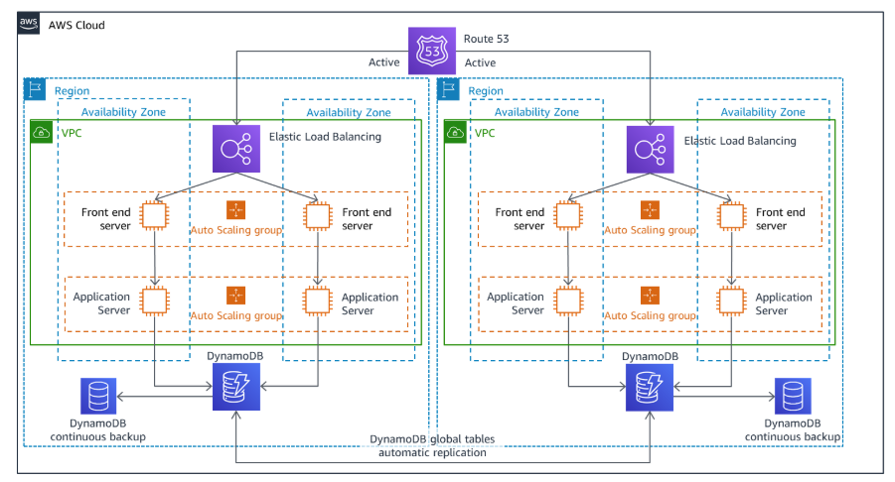
Multi-Region vs Single-Region Architecture
Single-Region Architecture
All workloads deployed in one AWS Region
Lower cost and simpler operations
Lower latency for users close to that region
Suitable for: All applications
Multi-Region Architecture
Workloads deployed across 2+ AWS Regions
Higher resilience: protects against region-wide failure
Supports global users with localized latency
Enables cross-region redundancy & data residency compliance
Suitable for: Mission Critical Applications, Globally Distributed Application
Key trade-off:
Simplicity & cost (single region) vs resilience, geo-performance & compliance (multi-region)

Slide 9
When to Use Multiple Regions
1. Disaster Recovery (DR)
Critical workloads needing business continuity during regional outages
Cross-region replication for RDS, DynamoDB Global Tables, S3 CRR
Recovery strategies: Pilot Light, Warm Standby, Hot Active-Active
2. Globally Distributed Applications
Latency-sensitive apps serving users in different continents
Regionalized deployments with global routing (Route53 latency-based routing, CloudFront)
3. Regulatory & Data Residency Requirements
Some industries require data to remain in a specific geography
Multi-region designs allow compliance while serving users globally
4. Mission-Critical, Zero-Downtime Systems
Availability requirements exceeding single-region durability
Use multi-region active-active or active-standby

Slide 10
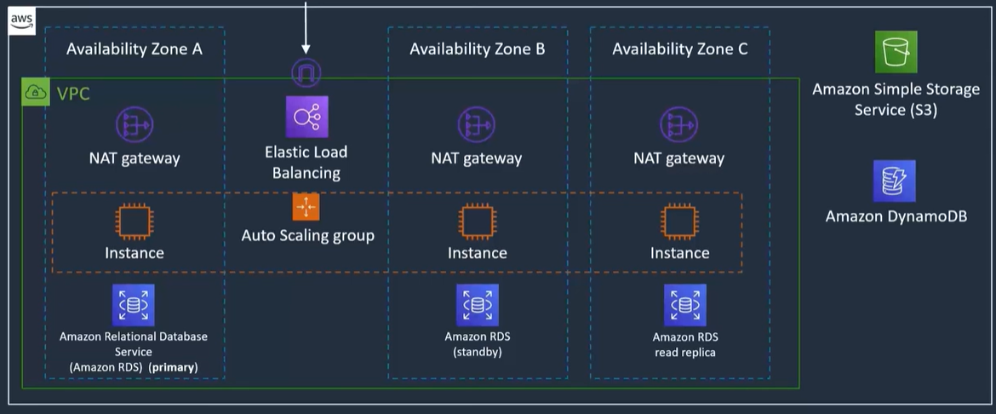
Multi-AZ Deployment for High Availability
Multi-AZ means running each layer in at least two physically separate data centers (AZs) in the same Region.
A Standard Multi-AZ Deployment for a web services:
Create the load balancer in public subnets
Deploy application servers in EC2s running in private subnets across multiple AZs behind an ALB.
Database is deployed in AWS-managed Multi-AZ configuration
This pattern gives protection from AZ failures while keeping latency low compared with multi-region designs
Jump / bastion Host
Laptop

Slide 11
AWS Shared Responsibility Model
Learning Objectives
Distinguish between AWS and customer responsibilities
Apply the model to different service types
Understand security implications

Slide 12
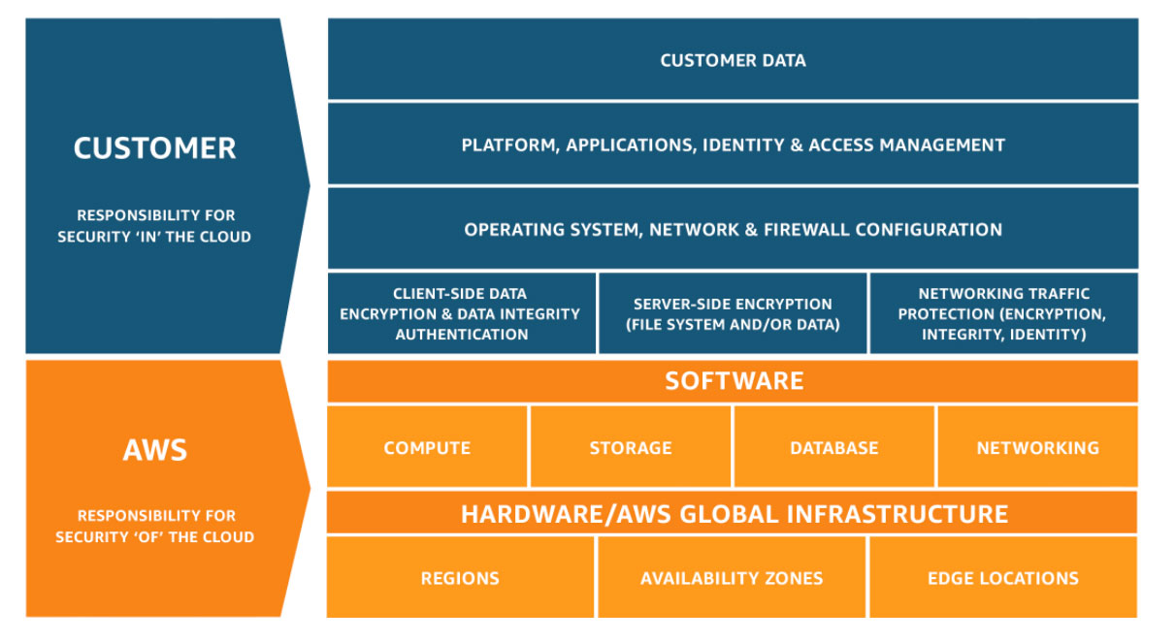
The Shared Responsibility Model

Slide 13
Explanation
🔐 Security OF the Cloud - AWS Responsibility
AWS is responsible for securing the foundation layer, including:
Physical security of data centers (access control, surveillance, facilities)
Hardware & global infrastructure (servers, storage, networking equipment)
Region / AZ infrastructure and power, physical redundancy
Network & hypervisor layer (virtualization stack)
Managed service platform security
(e.g., Lambda, DynamoDB, S3 - AWS secures the underlying OS, runtime, and infrastructure)
AWS secures everything that runs the cloud.
🔐 Security IN the Cloud - Customer Responsibility
Customers are responsible for securing what they run or configure on top of AWS:
Data protection (classification, encryption keys, backup configurations)
Application security (code vulnerabilities, API validation, secrets handling)
Identity & Access Management (IAM)
(permissions, roles, MFA, least privilege)
Network security controls
(Security Groups, NACLs, routing policies, WAF rules)
Operating system & runtime management
(patching, updates, hardening - for EC2, containers, self-managed software)
Resource configuration & compliance
(S3 policies, KMS rotation, logging & monitoring settings)
Customers secure everything they put inside the cloud.

Slide 14
Responsibility by Service Model
IaaS
Example: EC2
Customer manages:
OS patches & hardening
Application code
Security Groups, NACLs
Encryption (EBS, IAM keys)
Data protection
AWS manages:
Hardware
Virtualization layer
Network fabric
PaaS
Example: RDS
Customer manages:
Data & schema
IAM & access controls
Encryption settings
Parameter groups & backups configuration
AWS manages:
OS & database engine patching
High availability (Multi-AZ)
Storage & replication
Monitoring + failover
SaaS
Example: S3
Customer manages:
Access policies (Bucket / IAM)
Object encryption
Data lifecycle (retention, versioning)
AWS manages:
Infrastructure
Scaling + durability (11 nines)
Storage hardware & replication

Slide 15
Knowledge Check
Create a responsibility matrix:
Security Aspect | AWS | Customer | Shared
Data center physical security
EC2 OS patching
RDS database patching
S3 bucket policies
Network traffic protection
IAM user management

Slide 16
Cont.
1. Data Breach Scenario - S3 Bucket Left Public
Who is responsible?
Customer
  Customer configures S3 Bucket Policies, IAM, and ACLs.
  Misconfiguration of “public access” or overly permissive policies is customer responsibility.
How to prevent it?
Enable S3 Block Public Access (Account & Bucket level)
Use IAM least privilege
Enable Access Analyzer (S3 + IAM)
Key point: AWS secures S3 infrastructure; the customer secures S3 configuration.
2. Hardware Failure Scenario - EC2 Instance Disk Fails
Who is responsible?
AWS
  AWS maintains and replaces physical hardware, racks, networking, hypervisors, and EC2 hosts.
How to prevent it?
Customer Responsibilities:
Ensure data resiliency, because EC2 instance-store or even EBS can fail under certain conditions.
Recommended:
  EBS snapshots (automated)
  AMIs for golden images
  Using Multi-AZ architectures (ASG across AZs)
  Storing data in durable services (S3, DynamoDB, RDS)
Key point: AWS replaces failed hardware; the customer must architect for resilience.

Slide 17
AWS Well-Architected Framework
Learning Objectives
Understand the 6 pillars and their design principles
Apply framework principles to real scenarios
Use the framework for architecture reviews

Slide 18
The 6 Pillars
Remember: CROPS-S
What is the Well-Architected Framework?
A collection of best practices derived from thousands of successful AWS workloads
Not strict rules but guidelines to help you make tradeoffs and design well-structured systems
Used during architecture reviews, modernization discussions, and ongoing improvements
Helps ensure workloads are secure, reliable, performant, cost-efficient, and sustainable
The Six Pillars
1️⃣ Operational Excellence
Run workloads effectively
Automate, observe, improve continuously
2️⃣ Security
Protect data, systems, and assets
IAM, encryption, detection, least privilege
3️⃣ Reliability
Prevent and recover from failures
Multi-AZ, fault isolation, automated recovery
4️⃣ Performance Efficiency
Use resources efficiently
Select optimal compute, storage, and scaling patterns
5️⃣ Cost Optimization
Avoid unneeded cost
Right-size, auto-scale, use managed services, analyze spend
6️⃣ Sustainability
Reduce environmental impact
Use efficient architectures, right-size, use serverless where possible

Slide 19
1. Operational Excellence
❓ How do we run and monitor systems?
Key Principles
Perform operations as code (IaC)
Make frequent, small, reversible changes
Anticipate failure & design for it
Learn from operational events and improve continuously
Examples
Terraform / CloudFormation for infrastructure
CI/CD pipelines (CodePipeline, GitHub Actions, Jenkins, GitLab)
CloudWatch metrics, logs, alarms, dashboards
Run tests to validate resilience
Anti-patterns
Manual deployments
No monitoring or alerting
Fear of change / large untested releases

Slide 20
2. Security
❓ How do we protect information and systems?
Key Principles
Implement a strong identity foundation (IAM, MFA)
Enable traceability (CloudTrail, CloudWatch Logs)
Apply security at all layers (network, compute, application)
Automate security best practices
Protect data in transit & at rest
Keep people away from data (least privilege, automation)
Examples
MFA for all users
Encrypt EBS, S3, RDS (KMS keys)
VPC Security Groups, NACLs, WAF
IAM Access Analyzer
Anti-patterns
Root account usage
Overly permissive IAM policies (“*:*”)
No encryption on storage or data transfers

Slide 21
3. Reliability
❓ How do we ensure systems work correctly?
Key Principles
Automatically recover from failure
Test recovery procedures regularly
Scale horizontally, not vertically
Stop guessing capacity - use autoscaling and managed services
Examples
Multi-AZ deployments
Auto Scaling Groups
Health checks (ALB, Route53)
Regular backup + restore test cycles
RDS Multi-AZ or Aurora clusters
Anti-patterns
Single points of failure
No backups or untested backups
Manual scaling or manual failover

Slide 22
4. Performance Efficiency
❓ How do we use computing resources efficiently?
Key Principles
Democratize advanced technologies (managed AI/ML, analytics)
Go global in minutes
Prefer serverless or managed services
Experiment quickly and iterate
Examples
RDS / DynamoDB instead of self-managed DBs
CloudFront CDN for reduced latency
Choose the right EC2 instance type / family
Event-driven architecture with Lambda
Anti-patterns
Over-provisioning compute
Wrong instance family (CPU-heavy vs memory-heavy)
Ignoring caching or CDN

Slide 23
5. Cost Optimization
❓ How do we avoid unnecessary costs?
Key Principles
Implement Cloud Financial Management
Measure overall efficiency
Attribute and analyze cost allocation
Use demand-based or schedule-based scaling
Examples
Reserved Instances / Savings Plans
Stop dev/test environments during off-hours
Right-size EC2, RDS, EKS nodes
S3 lifecycle policies (IA, Glacier)
Auto Scaling policies
Tagging for cost allocation
Anti-patterns
Always-on dev environments
No cost visibility or monitoring
Over-provisioned instances and storage

Slide 24
6. Sustainability
❓ How do we minimize environmental impact?
Key Principles
Understand your workload’s impact
Establish sustainability targets
Maximize utilization of resources
Prefer managed services over self-hosted
Optimize architecture and data footprint
Examples
Use Graviton processors (energy efficient)
Use auto-scaling, serverless, and event-driven patterns
Choose regions powered by renewable energy
S3 Intelligent-Tiering / storage optimization
Anti-patterns
Idle or underutilized resources
Inefficient code or oversized compute
Storing unnecessary or unused data

Slide 25
Knowledge Check
Scenario: Design a web application architecture
Requirements: High availability, cost-effective, secure, global users
Task: Apply each pillar to the design
Operational Excellence: How will you deploy and monitor?
Security: How will you protect data and access?
Reliability: How will you handle failures?
Performance: How will you serve global users?
Cost: How will you optimize spending?
Sustainability: How will you minimize environmental impact?

Slide 26
AWS IAM
Learning Objectives
Create and manage IAM users, groups, and roles
Write effective IAM policies
Implement security best practices
Understand the principle of least privilege

Slide 27
IAM Fundamentals
🔑 Root Account
Used ONLY for account setup & critical operations
Never use for day-to-day tasks
Always enable MFA
👤 IAM Users
Represent individual people or applications
Long-term credentials (password, access keys)
Should follow least privilege
👥 IAM Groups
Logical grouping of users
Attach policies to groups -> users inherit permissions
Simplifies permission management
🎭 IAM Roles
No long-term credentials
Assume role to get temporary credentials
Used for:
  Cross-service access (EC2 -> S3)
  Cross-account access
  Federated access (SSO, external identity providers)
📄 IAM Policies
JSON documents defining allow/deny permissions
Attached to users, groups, or roles
Types:
  Managed Policies (AWS or customer-managed)
  Inline Policies (resource-specific)

Slide 28
IAM Users
👤 What is an IAM User?
Represents a specific person or application that needs long-term access to your AWS account.
Key Characteristics
Permanent credentials
(passwords, access keys, CLI/SDK authentication)
Can belong to multiple IAM groups
Inherits permissions from groups, plus any directly attached policies
Used for human access or legacy application access
(but modern apps should use roles, not users)
Best Practices
One user per person (no shared logins)
Enable MFA for every user (especially console access)
Rotate access keys regularly (automate where possible)
Use least privilege policies (grant only what is needed)
Apply password policies: length, rotation, complexity
Use IAM Access Analyzer to detect overly permissive access

Slide 29
IAM Groups
👥 What is an IAM Group?
A collection of IAM users who share similar permission requirements.
Benefits
Centralized permission management
(attach policies to the group, not each user)
Users automatically inherit group permissions
Scales well for large teams
Helps organize access by job function or workload
Common Examples
Developers - access to dev/test resources, CI/CD
Administrators - elevated privileges, break-glass accounts
Data Scientists - analytics tools, S3 datasets
Auditors / Security Reviewers - read-only access to logs & configs

Slide 30
IAM Roles
🎭 What is an IAM Role?
A role provides temporary security credentials for users, applications, or AWS services to access resources without long-term credentials.
Key Differences from IAM Users
No permanent credentials (no password, short term access keys)
Assumed by users, services, or applications
Temporary credentials automatically rotate and expire
Intended for machine-to-machine or cross-account access
More secure than embedding access keys in applications
Common Use Cases
EC2 -> S3 access via Instance Profile
Cross-account access (e.g., prod <-> audit account)
Federated users (SSO, IAM Identity Center, external IdPs)
Lambda / ECS tasks needing permissions
CI/CD pipelines assuming roles for deployments
Service-to-service access (EKS, API Gateway, Step Functions)

Slide 31
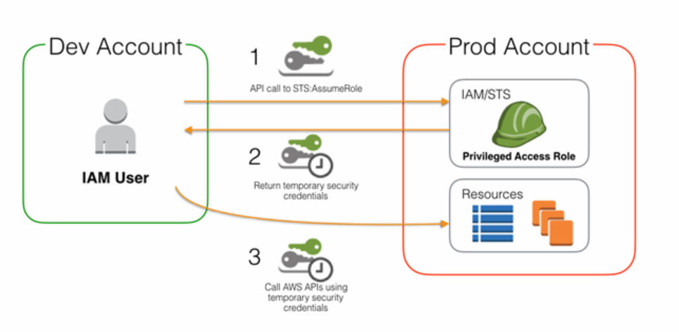
IAM Cross Account Roles

Slide 32
IAM Policies
📄 What is an IAM Policy?
A policy is a JSON document that defines who can do what on specific AWS resources.
Core Components
Effect - Allow or Deny
Action - What actions are permitted
(e.g., s3:GetObject, ec2:StartInstances)
Resource - Which resource(s) the policy applies to
(ARN format: arn:aws:s3:::my-bucket/*)
Condition (optional) - When/if access is allowed
(IP restrictions, MFA required, time of day, tags, etc.)
How Policy Evaluation Works
Default = Deny (no one has access initially)
Explicit Allow = Grants access
Explicit Deny = Always overrides Allow
Remember the rule: Deny -> Allow -> Deny (DAD rule)

Slide 33
IAM Security Best Practices
5️⃣ Rotate Credentials Regularly
Rotate access keys frequently
Enforce strong password policies (e.g., 90-day rotation)
6️⃣ Use Roles for Applications & Services
Never embed access keys in code or config files
Use EC2 instance roles, Lambda execution roles, ECS task roles
7️⃣ Enable CloudTrail (Account-Wide)
Log all API activity across regions
Detect unusual or unauthorized behavior
8️⃣ Use Policy Conditions for Extra Security
Restrict access by IP address, VPC, or time of day
Require MFA for sensitive API calls
Enforce tag-based access controls
1️⃣ Never Use the Root Account
Create IAM users immediately
Enable MFA on the root account
Store root credentials securely (do not use daily)
2️⃣ Apply the Principle of Least Privilege
Start with zero permissions
Grant only what is required
Review and remove unused permissions regularly
3️⃣ Use IAM Groups for Permission Management
Do not attach policies directly to individual users
Create groups by job function (e.g., Dev, Ops, Security)
4️⃣ Enable MFA Everywhere
Require MFA for all users - especially administrators
Use virtual MFA apps (Authy, Google Authenticator)

Slide 34
IAM Policies Deep Dive
1. Policy Example with Condition (IP Restriction):
{
"Version": "2012-10-17",
"Statement": [
{
"Effect": "Allow",
"Action": "s3:GetObject",
"Resource": "arn:aws:s3:::my-bucket/*",
"Condition": {
"IpAddress": {
"aws:SourceIp": "203.0.113.0/24"
}
}
}
]
}
Explanation
Allows GetObject only from specific IP range
Demonstrates the power of Conditions
Useful for compliance or corporate network restrictions

Slide 35
Cont..
2. Read-Only S3 Access Policy:
{
"Version": "2012-10-17",
"Statement": [
{
"Effect": "Allow",
"Action": [
"s3:GetObject",
"s3:ListBucket"
],
"Resource": [
"arn:aws:s3:::my-bucket",
"arn:aws:s3:::my-bucket/*"
]
}
]
}
Key Points
Minimal permissions required to browse & read objects in an S3 bucket
Covers bucket-level (ListBucket) and object-level (GetObject) permissions
Good for read-only apps, auditors, analysts

Slide 36
Cont..
3. EC2 Start/Stop Only (No Terminate)
{
"Version": "2012-10-17",
"Statement": [
{
"Effect": "Allow",
"Action": [
"ec2:StartInstances",
"ec2:StopInstances",
"ec2:DescribeInstances"
],
"Resource": "*"
},
{
"Effect": "Deny",
"Action": "ec2:TerminateInstances",
"Resource": "*"
}
]
}
Key Points
Granular privilege: start/stop allowed, terminate denied
Explicit Deny always overrides Allow (DAD rule)
Protects critical workloads from accidental deletion

Slide 37
Cont..
❌ Bad Practice: Full Access Policy
{
"Effect": "Allow",
"Action": "*",
"Resource": "*"
}
Why This is Dangerous
Grants full admin access
No restrictions -> violates least privilege
A single compromised user = full account compromise
Should never be used in production

Slide 38
Policy Evaluation Logic (Recap)
IAM Evaluation Rules:
Default = Deny
Explicit Allow = Grants access
Explicit Deny = Always wins
Final rule: Deny → Allow → Deny (DAD Model)
Tools to Validate
IAM Policy Simulator
IAM Access Analyzer
CloudTrail for monitoring API actions

Slide 39
Multi-Factor Authentication (MFA)
🔐 Why MFA?
Passwords can be stolen, guessed, or leaked
MFA adds a second layer of verification
Reduces account compromise risk by 99.9% (Microsoft/AWS industry data)
Critical for protecting administrative and root access
Types of MFA on AWS
1️⃣ Virtual MFA Apps: Google Authenticator, Authy, Microsoft Authenticator
Free and easy to deploy
2️⃣ Hardware MFA Devices: TOTP-based key fobs
Higher physical security
AWS Best Practices:
Enable MFA on the root account immediately
Require MFA for all admin or privileged IAM users
Enforce via IAM policies, IAM Identity Center, or AWS Organizations SCPs
Keep backup MFA devices or recovery codes

Slide 40
Knowledge Check
Part 1: Create policies for these scenarios:
1. Developer needs read/write to dev-* S3 buckets only
2. Auditor needs read-only access to CloudTrail logs
3. Application needs to write to DynamoDB table "users“
Part 2: Real-World Scenario Discussion:
Scenario:
A developer needs to:
Deploy code to EC2 instances
Read/write to application S3 bucket
Query application DynamoDB tables
View CloudWatch logs
Design the IAM setup:
What groups would you create?
What policies would you attach?
What additional security measures?

Slide 41
AWS Advanced Security Services
Learning Objectives
Implement multi-account strategies with AWS Organizations
Manage secrets securely
Understand encryption with KMS
Implement threat detection and protection

Slide 42
AWS Organizations
🏢 What is AWS Organizations?
A service that lets you centrally manage multiple AWS accounts under one unified structure.
Key Benefits:
Consolidated Billing: Single bill, shared discounts (Savings Plans, RI sharing)
Hierarchical Account Structure:
  Organize accounts by business unit, environment, or function
  Organizational Units (OUs): Logical containers to group accounts and apply policies consistently
Centralized Governance
  Apply SCPs (Service Control Policies) across accounts
  Enforce guardrails (no unapproved services, mandatory MFA, etc.)
Environment Separation
  Isolate dev / staging / prod to reduce blast radius
  Easier security, compliance, & auditing per environment
Best Practice: Treat every environment as its own AWS account - then manage them centrally using Organizations + OUs + SCPs.

Slide 43
Organizational Units (OUs)
🗂️ What Are Organizational Units?
A way to group multiple AWS accounts inside AWS Organizations to apply governance, structure, and consistent security controls.
Why Use OUs?
Apply policies at scale: Attach SCPs to an OU -> every account under it inherits the guardrails
Logical grouping: Organize accounts by environment, workload, business unit, or compliance level
Best Practices for OUs
Create separate OUs per environment (Prod, Dev, Sandbox)
Move security accounts (Logging, Audit, IAM Identity) into a dedicated OU
Apply strong SCPs at the root → loosen as needed at lower OUs
Keep the hierarchy simple and predictable (avoid over-nesting)
Use naming conventions for OUs and accounts
OU Structure Example
Root Org
├── Production OU
│ ├── prod-app-account
│ └── prod-data-account
│
├── Development OU
│ ├── dev-app-account
│ └── dev-test-account
│
├── Security OU
│ ├── logging-account
│ └── audit-account
│
└── Sandbox OU
└── experimental accounts

Slide 44
Service Control Policies (SCPs)
🛡️ What Are SCPs?
Permission guardrails that set the maximum allowed permissions for AWS accounts within an Organization.
Key Characteristics
Do NOT grant permissions - they only limit what IAM users/roles could be granted
Applied at the Organization Root, OU, or individual accounts
Root user is also restricted by SCPs
Enforced across all accounts under the targeted OU
Works together with IAM policies (IAM decides who, SCPs decide what’s allowed at all)
Common Use Cases
Region Restrictions: Block use of non-approved AWS regions (e.g., only allow eu-west-1)
Security Enforcement: Prevent disabling CloudTrail, GuardDuty, or Config, Require encryption for S3, EBS, RDS
Cost Control: Restrict specific EC2 instance types, Prevent creation of expensive GPU instances
Best Practice:
Use SCPs as organization-wide guardrails, and IAM policies for fine-grained permissions within accounts.

Slide 45
Service Control Policies (SCPs) Example
1️⃣ Prevents accounts from operating in any region except the ones explicitly allowed.
{
"Version": "2012-10-17",
"Statement": [
{
"Effect": "Deny",
"Action": "*",
"Resource": "*",
"Condition": {
"StringNotEquals": {
"aws:RequestedRegion": [
"us-east-1",
"eu-west-1"
]
}
}
}
]
}
Use Case:
Enforce compliance boundaries
Avoid accidental deployments in costly or unsupported regions
Maintain latency control
2️⃣ Ensures CloudTrail logging can never be turned off
{
"Version": "2012-10-17",
"Statement": [
{
"Effect": "Deny",
"Action": [
"cloudtrail:StopLogging",
"cloudtrail:DeleteTrail"
],
"Resource": "*"
}
]
}
Use Case:
Mandatory audit logging
Compliance frameworks (SOC 2, ISO 27001, PCI-DSS)
Prevent insider threats or accidental disablement

Slide 46
AWS Key Management Service (KMS)
🔐 What is AWS KMS?
A managed service that allows you to create, control, and manage encryption keys used to protect your data across AWS.
Key Types in KMS:
AWS Managed Keys (aws/*)
  No cost, automatically created by services
  AWS handles rotation and lifecycle
Customer Managed Keys (cmk)
  Full control over key policies, rotation, permissions, lifecycle
  Ideal for compliance and granular access control
AWS Owned Keys
  Fully abstracted, not visible to customers
  Used when encryption is required but key management is handled entirely by AWS
Common AWS Use Cases
✓ Encrypt EBS volumes (EBS-KMS integration)
✓ Encrypt S3 buckets (SSE-KMS)
✓ Encrypt RDS databases (KMS-backed storage encryption)
✓ Encrypt Secrets Manager secrets
✓ Encrypt SQS queues, EFS, Glue, Lambda env vars, Redshift, etc.

Slide 47
AWS Secrets Manager
🔐 What is AWS Secrets Manager?
A fully managed service to securely store, manage, and automatically rotate secrets used by applications.
Key Features
Store database credentials, API keys
Automatic secret rotation (built-in for RDS; customizable via Lambda)
Encryption at rest using AWS KMS
Fine-grained IAM access control
Supports secret versioning and staged updates
How Secrets Manager Works
Store the secret in Secrets Manager (encrypted with KMS)
Application requests the secret using an IAM role (no hardcoded credentials)
Secrets Manager returns the decrypted value securely over TLS

Slide 48
AWS Secrets Manager Example
🔐 Example: Storing a Database Password
# Create a secret
aws secretsmanager create-secret --name prod/db/password --secret-string '{"username":"admin","password":"MySecureP@ss"}'
# Retrieve secret (application or CLI)
aws secretsmanager get-secret-value --secret-id prod/db/password
What this shows:
Secrets are stored securely, encrypted with KMS and never in plaintext config files
Applications retrieve secrets using IAM roles, not embedded credentials
🔁 Automatic Rotation
Secrets Manager can rotate secrets automatically with minimal application changes.
Built-in rotation support for:
RDS (MySQL, Postgres, Aurora)
Redshift
DocumentDB
Custom rotation available via Lambda for any other service or custom credential store.
Rotation Intervals:
  Common: 30 / 60 / 90 days
  Can be fully customized

Slide 49
AWS WAF
🌐 What is AWS WAF?
A Web Application Firewall that protects web applications from Layer 7 (HTTP/S) attacks and unwanted traffic patterns.
Protects Against
SQL Injection (SQLi) attacks
Cross-Site Scripting (XSS)
Bot & crawler traffic
Credential stuffing / brute force
Request rate spikes (rate limiting)
Geo-restrictions / geo-blocking
Rule Types:
1️⃣ Managed Rule Groups
Provided by AWS (e.g., AWSManagedRulesCommonRuleSet)
Provided by AWS Marketplace Vendors (F5, Fortinet, Sophos, etc.)
Continuously updated: new threat signatures added automatically
2️⃣ Custom Rules
IP allow/block lists
Rate-based rules (e.g., block >100 requests/min/IP)
Header / URI / query string inspection
Regex pattern matching
Country/Geo-based blocking

Slide 50
AWS Shield
🛡️ What is AWS Shield?
A managed service that protects applications running on AWS from DDoS attacks (Layer 3/4 and some Layer 7 scenarios).
Available in 2 options:
1.) Shield Standard (Free / Default): Automatically enabled for all AWS customers
Protects against common network & transport layer attacks
  SYN/UDP floods
  Reflection attacks
  Port exhaustion
Integrated with CloudFront, Route 53, and Global Accelerator
No setup required
2.) Shield Advanced ($3,000/month per org) with Enhanced DDoS detection & mitigation
Protection for: CloudFront, Route 53, Global Accelerator, ALB / NLB, Elastic IPs
24/7 access to AWS DDoS Response Team (DRT)
Cost protection during DDoS attacks
(Credits for scaling costs triggered by the attack)
Detailed attack diagnostics & real-time visibility

Slide 51
AWS GuardDuty
🛡️ What is GuardDuty?
A fully managed, intelligent threat detection service that continuously monitors your AWS environment for malicious or suspicious activity.
Key Features
Machine-learning based anomaly detection
Continuous monitoring (no agents required)
Correlates data from VPC Flow Logs, CloudTrail Management & Data Events, DNS query logs
Integrates with Security Hub, EventBridge, and Lambda for automated response
GuardDuty Detects
Compromised EC2 instances
Unauthorized access attempts
Credential compromise (e.g., impossible travel logins)
Unusual or suspicious API activity
Malicious DNS requests
Reconnaissance (port scans, probing)

Slide 52
AWS Security Services Comparison
🛡️ AWS Shield - DDoS Protection (Layer 3/4)
Protects against large-scale network attacks
Shield Standard (free) + Shield Advanced (24/7 DRT, cost protection)
🔥 AWS WAF - Web Application Firewall (Layer 7)
Protects against SQLi, XSS, bot attacks, rate limiting
Managed rules + custom rules
🔍 Amazon GuardDuty - Threat Detection
ML-powered continuous monitoring
Detects compromised credentials, malware, crypto-mining, unusual API calls
🔐 AWS KMS - Encryption Key Management
Create & manage encryption keys
Essential for S3, EBS, RDS, Secrets Manager, SQS, EFS encryption
🔑 AWS Secrets Manager - Secret Storage & Rotation
Secure storage for DB passwords, API keys
Automatic rotation, policy control, auditing

Slide 53
Key Takeaways
Choose Regions with the 4 C’s
Compliance (data residency, regulations)
Cost (regional pricing differences)
Closeness (latency to users)
Capacity (service availability & AZ count)
Master the Shared Responsibility Model
AWS secures the cloud
You secure in the cloud (identity, data, configs)
Use the Well-Architected Framework
Apply all 6 pillars to every architecture: Operational Excellence, Security, Reliability, Performance, Cost Optimization, Sustainability
Follow IAM Best Practices
Enable MFA
Enforce least privilege
Prefer roles over IAM users
Rotate credentials and audit regularly
Adopt Defense-in-Depth Security
Layer services such as Shield, WAF, GuardDuty, KMS, Secrets Manager for comprehensive protection

