Slide 1
PROJECT OVERVIEW
AI-Powered Financial Transaction Anomaly Detection
A complete local pipeline, from raw synthetic transactions to recorded anomaly alerts and notification outcomes.
Synthetic transactions
Detected anomalies
Synthetic-label F1
1,000
50
0.980
Python • Isolation Forest • FastAPI • n8n • PostgreSQL • Ollama • Gmail
LOCAL BATCH PROTOTYPE • SYNTHETIC DATA
01

Slide 2
TECHNICAL WALKTHROUGH
What problem does the project solve?
Find unusual transaction behavior without reviewing every row manually.
Check data quality before using data for model inference.
Explain and record anomalies; send alerts and track failures.
Demonstrate integrated engineering—not certified fraud detection.
LOCAL BATCH PROTOTYPE • SYNTHETIC DATA
02

Slide 3
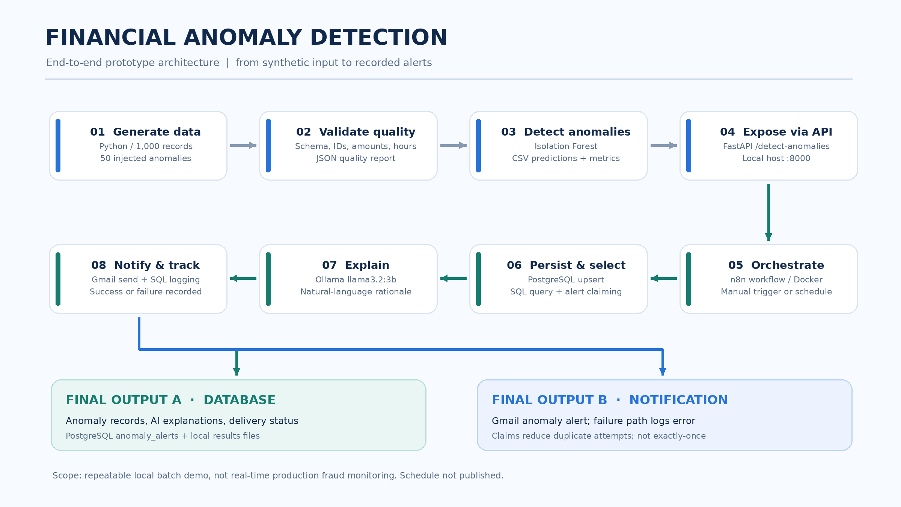
TECHNICAL WALKTHROUGH
End-to-end architecture — Step 1 to final outputs
LOCAL BATCH PROTOTYPE • SYNTHETIC DATA
03

Slide 4
TECHNICAL WALKTHROUGH
Steps 1–3 | Data and detection
01 Generate synthetic data
02 Run quality gates
03 Isolation Forest
1,000 transactions. 50 anomaly labels injected. Output: data/transactions.csv
Validate fields, missing IDs, duplicate IDs, amount and hour ranges. JSON report: 0 issues.
Amount + hour features. 100 trees, contamination=0.05. Outputs scored prediction CSV.
Validation result: 50 detections; precision, recall and F1 each 0.980 on synthetic labels.
LOCAL BATCH PROTOTYPE • SYNTHETIC DATA
04

Slide 5
TECHNICAL WALKTHROUGH
Steps 4–6 | API and orchestration
04 FastAPI endpoint
05 n8n trigger
06 PostgreSQL
POST /detect-anomalies runs the batch detection and makes results available to n8n.
Run manually to test; daily 9 AM Central schedule configured but not activated.
Upsert data, use SQL to select anomalies and claim alert rows before attempting email.
LOCAL BATCH PROTOTYPE • SYNTHETIC DATA
05

Slide 6
TECHNICAL WALKTHROUGH
Steps 7–8 | Explanations and alerts
07 Ollama explanation
08 Gmail and status logging
Local llama3.2:3b creates readable context for flagged transactions. It must not represent anomaly scores as fraud probabilities.
Send an alert; record successful delivery state or log a notification error. Claiming reduces duplicate sends but does not guarantee exactly-once delivery.
LOCAL BATCH PROTOTYPE • SYNTHETIC DATA
06

Slide 7
TECHNICAL WALKTHROUGH
Final outputs | Two things the pipeline produces
OUTPUT A | DATABASE AND RESULTS
OUTPUT B | NOTIFICATION OUTCOME
PostgreSQL anomaly_alerts entries with transaction ID, amount, anomaly score, explanation, email status and errors. Plus local CSV predictions and JSON quality report.
Gmail alert for an anomaly; successful send marks email_sent=true. Failure routing stores notification_error to support investigation.
LOCAL BATCH PROTOTYPE • SYNTHETIC DATA
07

Slide 8
TECHNICAL WALKTHROUGH
Validated results | What the metrics mean
Data-quality issues
Precision / recall
F1 on synthetic labels
0
0.980
0.980
Important: these figures come from injected labels on a synthetic batch; they do not measure real-world fraud accuracy or out-of-sample performance.
LOCAL BATCH PROTOTYPE • SYNTHETIC DATA
08

Slide 9
TECHNICAL WALKTHROUGH
How to reproduce the Python pipeline
git clone https://github.com/durgapbattula-sys/ai-financial-anomaly-detection-n8n.git
cd ai-financial-anomaly-detection-n8n
python3 -m venv .venv && source .venv/bin/activate
python -m pip install -r requirements.txt
python src/generate_data.py
python src/data_quality.py
python src/anomaly_detection.py
For full orchestration, also configure Docker, PostgreSQL, n8n, Ollama, FastAPI, and Gmail OAuth.
LOCAL BATCH PROTOTYPE • SYNTHETIC DATA
09

Slide 10
TECHNICAL WALKTHROUGH
System boundaries and next improvements
Static CSV batch, not live streaming transaction ingestion.
Retrains on each request; no untouched validation sample or drift monitoring.
AI explanations may hallucinate; anomaly scores are not probabilities.
Schedule remains unpublished to avoid duplicate historical alerts.
Next: automated tests, fresh ingestion, durable deduplication and monitoring.
LOCAL BATCH PROTOTYPE • SYNTHETIC DATA
10

Slide 11
NEXT STEPS
Project handoff and repository
Implementation, workflow export and reproducibility guide
github.com/durgapbattula-sys/ai-financial-anomaly-detection-n8n
Review the README and architecture illustration.
Run the synthetic Python demonstration locally.
Inspect the n8n JSON export; configure credentials only on your own machine.
LOCAL BATCH PROTOTYPE • SYNTHETIC DATA
11

