Slide 1
Global Superstore Performance: Proﬁts and Sales Insights

Slide 2
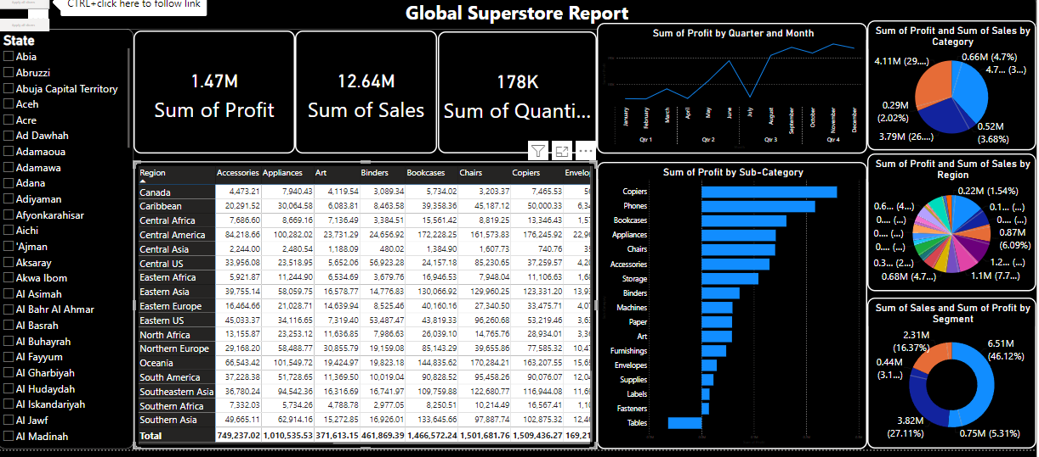
Introduction to Global Superstore
In this presentation, we will explore the performance of the Global Superstore by analyzing proﬁts and sales insights.
Understanding these metrics is crucial for improving business strategies and enhancing customer satisfaction. Join us as we delve into the key factors inﬂuencing success.

Slide 3
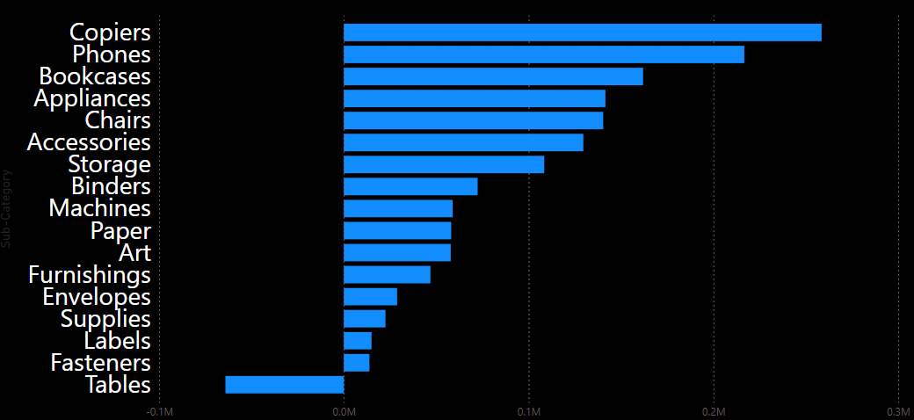



Sales Performance Overview
The sales performance of the Global Superstore has shown signiﬁcant trends over the past year. Key metrics such as revenue growth, customer acquisition, and market share will be analyzed. This overview will help us identify strengths and opportunities for improvement.

Slide 4
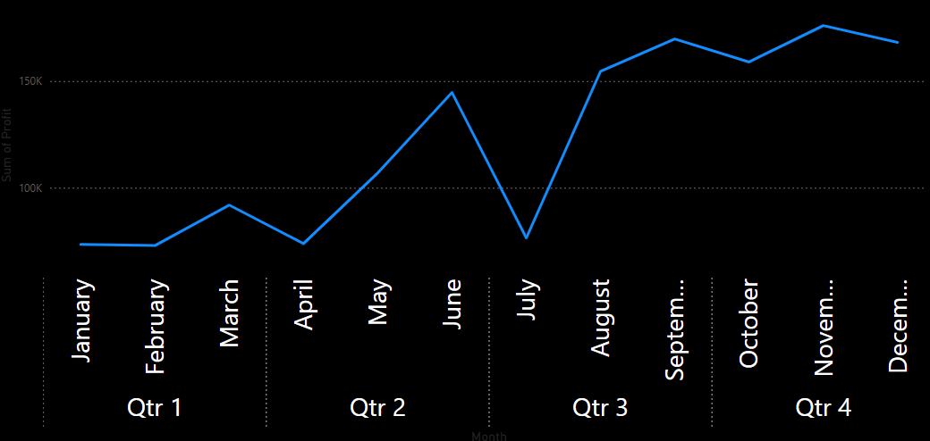
Analyzing proﬁts is essential to understanding the ﬁnancial health of the Global Superstore. We will look at proﬁt margins, operational costs, and net income.
Identifying areas for cost reduction and efﬁciency can lead to increased proﬁtability.

Slide 5
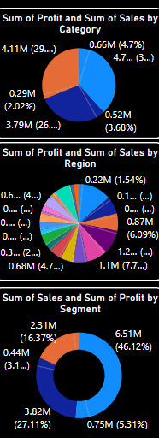





Customer Insights
Understanding customer behavior is vital for driving sales. We will explore customer demographics, purchase patterns, and feedback. By leveraging these insights, the Global Superstore can tailor its offerings to meet customer needs more effectively.

Slide 6



Challenges and Opportunities
The Global Superstore faces various challenges such as market competition and changing consumer preferences.
However, there are also numerous opportunities for growth through innovation and enhanced customer engagement. Identifying these factors is crucial for strategic planning.

Slide 7



Conclusion and Future Outlook
In conclusion, the performance of the Global Superstore hinges on effectively analyzing proﬁts and sales insights. By addressing challenges and capitalizing on opportunities, the store can enhance its market position and ensure sustainable growth in the future.

Slide 8
Thanks!

