Slide 1

Vel Tech Rangarajan Dr. Sagunthala R&D Institute of Science and Technology
School of Computing
Department of Computer Science and Engineering
10211DS224 / FULL STACK APPLICATION DEVELOPMENT (JAVA)
PROJECT REVIEW : MILESTONE PROJECT – FINAL REVIEW
Date: 06-05-2026
JOB PORTAL MANAGEMENT SYSTEM
SDG 8: Decent Work and Economic Growth
Presented By:
GL DURGA PRASAD – VTU27331 –23UECS0717
Courses Handling Faculty:
Dr. Sumithra M,- Assistant Professor

Slide 2
INTRODUCTION
The job search and hiring process remains fragmented, with employers relying on manual resume screening and candidates struggling to track status.
Existing systems lack seamless integration between posting, applying, and shortlisting workflows.
This project addresses inefficiencies by delivering a unified platform for resume uploads, job searches, and online applications.
Employers can post positions, view applicants, and manage the hiring pipeline effectively.
Built with Spring Boot the system provides role-based dashboards for automated tracking.
The platform enables real-time status updates for both job seekers and employers.
1
2
3
4
5
6
7
8
9

Slide 3

PROBLEM STATEMENT
1
Current portals lack automated shortlisting workflows, forcing manual review of every application.
Students face difficulties tracking application status and receiving notifications for shortlisted positions.
Manual resume collection leads to disorganized hiring pipelines and delays in selection.
The absence of integrated file upload and download functionality creates friction in the process.
These inefficiencies result in longer hiring cycles and missed opportunities.
2
3
4
5
6
7
8
9

Slide 4
OBJECTIVE(S)
To design and develop a web-based Job Portal enabling students to upload resumes, search/filter jobs, and apply online.
To implement employer-side functionality for posting jobs, downloading resumes, and managing candidate status
1
2
3
4
5
6
7
8
9

Slide 5
PROPOSED SYSTEM
Provides a unified platform with role-based access for students and employers.
Students can register, upload resumes (PDF/Word), and search jobs by category, location, or experience.
Employers can post detailed job requirements and view applicants with direct resume download links.
The system includes analytics dashboards showing total, shortlisted, and rejected counts per job.
Security is managed through Spring Security and BCrypt password hashing.
1
2
3
4
5
6
7
8
9

Slide 6
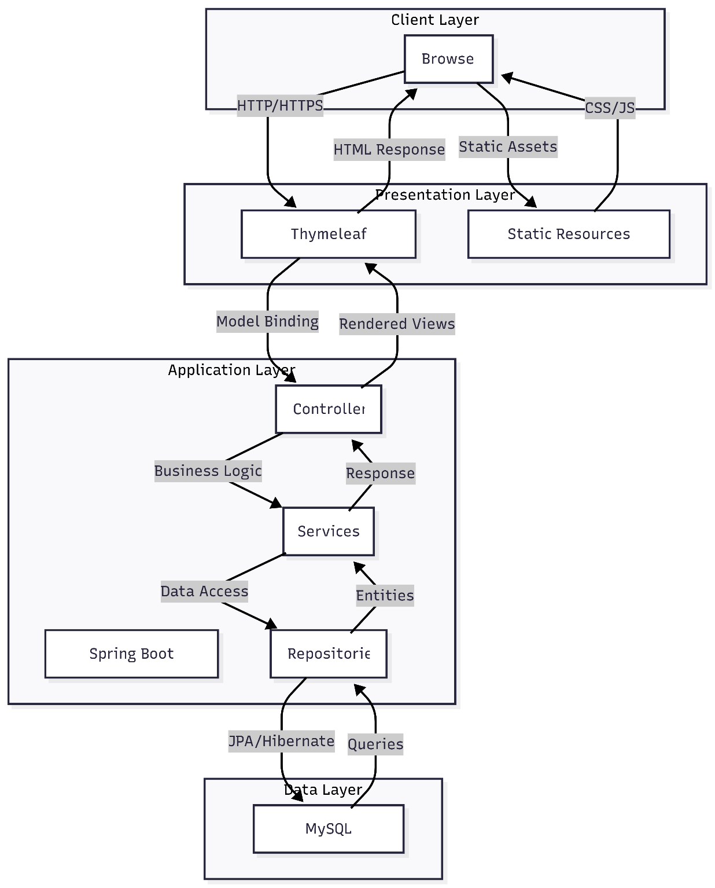
PROPOSED SYSTEM ARCHITECTURE
1
2
3
4
5
6
7
8
9

Slide 7
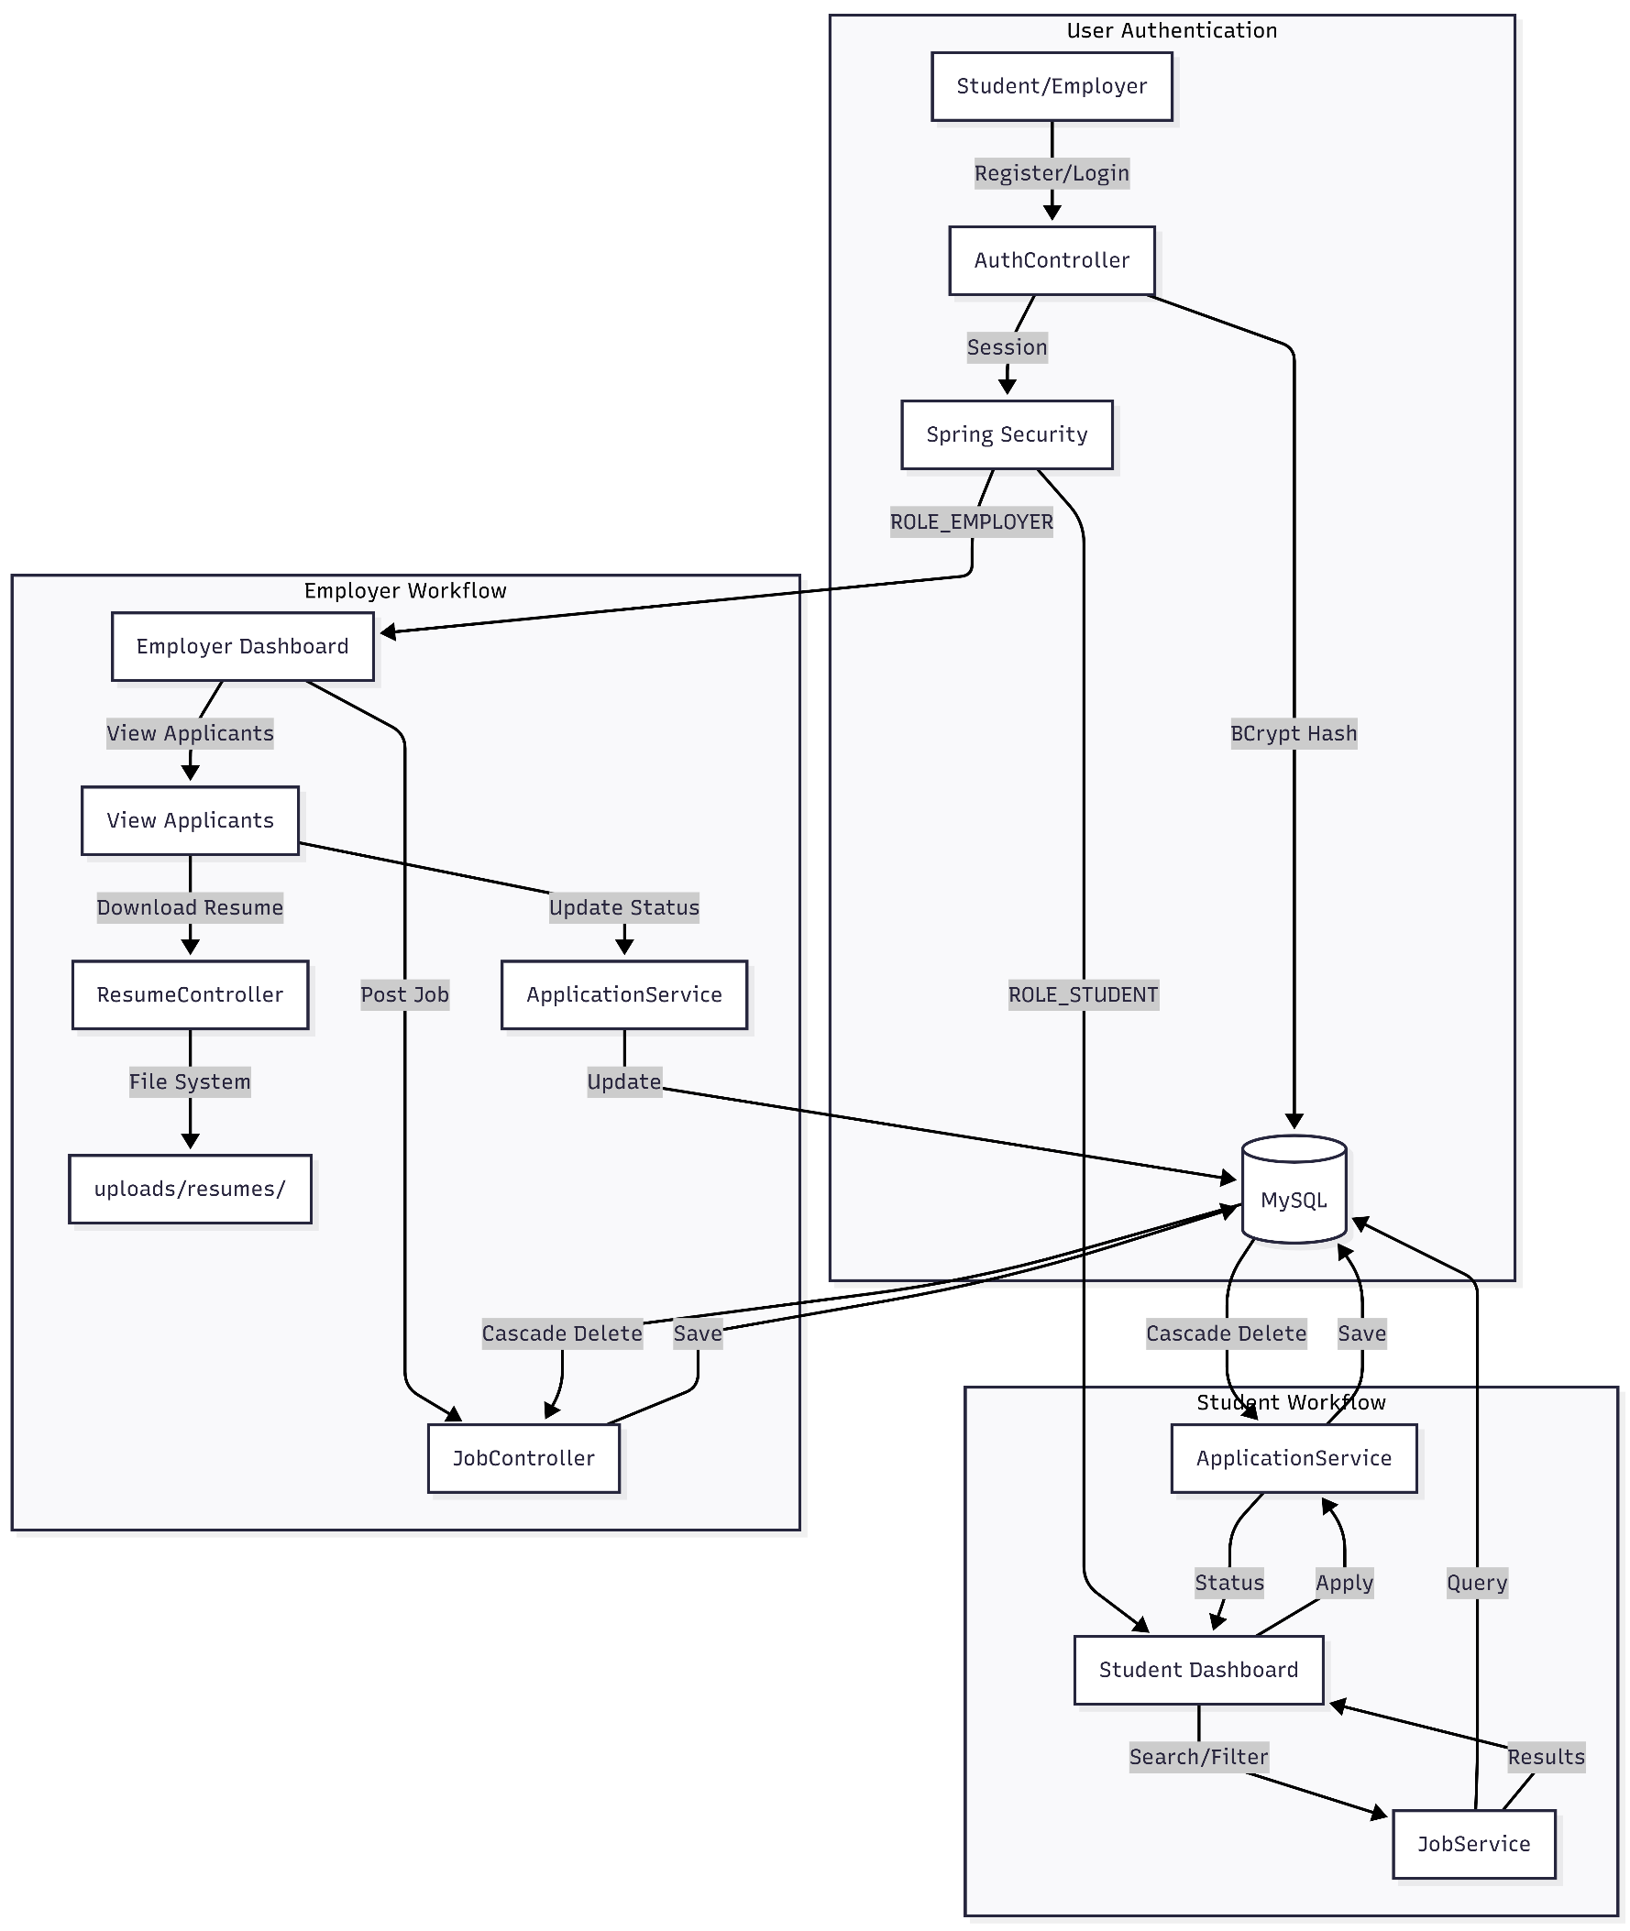
WORKFLOW
1
2
3
4
5
6
7
8
9

Slide 8
TECHNOLOGIES USED
Frontend: HTML5, CSS3, JavaScript (ES6), and Thymeleaf templates.
Backend: Spring Boot 3.2.4, Spring MVC, Spring Security, and Spring Data JPA.
Database: MongoDB
Tools: Maven, MySQL Workbench, and VS Code/IntelliJ IDEA.
Hardware/Software Requirements: 4GB RAM, 10GB disk space, Java 17, and a modern web browser.
1
2
3
4
5
6
7
8
9

Slide 9
MODULE DESCRIPTION
User Management: Handles registration, login, and role assignment (Student/Employer) via Spring Security.
Job Management: Enables employers to manage job postings and students to search using multiple filters.
Application Module: Facilitates the application process and tracks status (Pending, Shortlisted, Rejected).
Resume Management: Manages secure local storage for student uploads and employer downloads.
Analytics Module: Provides visual hiring statistics and application history on user dashboards
1
2
3
4
5
6
7
8
9

Slide 10
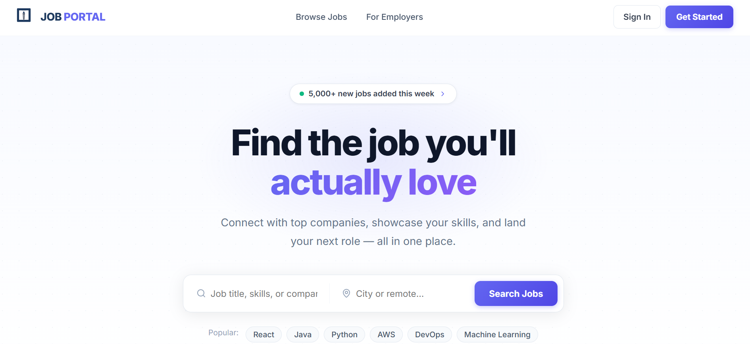
IMPLEMENTATION SCREENSHOTS
1
2
3
4
5
6
7
8
9
Home Page: Features the "Architectural Engine" design with a Blueprint Blue hero section and navigation bar.

Slide 11
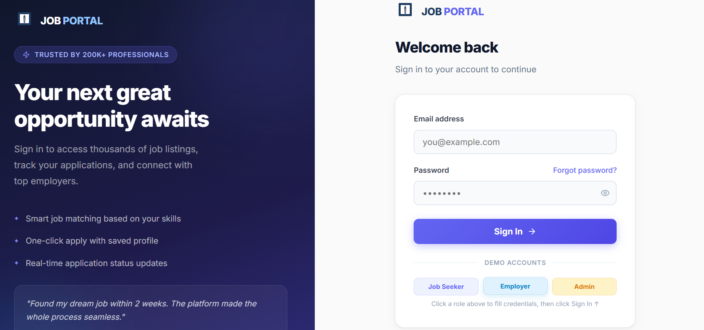
IMPLEMENTATION SCREENSHOTS
1
2
3
4
5
6
7
8(A)
Login Page: Displays the authentication form using JetBrains Mono typography and coordinate-labeled fields.
9

Slide 12
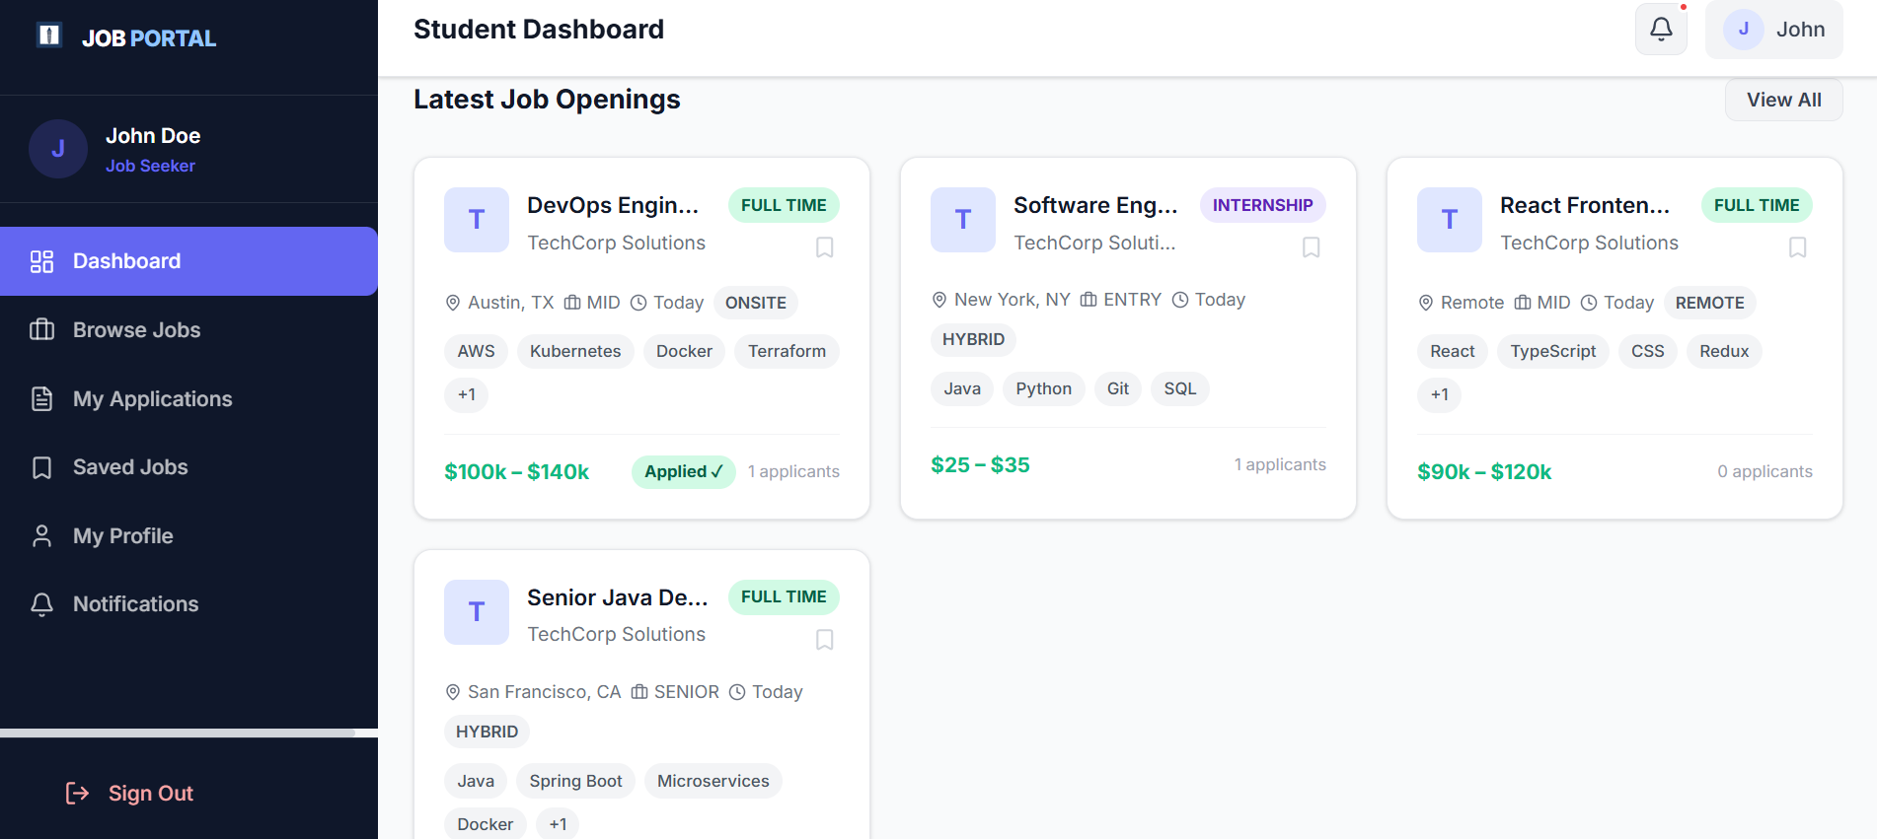
IMPLEMENTATION SCREENSHOTS
1
2
3
4
5
6
7
8(B)
9
Student Dashboard: Shows an analytics strip, resume upload zone, and filtered job history layout.

Slide 13
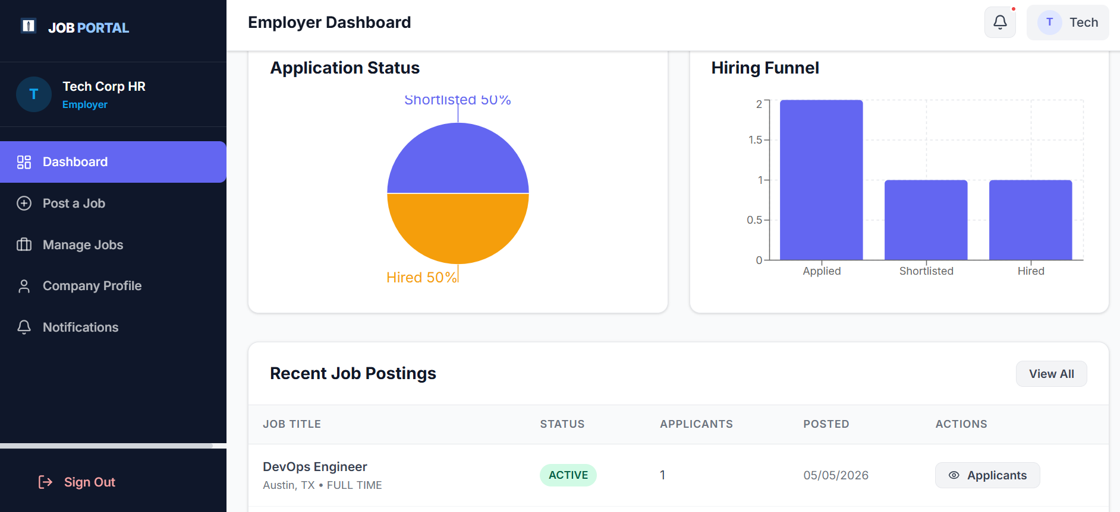
IMPLEMENTATION SCREENSHOTS
1
2
3
4
5
6
7
8(C)
9
Employer Dashboard: Includes the job posting form and a management list with per-job analytics and edit/delete tools.

Slide 14
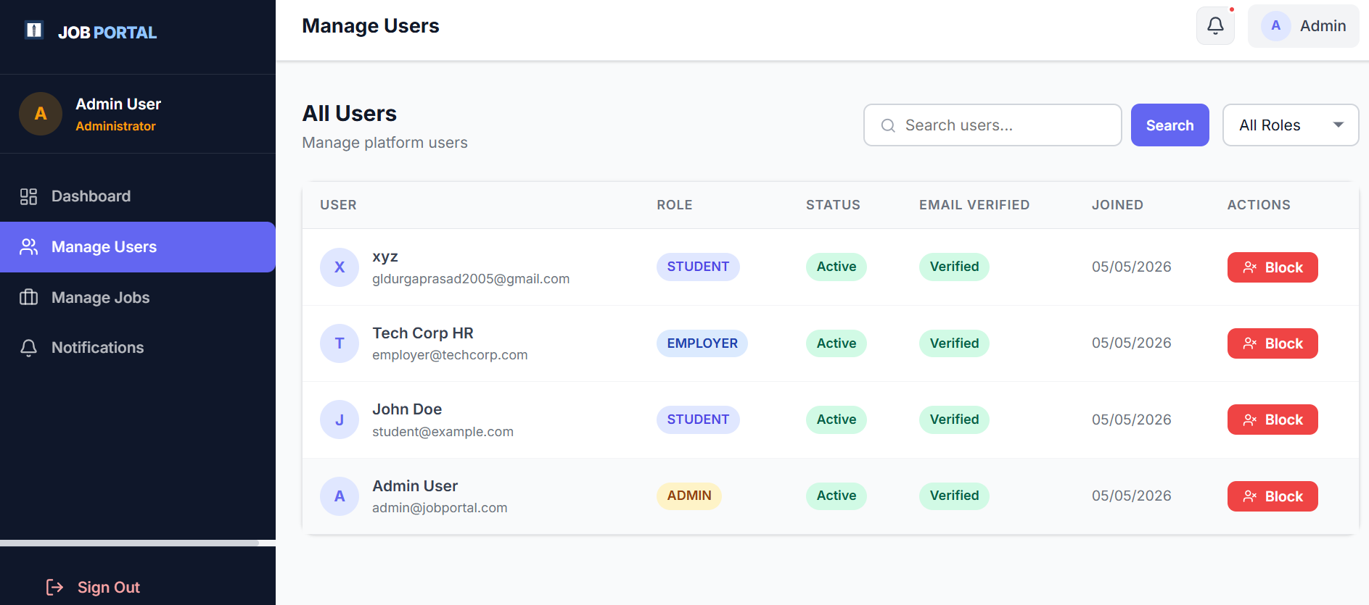
IMPLEMENTATION SCREENSHOTS
1
2
3
4
5
6
7
8(C)
9
Admin Page :The Admin Page in the Job Portal Management System provides a centralized dashboard for managing users, job postings, applications, and overall platform activities.

Slide 15
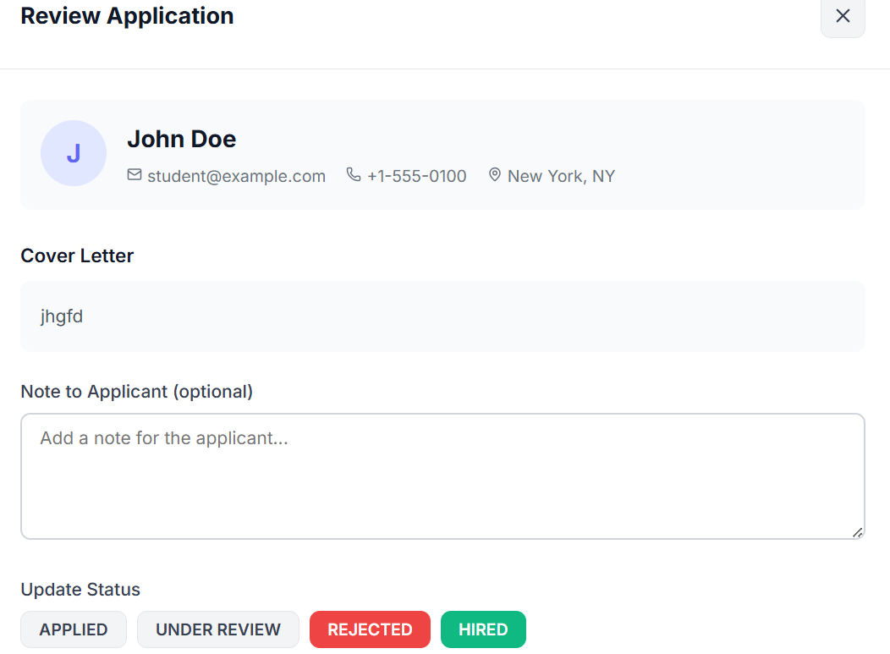
IMPLEMENTATION SCREENSHOTS
1
2
3
4
5
6
7
8(C)
9
Review Application Page:allows employers or administrators to examine candidate details, cover letters, and application status in a structured format. It also provides options to add notes and update the applicant’s status such as Applied, Under Review, Rejected, or Hired.

Slide 16
ADVANTAGES & LIMITATIONS
1
Advantages:
Role-based access control ensures data isolation between students and employers
Automated application tracking eliminates manual status updates
Resume upload/download functionality streamlines the hiring process
Real-time analytics provide hiring pipeline visibility
Clean "Architectural Engine" design system enhances usability
Limitations:
File uploads are stored locally rather than in a cloud storage service
No email notifications for shortlisted candidates
2
3
4
5
6
7
8
9

Slide 17
Thank you

