Slide 1

Join The Darkside
Selenium testing with Nightwatch.js
presented by seth mclaughlin on 10.21.14

Slide 2


Slide 3


Slide 4


Slide 5



Nightwatch.js
learn more: www.nightwatchjs.org

Slide 6
Project Overview
Features
Getting Started

Slide 7
"End to End" testing
Navigate to Login page
Locate username form field, type in seth
Locate password form field, type in html5dev
Locate submit form button and click it
Wait for form submission to complete
Verify that title of page is now equal to Welcome!

Slide 8
Test Script
Test Runner
HTTP
Selenium WebDriver
Web Browser
JAVA JAR

Slide 9
Test Script
Test Runner
HTTP
Selenium WebDriver
Web Browser
JAVA JAR

Slide 10

Node.js module
Test Script
HTTP
Selenium WebDriver
Test Runner
Web Browser
Node.js application
JAVA JAR

Slide 11


Selenium WebDriver
Web Browser
JAVA JAR
Selenium WebDriver
Web Browser
Test Script
JAVA JAR
Test Runner | HTTP | Selenium Grid
Selenium WebDriver
Web Browser
JAVA JAR
Selenium WebDriver
Web Browser
JAVA JAR

Slide 12
Features
★ Good documentation
★ Use CSS or XPATH selectors
★ Test runner can execute sequentially or in parallel
★ Test filtering by file name pattern, folders and tags
★ SauceLabs + BrowserStack support
★ Built in JUnit XML reporting
★ Extension model for custom commands

Slide 13


created by
Andrei Rusu
@beatfactor
learn more: www.linkedin.com/in/beatfactor

Slide 14
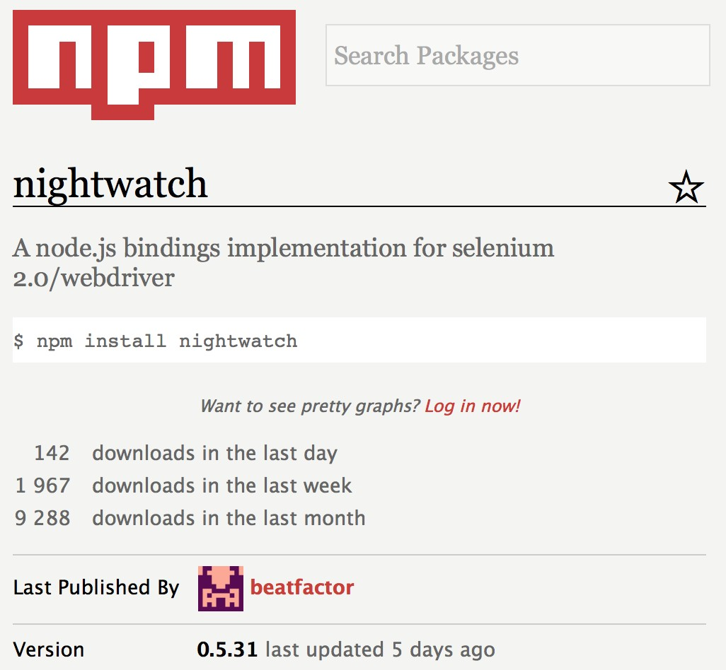
~9,000
downloads per month
~2,200
stars on github
~150
forks on github
~83%
code coverage
learn more: www.npmjs.org/package/nightwatch

Slide 15
27 contributors
1 primary contributor (Andrei)
1 pending pull requests (from 8/14/14)
46 open issues
164 closed issues
learn more: github.com/beatfactor/nightwatch

Slide 16
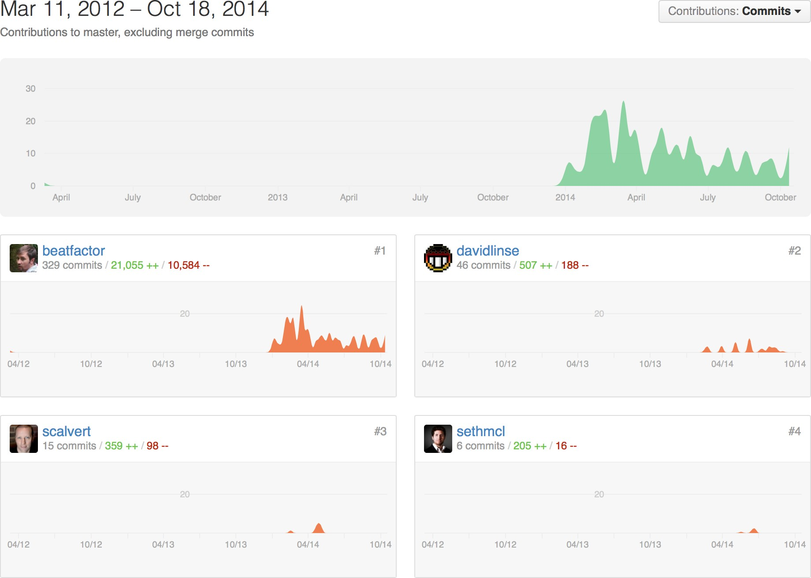

Slide 17
Sample test: Login flow
Navigate to Login page
Locate username form field, type in seth
Locate password form field, type in html5dev
Locate submit form button and click it
Wait for form submission to complete
Verify that title of page is now equal to Welcome!

Slide 18
├── Nightwatch.js
└── tests
└── login.js

Slide 19
├── Nightwatch.js
└── tests
└── login.js

Slide 20
login.js
module.exports = {
'Fill out form and login': function (client) { client
.url('http://localhost:8000')
.assert.title('Awesome App')
.setValue('input[name=username]', 'seth')
.setValue('input[name=password]', 'html5dev')
.click('input[type=submit]')
.assert.title('Welcome!')
.end();
}
};

Slide 21
login.js
module.exports = {
'Fill out form and login': function (client) { client
.url('http://localhost:8000')
.assert.title('Awesome App')
.setValue('input[name=username]', 'seth')
.setValue('input[name=password]', 'html5dev')
.click('input[type=submit]')
.assert.title('Welcome!')
.end();
}
};

Slide 22
login.js
module.exports = {
'Fill out form and login': function (client) { client
.url('http://localhost:8000')
.assert.title('Awesome App')
.setValue('input[name=username]', 'seth')
.setValue('input[name=password]', 'html5dev')
.click('input[type=submit]')
.assert.title('Welcome!')
.end();
}
};

Slide 23
login.js
module.exports = {
'Fill out form and login': function (client) { client
.url('http://localhost:8000')
.assert.title('Awesome App')
.setValue('input[name=username]', 'seth')
.setValue('input[name=password]', 'html5dev')
.click('input[type=submit]')
.assert.title('Welcome!')
.end();
}
};

Slide 24
login.js
module.exports = {
'Fill out form and login': function (client) { client
.url('http://localhost:8000')
.assert.title('Awesome App')
.setValue('input[name=username]', 'seth')
.setValue('input[name=password]', 'html5dev')
.click('input[type=submit]')
.assert.title('Welcome!')
.end();
}
};

Slide 25
login.js
module.exports = {
'Fill out form and login': function (client) { client
.url('http://localhost:8000')
.assert.title('Awesome App')
.setValue('input[name=username]', 'seth')
.setValue('input[name=password]', 'html5dev')
.click('input[type=submit]')
.assert.title('Welcome!')
.end();
}
};

Slide 26
login.js
module.exports = {
'Fill out form and login': function (client) { client
.url('http://localhost:8000')
.assert.title('Awesome App')
.setValue('input[name=username]', 'seth')
.setValue('input[name=password]', 'html5dev')
.click('input[type=submit]')
.assert.title('Welcome!')
.end();
}
};

Slide 27
login.js
module.exports = {
'Fill out form and login': function (client) { client
.url('http://localhost:8000')
.assert.title('Awesome App')
.setValue('input[name=username]', 'seth')
.setValue('input[name=password]', 'html5dev')
.click('input[type=submit]')
.assert.title('Welcome!')
.end();
}
};

Slide 28
login.js
module.exports = {
'Fill out form and login': function (client) { client.url('http://localhost:8000'); client.assert.title('Awesome App'); client.setValue('input[name=username]', 'seth'); client.setValue('input[name=password]', 'html5dev'); client.click('input[type=submit]'); client.assert.title('Welcome!');
client.end();
}
};

Slide 29
login.js
module.exports = {
'Fill out form and login': function (client) { client.url('http://localhost:8000'); client.assert.title('Awesome App'); client.setValue('input[name=username]', 'seth'); client.setValue('input[name=password]', 'html5dev'); client.click('input[type=submit]'); client.assert.title('Welcome!');
console.log('all done!'); // wrong! client.end();
}
};

Slide 30
login.js
module.exports = {
'Fill out form and login': function (client) { client.url('http://localhost:8000'); client.assert.title('Awesome App'); client.setValue('input[name=username]', 'seth'); client.setValue('input[name=password]', 'html5dev'); client.click('input[type=submit]'); client.assert.title('Welcome!'); client.perform(function (client, done) {
console.log('all done!'); // right!
});
client.end();
}
};

Slide 31
login.js
module.exports = {
'Fill out form and login': function (client) { client.url('http://localhost:8000'); client.assert.title('Awesome App'); client.setValue('input[name=username]', 'seth'); client.setValue('input[name=password]', 'html5dev'); client.click('input[type=submit]'); client.assert.title('Welcome!'); client.perform(function (client, done) {
foo.doSomethingAsync().then(done);
});
client.end();
}
};

Slide 32
├── Nightwatch.js
└── tests
└── login.js

Slide 33
Nightwatch.js
module.exports = { src_folders: ['./tests'], output_folder: './results',
selenium: { start_process: true,
server_path: './selenium-server-standalone-2.38.0.jar', log_path: './results',
host: '127.0.0.1',
port: 4444
},
test_settings: { default: {
selenium_host: '127.0.0.1',
selenium_port: 4444, screenshots: {
enabled: true,

Slide 34
Nightwatch.js
module.exports = {
src_folders: ['./tests'], output_folder: './results',
selenium: { start_process: true,
server_path: './selenium-server-standalone-2.38.0.jar', log_path: './results',
host: '127.0.0.1',
port: 4444
},
test_settings: { default: {
selenium_host: '127.0.0.1',
selenium_port: 4444, screenshots: {
enabled: true,

Slide 35
Nightwatch.js
module.exports = { src_folders: ['./tests'],
output_folder: './results',
selenium: { start_process: true,
server_path: './selenium-server-standalone-2.38.0.jar', log_path: './results',
host: '127.0.0.1',
port: 4444
},
test_settings: { default: {
selenium_host: '127.0.0.1',
selenium_port: 4444, screenshots: {
enabled: true,

Slide 36
Nightwatch.js
module.exports = { src_folders: ['./tests'], output_folder: './results',
selenium: { start_process: true,
server_path: './selenium-server-standalone-2.38.0.jar', log_path: './results',
host: '127.0.0.1',
port: 4444
},
test_settings: { default: {
selenium_host: '127.0.0.1',
selenium_port: 4444, screenshots: {
enabled: true,

Slide 37
Nightwatch.js
module.exports = { src_folders: ['./tests'], output_folder: './results',
selenium: { start_process: true,
server_path: './selenium-server-standalone-2.38.0.jar', log_path: './results',
host: '127.0.0.1',
port: 4444
},
test_settings: { default: {
selenium_host: '127.0.0.1',
selenium_port: 4444, screenshots: {
enabled: true,

Slide 38
port: 4444
},
Nightwatch.js
test_settings: { default: {
selenium_host: '127.0.0.1',
selenium_port: 4444, screenshots: {
enabled: true,
path: './results/screenshots'
},
desiredCapabilities: { browserName: 'firefox', javascriptEnabled: true, acceptSslCerts: true
}
}
}
};

Slide 39
port: 4444
},
Nightwatch.js
test_settings: { default: {
selenium_host: '127.0.0.1',
selenium_port: 4444, screenshots: {
enabled: true,
path: './results/screenshots'
},
desiredCapabilities: { browserName: 'firefox', javascriptEnabled: true, acceptSslCerts: true
}
}
}
};

Slide 40
port: 4444
},
Nightwatch.js
test_settings: { default: {
selenium_host: '127.0.0.1',
selenium_port: 4444, screenshots: {
enabled: true,
path: './results/screenshots'
},
desiredCapabilities: { browserName: 'firefox', javascriptEnabled: true, acceptSslCerts: true
}
}
}
};

Slide 41
port: 4444
},
Nightwatch.js
test_settings: { default: {
selenium_host: '127.0.0.1',
selenium_port: 4444, screenshots: {
enabled: true,
path: './results/screenshots'
},
desiredCapabilities: {
browserName: 'firefox',
javascriptEnabled: true, acceptSslCerts: true
}
}
}
};

Slide 42
> nightwatch -c ./Nightwatch.js --env default

Slide 43
[Login] Test Suite
==================
Running: Fill out form and login
✔ | Testing | if | the | page | title | equals | "Awesome App".
✔ | Testing | if | the | page | title | equals | "Welcome!".
OK. 2 total assertions passed. (2.233s)

Slide 44
login.js
module.exports = {
'Fill out form and login': function (client) { client
.url('http://localhost:8000')
.assert.title('Awesome App')
.setValue('input[name=username]', 'seth')
.setValue('input[name=password]', 'html5dev')
.click('input[type=submit]')
.assert.title('Welcome!')
.end();
}
};

Slide 45
login.js
module.exports = {
'Fill out form and login': function (client) { client
.url('http://localhost:8000')
.assert.title('Awesome App')
.setValue('input[name=username]', 'seth')
.setValue('input[name=password]', 'html5dev')
.click('input[type=submit]')
.assert.title('Welcome!')
.end();
}
};

Slide 46
login.js
module.exports = {
'Fill out form and login': function (client) { client
.url('http://localhost:8000')
.assert.title('Awesome App')
.setValue('input[name=username]', 'seth')
.setValue('input[name=password]', 'html5dev')
.click('input[type=submit]')
.assert.title('Welcome!')
.end();
}
};

Slide 47
login.js
module.exports = {
'Fill out form and login': function (client) { client
.url('http://localhost:8000')
.assert.title('Awesome App')
.setValue('input[name=username]', 'seth')
.setValue('input[name=password]', 'html5dev')
.click('input[type=submit]')
.assert.title('Welcome!')
.end();
}
};

Slide 48

Y U HARDCODE VALUES ???

Slide 49
Data Driven Tests

Slide 50
├── Nightwatch.js
├── data
│ ├── dev.js
│ └── staging.js
└── tests
└── login.js

Slide 51
data/dev.js
module.exports = { username: 'seth', password: 'html5dev', urls: {
login: 'http://localhost:8000'
}
};

Slide 52
Nightwatch.js
test_settings: { default: {
selenium_host: '127.0.0.1',
selenium_port: 4444, screenshots: {
enabled: true,
path: './results/screenshots'
},
desiredCapabilities: { browserName: 'firefox', javascriptEnabled: true, acceptSslCerts: true
},
globals: require('./data/dev')
}
}

Slide 53
login.js
module.exports = {
'Fill out form and login': function (client) {
var data = client.globals;
client
.url(data.urls.login)
.assert.title('Awesome App')
.setValue('input[name=username]', data.username)
.setValue('input[name=password]', data.password)
.click('input[type=submit]')
.assert.title('Welcome!')
.end();
}
};

Slide 54
login.js
module.exports = {
'Fill out form and login': function (client) {
var data = client.globals;
client
.url(data.urls.login)
.assert.title('Awesome App')
.setValue('input[name=username]', data.username)
.setValue('input[name=password]', data.password)
.click('input[type=submit]')
.assert.title('Welcome!')
.end();
}
};

Slide 55
login.js
module.exports = {
'Fill out form and login': function (client) {
var data = client.globals;
client
.url(data.urls.login)
.assert.title('Awesome App')
.setValue('input[name=username]', data.username)
.setValue('input[name=password]', data.password)
.click('input[type=submit]')
.assert.title('Welcome!')
.end();
}
};

Slide 56
login.js
module.exports = {
'Fill out form and login': function (client) {
var data = client.globals;
client
.url(data.urls.login)
.assert.title('Awesome App')
.setValue('input[name=username]', data.username)
.setValue('input[name=password]', data.password)
.click('input[type=submit]')
.assert.title('Welcome!')
.end();
}
};

Slide 57
login.js
module.exports = {
'Fill out form': function (client) {
var data = client.globals; client
.url(data.urls.login)
.assert.title('Awesome App')
.setValue('input[name=username]', data.username)
.setValue('input[name=password]', data.password);
},
'Submit form': function (client) { var data = client.globals; client
.click('input[type=submit]')
.assert.title('Welcome!')
.end();
},
};

Slide 58
login.js
module.exports = {
'Fill out form': function (client) {
var data = client.globals; client
.url(data.urls.login)
.assert.title('Awesome App')
.setValue('input[name=username]', data.username)
.setValue('input[name=password]', data.password);
},
'Submit form': function (client) { console.log('previous step is done executing'); var data = client.globals;
client
.click('input[type=submit]')
.assert.title('Welcome!')
.end();
},
};

Slide 59
[Login] Test Suite
===================
Running: Fill out form
✔ Testing if the page title equals "Awesome App". OK. 1 assertions passed. (1.567s)
Running: Submit form
✔ Testing if the page title equals "Welcome!". OK. 1 assertions passed. (204ms)

Slide 60
Terminology
Login
Test suite
Fill out form
Test
Submit form
Test

Slide 61
Assert vs. Verify
assert.title('Awesome App')
If false, log failure and stop running current test suite
If false, log failure and continue running current test suite
verify.title('Awesome App')

Slide 62
Debugging tips
pause()
Pause test execution, leaving browser window open.
client
.url('http://localhost:8000')
.assert.title('Awesome App')
.setValue('input[name=username]', 'seth')
.setValue('input[name=password]', 'html5dev')
.pause()
.click('input[type=submit]')

Slide 63
Debugging tips
debugger; Insert breakpoint (in node.js code)
> node debug `which nightwatch`
-c ./Nightwatch.js --env default
Commands: run (r), cont (c), next (n), step (s), out (o), backtrace (bt), setBreakpoint (sb), clearBreakpoint (cb), watch, unwatch, watchers, repl, restart, kill, list, scripts, breakOnException, breakpoints, version
learn more: nodejs.org/api/debugger.html

Slide 64
Commands
clearValue click deleteCookie deleteCookies end getAttribute getCookie getCookies getCssProperty
getElementSize getLocation
getLocationInView getTagName getText
getTitle getValue init injectScript isVisible
maximizeWindow moveToElement pause
resizeWindow saveScreenshot setCookie setValue submitForm switchWindow urlHash
waitForElementNotPresent waitForElementNotVisible waitForElementPresent waitForElementVisible
learn more: nightwatchjs.org/api

Slide 65
Assertions
attributeEquals containsText cssClassPresent cssClassNotPresent cssProperty elementPresent elementNotPresent
hidden title
urlContains value valueContains visible
learn more: nightwatchjs.org/api

Slide 66
Using custom commands and assertions
module.exports = {
'Load Netflix.com': function (client) { client
.url('http://www.netflix.com')
.tagCount('a', function (result) { console.log(
'NOTE: there are %s anchor elements on the page\n', result.value
);
})
.assert.tagCountGreaterThan('a', 100)
.end();
}
};
learn more: nightwatchjs.org/guide#custom-commands

Slide 67
Using custom commands and assertions
module.exports = {
'Load Netflix.com': function (client) { client
.url('http://www.netflix.com')
.tagCount('a', function (result) { console.log(
'NOTE: there are %s anchor elements on the page\n', result.value
);
})
.assert.tagCountGreaterThan('a', 100)
.end();
}
};
learn more: nightwatchjs.org/guide#custom-commands

Slide 68
Using custom commands and assertions
module.exports = {
'Load Netflix.com': function (client) { client
.url('http://www.netflix.com')
.tagCount('a', function (result) { console.log(
'NOTE: there are %s anchor elements on the page\n', result.value
);
})
.assert.tagCountGreaterThan('a', 100)
.end();
}
};
learn more: nightwatchjs.org/guide#custom-commands

Slide 69
Extending Nightwatch: custom commands
// command to return the number of elements in a page
// which are of a certain tag name exports.command = function (tagName, callback) {
callback = callback || function () {};
this.execute(function (tagName) {
return document.getElementsByTagName(tagName).length;
}, [tagName], function (result) { callback.call(this, result);
});
return this; // allows the command to be chained.
};
learn more: nightwatchjs.org/guide#custom-commands

Slide 70
Extending Nightwatch: custom assertions
var util = require('util');
exports.assertion = function(tagName, minCount, msg) {
var defaultMessage = 'Testing if there are more than %s <%s> elements on the page';
var errorMessage = 'Error executing command';
// Set default message
this.message = msg || util.format(defaultMessage, minCount, tagName);
// The expected text
this.expected = function () {
return 'to find at least ' + (minCount+1) + ' ' + tagName + ' elements on page';
};
// returning true means assertion passed
// returning false means assertion failed
this.pass = function(value) {
return (value > minCount);
};
// returning true means element could not be found
this.failure = function (result) {
var failed = (result === false || (result && result.status === -1));
if (failed) {
this.message = msg || errorMessage;
}
return failed;
};
learn more: nightwatchjs.org/guide#custom-assertions
// passed result of calling this.command()
this.value = function (result) {

Slide 71
Nightwatch.js
module.exports = { src_folders: ['./tests'], output_folder: './results',
custom_commands_path: './commands', custom_assertions_path: './assertions',
selenium: { start_process: true,
server_path: './selenium-server-standalone-2.38.0.jar', log_path: './results',
host: '127.0.0.1',
port: 4444
},
test_settings: { default: {
selenium_host: '127.0.0.1',
selenium_port: 4444,

Slide 72
more to explore
before and after test hooks! create custom commands!
take screenshots! create custom assertions! use sauce labs to run tests! contribute to nightwatch! use tags to organize test suites! ...and more
learn more: www.nightwatchjs.org

Slide 73
Get started
prerequisite: node.js
Use npm to install nightwatch
Download selenium-server-standalone.jar
Create Nightwatch config file
Create some tests

Slide 74
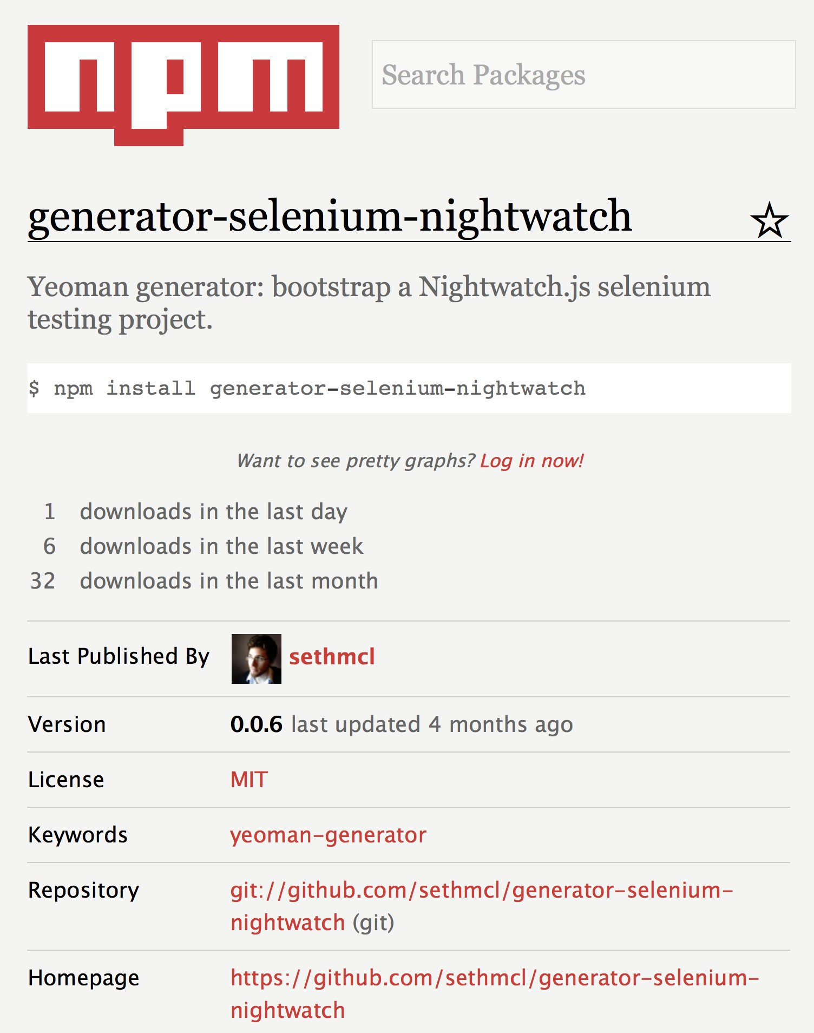

Slide 75
Closing thoughts
Nightwatch.js is best selenium testing framework available to JavaScript developers
Good community, actively supported Easy to get started, check it out

Slide 76
Resources
documentation
http://nightwatchjs.org/guide & http://nightwatchjs.org/api
sample code
https://github.com/sethmcl/join-the-dark-side
nightwatch generator (quick start)
https://github.com/sethmcl/generator-selenium-nightwatch
nightwatch page object model
https://github.com/beatfactor/nightwatch/issues/242

