Slide 1




Frameworks for Browser Automation Testing
Luís A. Bastião Silva
University of Aveiro DETI / IEETA
bastiao@ua.pt

Slide 2


Outline
Motivation
Comparison between frameworks
Nightwatch.js
  How it works?
  How to write tests?
  How to run the tests?
How to use in your project?
Demo

Slide 3


What is Browse Automating Tests?
You can use it also to automate your daily tasks, if you are able to do it..
Launch and automate your browser
Fill and submit forms
Click and follow links
Verify if the output is according of what
you define.

Slide 4





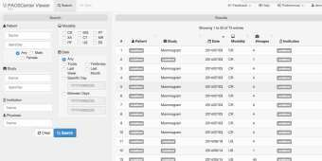
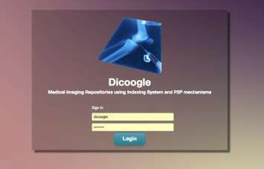
Motivation
.. or in other words, why should I use Browse Automated Testing?
Often web developers changes in the interface,
change the code, we fix bugs and add new
_{features.} Software developers are humans and they made
mistakes. Developers can type:
Sometimes it conduct to wrong results
•
•
͞id="buttob_searc͟ where should be
Browser͞idC=͞obumttopn_asetaibrchil͟it–yan-d ibt brreeaakskthfeufunnccttioionanlitay. lity
^{Test with het}B^{e}ro^{r}wºse^{g}a^{e}ut^{n}om^{e}aºte^{u}d^{s}tes^{d}tsªca^{t}nªd^{s}e^{e}te^{t}c^{s}t it!
4

Slide 5


Comparison between different frameworks
Name | Nightwatch.js | Selenium | Browsera | dalekjs | htmlunit | watin | sahipro | venusjs
OSS | Yes | Yes | Paid | Yes | Yes | Yes | Paid | Yes
Activity | High | High | Support | Medium | Low | Low | Support | Medium
WebDriver | Yes | Yes | Yes | Yes | No | No, IE only | Yes | Yes
Jenkins* | Medium | Medium | Automated tests, reports | Medium | Unknown | Unknown | Automated tests, reports | Medium
Output | Very good, JUnit | Very good, JUnit | Very good, UI Navigation | Good | Good | Unknown | Very good, UI Navigation | Unknown
Difficulty to write | Easy | Medium (syntax is not good) | Easy | Easy | Verbose | Easy | Easy--- | Easy
Deployment | Medium | Medium | Easy | Medium | Medium | Easy | Easy | Medium
Observations | Selenium | - | - | Docs not good | - | - | - | Developed by LinkedIn
Feel free to contribute to this comparison: http://goo.gl/Vq3WeO

Slide 6



Why nightwatch.js?
Easy to write tests
Github activity
Free
Good documentation
Supports IE ( we know that no one cares, but
in the end everybody cares. )
It is working now. ☺
More info:
  ~10k downloads/month
  ~150 forks (github)
  ~2300 stars (github)

Slide 7


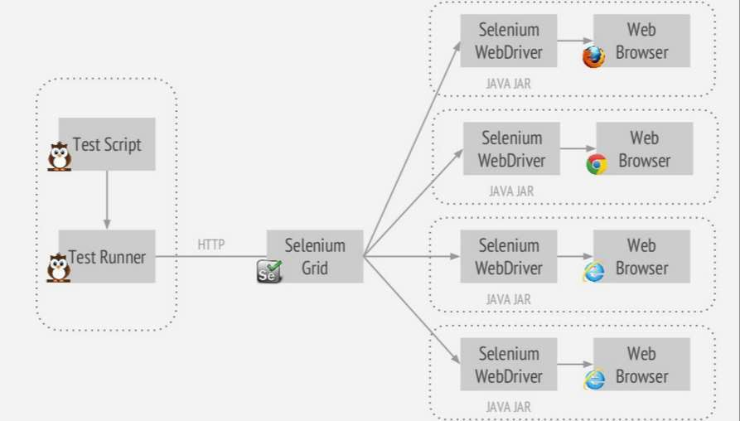
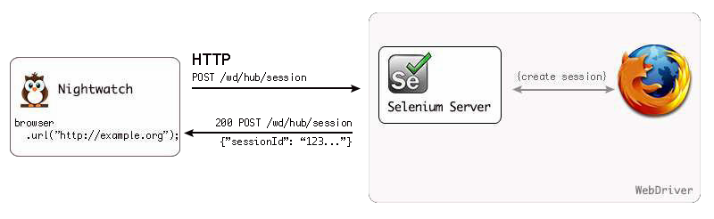
Nightwatch.js architecture
What are behind it?
From: http://nightwatchjs.org/guide#theory-of-operation and http://www.slideshare.net/sethmcl/join-the-darkside- nightwatchjs

Slide 8


Directory structure
How to start? What files should I have? How the test groups works?
Install:
  $ npm install nightwatch
  Run Selenium server
nightwatch.js
  #!/usr/bin/env node
  require('nightwatch/bin/runner.js');
nightwatch.json
Tests/
  Login.js
  Accounts/0001_landing_page.js
  Accounts/0002_register.js
  dashboard/0001_widgets.js
  Your own structure, you define it!

Slide 9
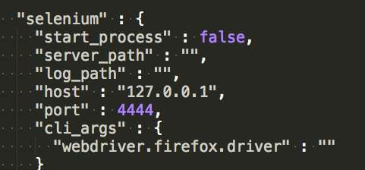
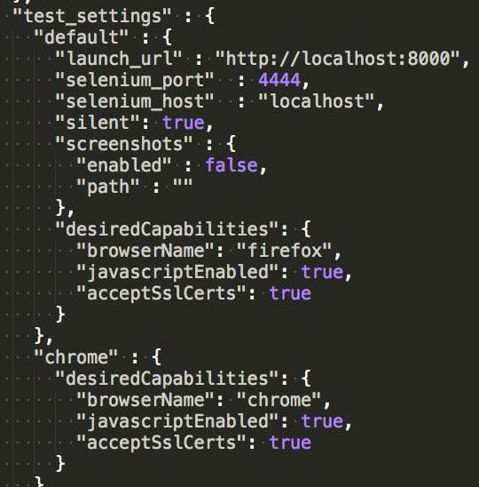
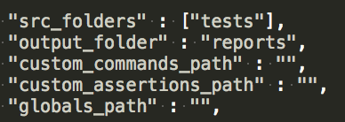
Setup nightwatch.json

Slide 10

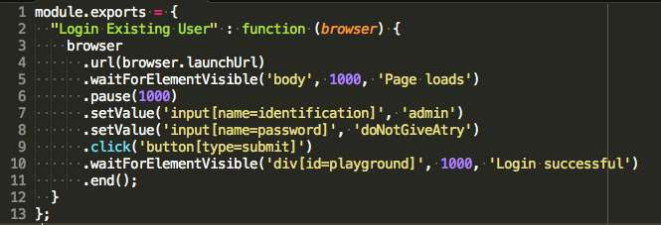


Test sample workflow
1. Open Browser URL 2
3
4
5
. Locate the username field and fill it with
“admin”
. Find the password field and fill it with
“doNotGiveATry”
. Find the Login button and submit
. Verify the output to check if it successes.
You need to know Javascript and how to use CSS or Xpath Selectors.
You can learn about it here: http://www.w3.org/TR/CSS21/selector.html or http://www.w3schools.com/css/css_attribute_selectors.asp

Slide 11




Assertation or Verification
assert.title(‘automated tests rocks’)
– If false, log failure and stop to run the test suite.
verification.title(‘automated tests rocks’)
– If false, log failure and continue running the test suite.

Slide 12



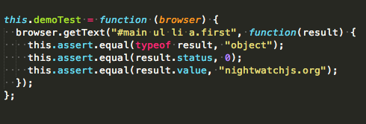
What kind of assertations exists?
.assert.title(‘Catalogue’)
.assert.urlContains('done')
.assert.elementPresent('#results_size', ’0
results')
css properties, … and more available!

Slide 13

How to run?
$ node nightwatch.js –-env=chrome
Windows you can test with ie:
  $ node nightwatch.js –-env=chrome,ie, firefox
You can skip test groups:
  $ node nightwatch –-env=chrome –-skip- group=accounts,dashboard
You can run the only ones that has a
specific tag:
  $ node nightwatch –-env=chrome –-tag=login

Slide 14

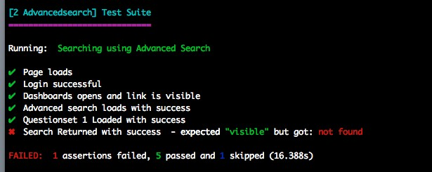
What the output it retrieves?
Console output

Slide 15
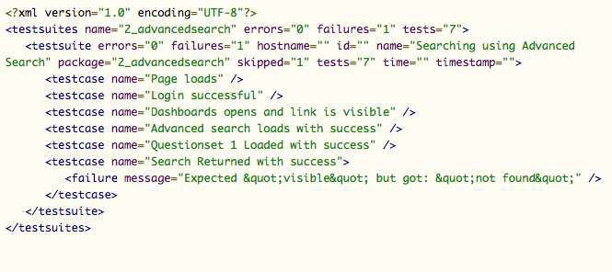
What the output it retrieves?
Junit format

Slide 16











Can I use it in my own project?
Write tests? Nooooooooooooooo!
Is your project web? If yes:
  Yes, you should.
  We have a Windows machine up and running You can integrate Jenkins of the Bio group.
  In some cases you may need to change the
webapp to become the life easier.
  You will avoid headaches in the future ☺
If you do NOT use Browse Automating Testing:
Development
stage
Productio
User Fee^{n}dback

Slide 17












Can I use it in my own project?
Write tests? Easy life! But yes, you still spend time, but you win upfront.
Is your project web? If yes:
  Yes, you should.
  We have a Windows machine up and running You can integrate Jenkins of the Bio group.
  In some cases you may need to change the
webapp to become the life easier.
  You will avoid headaches in the future ☺
If you do USE Browse Automating Testing:
Development
Productio
Write Tests
Use^{n}r Feedback

Slide 18

Credits & References
Ricardo Ribeiro
  He did the first steps in the nightwatch.js
  Deployed the full solution in Windows environment
  Write tests for EMIF Catalogue
http://nightwatchjs.org/
http://www.slideshare.net/sethmcl/join-
the-darkside-nightwatchjs
It will be available in my slideshare:
  http://www.slideshare.net/bastiao

Slide 19
See it running…
EMIF Catalogue, let’s check the tests

Slide 20
Thanks for your attention!
Luís A. Bastião Silva
University of Aveiro DETI / IEETA
bastiao@ua.pt

