Slide 1
PROPOSED SYSTEM
Our Hybrid Deep Learning Approach:
BERT Model – Detects misinformation in text-based content.
CNN + YOLO – Detects criminal activities in images.
Multi-Modal Fusion – Combines text + image processing for better accuracy.
Advantages:
Privacy-Preserving: No raw data storage.
Scalable & Fast: Handles large social media data streams.
Accurate & Adaptive: Detects evolving misinformation and crimes.

Slide 2
BERT (Bidirectional Encoder Representations from Transformers) is a pre-trained language model developed by Google. It's a type of neural network designed to process natural language inputs and generate contextualized representations of words and phrases. BERT is trained on a massive corpus of text data, including the entire Wikipedia and BookCorpus datasets. BERT uses a multi-layer bidirectional transformer encoder to process input text. Here's a simplified overview of the BERT architecture: 1. Input Embeddings: The input text is first tokenized into individual words or subwords. Each token is then embedded into a vector space using a learned embedding layer. 2. Encoder Layers: Encoder layer consists of two sub-layers: a self-attention mechanism and a feed-forward neural network (FFNN). 3. Self-Attention Mechanism: The self-attention mechanism allows the model to attend to different parts of the input sequence simultaneously and weigh their importance. 4. Feed-Forward Neural Network (FFNN): The FFNN is used to transform the output of the self-attention mechanism into a higher-dimensional space. 5. Output: The final output of the BERT model is a sequence of vectors, each representing a token in the input sequence.
BERT

Slide 3
CNN
A Convolutional Neural Network (CNN) is a type of deep learning algorithm that is particularly well-suited for image and video processing tasks. CNNs are designed to automatically and adaptively learn spatial hierarchies of features from images, which allows them to be highly effective for tasks such as image classification, object detection, and segmentation.
YOLO (You Only Look Once) is a real-time object detection algorithm that uses a CNN to detect objects in images and videos. YOLO is designed to be fast and accurate, and it is widely used for applications such as surveillance, security, and autonomous vehicles.
YOLO works by dividing the input image into a grid of cells, where each cell is responsible for detecting objects within its region. Each cell predicts a set of bounding boxes, which are then filtered and non-maximum suppressed to produce the final detections.

Slide 4
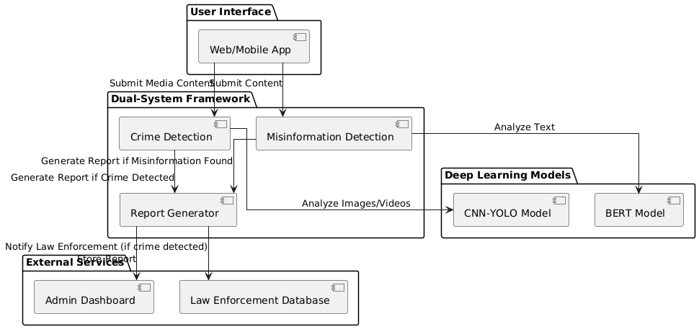
SYSTEM ARCHITECTURE

Slide 5
SYSTEM MODEL
The proposed Hybrid Deep Learning-Based System is designed for real-time misinformation and crime detection on social networks. It follows a multi-layered architecture, ensuring scalability, efficiency, and accuracy.
Data Ingestion Layer: Collects data from platforms like Twitter, Facebook, and Instagram.
Data Preprocessing Layer: Tokenization, Lemmatization, Stop-word Removal using BERT embedding.
Hybrid Deep Learning Model Layer: Tokenization, Lemmatization, Stop-word Removal using BERT embedding.
User Interface & Reporting Layer: Connects with external security platforms for sharing insights.
Model Retraining & Maintenance Layer: Uses real-world feedback & new data to enhance detection accuracy. Periodically re-trains BERT & CNN-YOLO models.

Slide 6
SYSTEM REQUIREMENTS
Hardware Requirements:
High-Performance GPUs: Multiple high-end GPUs (e.g., NVIDIA A100, RTX 3090/4090, or similar) are essential for accelerating deep learning model training and inference. GPU memory (VRAM) is crucial for handling large models and batch sizes.
Powerful CPUs: Multi-core CPUs with high clock speeds are necessary for data preprocessing, model orchestration, and other computational tasks.
Large RAM: Significant RAM (e.g., 128 GB or more) is needed to handle large datasets and complex models.
Network Infrastructure: High-bandwidth network connections are required for real-time data ingestion and distribution. If a cloud-based system, then a very robust network connection to the cloud provider.

Slide 7
SYSTEM REQUIREMENTS
Software Requirements:
Operating System: Linux-based operating systems (e.g., Ubuntu, CentOS) are typically preferred for deep learning development and deployment.
Deep Learning Frameworks:TensorFlow is essential for building and training deep learning models. Transformers library from Hugging Face for BERT-related operations.
Programming Languages: Python is the primary programming language for deep learning.
Natural Language Processing (NLP) Libraries: NLTK, spaCy, and Hugging Face Transformers are used for text processing and analysis
Database Systems: A scalable database system (e.g., PostgreSQL, MySQL, or NoSQL databases like MongoDB) is needed for storing and managing social network data.

Slide 8
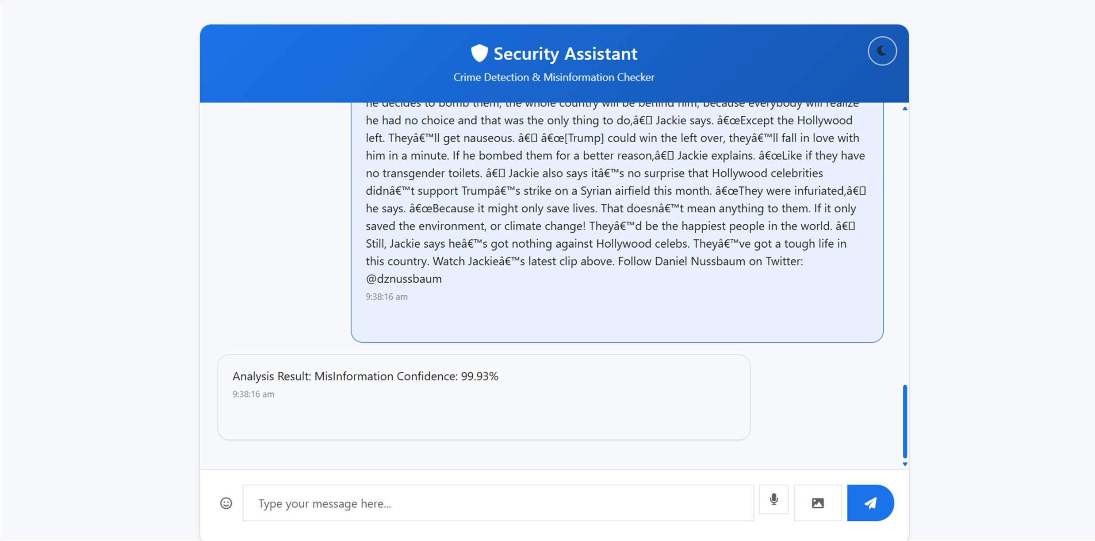
OUTPUT SCREENSHOTS
Misinformation Output 1

Slide 9
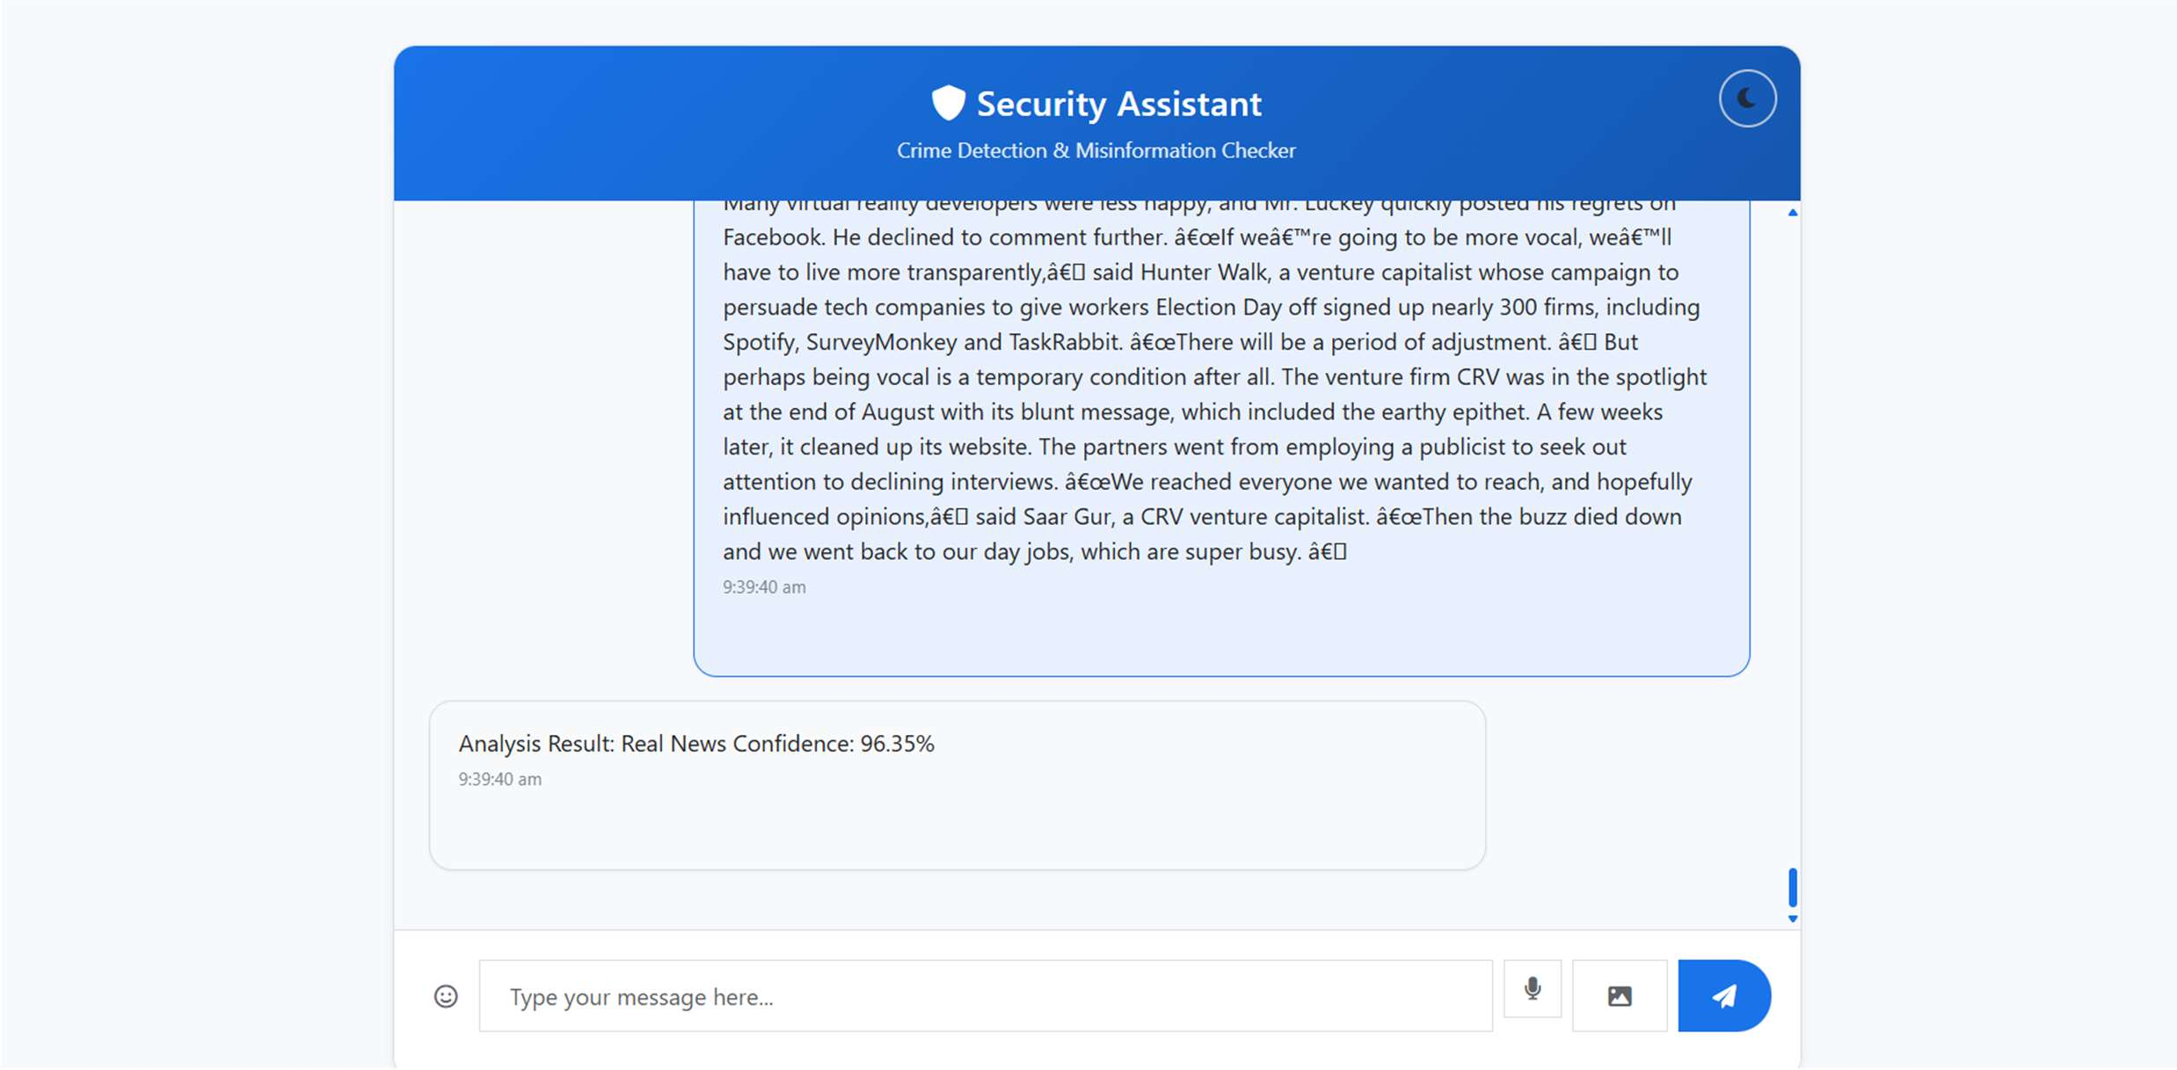
OUTPUT SCREENSHOTS
Misinformation Output 2

Slide 10
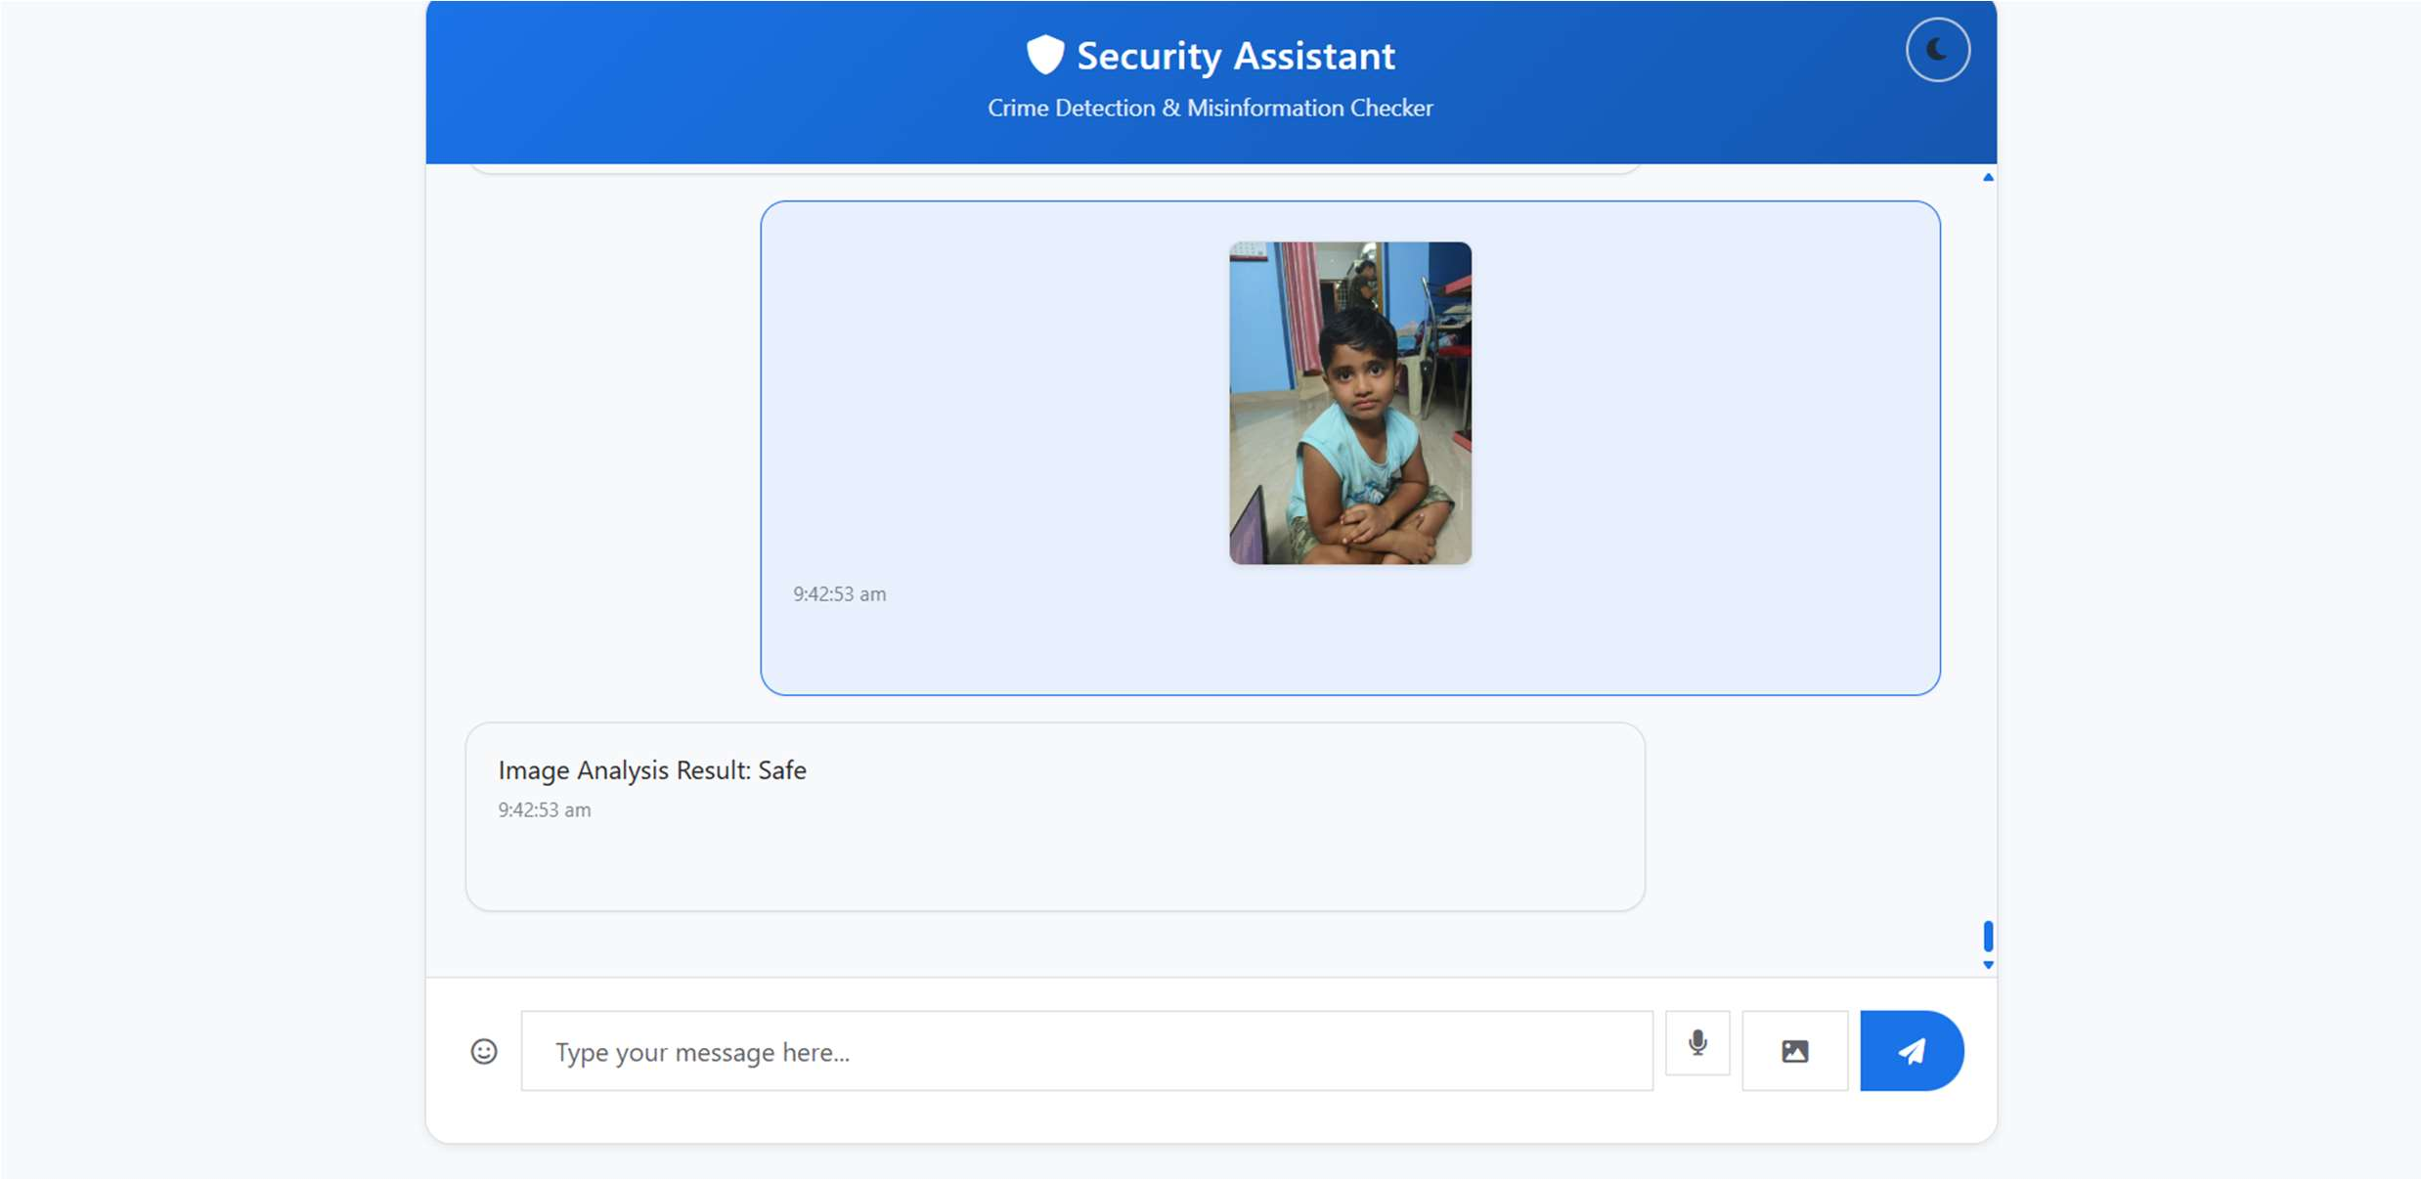
OUTPUT SCREENSHOTS
Crime Detection Output 1

Slide 11
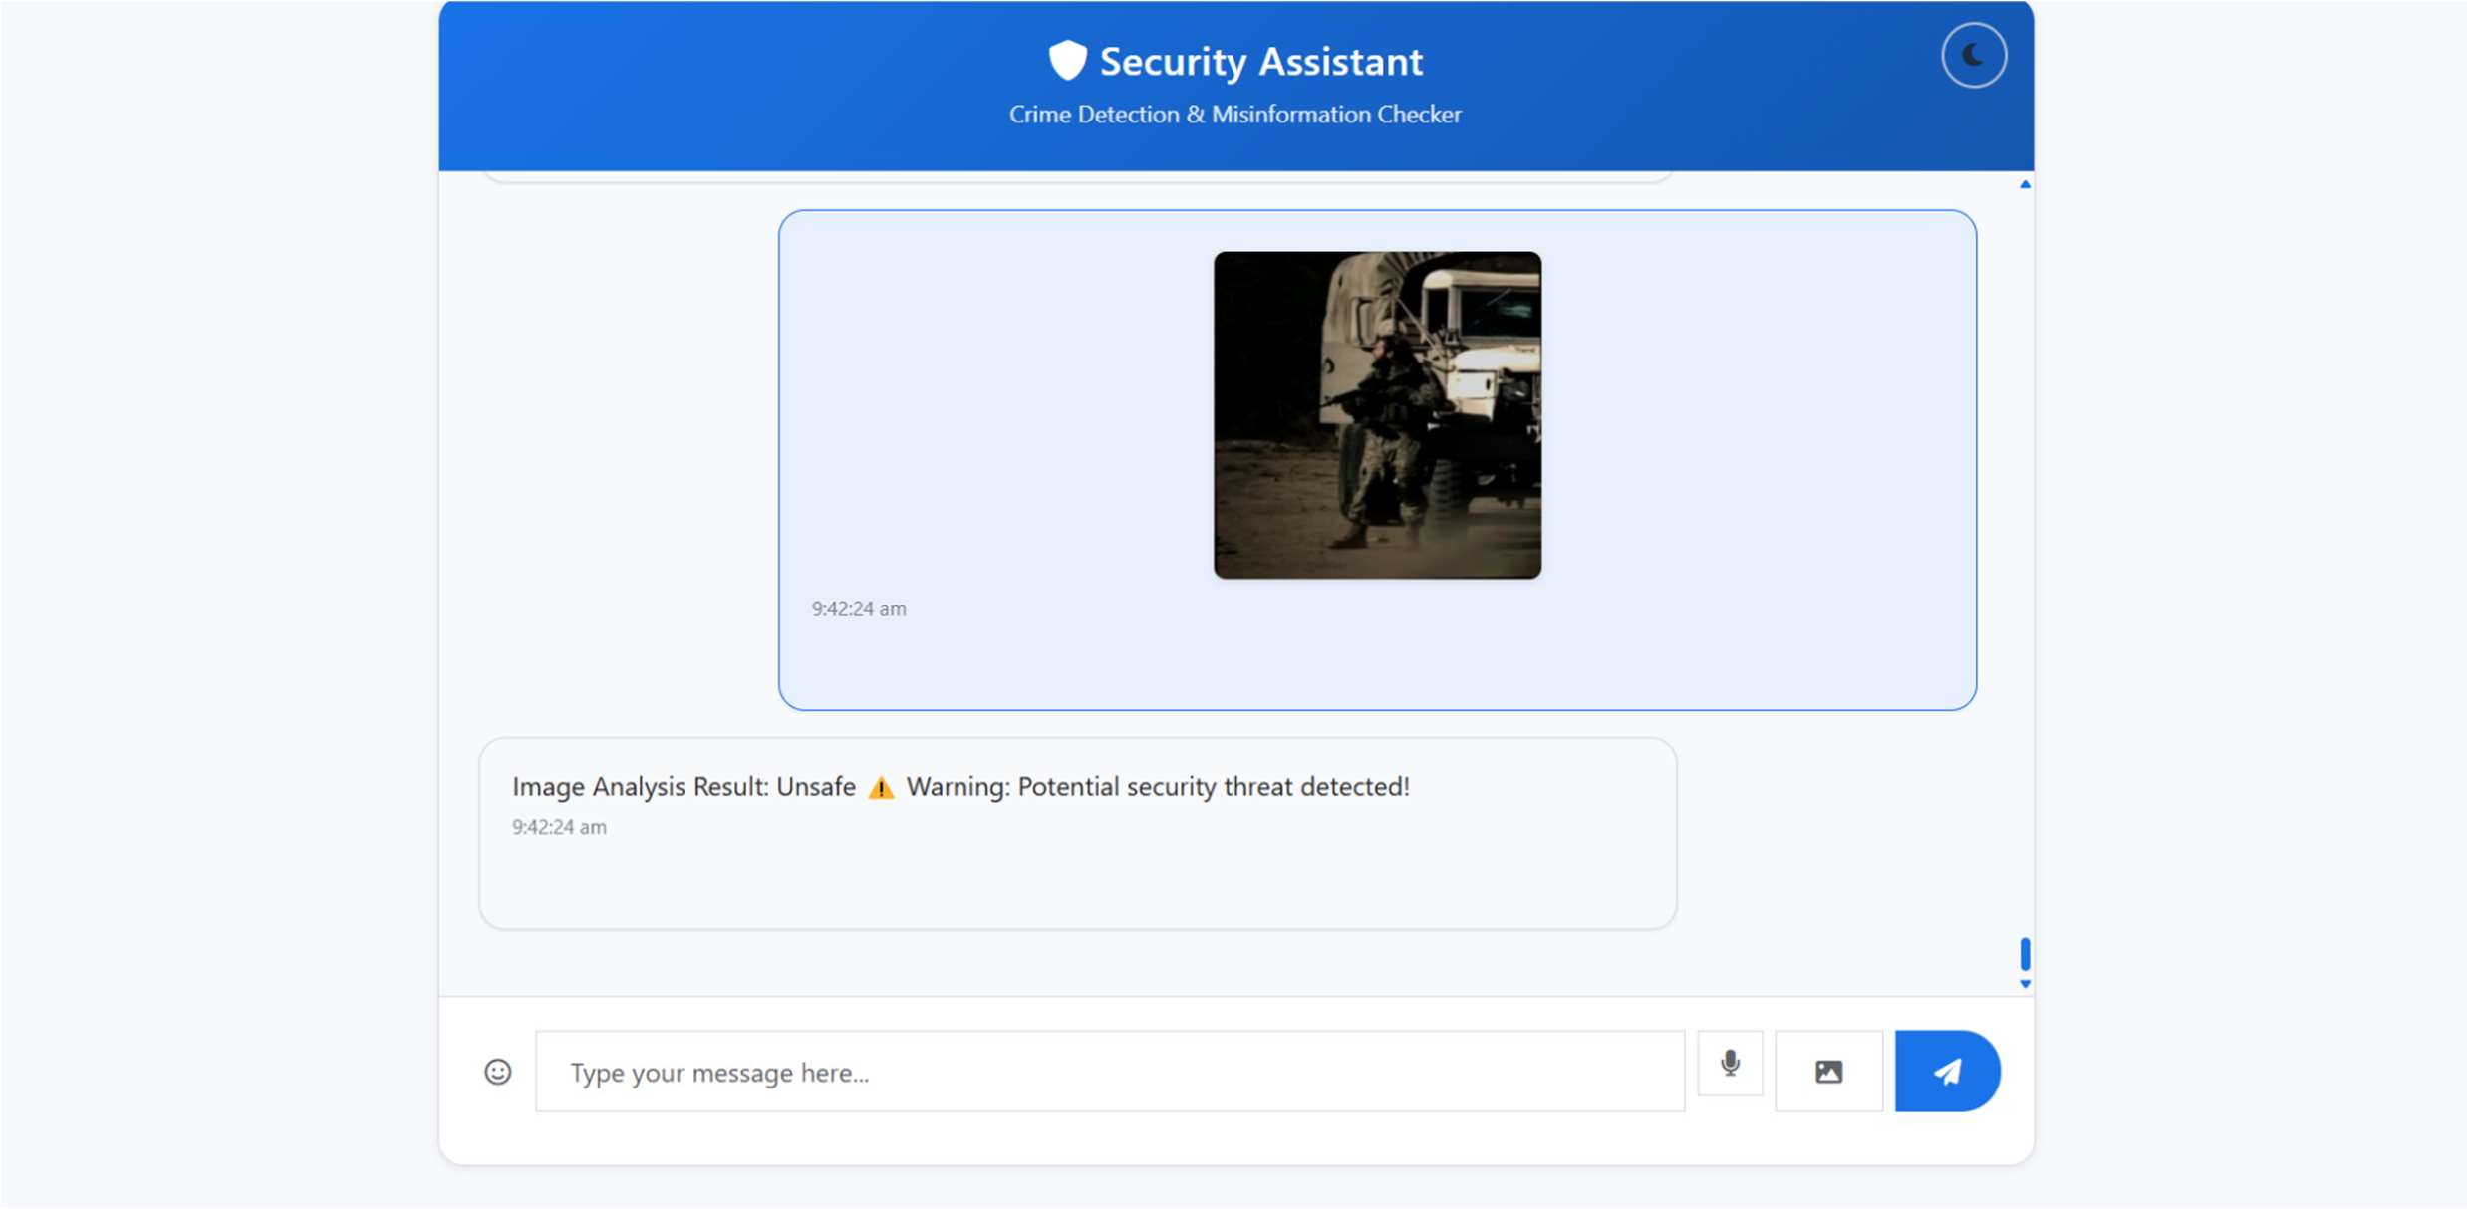
OUTPUT SCREENSHOTS
Crime Detection Output 2

Slide 12
CONCLUSION:
In conclusion, The Hybrid Deep Learning-Based System for Real-Time Misinformation andCrime Detection on Social Networks addresses a critical need in today's digital landscape. By leveraging the power of advanced deep learning models, including BERT, CNNs, and potentially GNNs, this system offers a robust and scalable solution to combat the rapid spread of harmful content. Its ability to analyze multimodal data in real-time enables the accurate detection of misinformation, such as fake news and manipulated media, as well as criminal activities like cyberbullying and online scams, ultimately contributing to a safer online environment. The successful implementation of this system has the potential to significantly mitigate the negative impacts of deceptive and illicit content on social networks. By automating the detection process, it reduces the reliance on manual moderation, which is often overwhelmed by the sheer volume of data. This proactive approach allows for timely intervention, preventing the widespread dissemination of harmful information and protecting vulnerable users from online threats. Furthermore, the system's ability to adapt to evolving patterns of misinformation and crime ensures its continued effectiveness in the face of emerging challenges.

