Slide 1

TKR COLLEGE OF ENGINEERING & TECHNOLOGY
SPARK EXPO-2026
E-COMMERCE SALES & CUSTOMER ANALYSIS USING MYSQL AND POWER BI
A MINI PROJECT ON
UNDER THE GUIDANCE OF
Prof.. Tejashwini
Class Incharge, CSD-B
BY
MADDI DURGA PRASAD (25K95A6709)

Slide 2
Overview
Abstract
Introduction
Problem
Scope & Objective of Project
Hardware & Software requirements
Project workflow
Database Tables
Dashboard
Conclusion
References

Slide 3
ABSTRACT
This project presents a comprehensive E-Commerce Sales and Customer Analysis solution leveraging MySQL for robust data management and Power BI for interactive business intelligence and visualization. The primary objective was to transform raw transactional data into actionable insights to optimize sales performance, enhance customer segmentation, and improve overall business decision-making in a competitive e-commerce environment. Data from multiple sources—including orders, customers, products, and returns—was ingested and stored in a well-normalized MySQL relational database. Complex SQL queries were developed to clean the data, handle missing values, calculate key performance indicators (KPIs) such as Revenue, Average Order Value (AOV), Customer Lifetime Value (CLV), and Retention Rate, and perform advanced analytics including RFM (Recency, Frequency, Monetary) segmentation and cohort analysis.
Keywords: E-Commerce Analytics, Sales Analysis, Customer Segmentation, MySQL, Power BI, RFM Analysis, Business Intelligence.

Slide 4
Introduction-EXISTING SYSTEM
This project, E-Commerce Sales and Customer Analysis using MySQL and Power BI, aims to build a complete data analytics solution that enables stakeholders to understand key business metrics, identify trends, segment customers effectively, and make informed strategic decisions. The rapid growth of e-commerce has transformed the global retail landscape, generating massive volumes of transactional data every day. In today’s highly competitive digital marketplace, businesses must move beyond traditional reporting to gain deep, actionable insights into sales performance and customer behavior. Effective analysis of this data is critical for optimizing marketing strategies, improving customer retention, managing inventory efficiently, and driving sustainable revenue growth.
DRAWBACKS:-
Data Quality and Completeness
Limited Dataset Scope

Slide 5
PROBLEM STATEMENTS
Organizations require data-driven decision-making to remain competitive in today's digital marketplace. However, large volumes of transactional data often remain underutilized due to the lack of structured analysis and visualization. This project provides an end-to-end analytics solution by designing a relational database in MySQL, performing SQL-based business analysis, and developing interactive Power BI dashboards to enable strategic decision-making through actionable insights.

Slide 6
PROPOSED SYSTEM:
The proposed system is a comprehensive, end-to-end data analytics solution designed to analyze e-commerce sales and customer behavior using MySQL as the backend database and Power BI as the visualization and business intelligence tool.
ADVANTAGES:-
Enhanced Customer Understanding,
Improved Decision Making
Cost-Effective Solution
Increased Operational Efficiency
Interactive and User-Friendly Visualization
Time-Saving Automation

Slide 7
SCOPE & OBJECTIVE OF PROJECT
For this project To design and implement a relational database schema in MySQL for e-commerce sales and customer data,To conduct customer segmentation using techniques like RFM analysis.
To develop interactive and visually appealing dashboards in Power BI for real-time monitoring and decision support.
To perform exploratory data analysis and calculate essential KPIs such as total revenue, average order value, customer lifetime value, and retention rates.

Slide 8
Hardware Requirements
PROCESSOR : Intel Core i5 (8th Gen)
RAM : 8GB RAM
HARD DISK : 256 GB
Software Requirements
OPERATING SYSTEMS : WINDOWS 10/11
Database Client : MySQL Workbench
PROGRAMMING LANGUAGE : SQL

Slide 9
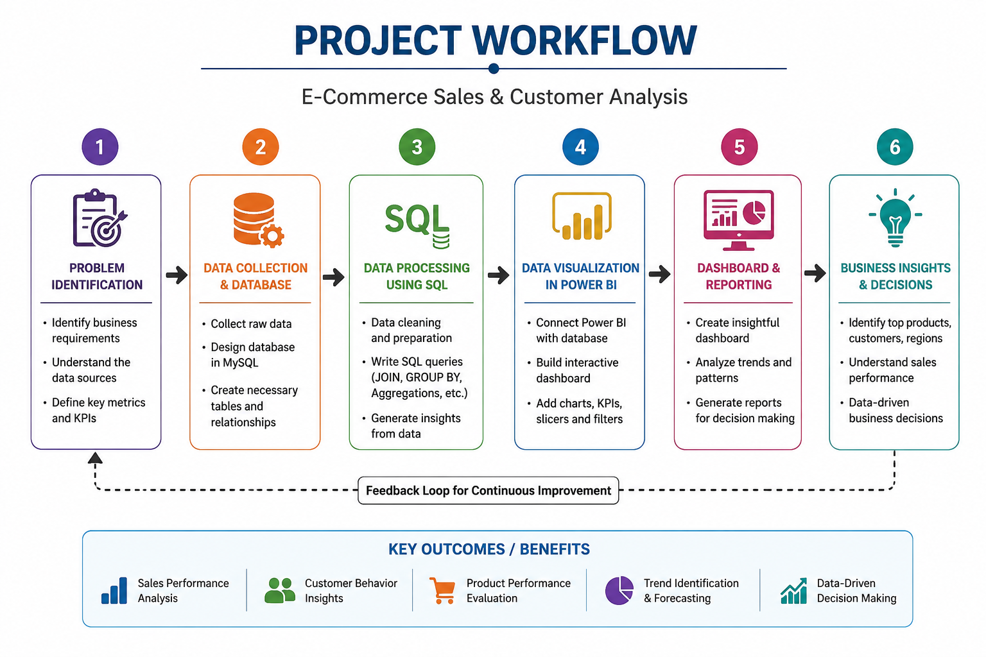
PROJECT WORKFLOW

Slide 10
DATABASE TABLES
Customer Table
Product Table
Orders Table
Ordered item Table

Slide 11
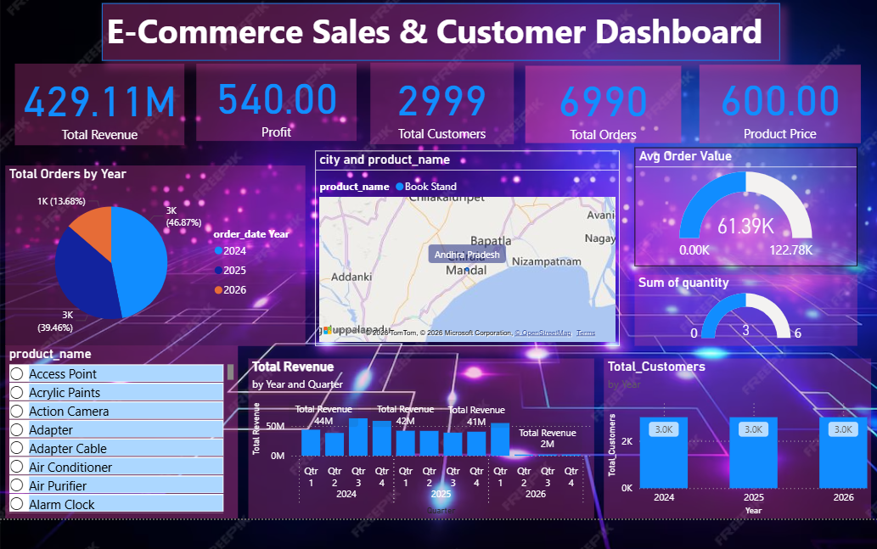
DASHBOARD

Slide 12
CONCLUSION
The E-Commerce Sales and Customer Analysis using MySQL and Power BI project successfully demonstrates how effective data management and visualization tools can transform raw transactional data into valuable business insights.
The E-Commerce Sales and Customer Analysis using MySQL and Power BI project successfully demonstrates how effective data management and visualization tools can transform raw transactional data into valuable business insights.

Slide 13
Future Scope
Integration of Machine Learning models for sales forecasting and customer churn prediction.
Implementation of real-time analytics using tools like Apache Kafka.
Migration to cloud platforms (AWS, Azure, or Google Cloud) for better scalability.
Development of a web-based dashboard using Power BI Service for wider accessibility.

Slide 14
REFERENCES [1Chen, H., Chiang, R. H. L., & Storey, V. C. (2012). Business Intelligence and Analytics: From Big Data to Big Impact. MIS Quarterly, 36(4), 1165–1188. [2] Verhoef, P. C., Kannan, P. K., & Inman, J. J. (2015). From Multi-Channel Retailing to Omni-Channel Retailing. Journal of Retailing, 91(2), 174–181. [3Chaffey, D., & Ellis-Chadwick, F. (2019). Digital Marketing: Strategy, Implementation and Practice (7th ed.). Pearson. [4Marr, B. (2016). Big Data in Practice: How 45 Successful Companies Used Big Data Analytics to Deliver Extraordinary Results. Wiley. [5] Power, D. J. (2016). Data Science: Supporting Decision Making. Journal of Decision Systems, 25(4), 345–356.. [6] Oracle Corporation. (2024). MySQL Performance Tuning Guide. [7] Han, J., Kamber, M., & Pei, J. (2012). Data Mining: Concepts and Techniques (3rd ed.). Morgan Kaufmann Publishers.

Slide 15
THANK YOU

