Slide 1
COVID DATA ANALYSIS

Slide 2
OBJECTIVE
To perform data analysis and visualization on Covid_19 data using AWS
To perform data analysis on Covid_19 data and extract the meaningful information from the dataset which will help in taking quick and informed decision.

Slide 3
TECHNOLOGIES USED
AWS Glue
SparkSQL
Redshift
AWS S3
Crawler
AWS Lambda

Slide 4
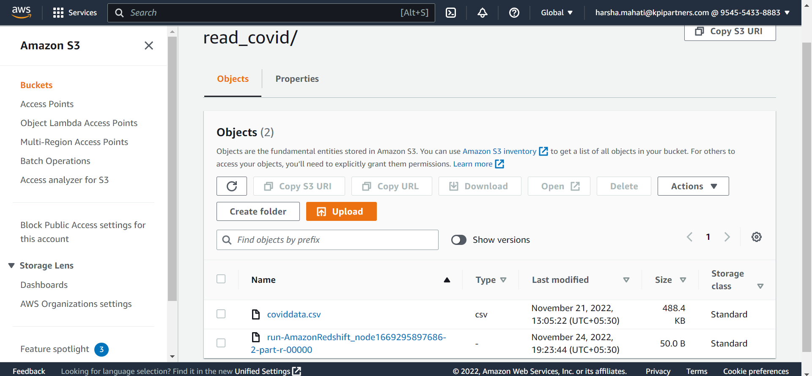
Problem Statements 1.Create a S3 Bucket with region in East Asia and upload the dataset..

Slide 5
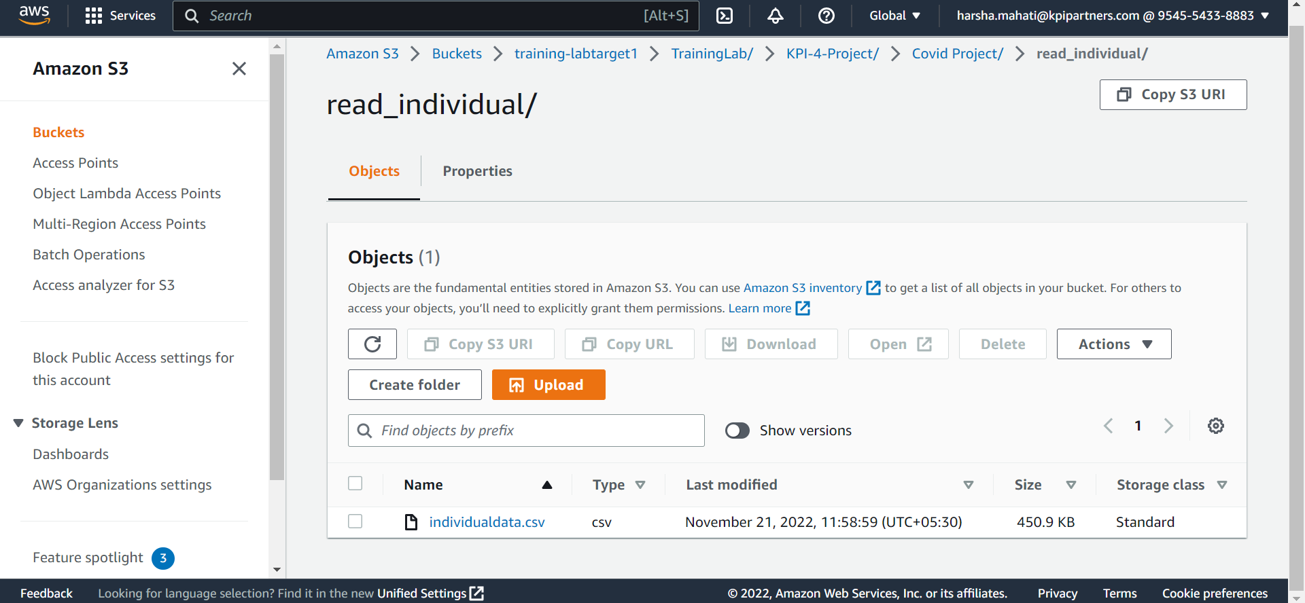
1.1 Uploading of dataset

Slide 6
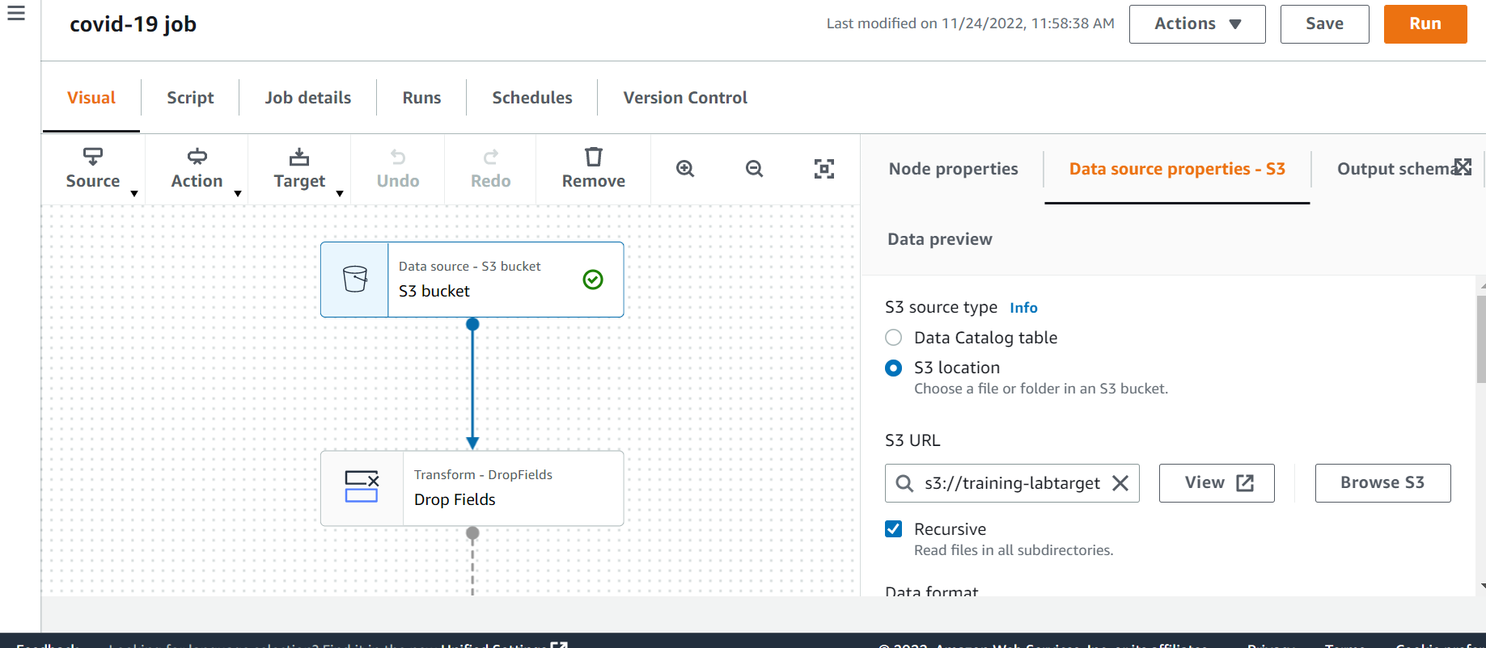
3.Clean and transform data using AWS Glue Uploading source data to modify covid data by using ETL Jobs

Slide 7
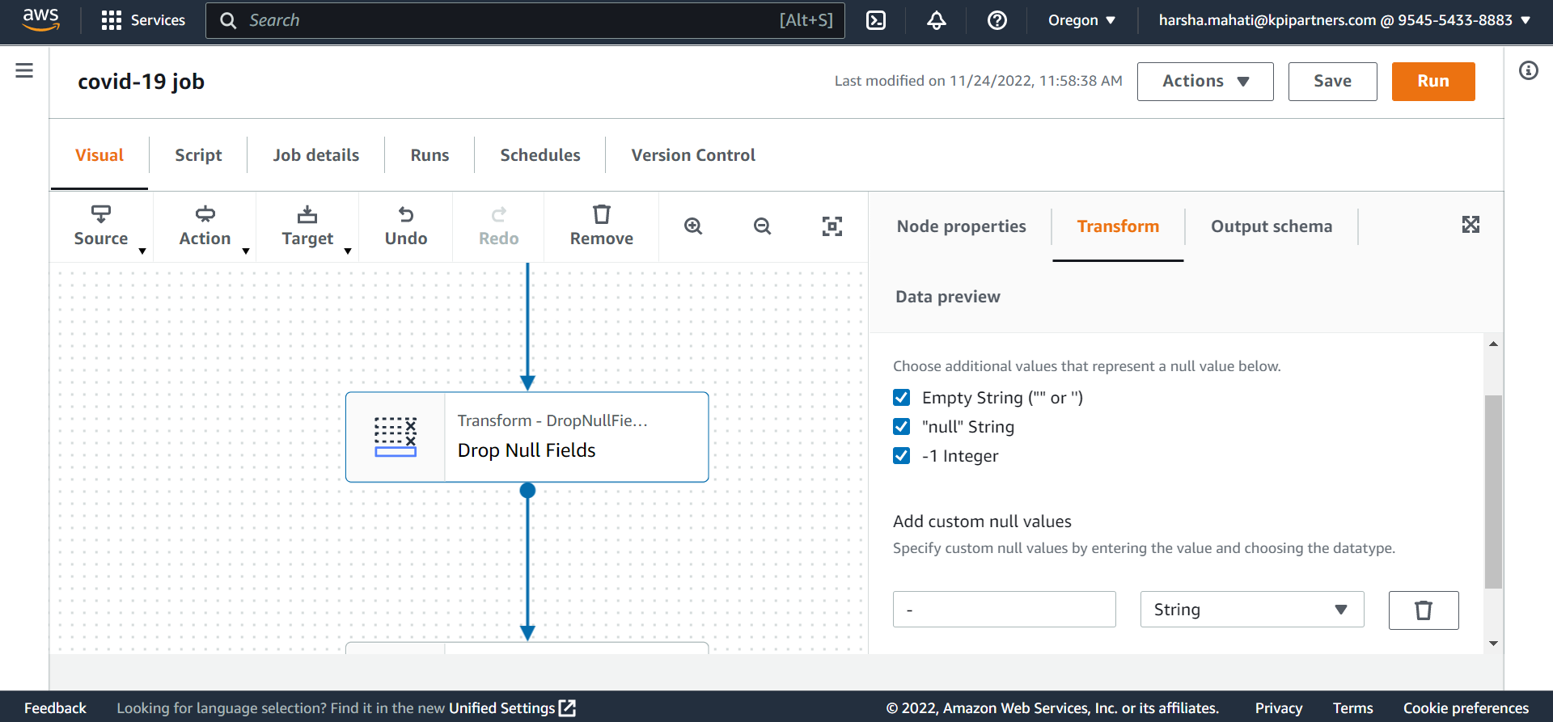
Remove Null Values for the necessary columns.

Slide 8
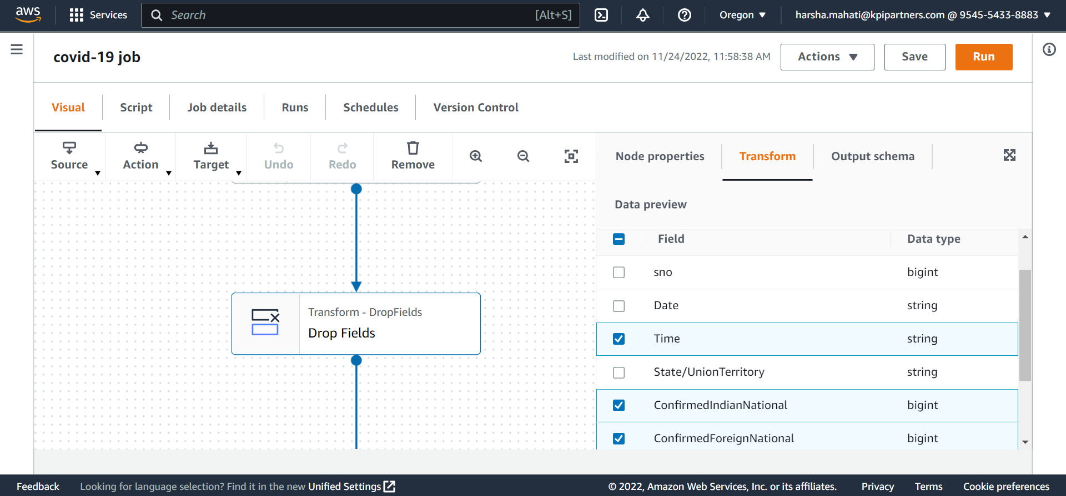
Drop the columns that are unnecessary

Slide 9
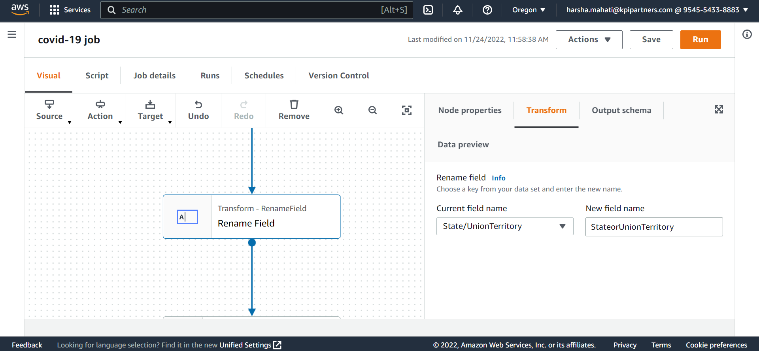
Rename Columns that are not in proper format for querying

Slide 10
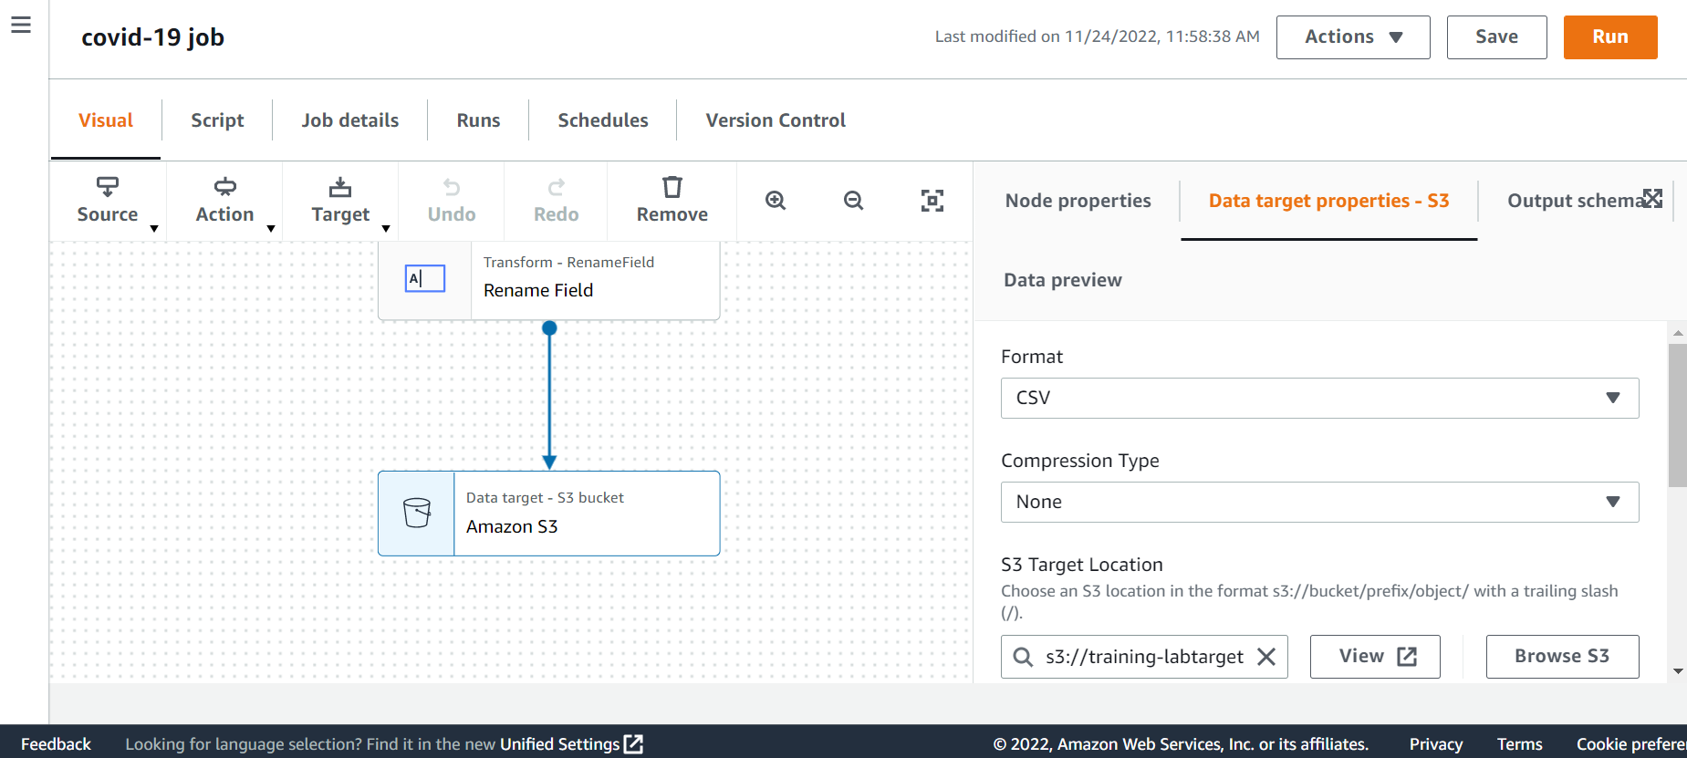
Setting target location for the modified covid data file

Slide 11
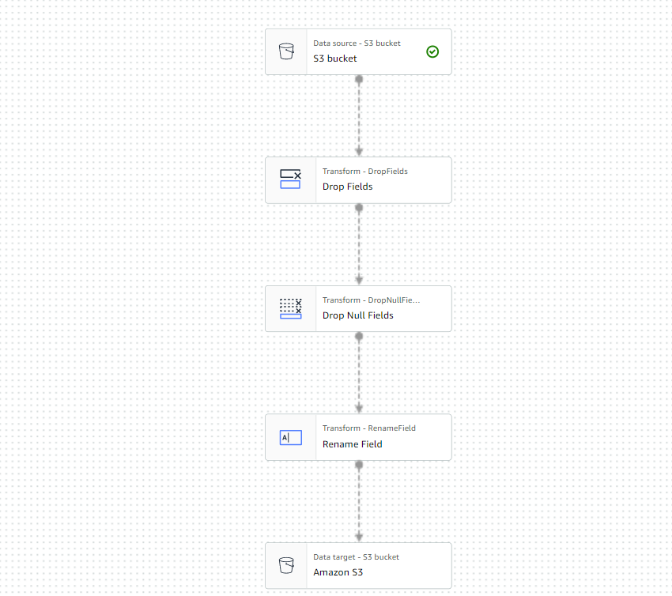
ETL Job visual to modify covid data file

Slide 12
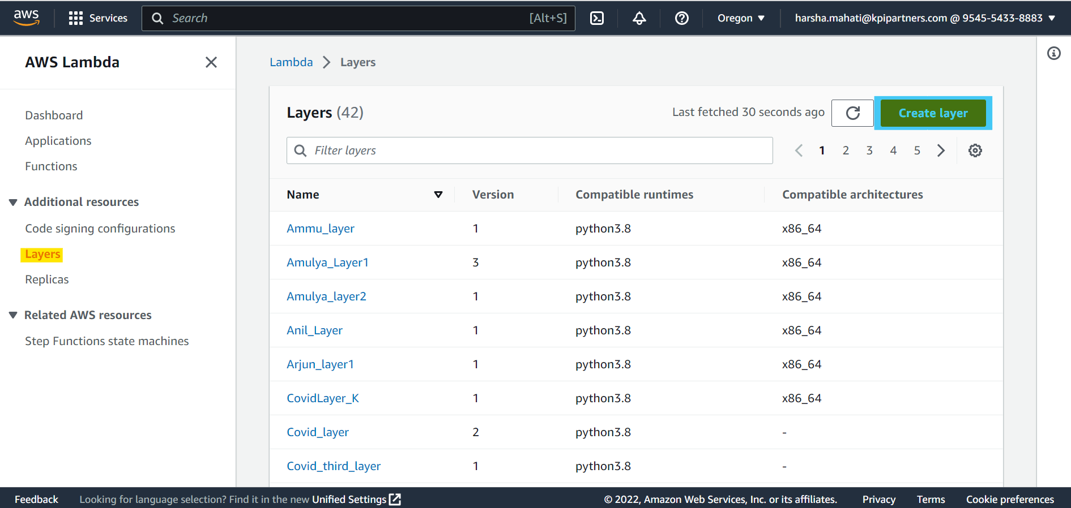
4.Store the modified data in S3 Bucket using AWS Lambda Layer creation process..

Slide 13
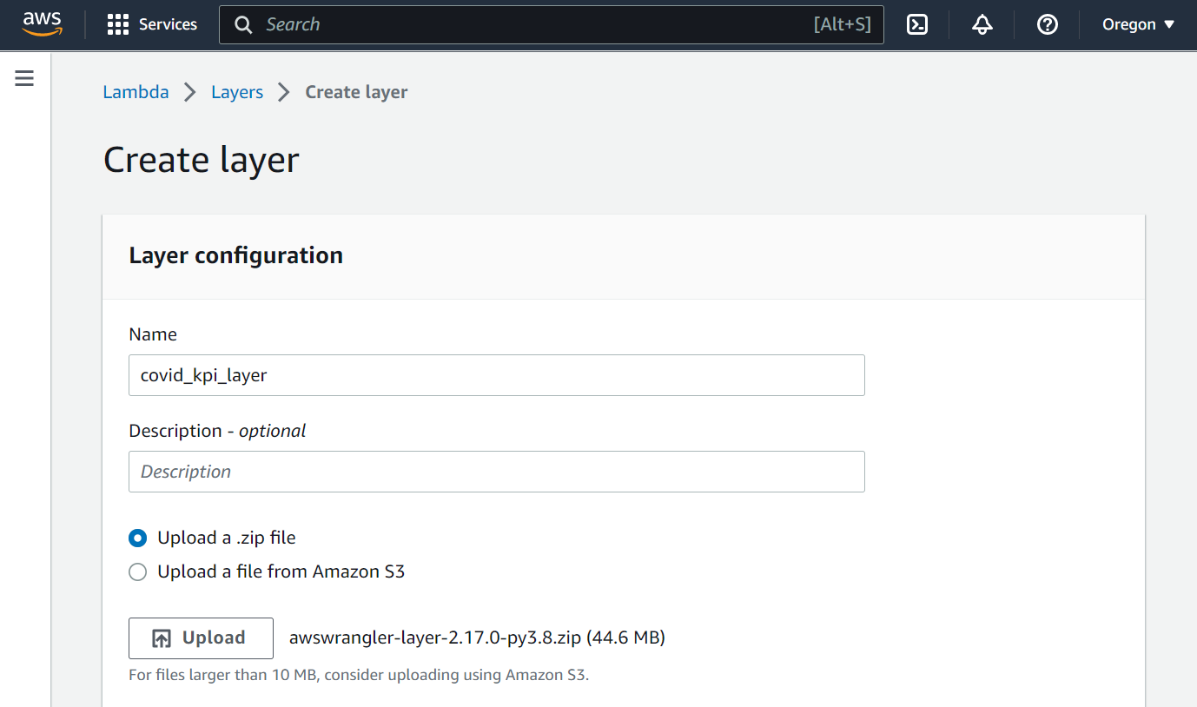
Creating layer :- covid_kpi_layer

Slide 14
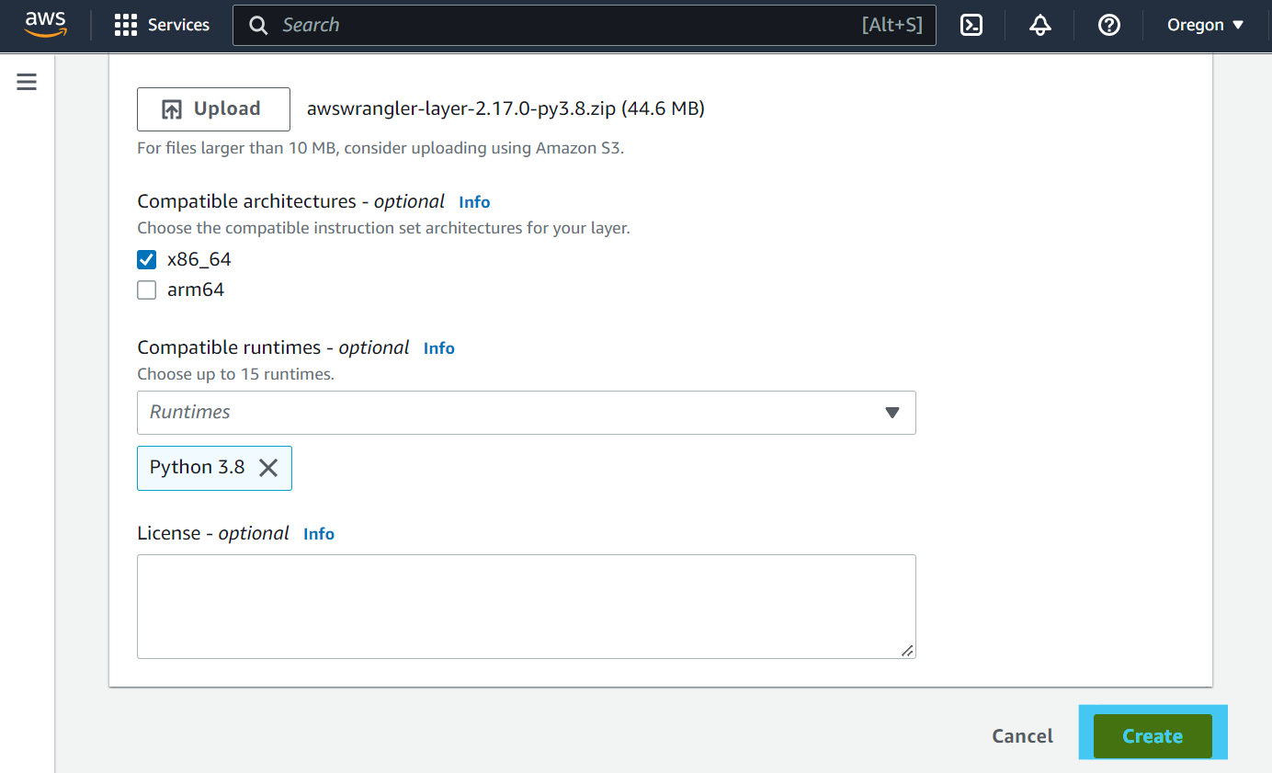

Slide 15
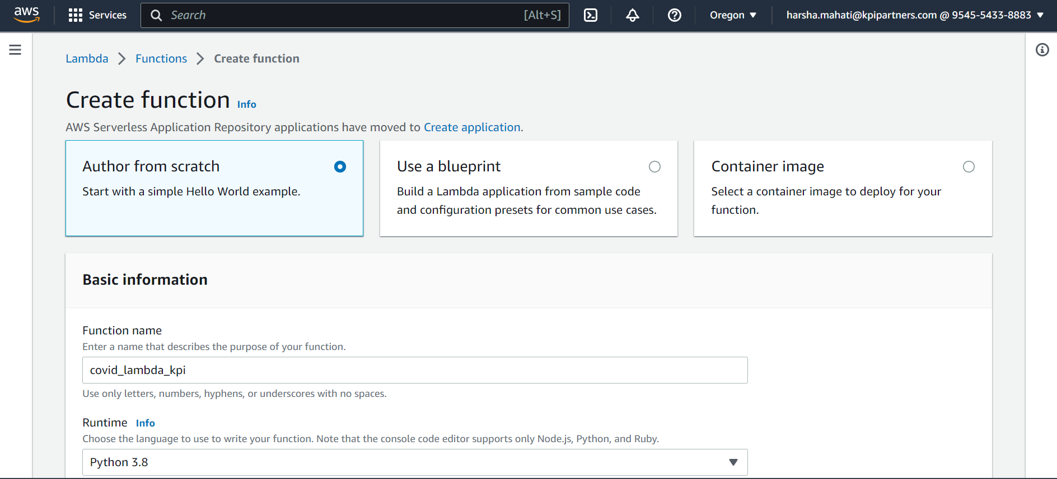
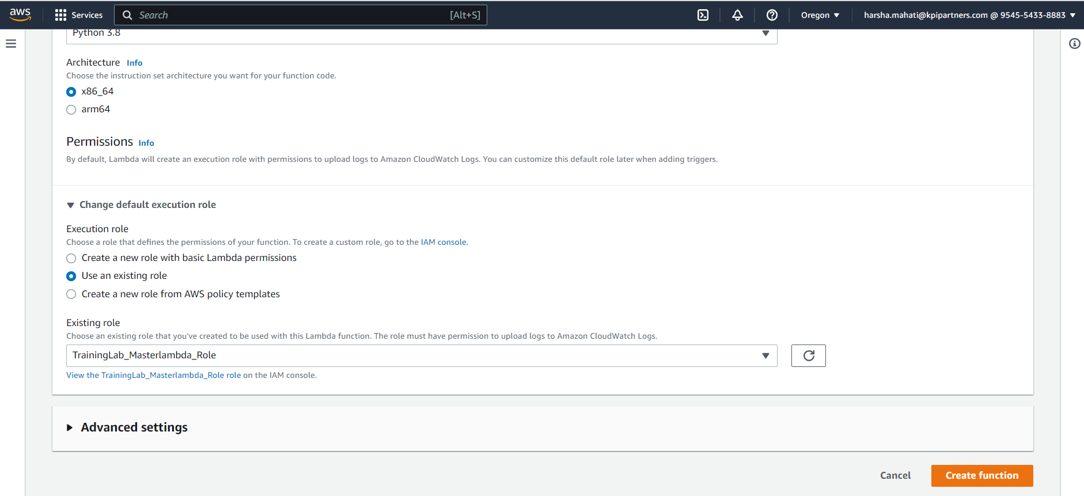
Function creation

Slide 16
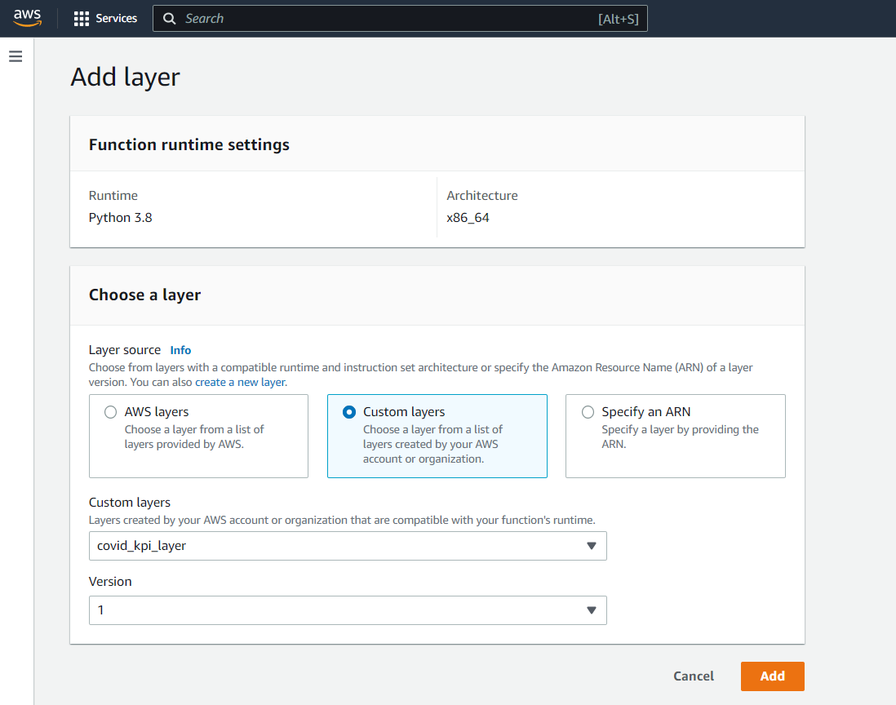
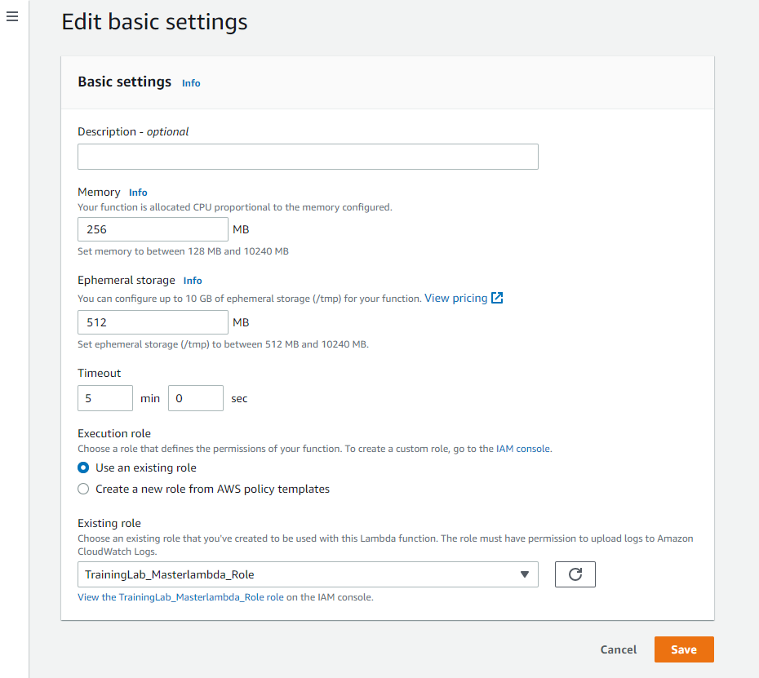
Adding layer to lambda function

Slide 17
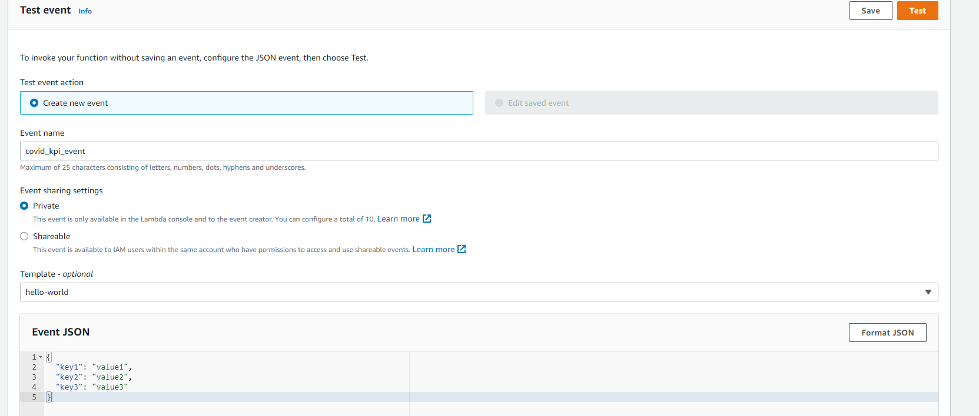
Creating Test Event

Slide 18
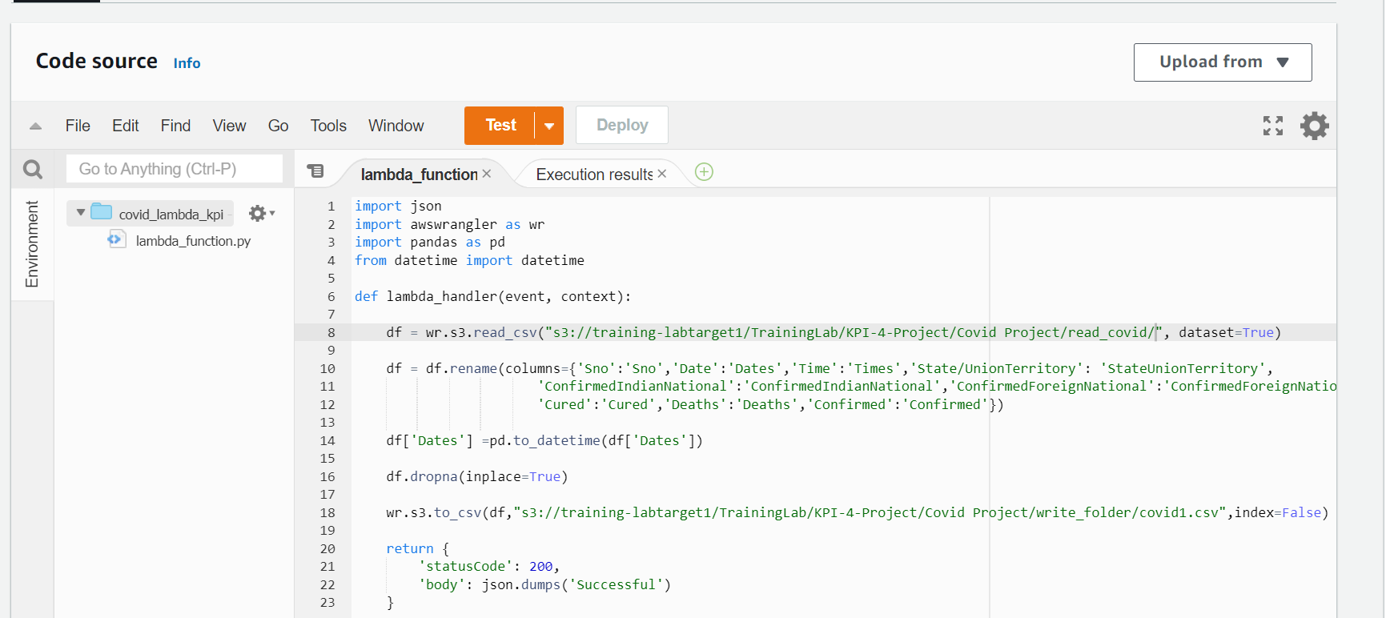
Source code

Slide 19
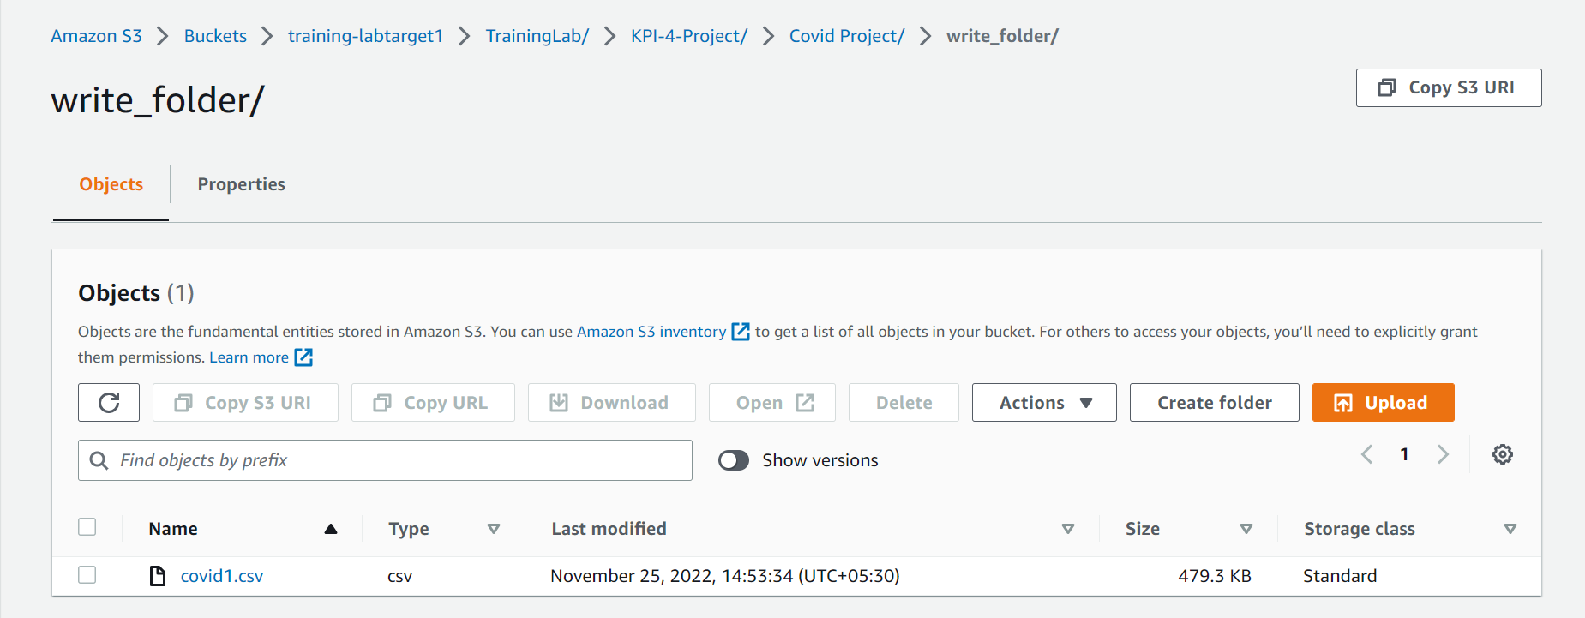
Modified data by Lambda stored in s3 bucket

Slide 20
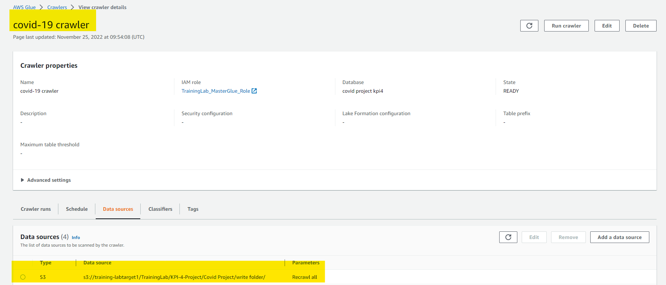
5. From the modified data create a table and data catalog using AWS Crawler.

Slide 21
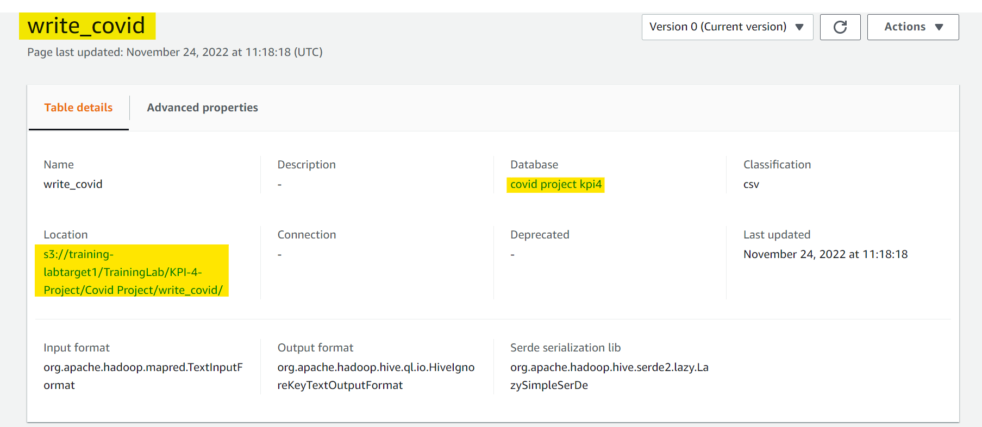
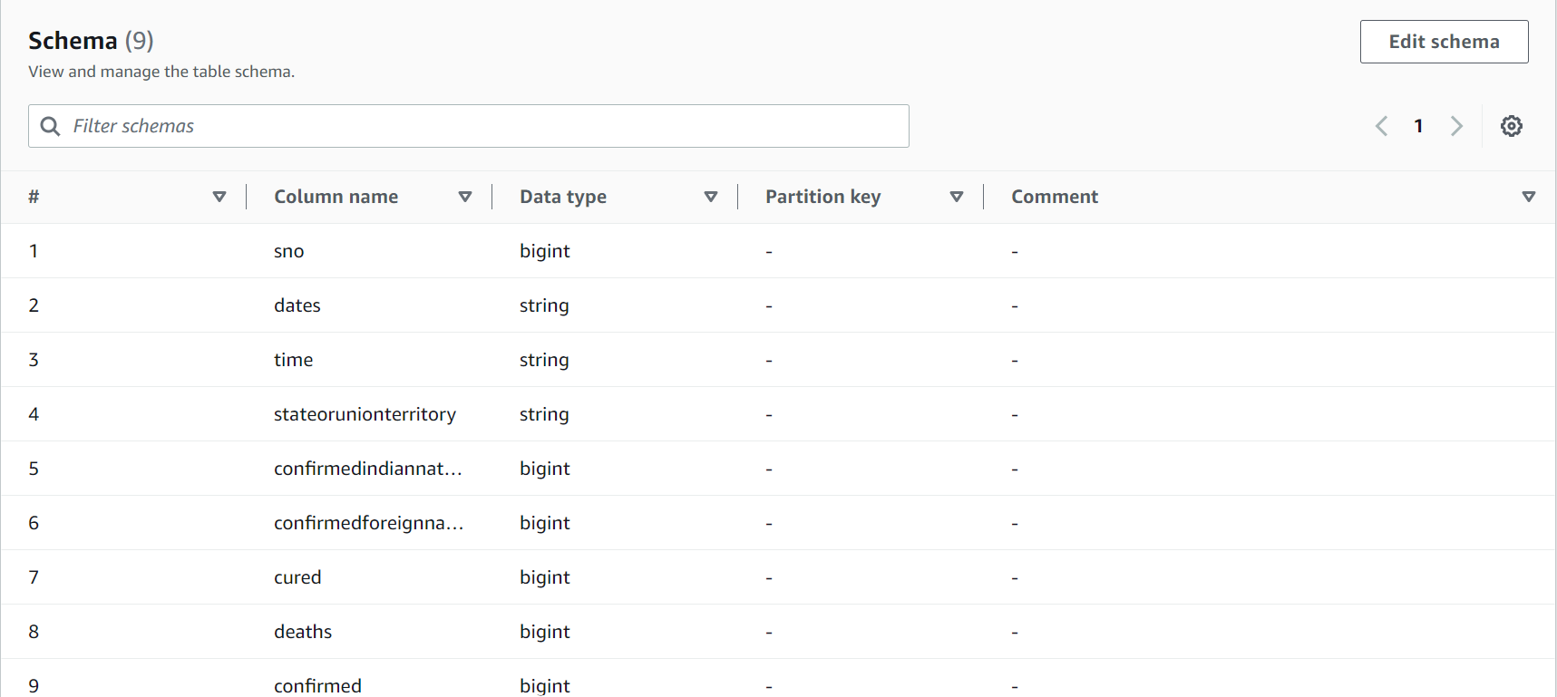

Slide 22
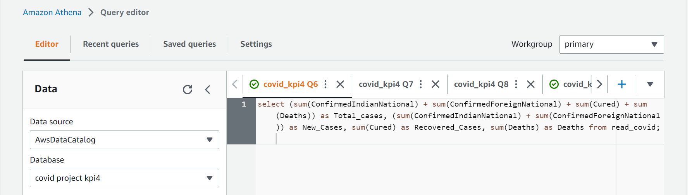
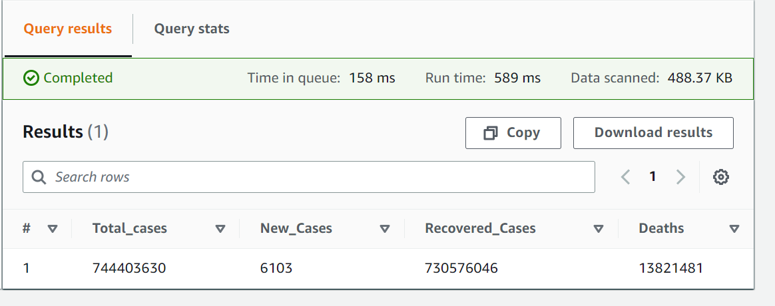
6.Display Total- Cases, New Cases, recovered cases and deaths using SparkSql
select (sum(ConfirmedIndianNational) + sum(ConfirmedForeignNational) + sum(Cured) + sum(Deaths)) as Total_cases, (sum(ConfirmedIndianNational) + sum(ConfirmedForeignNational)) as New_Cases, sum(Cured) as Recovered_Cases, sum(Deaths) as Deaths from read_covid;

Slide 23
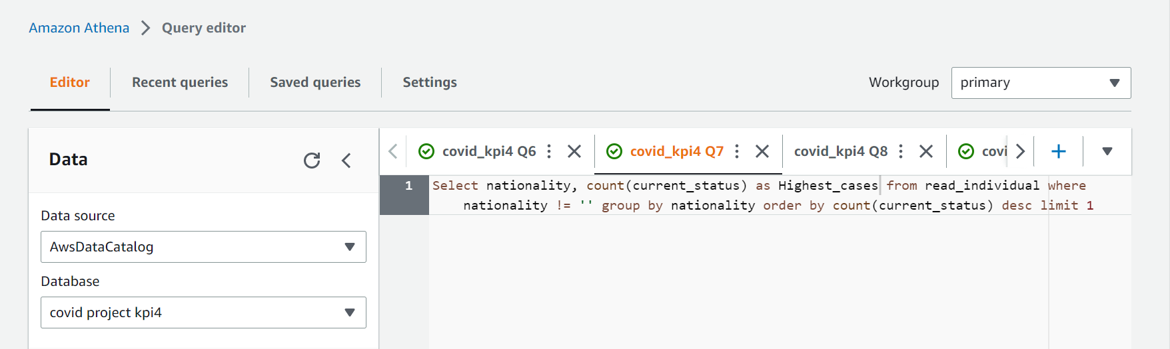
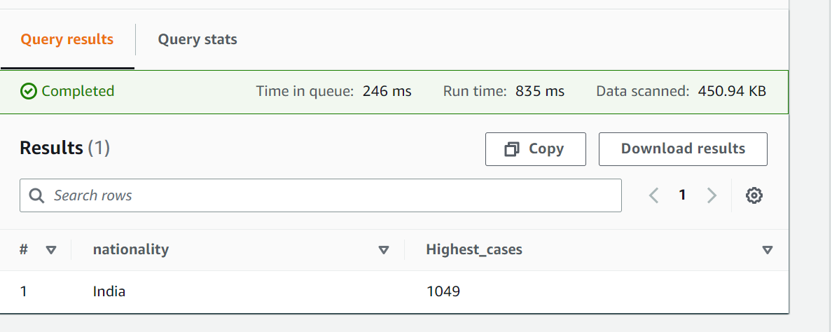
7.Which country in Distinct WHO region has highest cases in till date.
Select nationality, count(current_status) from read_individual where nationality != '' group by nationality order by count(current_status) desc limit 1

Slide 24
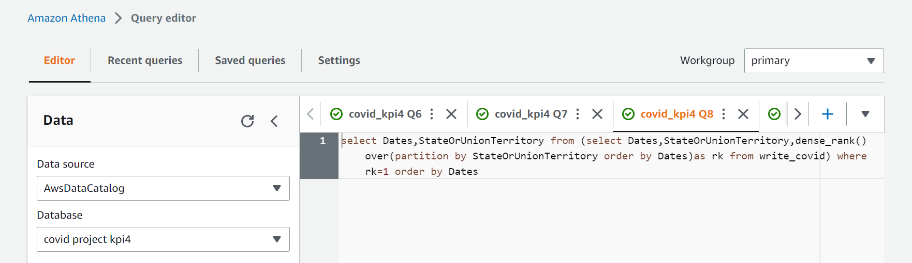
8.Date of first confirmed case in a particular region
select Dates,StateOrUnionTerritory from (select Dates,StateOrUnionTerritory,dense_rank() over(partition by StateOrUnionTerritory order by Dates)as rk from write_covid) where rk=1 order by Dates

Slide 25
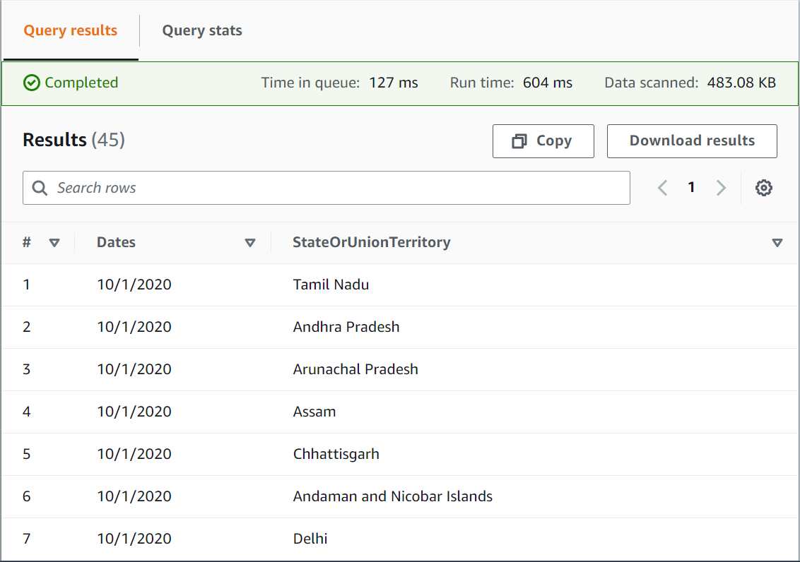

Slide 26
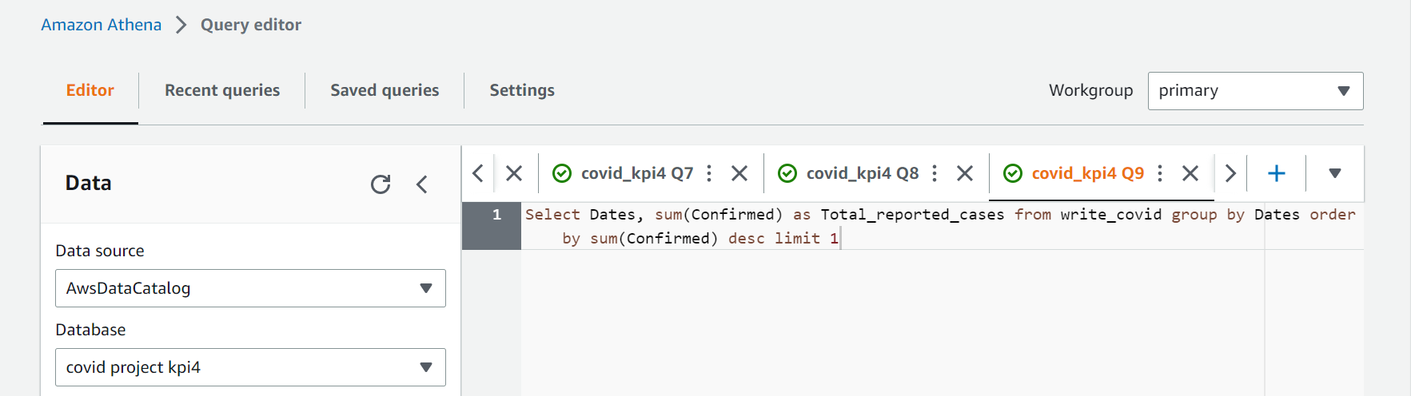
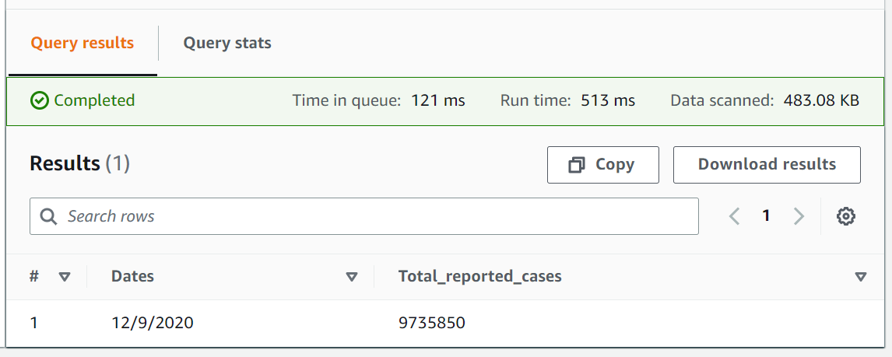
9.Date on which max no. cases were reported in a country
Select Dates, sum(Confirmed) as Total_reported_cases from write_covid group by Dates order by sum(Confirmed) desc limit 1

Slide 27
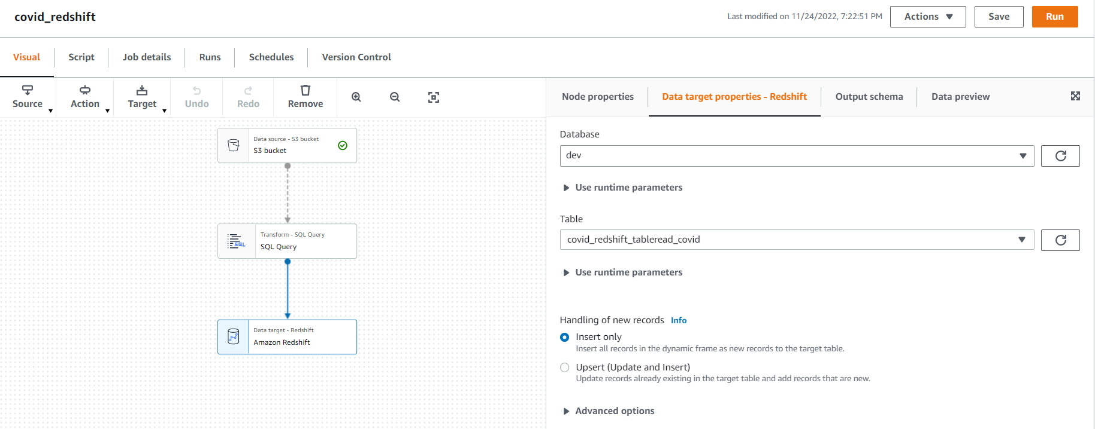
10.Load the total cured and deaths in the Amazon Redshift from S3 bucket and Show the visualizations in Redshift.

Slide 28
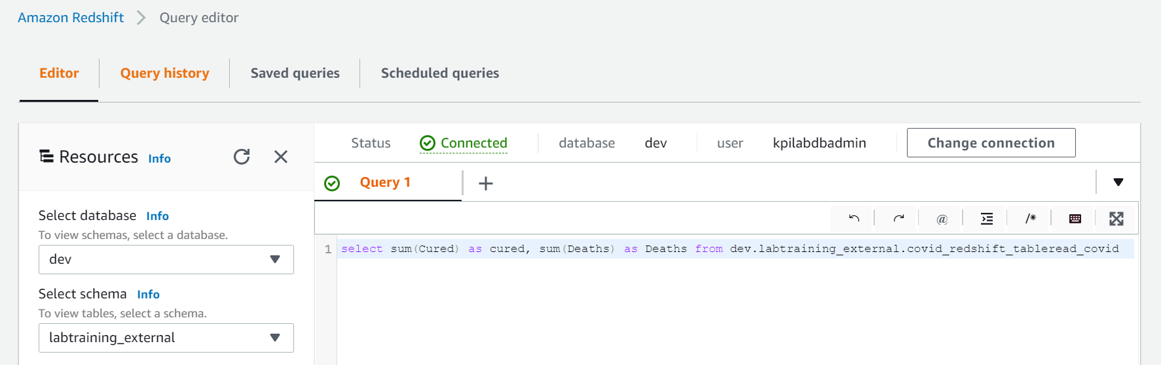
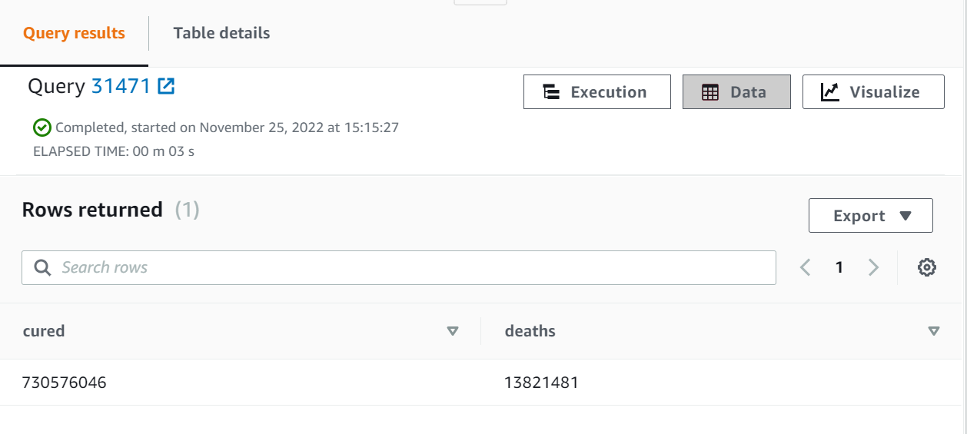
select sum(Cured) as cured, sum(Deaths)as Deaths from dev.labtraining_external.covid_redshift_tableread_covid

Slide 29
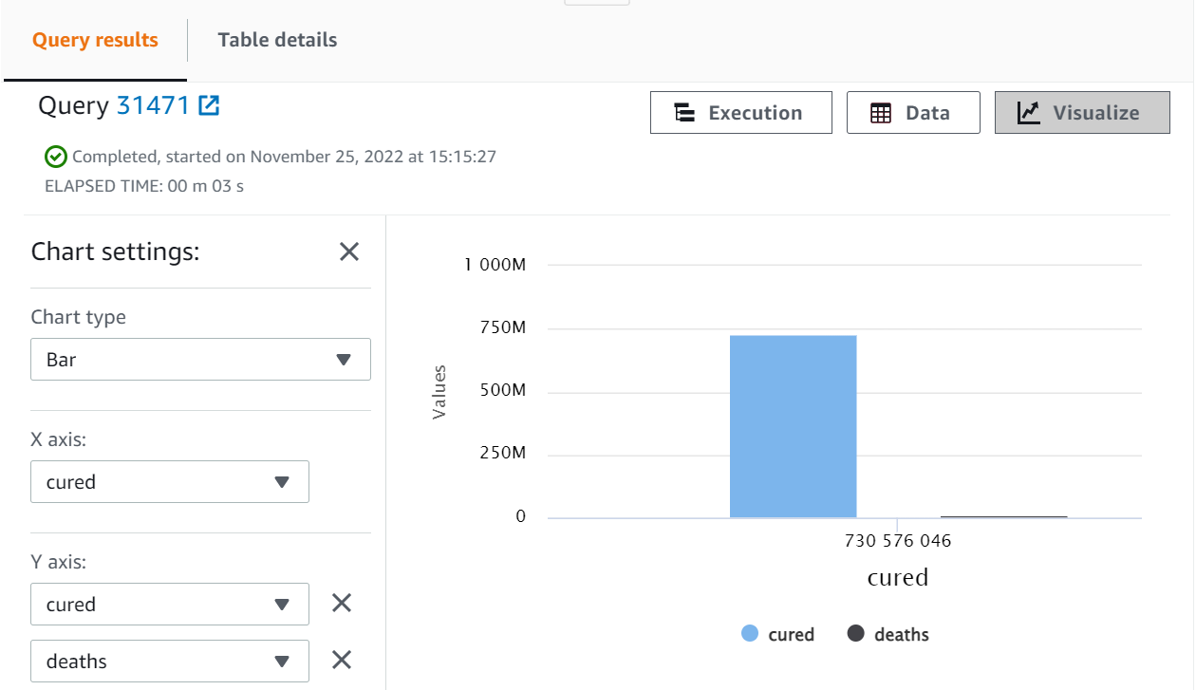
Visualized output

Slide 30
THANK YOU

