Slide 1


Group 5
PLP
using
PAGE OBJECT MODEL AND
TestNG
IGATE is now a part of Capgemini

Slide 2

TEAM
SS Krishnakanth Sattiraju
Durga Venkatesan
Utti Jayasree
Meghana Upputuri
Devisetty Raga
S Harshitha
Tamonash Mukherjee

Slide 3
STEPS INVOLVED: ADD NEW ADDRESS
LOGIN
GO TO ADDRESS PAGE
ADD NEW ADDRESS
CONTINUED…
TESTCASES

Slide 4
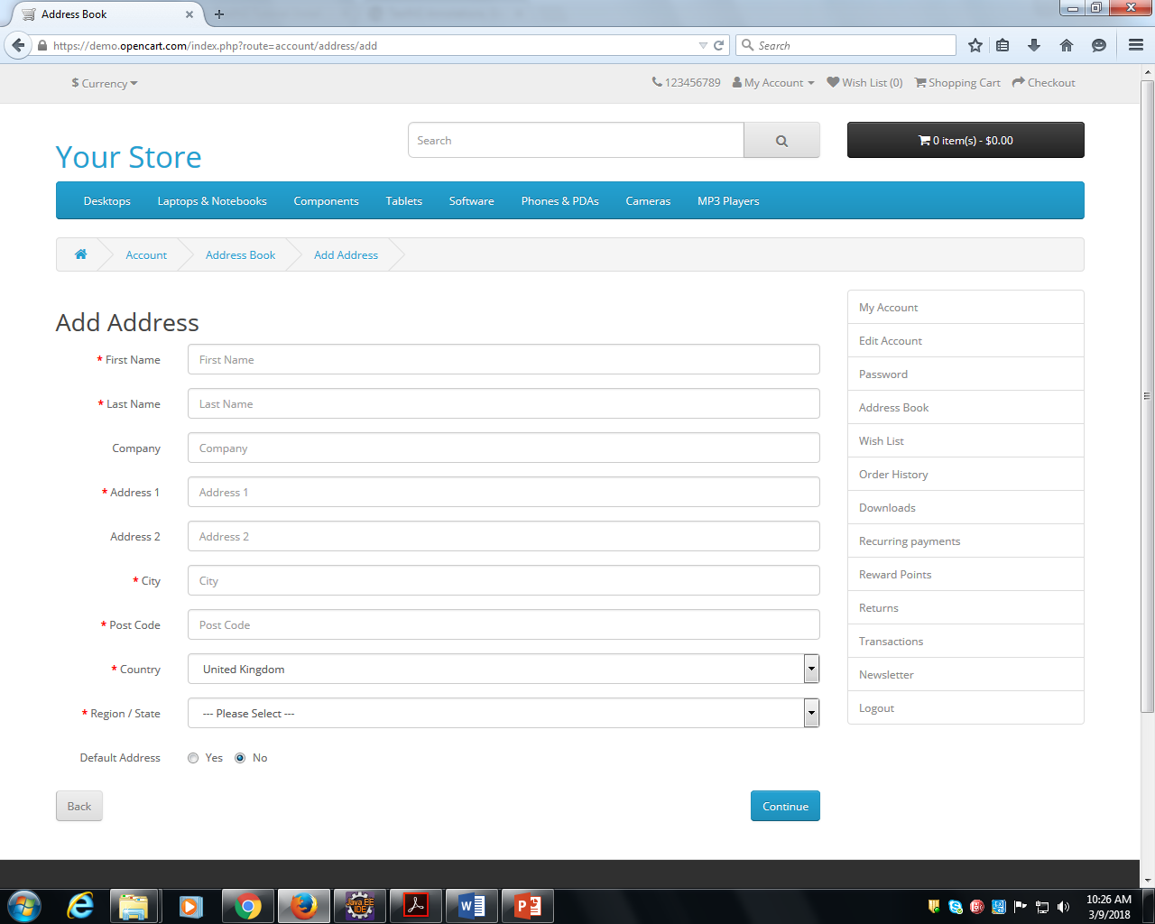

Slide 5
Files used
POM_file
Basic
Excel sheet

Slide 6
Frameworks used
Selenium
Page Object Model
TestNG
Data driven

Slide 7
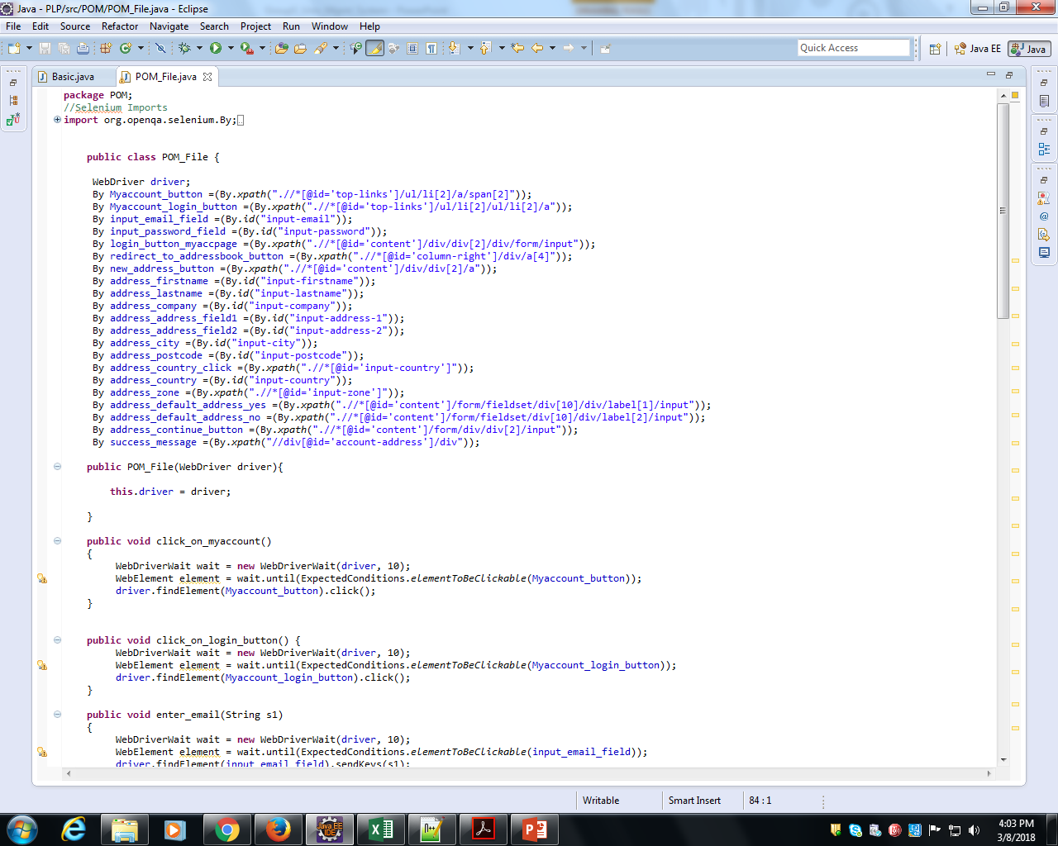

POM_file program

Slide 8
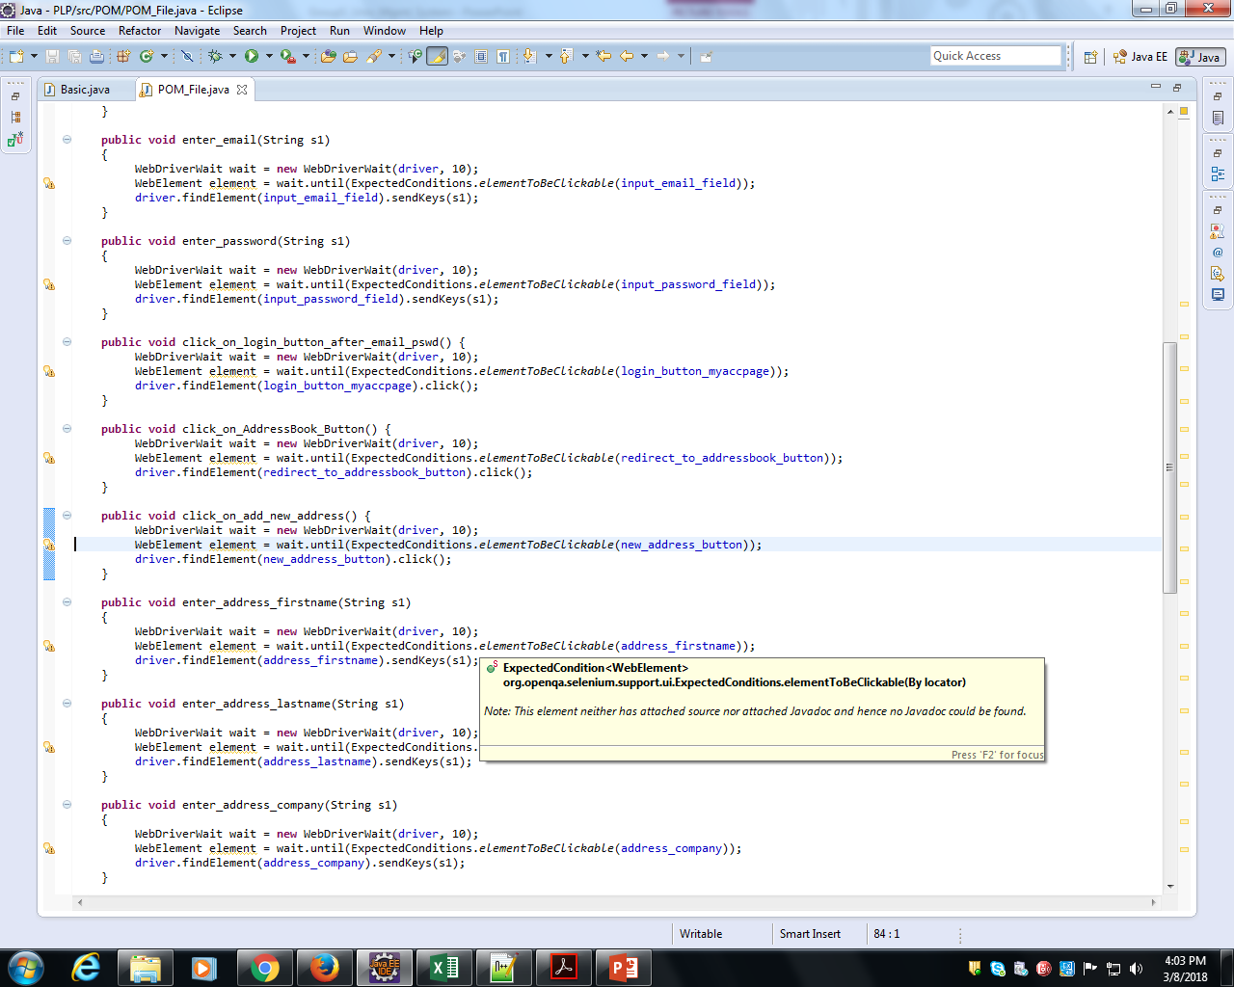

POM_file program(Contd….)

Slide 9
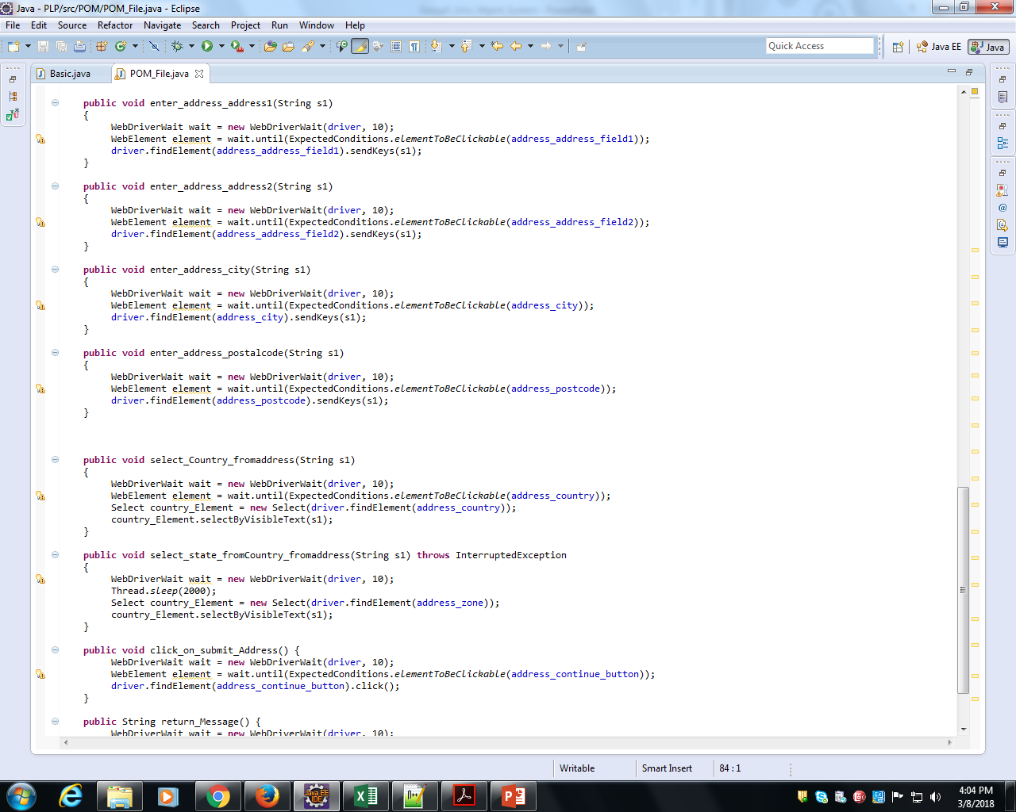

POM_file program(Contd….)

Slide 10
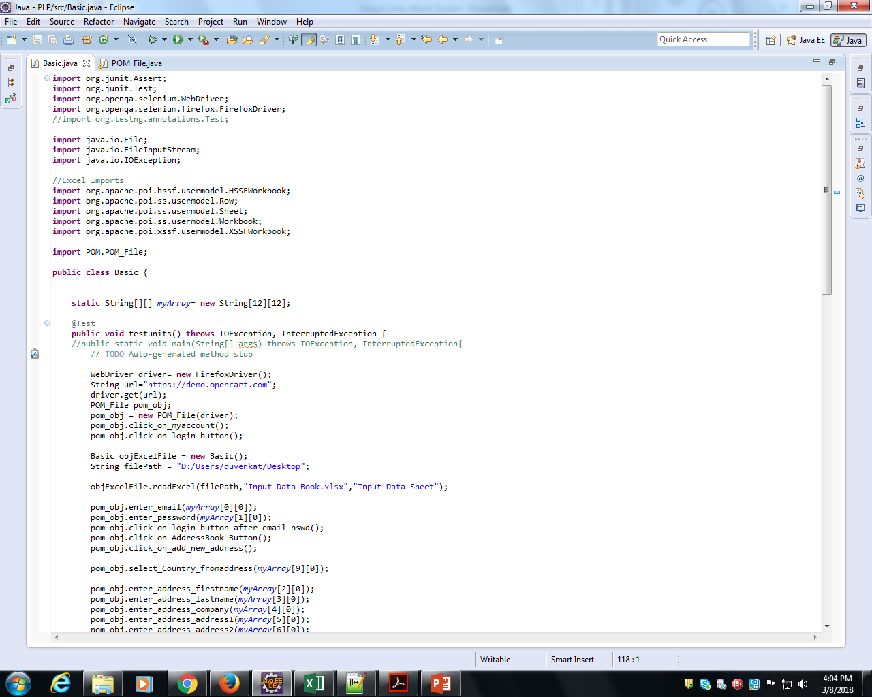

Basic Program

Slide 11
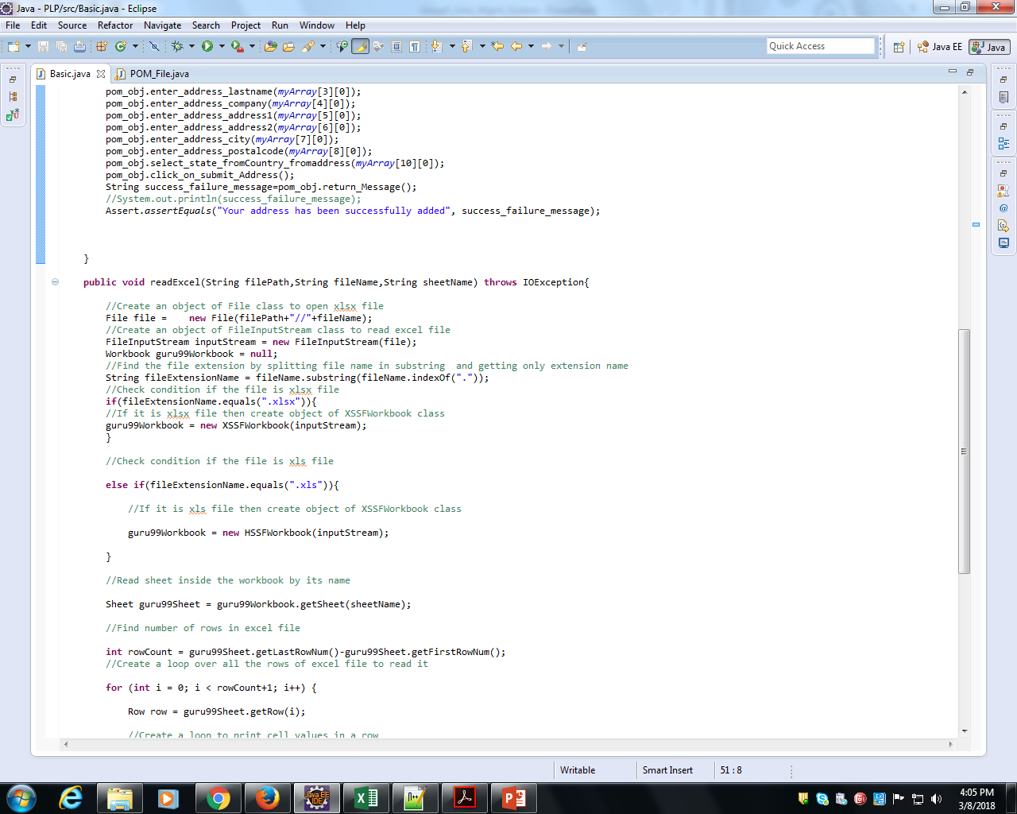

Basic Program(contd…)

Slide 12
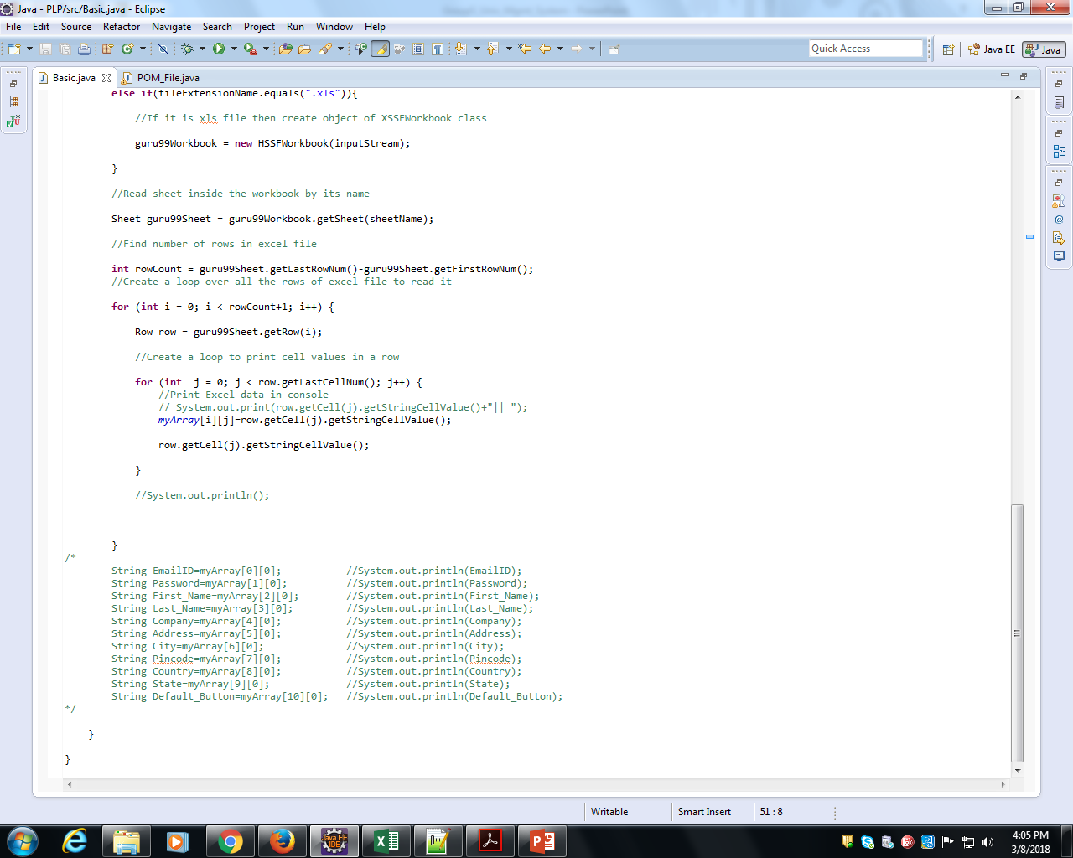

Basic Program(contd…)

Slide 13


Input data from Excel Sheet

Slide 14
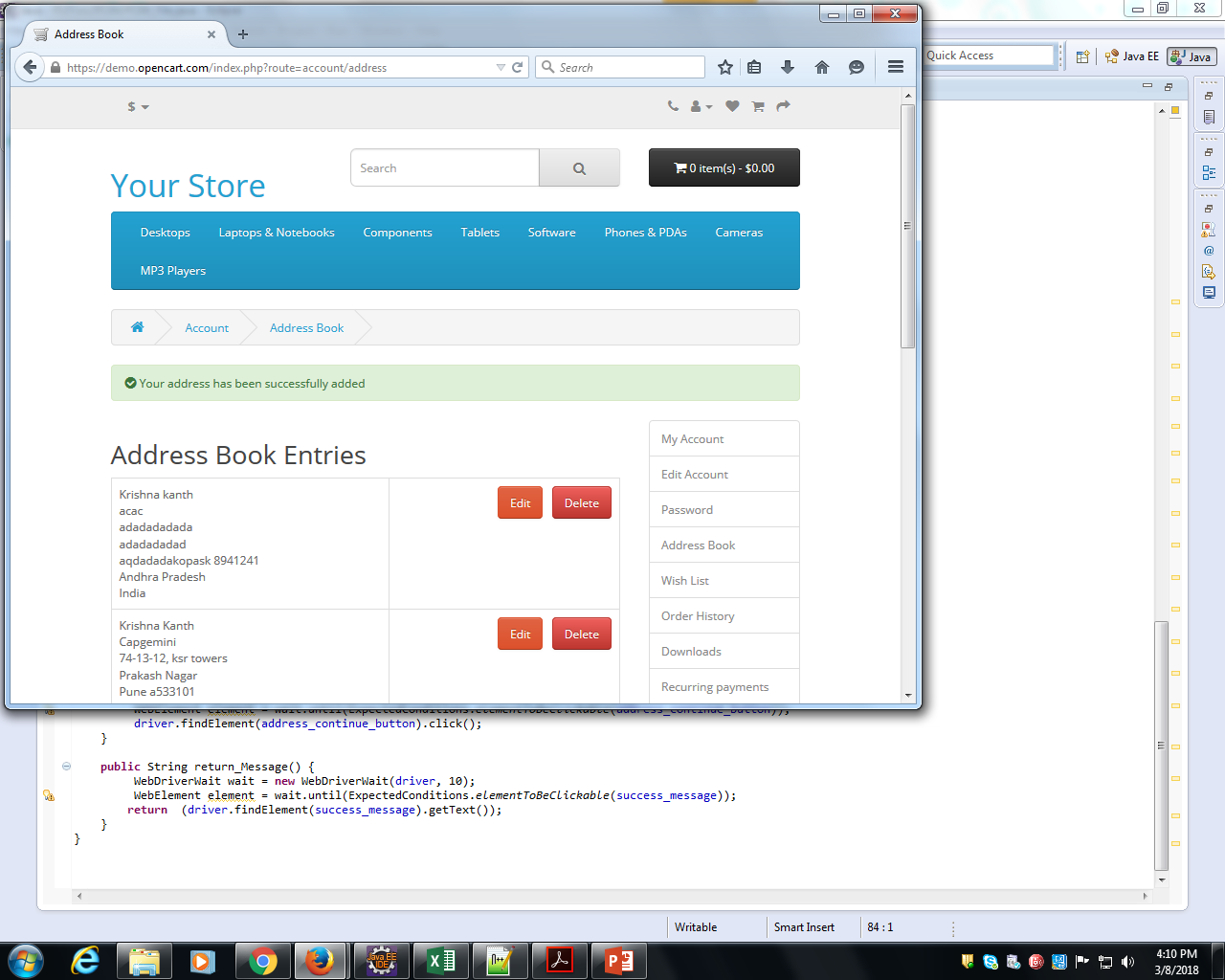

Output

Slide 15
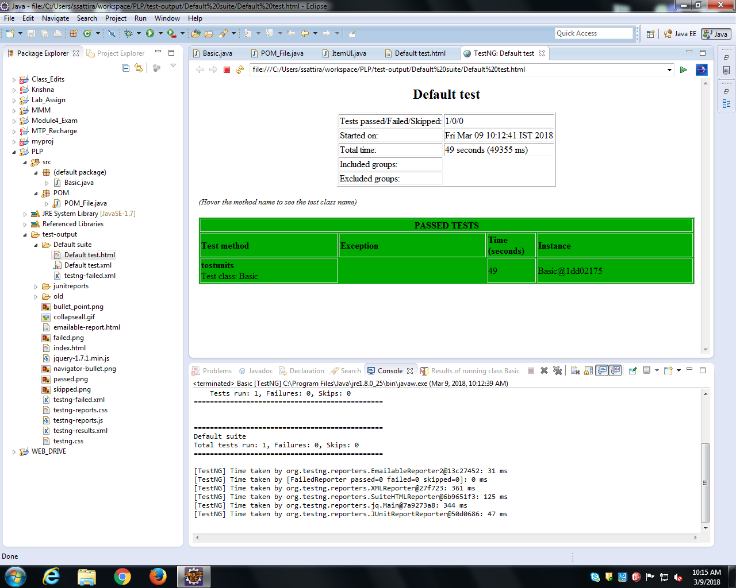

Slide 16
THANK YOU

