Slide 1
2-D String Matching
And
Pattern Identification
Presented By:
Jyoti Gambhir
Arushi Agarwal

Slide 2
Topics to be covered:
Problem Statement
1-D String Matching Algorithms
Rabin Karp Algorithm
Knuth Morris Pratt
Aho-Corasick Algorithm
2-D String Matching Algorithms:
Naive (Brute Force)
Zhu-Takaoka
Baker-Bird
Baeza-Yates Regnier
Experimental Results & Conclusion

Slide 3
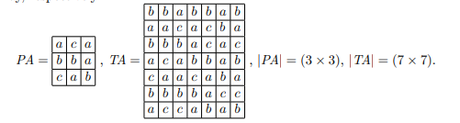
Problem Statement
Let q be an alphabet over the character set,
Given a Text Array TA (n * n) and Pattern Array PA(m * m), report all locations (i, j) in TA where there is an occurrence of PA, i.e. TA (I + k, j + l) = PA(k, l) for 0 <= k, l <= n and m <= n.

Slide 4
1-D String Matching Algorithms
1D string matching requires searching of a linear pattern inside a 1 dimensional text. Following 1-D String Matching Algorithms can be extended to solve 2-D String Matching Problem:
Rabin Karp Algorithm
Knuth Morris Pratt Algorithm
Aho-Corasick Algorithm

Slide 5
Rabin Karp Algorithm
Checks pattern by moving window one by one.
Without checking all characters for all cases, computes hash value.
When hash value matches, it compares the strings for equality.
We need to compute hash values efficiently.
Uses the concept of Rolling Hash.
Hash is recomputed from the current hash.
Rehash must be in O(1).

Slide 6
Knuth Morris Pratt
Uses degenerating property of the pattern
Improves the worst case complexity to O(n)
Whenever a mismatch detected, avoid matching the characters that we know will anyway match.
Finds longest proper prefix which is also suffix to find the starting index for comparison on mismatch.
Has 2 phase: build the lps[] array and then search for the pattern using lps[]

Slide 7
Aho-Corasick Algorithm
Contains two main stages:
Finite State Machine Construction Stage
Matching Stage
Finite State Machine Construction:
Constructs a finite state machine that resembles trie with additional links between internal nodes.
Extra links allows fast transitions between failed string matches.
Matching Stage:
Text is iterated over constructed automata for pattern search.

Slide 8
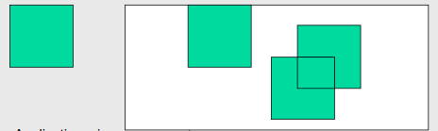
Onto the problem of 2D Pattern Matching
Finds application in image processing, graphical imaging and multimedia
Need to work in higher levels of pattern matching dimensions noticed.
Given a 2D pattern and a 2D text, find all occurrences of pattern in text
Naive approach is to go repeatedly check the entire text for pattern

Slide 9
Need to do better than Brute Force.
Consider some combination of 1D string matching Algorithms?

Slide 10

ZHU TAKAOKA ALGORITHM
Apply RK’s Rolling Hash idea on columns
Translate the 2D arrays of characters of TEXT and PATTERN to one-dimensional numbers TEXT’ and PATTERN’ respectively;
Then search TEXT' for the occurrences of the PATTERN' using the KMP technique row by row
Rolling Hash makes for efficient preprocessing of text
Time Complexity : O(n*n + m*m)
Space Complexity : O(n*n + m*m)

Slide 11
Baker Bird Algorithm
Uses standard Aho-Corasick Algorithm.
Row Matching Step:
Give a number for each distinct row.
Give number for each row of Pattern (PA’).
Build new array R (Text Matrix processed).
Computation of R is done by AC.
Build Deterministic Automata for rows of PA.
For each row of TA, run AC.
Column Matching Step:
Given R, check if all rows of PA appear vertically.
For each column of R, run KMP with processed PA’ as pattern.
Time Complexity : O(n*n + m*m)
Space Complexity : O(n*n + m)

Slide 13
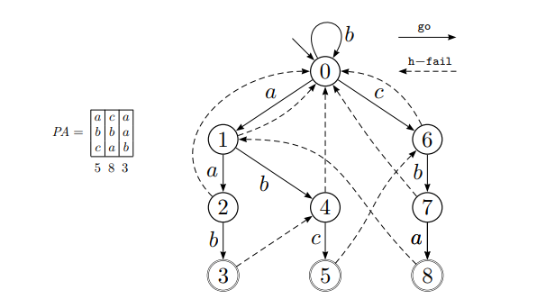

Slide 14
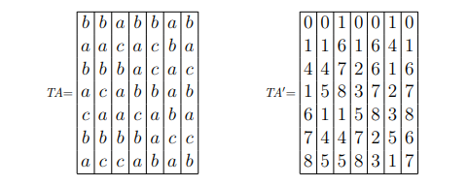

Slide 15
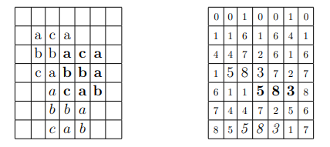

Slide 16
Baeza-Yates Regnier Algorithm
uses dictionary searching to locate two-dimensional pattern.
Treat pattern as a dictionary of strings and perform search only in n/m rows.
If match is found at ith location then m-1 rows above and below ith location are searched.
Search is performed using Aho-Corasick algorithm similar to Baker Bird Algorithm.
Time Complexity : O(n*n + m*m)
Space Complexity : O(n*n + m)

Slide 17
Experimental Results
We’ve used Python’s matplotlib module to plot graph of input text-size vs run time for all the 4 algorithms.
Various square text matrices were given as input
The performance of each of the 4 algorithms can easily be observed from the graphs, and analysis of how they scale against each other can be made too.

Slide 18
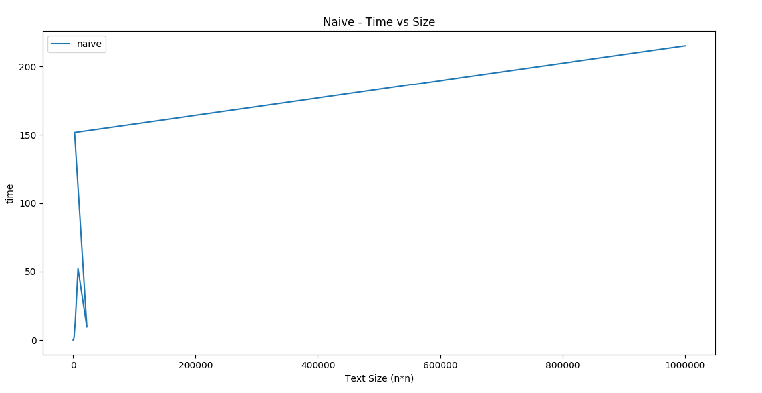
NAIVE Algorithm

Slide 19
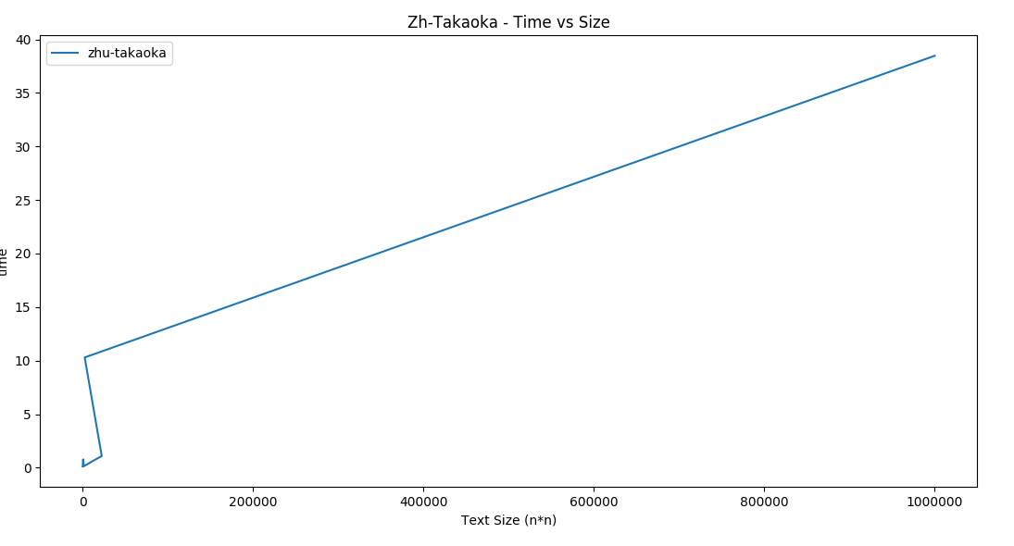
ZHU-TAKAOKA

Slide 20
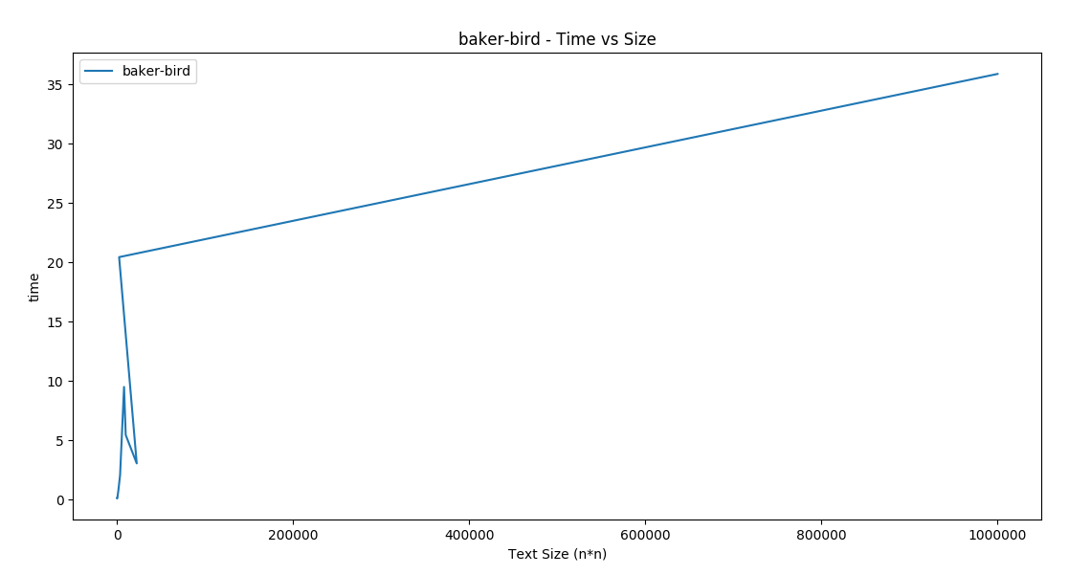
BAKER-BIRD

Slide 21
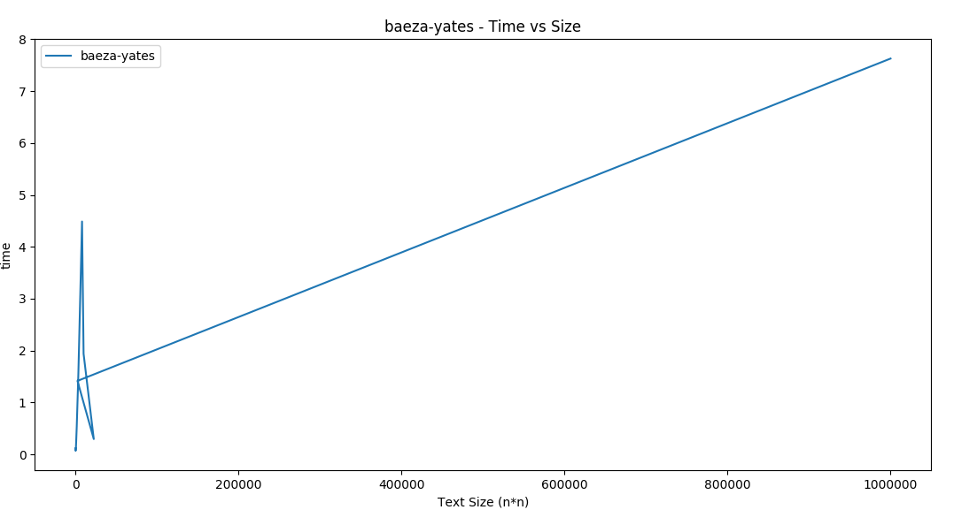
BAEZA-YATES REGNIER

Slide 22
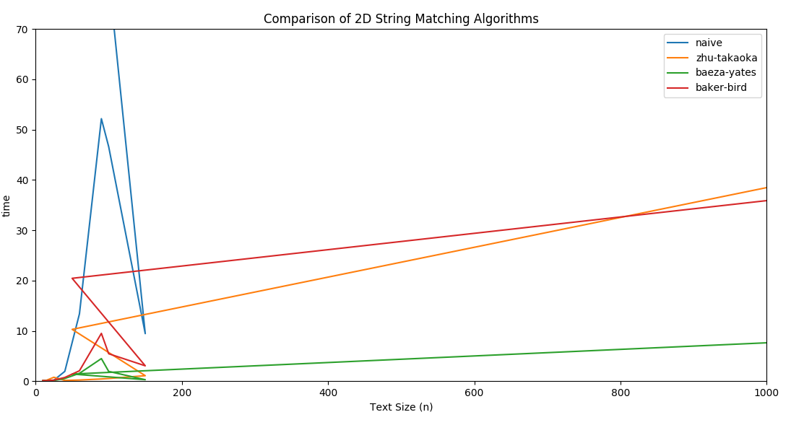
Naive vs Zhu-Takaoka vs Baeza-Yates vs Baker-Bird

Slide 23
Conclusion
Following conclusions can be drawn from the above experimental results:
Naive algorithm with time complexity O(m*n*m*m) performs the worst in all cases.
Although all the three algorithms, namely Zhu-Takaoka, Baker-Bird, Baeza-Yates Regnier, have the same time complexity of O(n*n+m*m), but with increase in size of the text matrix, Baeza-Yates outperforms the other two giving the best performance.
Thus, we can conclude that for larger input sizes Baeza-Yates Regnier would give best worst case time complexity.

Slide 24
Thank You!

