Slide 1
KURRA DURGA SRINIVAS
Final Project
3/21/2024 Annual Review

Slide 2

KEY LOGGER AND SECURITY
This Photo by Unknown Author is licensed under CC BY-ND
3/21/2024 Annual Review

Slide 3


AGENDA
*INDRODUCTION
*PROBLEM STATEMENT
*PROJECT OVERVIEW
*WHO ARE THE END USERS?
*SOLUTION AND ITS VALUE PROPOSITION
*”WOW” FACTOR IN SOLUTION
*MODELLING
*RESULT
*CONCLUSION OF THE PROJECT
3/21/2024 Annual Review

Slide 4

PROBLEM STATEMENT Develop a keylogger application for security and monitoring purposes, equipped with a graphical user interface (GUI) Using python *KEYLOGGER:Keyloggers are a significant threat to cybersecurity, leading to unauthorized access to sensitive information, identity theft, and financial fraud. *IMPACTS: Affects individuals, businesses, and organizations by compromising data privacy and security.
3/21/2024 Annual Review

Slide 5

PROJECT OVERVIEW 1.Objective: Develop an ethical keylogger software with a user-friendly graphical user interface (GUI) to monitor keyboard activity on a computer. The software will ensure transparency, security, and ease of use, making it suitable for parental control. 2. Scope: The keylogger and its GUI will be designed for family computers with explicit consent from all users. The software will only be used for ethical purposes, such as monitoring children’s computer activities.
3/21/2024 Annual Review

Slide 6
PROJECT OVERVIEW *KEYLOGGING Capture and record all keystrokes made by the user. Distinguish between keys that are pressed, held, and released. Store keystrokes in a JSON file (key_log.json) in a structured format. Append all keystrokes to a text file (key_log.txt) in a continuous string format. *GUI Create a GUI using Tkinter. Include a label to display the current status of the keylogger. Provide "Start" and "Stop" buttons to control the keylogging process. The "Start" button should initiate the keylogging and become disabled once clicked. The "Stop" button should stop the keylogging and become disabled until the keylogger is started again.
3/21/2024 Annual Review

Slide 7

WHO ARE THE END USERS? *Individuals: Concerned about personal data security and privacy. * Businesses: Need to protect corporate data and ensure compliance with security standards *Organizations: Require robust security measures to safeguard sensitive information. *Security Professionals: Aim to understand and mitigate keylogging threats.
3/21/2024 Annual Review

Slide 8
YOUR SOLUTION AND ITS VALUE PROPOSITION Solution: Implement a multi-layered security strategy that includes anti-keylogging software, regular system scans, software updates,and user education. AVOID KEYLOGGERS: *Use anti virus program *Use password manager *Use multi factor authentication *Use a firewall *Avoid suspicious links and downloads *Change password periodically *Update your system *Use Virtual Keyboard to type passwords and sensitive information
3/21/2024 Annual Review

Slide 9
YOUR SOLUTION AND ITS VALUE PROPOSITION VALUE PROPOSITION: Enhanced Security: Reduces the risk of data breaches and identity theft. User Awareness: Educates users about keylogging threats and protection methods. Compliance: Helps businesses and organizations comply with data protection regulations.
3/21/2024 Annual Review

Slide 10

THE WOW IN YOUR SOLUTION 1.User-Friendly Interface:Intuitive GUI 2.Real-Time Monitoring and Logging: Immediate Feedback 3.Multi-Format Logging: Versatile Data Storage 4.Enhanced Security and Privacy: Encrypted Logs, User Consent Mechanism 5.Advanced Keystroke Tracking: Detailed Event Capture Scalable and Customizable 6.Ethical and Legal Compliance: Clear Documentation
3/21/2024 Annual Review
10

Slide 11
MODELLING
Data Modeling
System Architecture
Security Measures
Pseudocode
Use Case Scenarios
This Photo by Unknown Author is licensed under CC BY-SA
3/21/2024 Annual Review
11

Slide 12
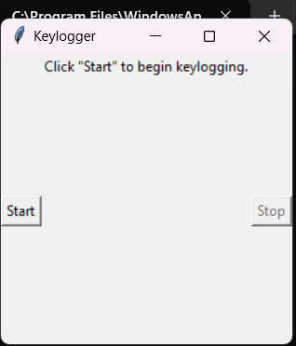
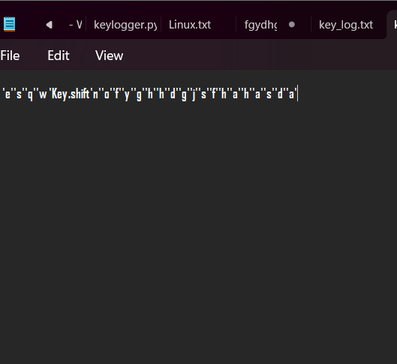
RESULTS
3/21/2024 Annual Review
12

Slide 13
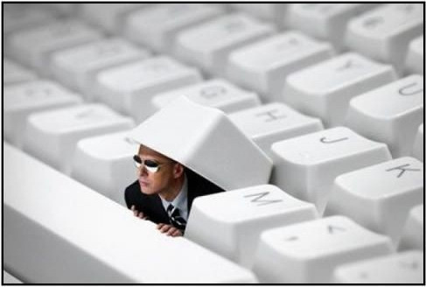
This Photo by Unknown Authoris licensed under CC BY-SA-NC
CONCLUSION
Successfully implemented a keylogger that captures keystrokes
and records them into both text and JSON files.
Real-time keylogging with start and stop functionality controlled via a simple GUI.
*The keylogger project demonstrated the capability to effectively capture and log keystrokes in real-time.
*The GUI provided a user-friendly way to control the keylogger, making it accessible and easy to use.
*Emphasized the ethical use of keyloggers and the importance of implementing security measures to protect against malicious use.
3/21/2024 Annual Review
13

