Slide 1


Machine Learning and Cognitive Services
Karthikeyan VK
@karthik3030
Karthik_3030@yahoo.com

Slide 2

What is Machine Learning ?
Enter Text
Looking for patterns in Data
Generate Code
Recognize those pattern in new Data

Slide 3
What Machine Learning does ?
Enter Text
Predicting future
Organizing or Grouping

Slide 4
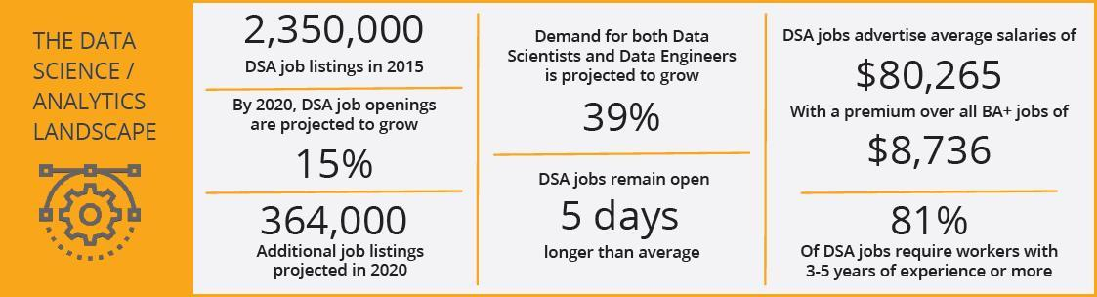
Why should I Care ?
Enter Text

Slide 5
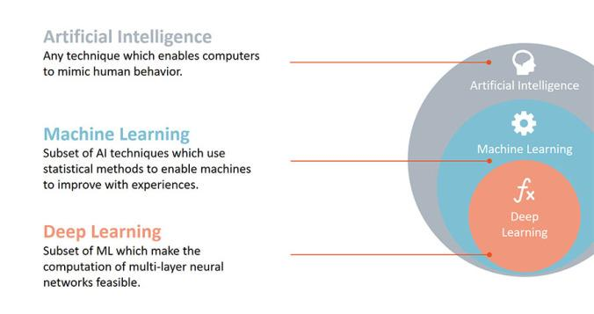
Artificial Intelligence vs ML vs Deep Learning
Enter Text
Notes:
Talk about neural networks
Talk about AI will never be AI
Talk about Siri, Cortana

Slide 6
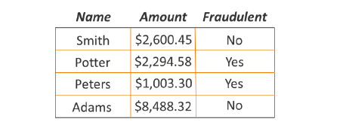
Find Patterns
Enter Text

Slide 7
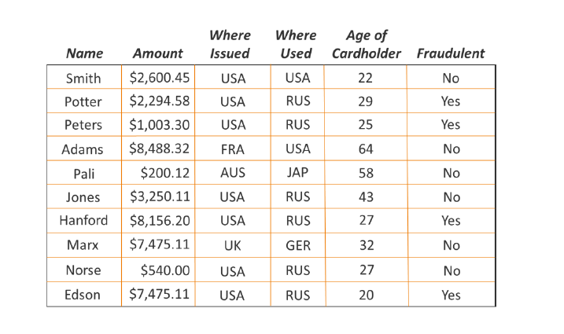
Enter Text
Find Patterns now

Slide 8
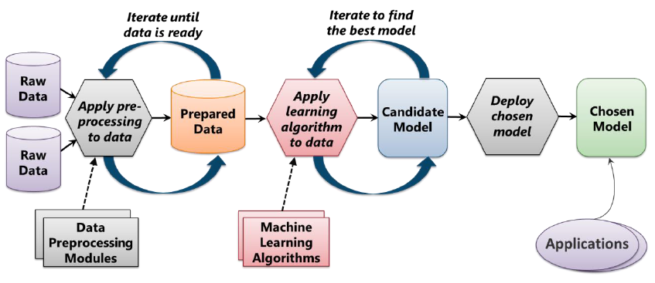
Enter Text
Machine Learning Process
Notes:
Prepare/Clean Data
Split Data between train and test
Choose algorithm
Train model
Test model
Evaluate model

Slide 9
Role of Data Scientist
Enter Text
Which raw data to use?
How should that data be processed to create prepared data?
Identify Combinations of prepared data and machine learning algorithms should you use to create the best model?
Notes:
data scientist is a specialist in solving problems like the ones that arise in machine learning. People in this role typically have a wide range of skills. They’re comfortable working with complex machine learning algorithms, for example, and they also have a strong sense of which of these algorithms are likely to work best in different situations. A data scientist might also need to have software development skills, as they’re often called upon to write code.

Slide 10
Basics
Enter Text
Statistics
Linear algebra
Probability
Standard deviation
Slope
Notes:
Naïve bayes – finding whose emails it might be based on word, the label is hidden

Slide 11

Fallacies vs Bias vs Variance
Enter Text
Fallacies are mistakes of reasoning
Thinking habits which are likely to threaten objectivity or to lead to errors in reasoning.
Error from sensitivity to small fluctuations(Including anomaly)

Slide 12
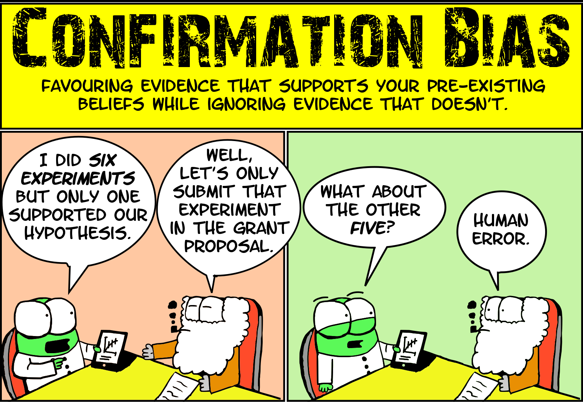
Enter Text

Slide 13
Features vs Labels
Enter Text
Features
Input
Labels
Output
Name, Amount, Where Issued, Age of Cardholder
Genuine/Fraud

Slide 14
Five Questions
Enter Text
Is this A or B ?
Is this Weird ?
How much or many ?
How this is organized ?
What should I do next ?

Slide 15
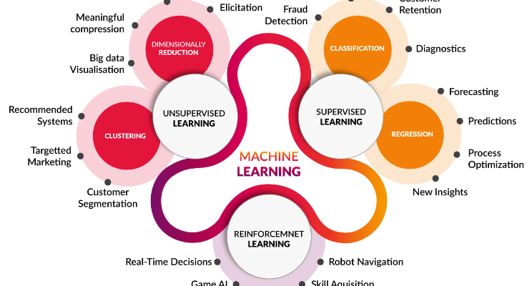
Types of algorithms
Enter Text
Notes:
Error from sensitivity to small fluctuations(Including anomaly) . Overfitting

Slide 16
Supervised Learning
Enter Text
Classification
Regression
Anomaly Detection
Notes:
Error from sensitivity to small fluctuations(Including anomaly) . Overfitting

Slide 17
Enter Text
Supervised Learning - Classification
Notes:
Error from sensitivity to small fluctuations(Including anomaly) . Overfitting

Slide 18
Enter Text
Supervised Learning - Regression
Notes:
Error from sensitivity to small fluctuations(Including anomaly) . Overfitting

Slide 19
Enter Text
Supervised Learning – Anomaly Detection
Notes:
Error from sensitivity to small fluctuations(Including anomaly) . Overfitting

Slide 20
Un-Supervised Learning
Enter Text
Clustering
Dimensionally Reduction
Notes:
Error from sensitivity to small fluctuations(Including anomaly) . Overfitting

Slide 21
Un-Supervised Learning - Clustering
Enter Text
Notes:
Error from sensitivity to small fluctuations(Including anomaly) . Overfitting

Slide 22
Enter Text
R vs Python
Notes:
Error from sensitivity to small fluctuations(Including anomaly) . Overfitting

Slide 23
Enter Text
Usages of Machine learning
Notes:
Error from sensitivity to small fluctuations(Including anomaly) . Overfitting

Slide 24
Enter Text
Philosophical question

Slide 25
Books & Movies
Enter Text
Cartoon Introduction to Statistics
Thinking Fast & Slow by Daniel Kaheman
Art of thinking clearly – Rolf Dobelli
I-Robot
Terminator 2
Notes:
I-Robot
Terminator 2

Slide 26
Enter Text
DEMO

Slide 27
Enter Text
References
https://docs.microsoft.com/en-us/azure/machine-learning/studio/data-science-for-beginners-the-5-questions-data-science-answers
https://docs.microsoft.com/en-us/azure/machine-learning/studio/what-is-ml-studio
https://in.udacity.com/course/intro-to-machine-learning--ud120
https://app.pluralsight.com/player?course=python-getting-started&author=bo-milanovich&name=python-getting-started-m1&clip=2&mode=live
@karthik3030

Slide 28
Enter Text
Need Meetup Space
@karthik3030

Slide 29
Enter Text
Thank you /Q&A
@karthik3030

