Slide 1
Server-less Architecture
Karthikeyan VK
Web Architect
Karthik_3030@yahoo.com
Twitter: @Karthik3030
Facebook: karthik3030
Blogs.karthikeyanvk.in

Slide 2
What is Server-less Architecture
No server dedicated for a single application
Third party services
You don’t own a server
Custom code that is not ALWAYS ON
Notes:
No Server dedicated which listens to one application all the time
Third Party application such as Auth0, Cloud based systems, Google drive

Slide 3
Types of Server-less Architecture
Baas
Backend as a Service
Faas
Function as a service
Notes:
Baas – Backend as service, mainly used for mobile development platform – Push notifications, Integration with Social media
Faas – Functions as Service, AWS lambda and Azure functions

Slide 4
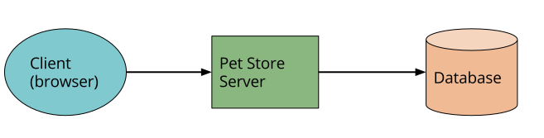
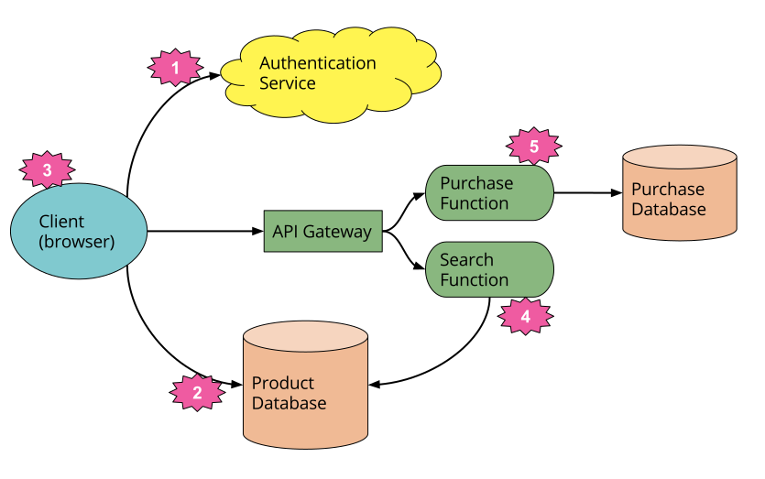
Server vs Server-less Architecture
Server
Server-less Architecture
Notes:
We’ve deleted the authentication logic in the original application and have replaced it with a third party BaaS service.
Using another example of BaaS, we’ve allowed the client direct access to a subset of our database (for product listings), which itself is fully 3rd party hosted (e.g. AWS Dynamo.) We likely have a different security profile for the client accessing the database in this way from any server resources that may access the database.
These previous two points imply a very important third - some logic that was in the Pet Store server is now within the client, e.g. keeping track of a user session, understanding the UX structure of the application (e.g. page navigation), reading from a database and translating that into a usable view, etc. The client is in fact well on its way to becoming a Single Page Application.
Some UX related functionality we may want to keep in the server, e.g. if it’s compute intensive or requires access to significant amounts of data. An example here is ‘search’. For the search feature instead of having an always-running server we can implement a FaaS function that responds to http requests via an API Gateway (described later.) We can have both the client, and the server function, read from the same database for product data.
Since the original server was implemented in Java, and AWS Lambda (our FaaS vendor of choice in this instance) supports functions implemented in Java, we can port the search code from the Pet Store server to the Pet Store Search function without a complete re-write.
Finally we may replace our ‘purchase’ functionality with another FaaS function, choosing to keep it on the the server-side for security reasons, rather than re-implement it in the client. It too is fronted by API Gateway.

Slide 5
Faas – In Detail
Running back end code without own server system
Different deployment system
Horizontal scaling
Triggered by event types
Notes:
Fundamentally FaaS is about running back end code without managing your own server systems or your own server applications. That second clause - server applications
FaaS offerings do not require coding to a specific framework or library.
Since we have no server applications to run deployment is very different to traditional systems
Horizontal scaling is completely automatic, elastic, and managed by the provider.
Functions in FaaS are triggered by event types defined by the provider.

Slide 6
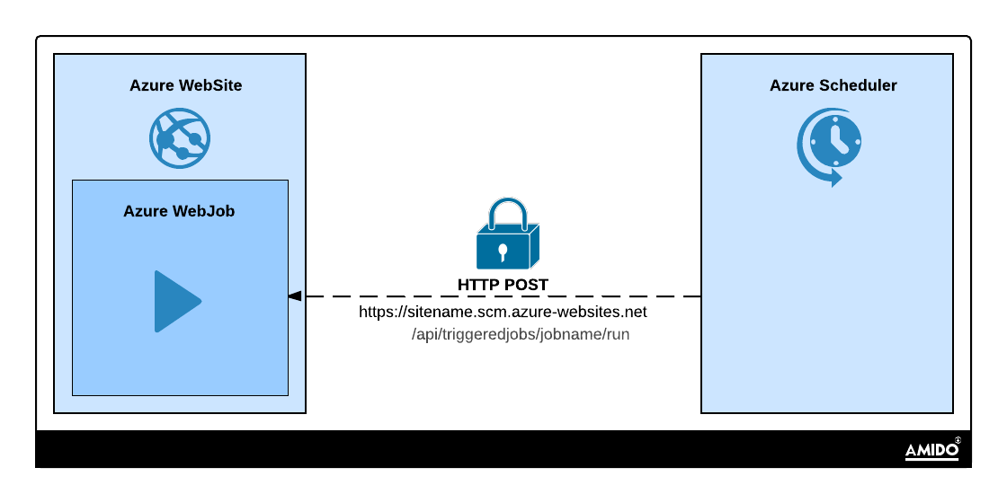
Web Jobs
Notes:
Running a program in App services. On Demand, Continously, On Schedule.

Slide 7
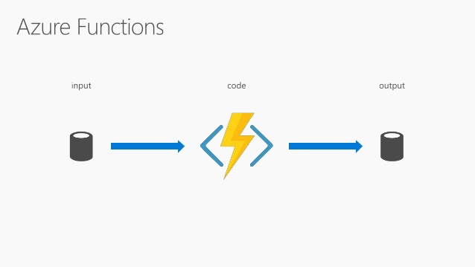
Azure Functions - Faas

Slide 8
Web Jobs vs Azure functions
Web Jobs
Azure Functions
Executable/Script always running
Requires always on - Basic tier and above
Scaling is manual to set up
You can extend and run whatever you want. Full control
Run on Demand or event triggered
Fully managed, dynamic scaling
Charged only for usage
Separate process
Slow Start-up

Slide 9
Types of Azure functions
Timer Trigger
Web Hook + API
Data Processing

Slide 10
Demo

