Slide 1
Project Title:
Hybrid Deep Learning Model for Brain Tumor Detection Using CNN and EfficientNet from MRI Images
Project Guide
N.Bhuvaneswari
Department of CSE
NRIIT,Guntur
Head of the Department
K.Nageswara Rao
Professor & HOD
Department of CSE
NRIIT,Guntur

Slide 2
Vaka Durga Teja Department of Computer Science and Engineering NRI Institute of Technology, Guntur, Andhra Pradesh-522438 Email: durgtejavaka@gmail.com 24KP1D5838

Slide 3
Abstract
Brain tumors are dangerous neurological disorders requiring early diagnosis.
Manual MRI analysis is time-consuming and may lead to human errors.
The proposed system uses a hybrid deep learning model combining CNN and EfficientNet.
MRI images are processed and classified automatically.
The system improves detection accuracy and assists radiologists in diagnosis.
Achieved accuracy of approximately 97%.

Slide 4
Problem Statement
Manual brain tumor detection requires expert radiologists.
Diagnosis from MRI scans can be slow and error-prone.
Existing systems provide lower accuracy and inefficient feature extraction.
Need for an automated, fast, and accurate detection system.
Objective
To develop a deep learning-based automated brain tumor detection system using MRI images.

Slide 5
Existing System
Manual MRI image analysis
Time-consuming process
Requires experienced radiologists
Lower prediction accuracy
Difficult to handle large datasets
Limitations
Human Errors
Slow Diagnosis
Inefficient feature extraction

Slide 6
Proposed System
Automated Brain Tumour Detection Using Deep Learning
Hybrid CNN + EfficientNet model
Automatic Feature Extraction
Faster and more accurate predicitions
Improved classification performance
Advantages
High accuracy
Reduced human effort
Faster Diagnosis
Better Feature Learning

Slide 7
Existing vs Proposed System
Existing System | Proposed System
Manual analysis | Automated detection
Lower accuracy | Higher accuracy
Slow processing | Fast prediction
Human dependency | AI-based system
Basic methods | CNN + EfficientNet

Slide 8
Technologies used
Programming Language
Python
Libraries & Frameworks
TensorFlow
Keras
OpenCV
NumPy
Matplotlib
Scikit-learn
Tools
Google Colab
Jupyter Notebook
VS Code
Dataset
Brain MRI Image Dataset

Slide 9
System Architecture /workflow
Data Collection
Data
Preparation
Data
Augmentation
Data Pre
processing
Model Training
Evaluation
Testing

Slide 10
01
Data Collection and Pre-Processing analysis

Slide 11


Research and
Data Collection
Data Collection

Slide 12



Data Pre-Processing analysis
1) Rotation
2) Flipping
3) Scaling
Data Pre-processing

Slide 13
02
Data set Organization

Slide 14
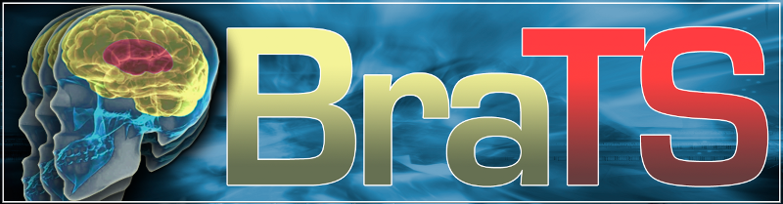
Data Set
Feature | Description
Focus | Glioblastoma (GBM/HGG) & Lower Grade Glioma (LGG)
Imaging Modalities | T1, T1Gd, T2, T2-FLAIR
Spatial Resolution | Interpolated to 1 mm³
Associated Competition | Part of MICCAI 2020 Conference
Challenges | Segmentation, OS prediction, uncertainty evaluation

Slide 15
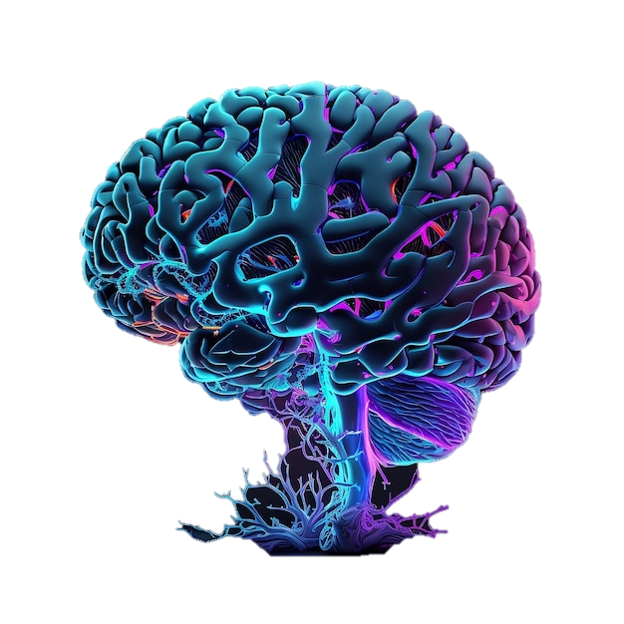
Data Set
Annual MICCAI event since 2012, dedicated to automated brain tumor segmentation.
Large-scale public datasets, hosting thousands of MRI scans and enabling fair comparison of techniques.
Attracts hundreds of global participants yearly, accelerating advances in diagnostics and personalized care.

Slide 16
03
Data Segmentation

Slide 17
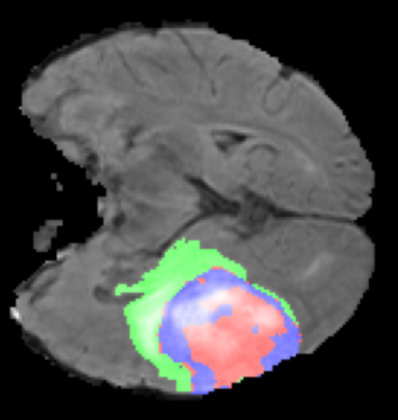
Data Segmentation
Data segmentation is the process of partitioning medical imaging data, such as MRI or CT scans of the brain, into meaningful segments or regions. In brain tumor detection, segmentation involves identifying and delineating tumors or regions of interest from surrounding tissues.
Accurate segmentation plays a pivotal role in diagnosis, treatment planning, and monitoring of brain tumors. It provides crucial spatial information about tumor location, size, and shape, aiding clinicians in making informed decisions about patient care.
Traditional segmentation methods, such as thresholding and region growing, have been supplemented by advanced approaches like deep learning-based segmentation using convolutional neural networks (CNNs). These methods offer improved accuracy and robustness in segmenting brain tumors from complex medical imaging data.

Slide 18
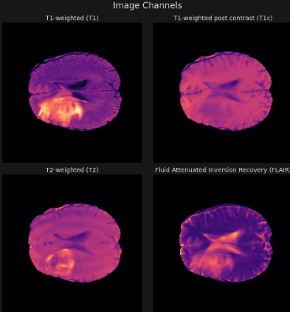
Segmentation Channels

Slide 19
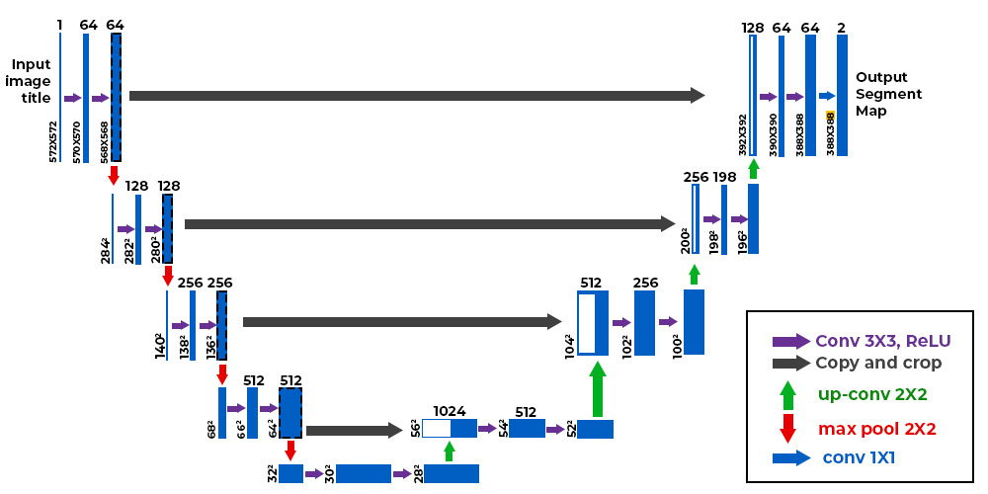
Segmentation Architecture

Slide 20
04
Data Classification

Slide 21
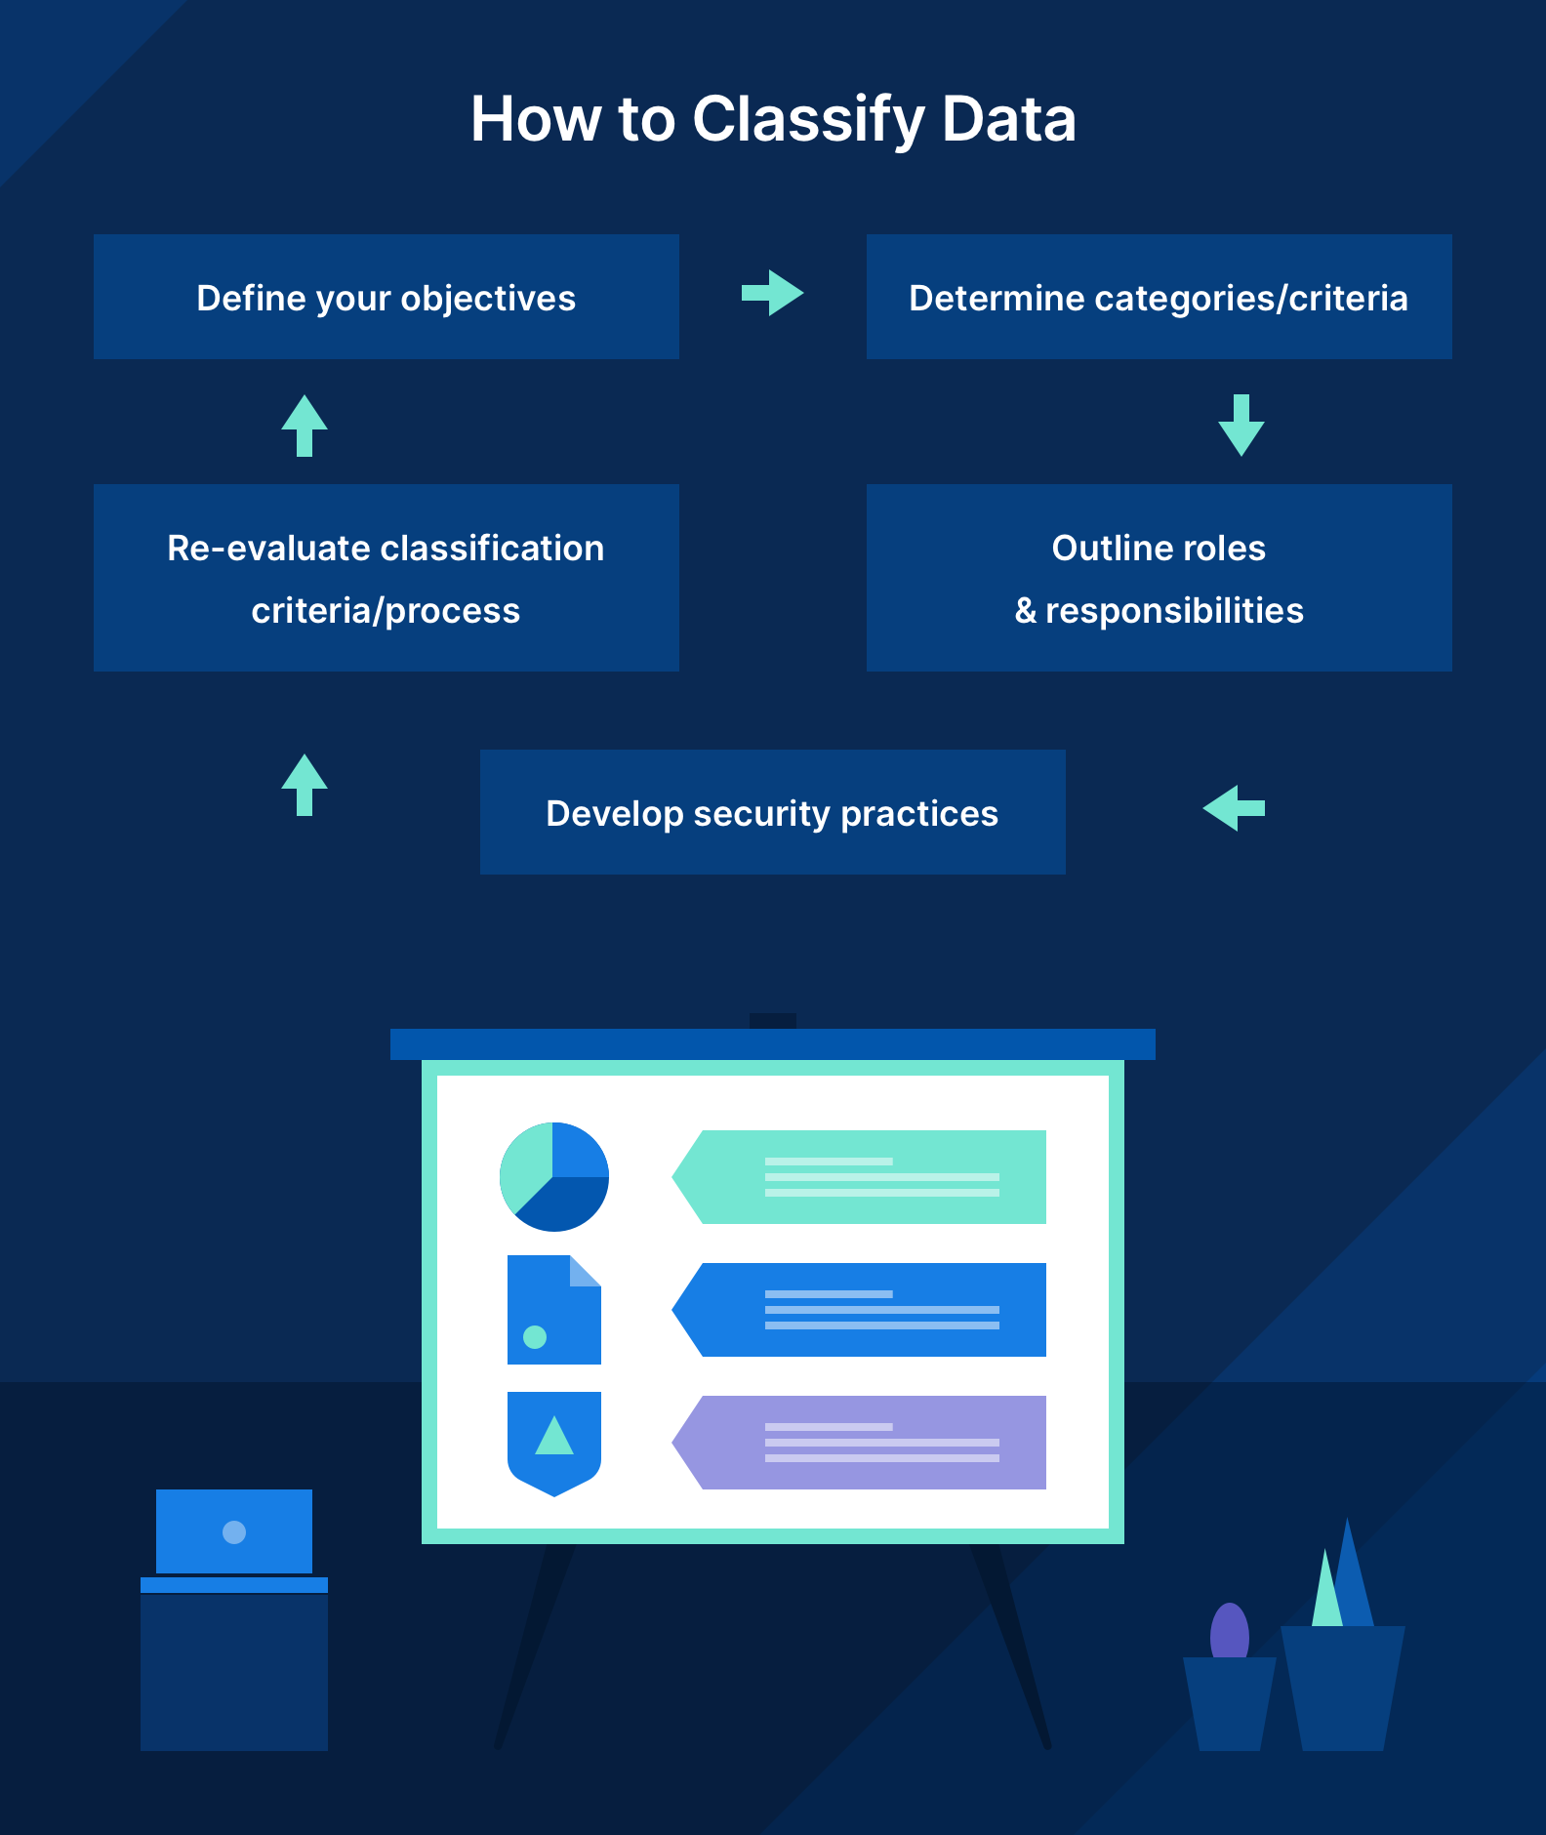
Data Classification
Data classification is the process of categorizing data into distinct groups or classes based on specific criteria or attributes. The primary objective of data classification is to organize and label data according to its characteristics, making it easier to manage, analyze, and utilize for various purposes.
Classification involves assigning predefined labels or categories to data instances, enabling automated decision-making, pattern recognition, and information retrieval.
This process is fundamental in various domains, including machine learning, data mining, information retrieval, and database management, where data classification facilitates tasks such as predictive modeling, pattern recognition, and knowledge discovery.

Slide 22
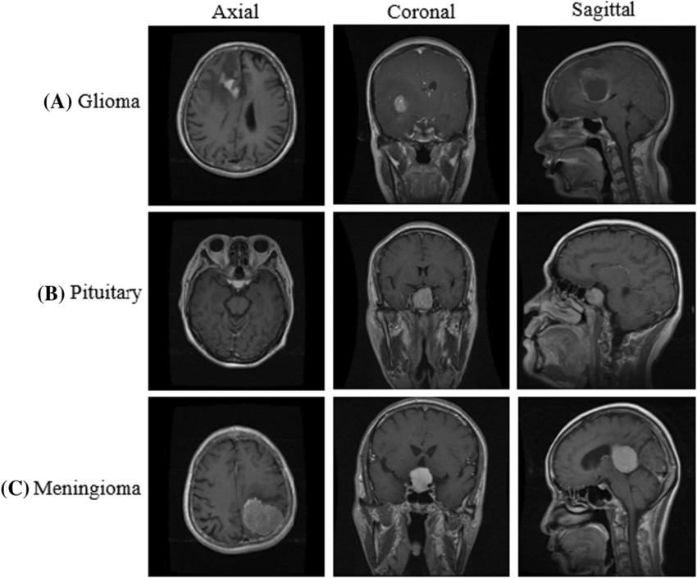
Types of Tumors

Slide 23
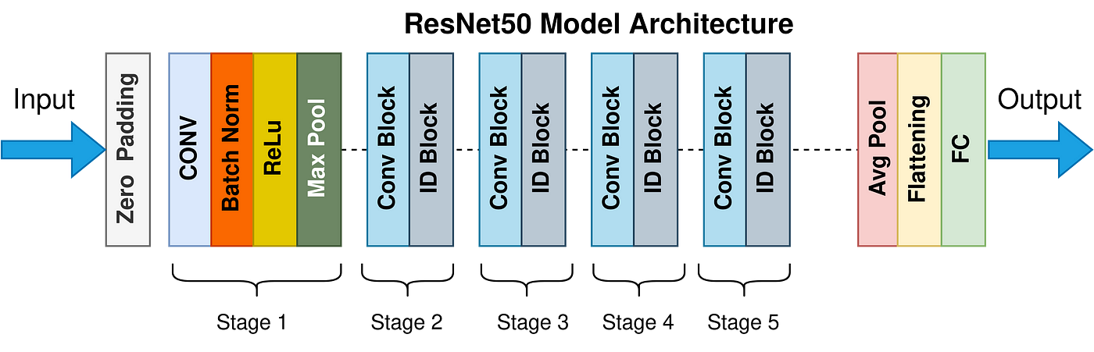
Classification Architecture

Slide 24
05
Model Testing & Front-end

Slide 25
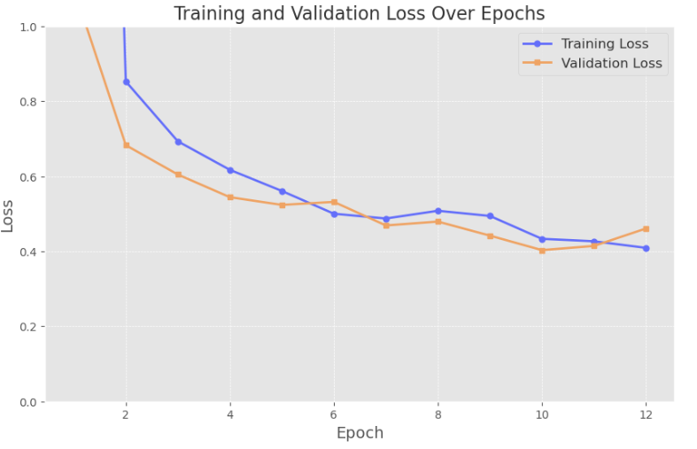
Model Testing

Slide 26
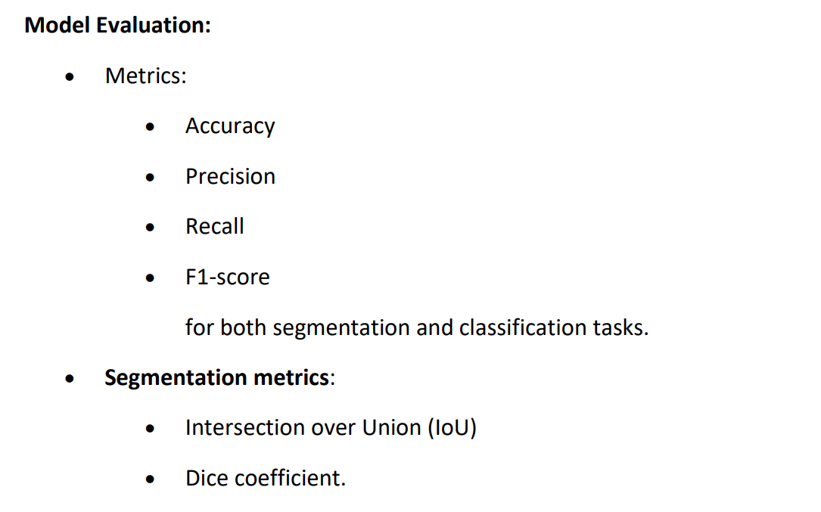
Model Testing

Slide 27
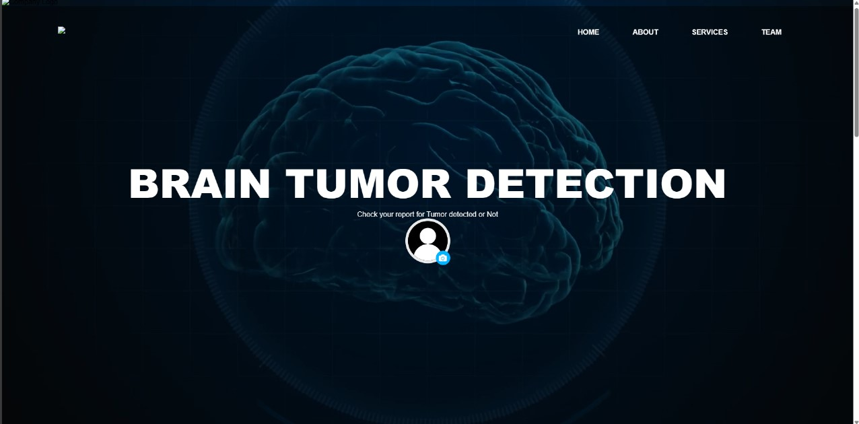
UI(User Interface)

Slide 28
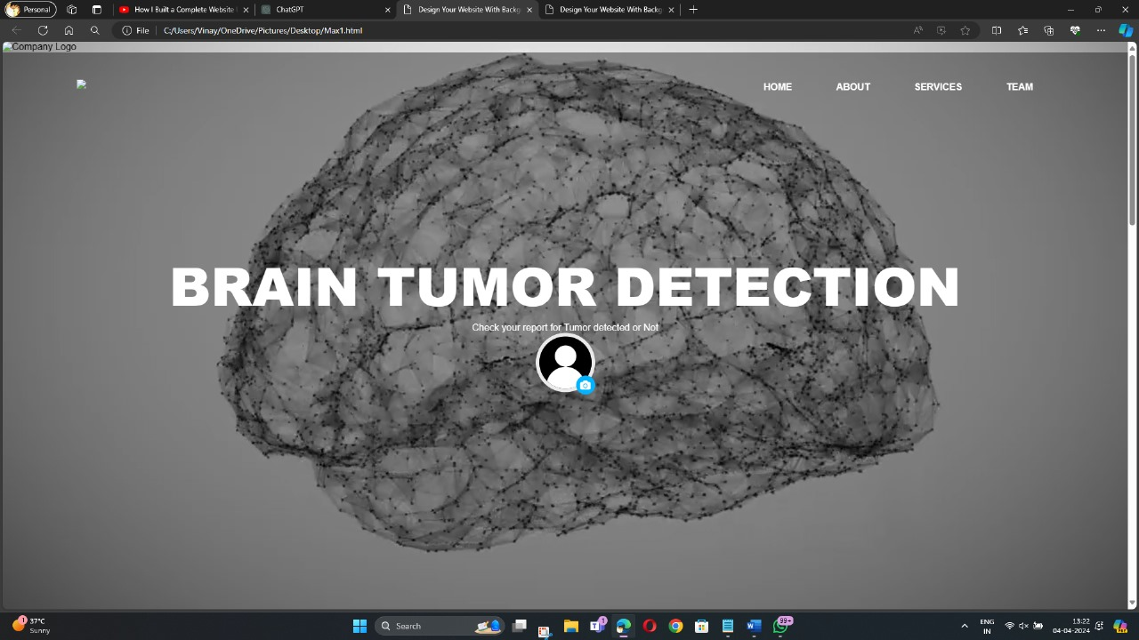
UI(User Interface)

Slide 29
Performance Metrics
Metric | Value
Accuracy | 97%
Precision | 96%
Recall | 97%
F1-Score | 96.5%

Slide 30
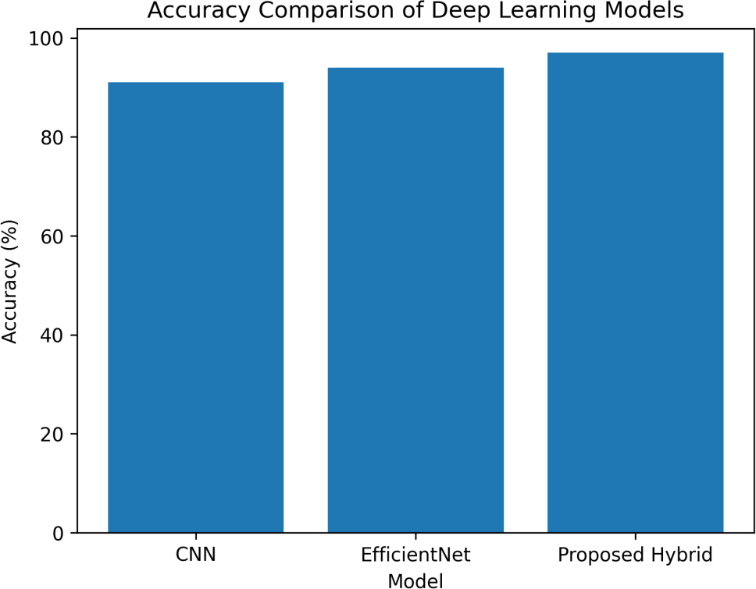
Model Comparison
Model | Accuracy
CNN | 91%
ResNet | 93%
EfficientNet | 95%
Proposed CNN + EfficientNet | 97%

Slide 31
Challenges Faced
MRI image preprocessing complexity
Handling large datasets
Model overfitting
GPU and memory limitations
Hyperparameter tuning
Long training time

Slide 32
Conclusion
The proposed hybrid CNN + EfficientNet model successfully detects brain tumors from MRI images.
The system improves prediction accuracy and reduces diagnosis time.
Automated detection helps radiologists in medical analysis.
Achieved better performance compared to existing models.

Slide 33
Future Scope
Real-time hospital implementation
Cloud-based deployment
Mobile/web application development
Multi-class tumor classification
Integration with IoT healthcare systems
Use of larger medical datasets

Slide 34
References
Brain MRI Dataset – Kaggle
TensorFlow Documentation
EfficientNet Research Paper
CNN Research Papers
IEEE/Scopus Journal References

Slide 35
Thank You!

