Slide 1
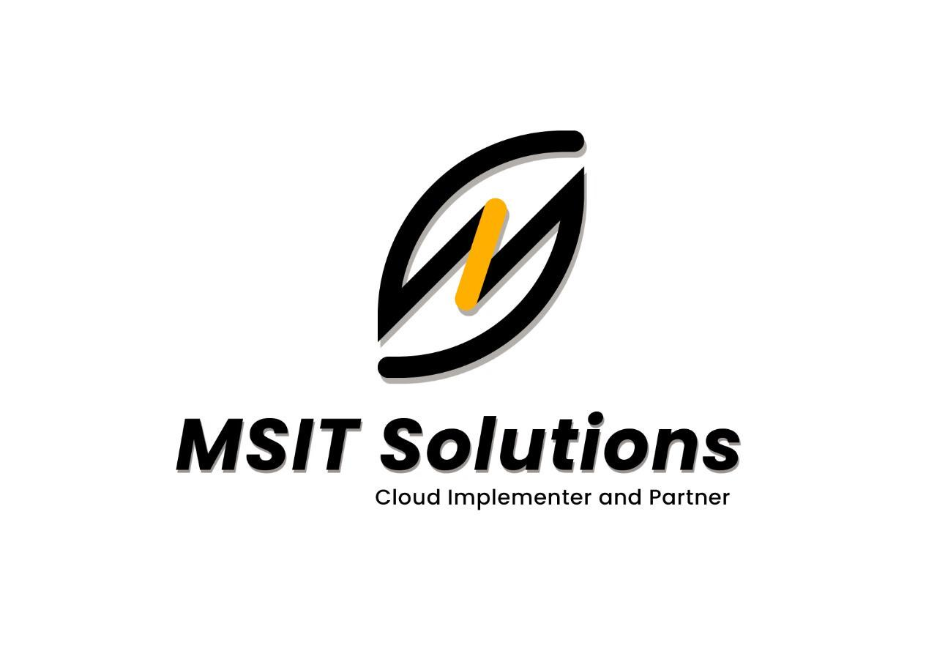
DEVOPS
http://msitsolutions.org/

Slide 2
Content
1.What is Devops
3
2.Benfits of Devops
4
CONTENTS
3.Devops Flow Model
7
TABLE OF
4.Devops Tools
8
http://msitsolutions.org/

Slide 3
What is meant by DevOps?
DevOps is the combination of cultural philosophies, practices, and tools that increases an organization's ability to deliver applications and services at high velocity.
Why DevOps ?
DevOps, essentially as an approach or a work culture, is implemented by the right amalgamation of collaboration, automation, integration, continuous delivery, testing and supervising.
http://msitsolutions.org/

Slide 4
Benefits of DevOps
1. Ensure faster deployment
2. Stabilize work environment
3. Significant improvement in product quality
4. Automation in repetitive tasks leaves more room for innovation
5. Promotes agility in your business
6. Continuous delivery of software
7. Fast and reliable problem-solving techniques
8. Transparency leads to high productivity
9. Minimal cost of production
http://msitsolutions.org/

Slide 5
INDUSTRIAL TRAINING COURSE STRUCTURE FOR DEVOPS
http://msitsolutions.org/

Slide 6
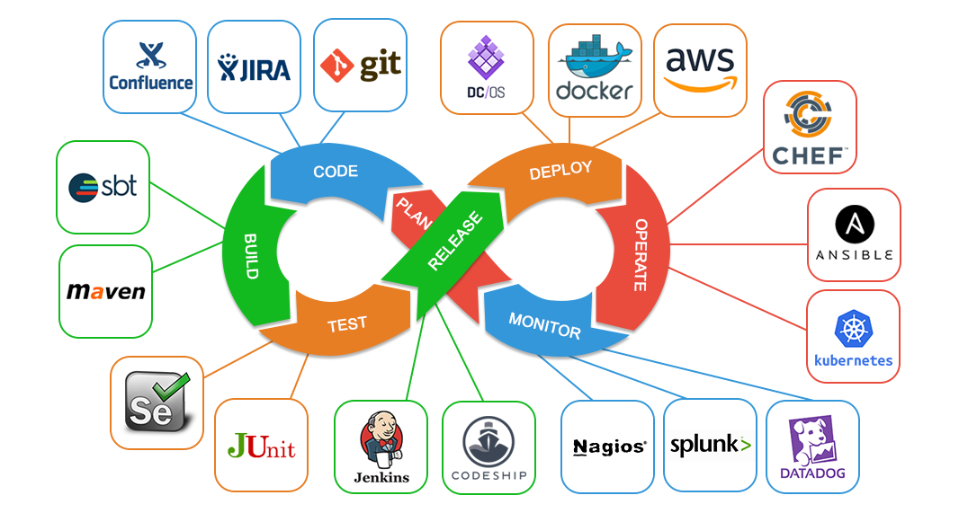
Devops Model Flow
3
4
5
6
http://msitsolutions.org/

Slide 7
DEVOPS TOOLS
1. Version Controlling system
Git : Git is a distributed version control system. This means that a local clone of the project is a complete version control repository.
These fully-functional local repositories make it is easy to work offline or remotely .
For more information click below link :
https://www.atlassian.com/git/tutorials/what-is-git.
Similar tools : Github , Gitlab, Bitbucket, Stash.
2. Operating system
Linux : Linux is a Unix-like, open source and community-developed operating system (OS) for computers, servers, mainframes, mobile devices and embedded devices. In devops perspective we use linux as main source of installation in cloud and we use some commands which are required for devops. Similar : Unix, Linux ( ubuntu, centos), Windows.
For more information click below link :
https://www.javatpoint.com/linux-commands.
http://msitsolutions.org/

Slide 8
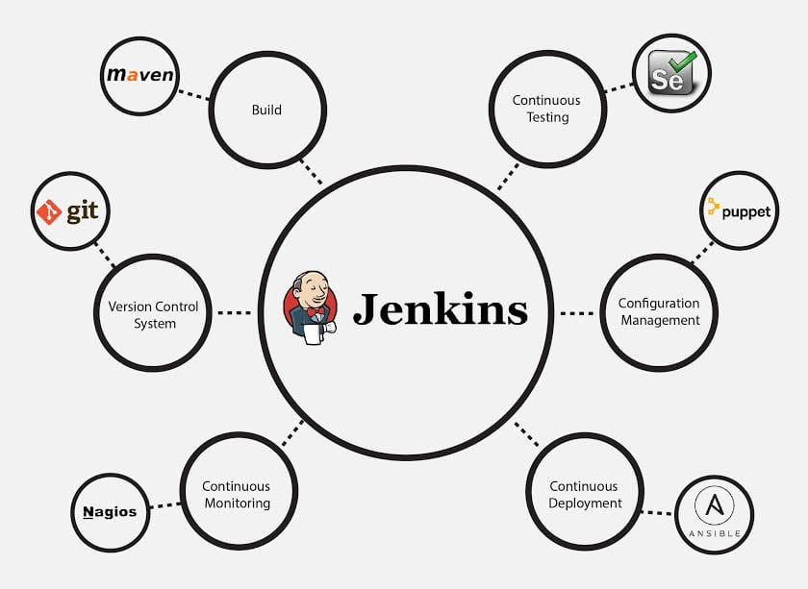
3. For Continous-Integration(CI-CD)
Jenkins : jenkins is an open-source DevOps tool that is used to automate build,test,and deployment of software. It has also integrations with other tools used in IT to make life easier.Although Jenkins is used for CI/CD (Continuous Integration/Continuous) mostly, we can think of Jenkins as tool that triggers any task.
http://msitsolutions.org/

Slide 9
In jenkins we are creating stages for ci-cd process ,creation of the code build, pieline jobs ,creation of Jenkins file ,creation of multibranches pipeline.
For more information click below link:
https://www.jenkins.io/doc/tutorials/.
https://github.com/jenkinsci/jenkins jenkins.
Bamboo : Bamboo is a continuous integration (CI) and continuous delivery (CD) tool that ties automated builds, tests and releases into a well-crafted workflow ,the differents Bamboo and other tools is the continuous delivery aspect, as Bamboo separates the actual build workflow from the deployment.
Similar tools : Team city ,Git lab, Code ship, Buddy.
http://msitsolutions.org/

Slide 10
4. Cloud :Cloud computing is the on-demand delivery of IT resources over the Internet with pay-as-you-go pricing. Instead of buying, owning, and maintaining physical data centers and servers, you can access technology services, such as computing power, storage, and databases on an as-needed basis
Aws : Amazon Web Services(AWS) is a cloud service from Amazon, which provides services in the form of building blocks, these building blocks can be used to create and deploy any type of application in the cloud.
Below are some of AWS services
s3 :s3 is (Simple Storage Service) provides object storage, which is built for storing and recovering any amount of information or data from anywhere over the internet. It provides this storage through a web services interface. While designed for developers for easier web-scale computing, it provides 99.999999999 percent durability and 99.99 percent availability of objects.

Slide 11
Ec2 : An EC2 instance is nothing but a virtual server in Amazon Web services terminology. It stands for Elastic Compute Cloud. It is a web service where an AWS subscriber can request and provision a compute server in AWS cloud ,In aws creation of resources in cloud .
For more information click below link:
https://docs.aws.amazon.com/. go to each service of the doc.
5.Configuration Managment Tools
Ansible : Ansible is an open sourceIT automation tool that automates provisioning, configuration management, application deployment, orchestration. Ansible users like system administrators, developers and architects.
For more information click below link:
https://www.ansible.com/overview/how-ansible-works.
http://msitsolutions.org/

Slide 12
Chef: Chef in DevOps is an automation tool.
It is a Configuration Management (CM) tool that lets you automate processes and tasks across numerous servers and other devices of an organization in simple steps. Such a framework is highly beneficial to a company.
Similar : Puppet, salt stack , Octopus Deploy, Rudder.
6. Container orchestration tool
DOCKER :Docker is an open source containerization platform. It enables developers to package applications into containers—standardized executable components combining application source code with the operating system (OS) libraries and dependencies required to run the code in any environment.
For more information click below link:
https://stackify.com/docker-tutorial/.
Similar : Open shift, Docker swarm , Docker compose , Cloudify.
http://msitsolutions.org/

Slide 13



MSIT SOLUTIONS P.V.T L.T.D
CLOUD IMPLEMENTER AND PARTNER
www.msitsolutions.org.
https://www.linkedin.com/company/80361081/admin/.
https://www.instagram.com/msitsolutionscloud/.
https://twitter.com/home.

