Slide 1
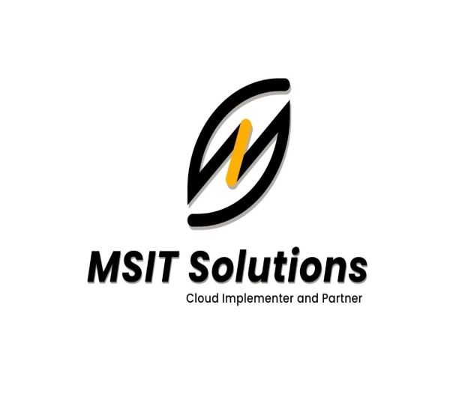
SRE
http://msitsolutions.org/

Slide 2
Content
1.What is SRE ?
3
2.Difference between SRE and Devops ?
5
4
CONTENTS
3.Flow model
6
5
TABLE OF
4.Principles of Sre
7
6
5.Monitoring Tools
9
http://msitsolutions.org/

Slide 3
S R E : Site Relaiability Engineering
1
2
3
4
5
Site reliability engineering (SRE) is a software engineering approach to IT operations. SRE teams use software as a tool to manage systems, solve problems, and automate operations tasks.
SRE takes the tasks that have historically been done by operations teams, often manually, and instead gives them to engineers or ops teams who use software and automation to solve problems
SRE is a valuable practice when creating scalable and highly reliable software systems. It helps you manage large systems through code, which is more scalable and sustainable for sysadmins
SRE helps teams find a balance between releasing new features and making sure that they are reliable for users.
Standardization and automation are 2 important components of the SRE model. Site reliability engineers should always be looking for ways to enhance and automate operations tasks.
Technology to support SRE:
SRE relies on automating routine operational tasks and standardization across an app’s lifecycle. Linux® containers give your team the underlying technology needed for a cloud-native development style. Containers support a unified environment for development, delivery, integration, and automation.

Slide 4
INDUSTRIAL TRAINING COURSE STRUCTURE FOR SRE
http://msitsolutions.org/

Slide 5
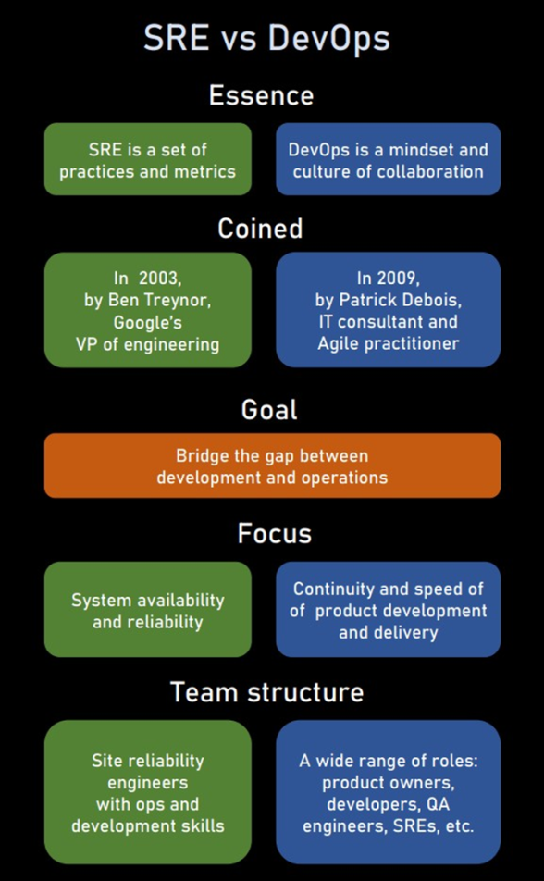
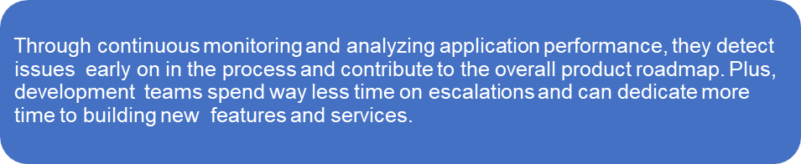
What Are the Differences Between SREs and DevOps?

Slide 6
Sre aim create more value in linking Operations activities with development.

Slide 7
Principles of Sre
Scalability:
Scalability is the property of a system to handle a growing amount of work by adding resources to the system. Scalability is the measure of a system's ability to increase or decrease in performance and cost in response to changes in application and system processing demands.
Observability:
Observability is instrumenting your systems to collect actionable data to know when the errors occur—but more importantly, why they happen. It’s an approach to understanding multilayer architectures to find what is broken and what requires improvement for better performance.

Slide 8
Telemetry:
Telemetry is the automated communication processes from multiple data sources. Telemetry data is used to improve customer experiences, monitor security, application health, quality, and performance.
Monitoring :
Monitoring aims to optimize any performance issue and alert teams if fixes or resolutions are needed to reduce any impact on the end-users. As SRE teams monitor, data is collected, processed, aggregated, and displayed in charts about the system and services.

Slide 9
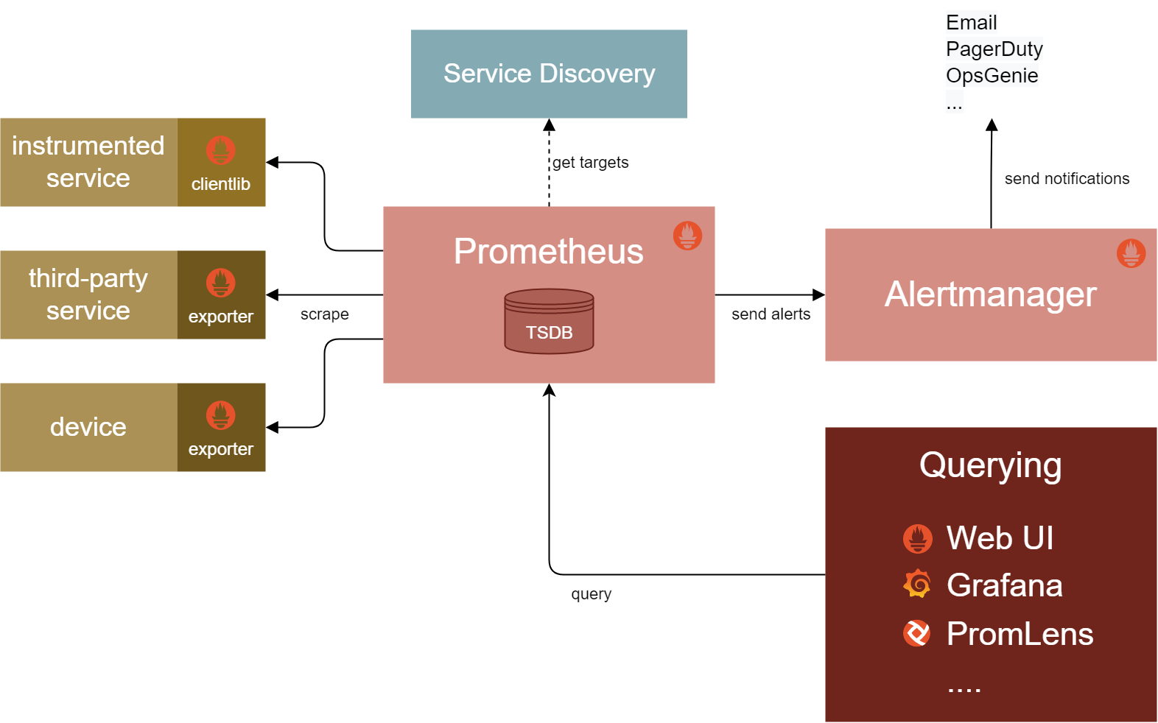
MONITORING TOOLS:
Prometheus :
Prometheus gets metric from an exposed HTTP endpoint. A number of client libraries are available to provide this application integration when building software. With an available endpoint, Prometheus can scrape numerical data and store it as a time series in a local time series database.
For more information click below link :
https://prometheus.io/docs/introduction/overview/.

Slide 10
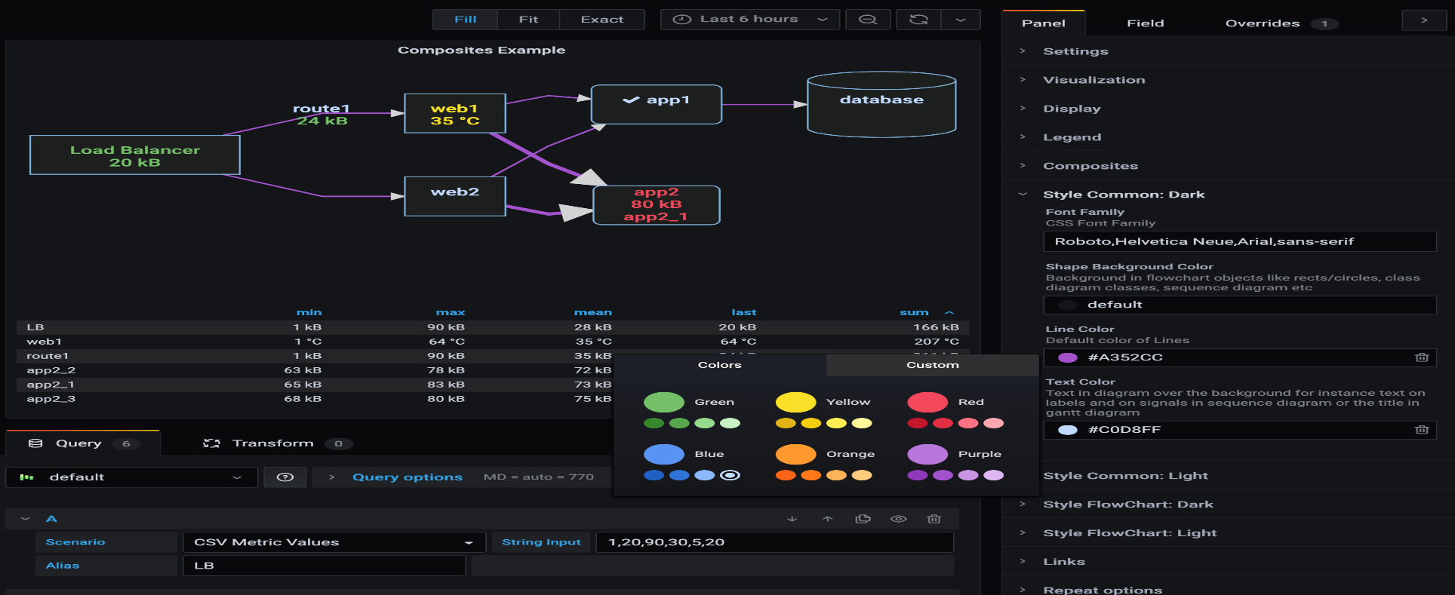
Grafana :
Grafana is an open source solution for running data analytics, pulling up metrics that make sense of the massive amount of data & to monitor our apps with the help of cool customizable dashboards. Grafana connects with every possible data source, commonly referred to as databases such as Graphite, Prometheus, Influx DB, Elastic Search, MySQL, PostgreSQL etc .
For more information click below link :
https://grafana.com/docs/grafana/latest/dashboards/.

Slide 11
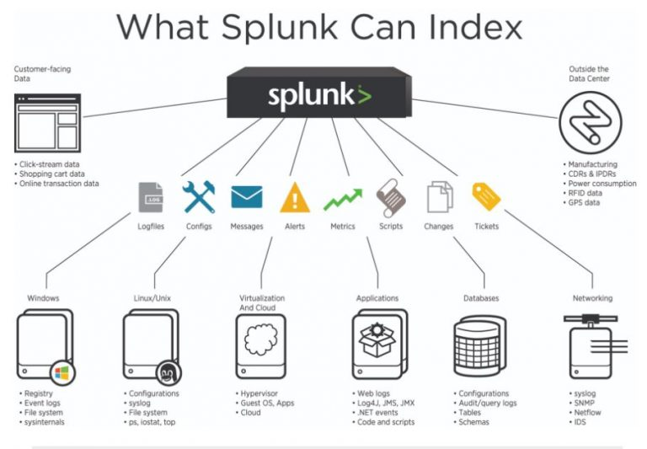
Splunk :
Splunk is used for monitoring and searching through big data. It indexes and correlates information in a container that makes it searchable, and makes it possible to generate alerts, reports and visualizations
For more details click below link :
https://docs.splunk.com/Documentation/Splunk/8.2.5/SearchReference/ListOfSearchCommands.

Slide 12
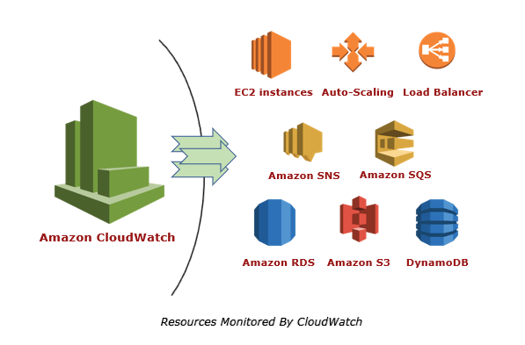
CloudWatch :
It enables you to monitor your complete stack (applications, infrastructure, and services) and use alarms, logs, and events data to take automated actions and reduce mean time to resolution (MTTR).
For more details click below link :
https://docs.harness.io/article/huoann4npq-cloud-watch-connection-setup.

Slide 13
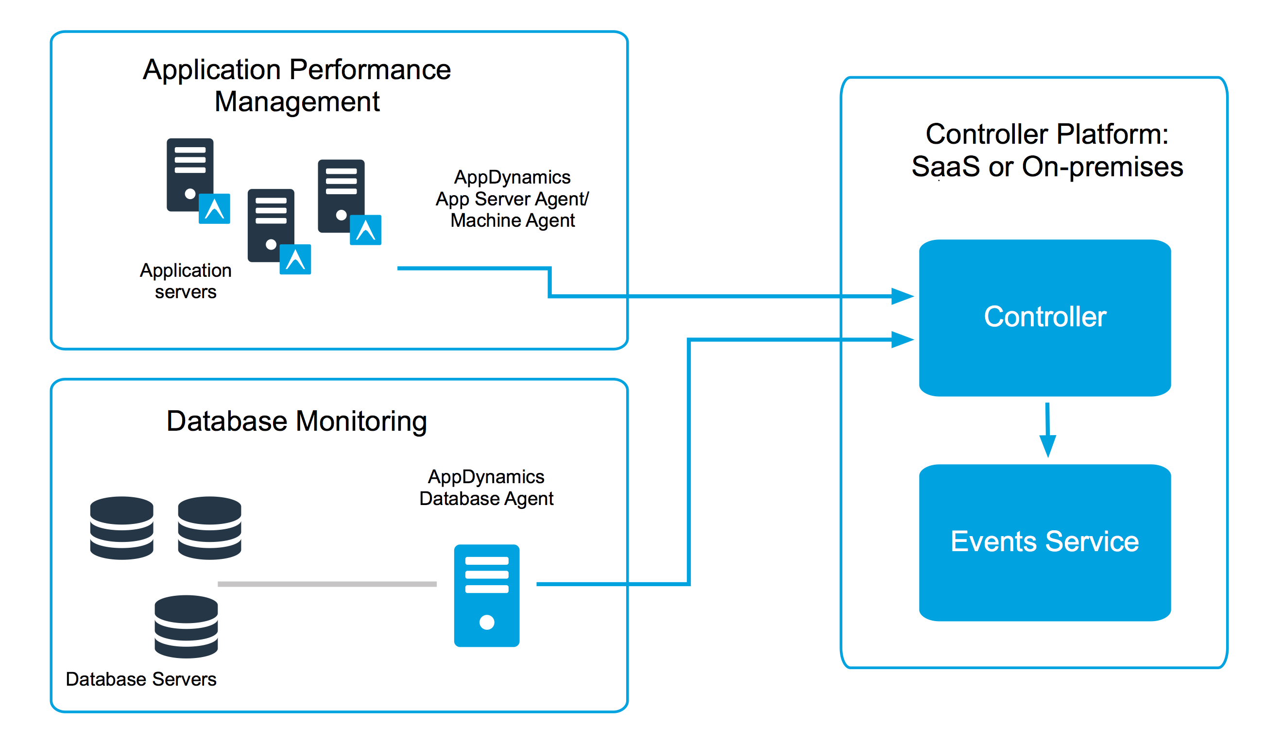
AppDynamics DevOps :
AppDynamics offers a consolidated view of web applications, infrastructures, and supporting services across traditional and modern multi-cloud architectures. Collect, tag, and analyze cloud and microservice-related metrics and contextually evaluate the impact of releases on user experience and business outcomes.
For more details click below link :
https://github.com/pivotal-cf/docs-appdynamics-platform.

Slide 14



MSIT SOLUTIONS P.V.T L.T.D
CLOUD IMPLEMENTER AND PARTNER
www.msitsolutions.org.
https://www.linkedin.com/company/80361081/admin/.
https://www.instagram.com/msitsolutionscloud/.
https://twitter.com/home.
hr@msitsolutionsgroup.com

