Slide 1

A descriptive analysis on access to Electricity, production from different sources(Nuclear, oil & renewable energy) and distribution losses across different countries.

Slide 2
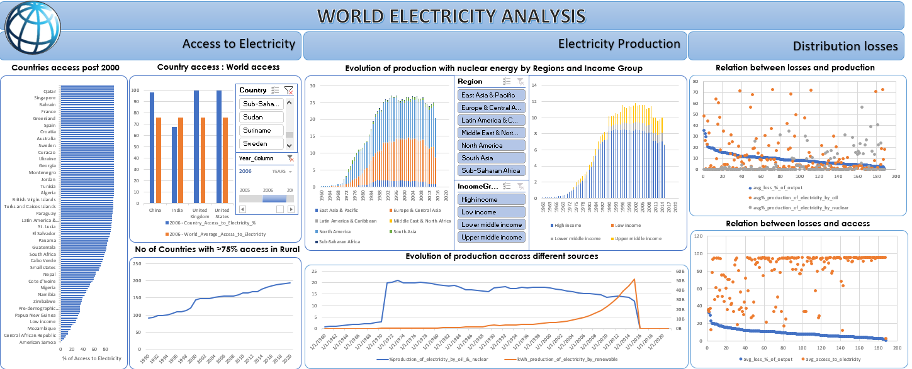
Analysis Dashboard

Slide 3
ACCESS TO ELECTRICITY
Country access post 2000s.
Country access : World Average Access.
A trend of increasing countries with electricity access to rural.
ELECTRICITY PRODUCTION.
Evolution of production through nuclear power by region and Income Group.
Evolution of production across different sources.
DISTRIBUTION LOSSES
Comparison between distribution losses and access.
Comparison between distribution losses and production.

Slide 4
COUNTRY ACCESS POST 2000.
Access to Electricity across world [Top]
Access to Electricity across world [Bottom]

Slide 5
COUNTRY ACCESS : WORLD AVERAGE ACCESS.
A comparison overview of country’s access to world’s average access.
Overview responds to manual selection of country and years.

Slide 6
A TREND OF INCREASING COUNTRIES WITH ELECTRICITY ACCESS >=75% IN RURAL AREAS.

Slide 7
EVOLUTION OF PRODUCTION THROUGH NUCLEAR POWER BY REGION .
Production through nuclear power has been in increasing trend from 1970s to 1990s.
North American, European & Central Asian regions have been dominant in production from nuclear energy through out the evolution.
This viz is dynamic to region selection, feel free to try on Excel.

Slide 8
EVOLUTION OF PRODUCTION THROUGH NUCLEAR POWER BY INCOME GROUP.
Production through nuclear power has been in increasing trend from 1970s to 1990s.
High Income Group countries contribute to more than 70% of production through nuclear energy.
Low Income group couldn’t contribute towards production through nuclear energy.
This viz is dynamic to income group selection, feel free to try on Excel.

Slide 9
EVOLUTION OF PRODUCTION ACROSS DIFFERENT SOURCES.
Production through oil sources has been in declining trend since mid-1960s, which can be attributed to environmental concern and awareness.
Recent years have shown a sudden spike in production through nuclear energy, can be attributed to increased efficiency in recent years.
Production through renewable sources has seen a sharp increasing trend from mid-1970s, can be attributed to environmental concerns and awareness.

Slide 10
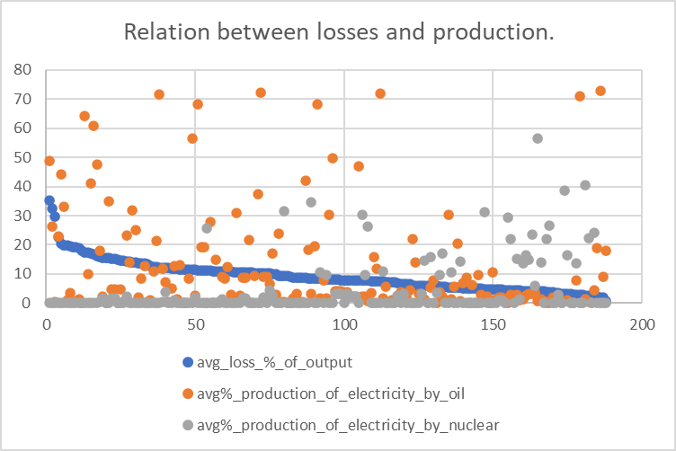
RELATION ON BETWEEN DISTRIBUTION LOSSES AND PRODUCTION.
An insight can be drawn that dependency on oil based production can attract losses in electricity distribution.
Exceptions like oil producing nation, pricing mechanisms, etc may stand false for above insight.
Diversifying production from costlier sources to alternatives can minimize distribution losses.
Assumptions: considered statistics after 2000.

Slide 11
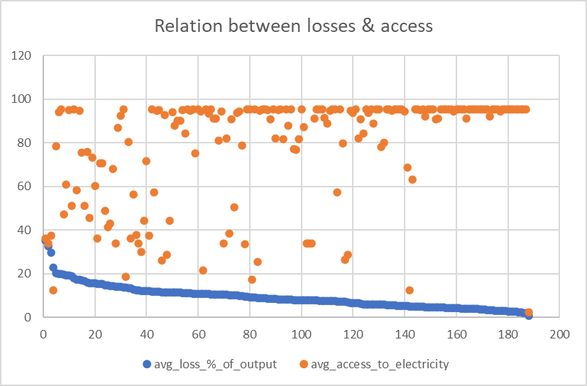
RELATION BETWEEN DISTRIBUTION LOSSES AND ACCESS.
An insight can be drawn that inefficiency or least access to electricity can attract losses.
Countries should aim for achieving access to electricity which leads to more revenue and in turn reduce losses.
Even with high access to electricity, if a country makes significant losses, pricing mechanism have to be figured out or leakage in production has to be dealt.
Assumptions: considered statistics after 2000.

Slide 12
Key Insights
Countries with more than 75% access to rural electricity have more than doubled to 193 countries in 2020 from 92 countries in 1990.
Production through nuclear power has been in increasing trend from the 1970s to 1990s.
North American, European & Central Asian regions have been dominant in electricity production from nuclear energy throughout the evolution.
High Income Group countries contribute to more than 70% of production through nuclear energy.
Production through oil sources has been on a declining trend since the mid-1960s, which can be attributed to environmental concerns and awareness.
Recent years have shown a sudden spike in production through nuclear energy, which can be attributed to increased efficiency.
Production through renewable sources has seen a sharp increasing trend since the mid-1970s, which can be attributed to environmental concerns and awareness.
An insight can be drawn that dependency on oil-based production can attract losses in electricity distribution.
An insight can be drawn that inefficiency or the least access to electricity can attract losses.

