Slide 1
Computer Graphics
2D transformations
y
y
x
x
y
x

Slide 2
2D Transformation
Given a 2D object, transformation is to change the object’s
  Position (translation)
  Size (scaling)
  Orientation (rotation)
  Shapes (shear)
Apply a sequence of matrix multiplication to the object vertices

Slide 3
Point representation
We can use a column vector (a 2x1 matrix) to represent a 2D point x
y
A general form of linear transformation can be written as:
x’ = ax + by + c
OR
y’ = dx + ey + f
X’ a b c x
Y’ = d e f * y
1 0 0 1 1

Slide 4
Transformations
instantiation…
world
train
animation…
viewing…
wheel
image
modelling…

Slide 5
Why transformation?
Model of objects
  world coordinates: km, mm, etc.
  Hierarchical models::
  human = torso + arm + arm + head + leg + leg
  arm = upperarm + lowerarm + hand …
Viewing
  zoom in, move drawing, etc.
Animation

Slide 6
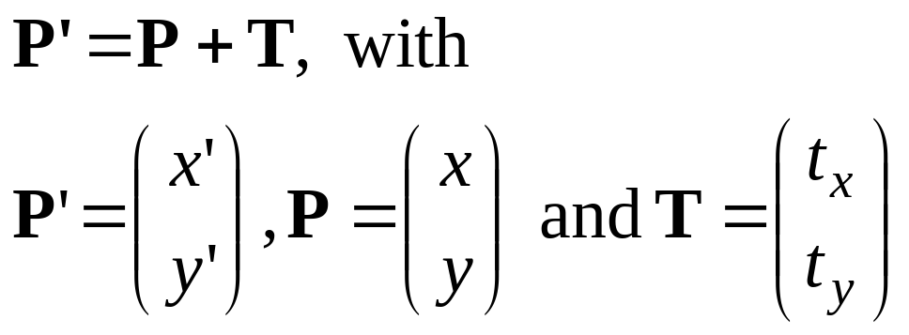
Translation
Translate over vector (t_{x}, t_{y})
x’=x+ t_{x}, y’=y+ t_{y}
or
y
P+T
T
P
x

Slide 7
Translation
How to translate an object with multiple vertices?
Translate individual
vertices

Slide 8
Translation polygon
Translate polygon:
Apply the same operation on all points.
Works always, for all transformations of objects defined as a set of points.
y
T
x

Slide 9
Rotation
(x,y) -> Rotate about the origin by θ
(x’,y’)
(x’, y’)
θ
(x,y)
r
φ
How to compute (x’, y’) ?
x = r cos (φ) y = r sin (φ)
x’ = r cos (φ + θ) y = r sin (φ + θ)

Slide 10
Rotation
(x’,y’)
x = r cos (φ) y = r sin (φ)
x’ = r cos (φ + θ) y = r sin (φ + θ)
(x,y)
θ
r
φ
x’ = r cos (φ + θ)
= r cos(φ) cos(θ) – r sin(φ) sin(θ)
= x cos(θ) – y sin(θ)
y’ = r sin (φ + θ)
= r sin(φ) cos(θ) + r cos(φ)sin(θ)
= y cos(θ) + x sin(θ)

Slide 11
Rotation
(x’,y’)
x’ = x cos(θ) – y sin(θ)
y’ = y cos(θ) + x sin(θ)
θ
r
(x,y)
φ
Matrix form?
x’ cos(θ) -sin(θ) x
y’ sin(θ) cos(θ) y
=

Slide 12
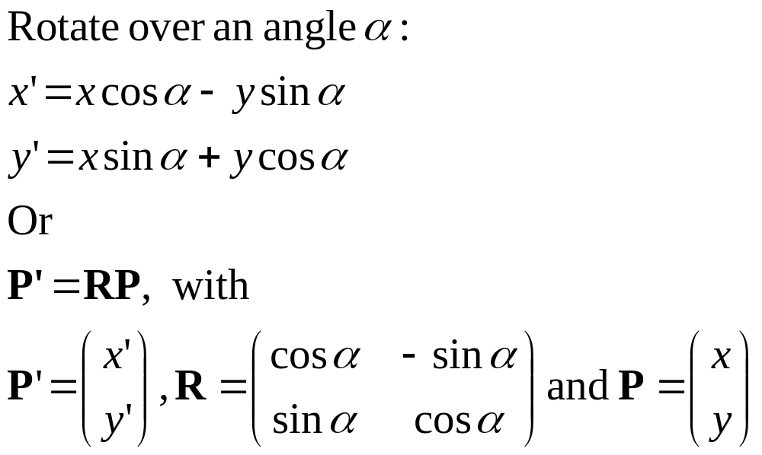
Rotation
y
y
P’
α
P
x
x

Slide 13
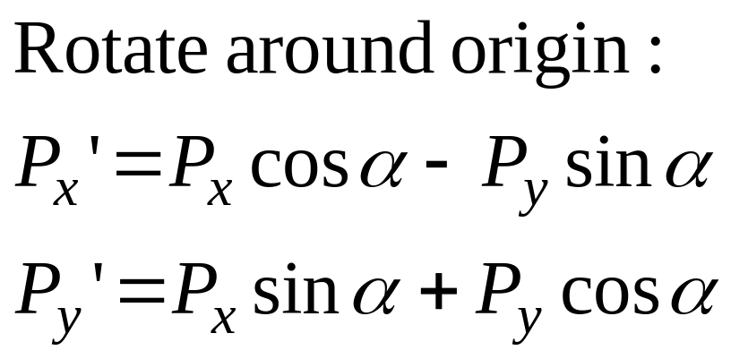
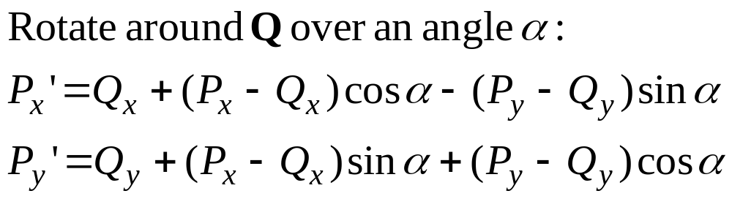
Rotation around a point Q
y
y
P’
α
P
P−Q
Q
x
x

Slide 14
Rotation
How to rotate an object with multiple vertices?
θ
Rotate individual
Vertices

Slide 15
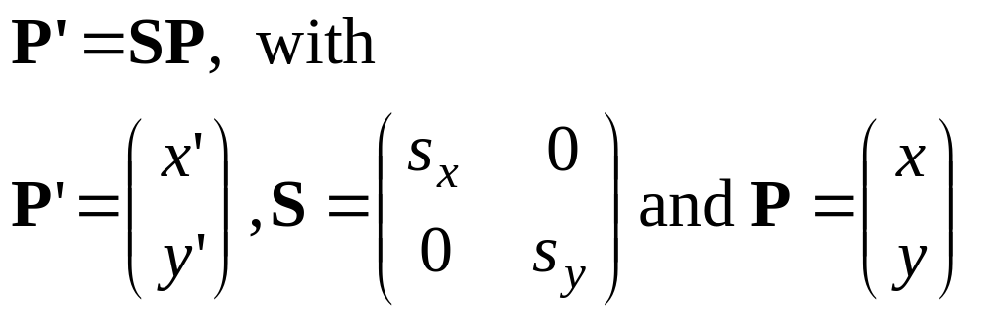
Scaling
Schale with factor s_{x} and s_{y}:
x’= s_{x} x, y’= s_{y} y
or
y
P’
P
Q’
Q
x
x

Slide 16
Scaling with respect to a point F
y
Scale with factors s_{x} and s_{y}:
P_{x}’= s_{x} P_{x}, P_{y}’= s_{y}P_{y}
With respect to F:
P_{x}’ − F_{x} = s_{x} (P_{x} − F_{x}),
P_{y}’ − F_{y} = s_{y} (P_{y} − F_{y})
or
P_{x}’= F_{x} + s_{x} (P_{x} − F_{x}),
P_{y}’= F_{y} + s_{y} (P_{y} − F_{y})
P’
P
P−F
Q’
F
Q
x
x

Slide 17
Transformations
Translate with V:
  T = P + V
Schale with factor s_{x} = s_{y} =s:
  S = sP
Rotate over angle α:
  R’_{x} = cos α P_{x} − sin α P_{y}
  R’_{y} = sin α P_{x} + cos α P_{y}
y
S
R
T
P
x

Slide 18
Transformations…
Messy!
Transformations with respect to points: even more messy!
How to combine transformations?

Slide 19
Homogeneous coordinates 1
Uniform representation of translation, rotation, scaling
Uniform representation of points and vectors
Compact representation of sequence of transformations

Slide 20
Homogeneous coordinates 2
Add extra coordinate:
P = (p_{x} , p_{y} , p_{h}) or
x = (x, y, h)
Cartesian coordinates: divide by h
x = (x/h, y/h)
Points: h = 1 (for the time being), vectors: h = 0
The point (x,y) needs to be represented as
(x,y,1) --> this is called Homogeneous
coordinates!

Slide 21
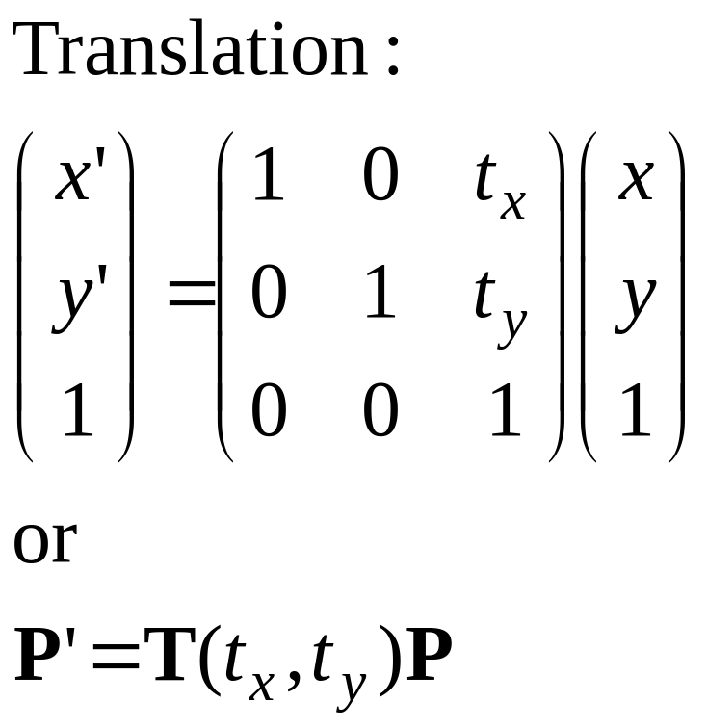
Translation matrix

Slide 22
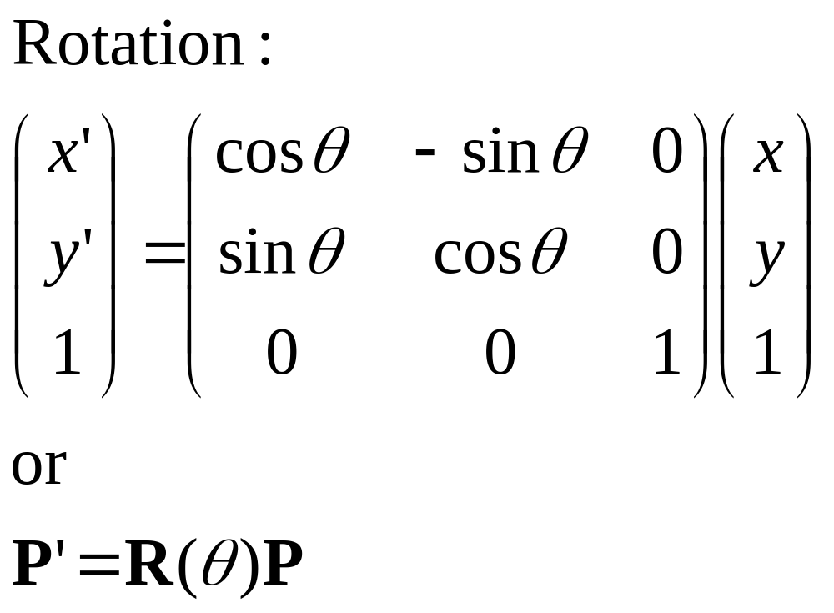
Rotation matrix

Slide 23
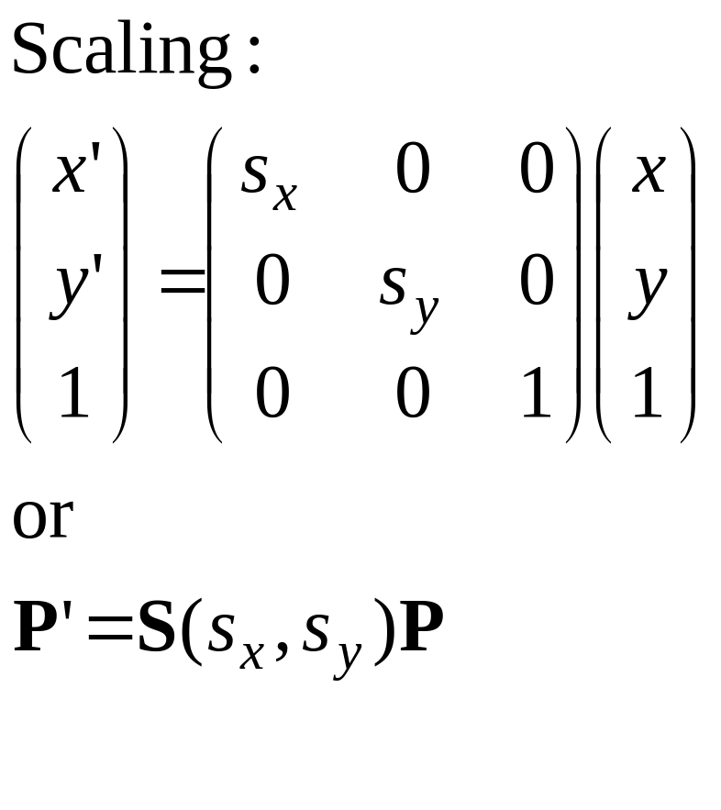
Scaling matrix

Slide 24
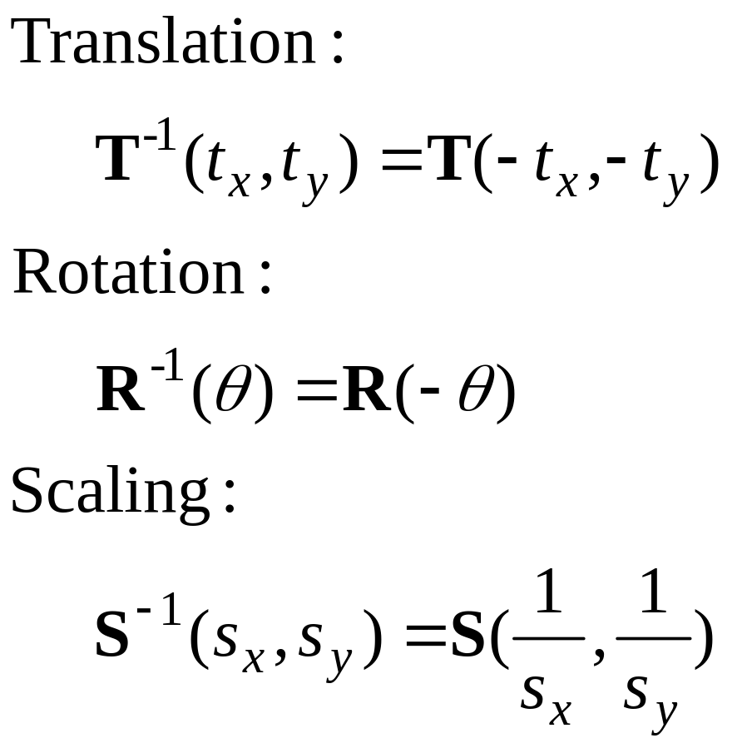
Inverse transformations

Slide 25
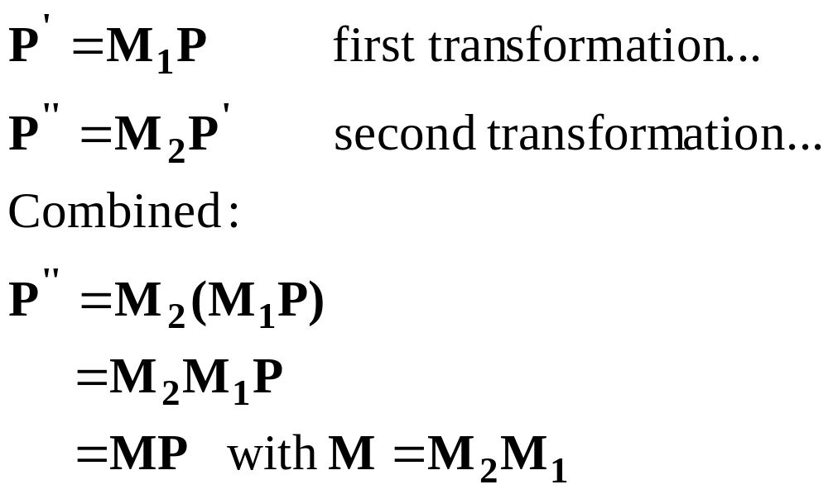
Combining transformations 1

Slide 26
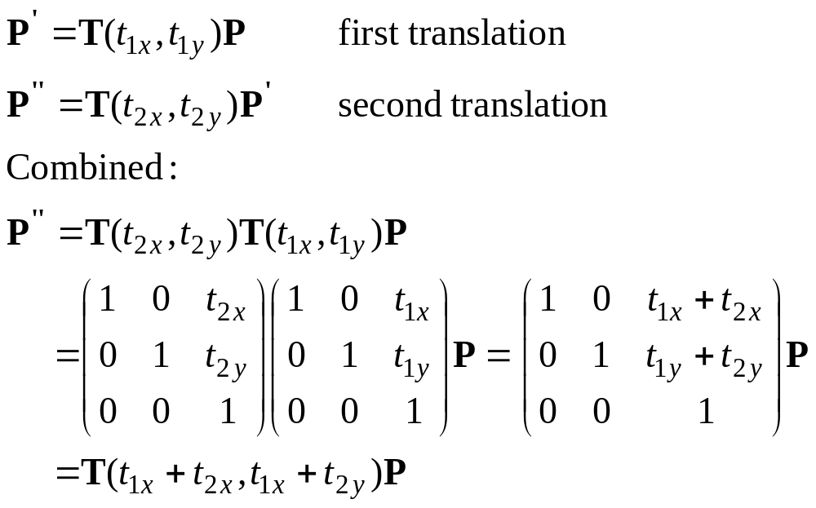
Combining transformations 2

Slide 27
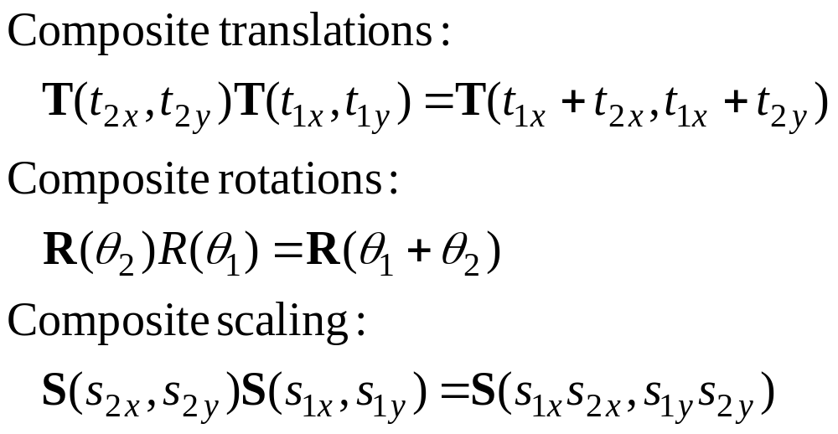
Combining transformations 3

Slide 28
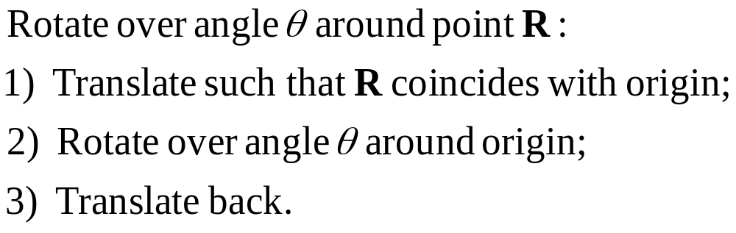
Rotation around a point 1
R
1) 2) 3)

Slide 29
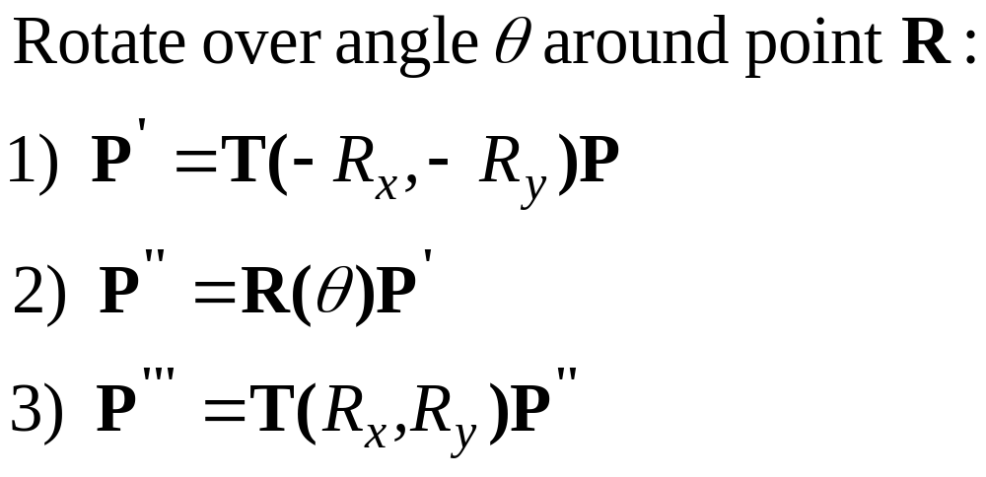
Rotation around a point 2
R
1) 2) 3)

Slide 30
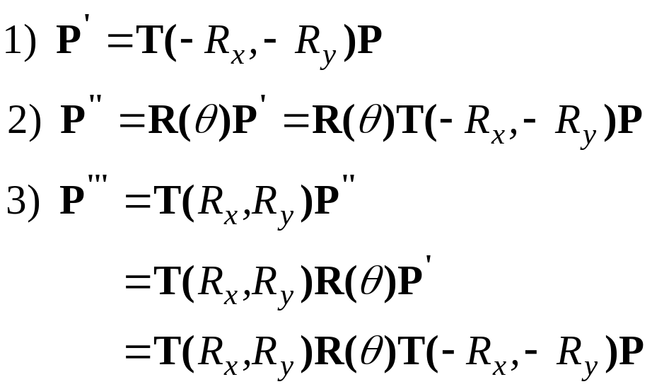
Rotation around point 3
R
1) 2) 3)

Slide 31
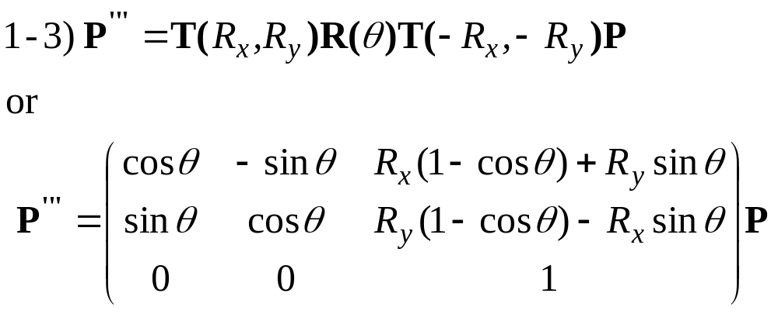
Rotation around point 4
R
1) 2) 3)

Slide 32
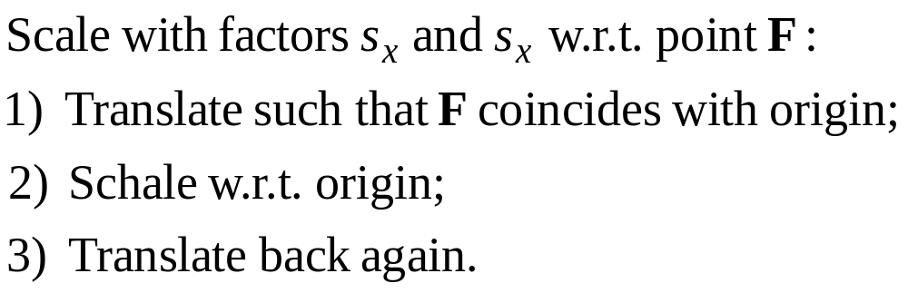
Scaling w.r.t. point 1
F
1) 2) 3)

Slide 33
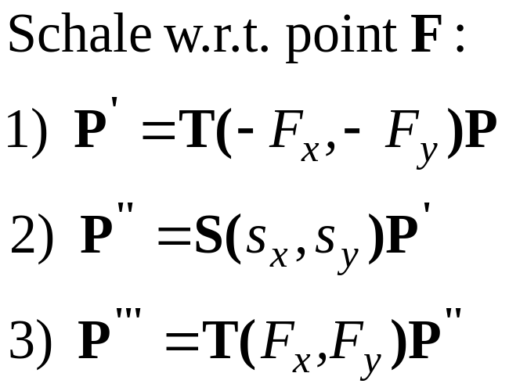
Scaling w.r.t.point 2
F
1) 2) 3)

Slide 34
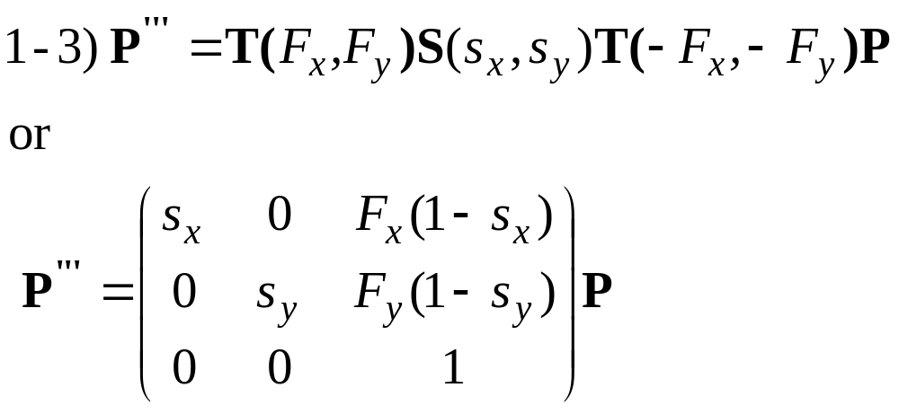
Scaling w.r.t.point 3
F
1) 2) 3)

Slide 35
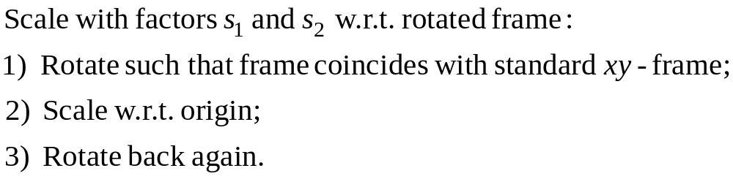
Scale in other directions 1
1) 2) 3)

Slide 36
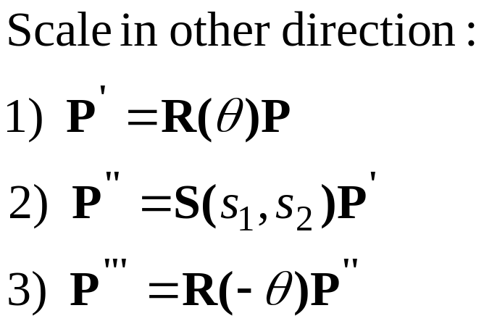
Scale in other directions 2
1) 2) 3)

Slide 37
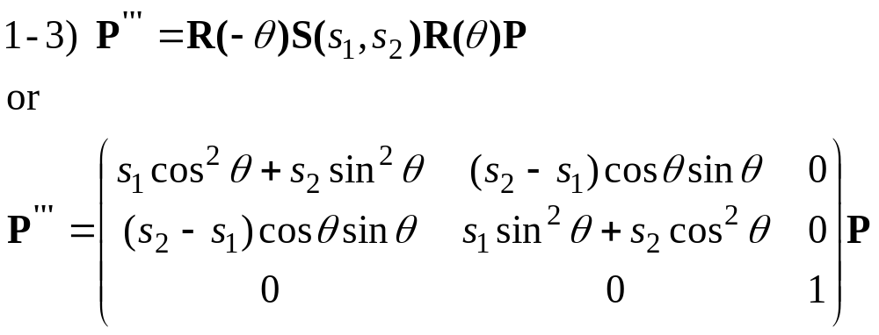
Scale in other directions 3
1) 2) 3)

Slide 38
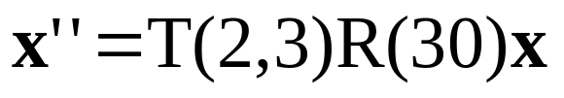
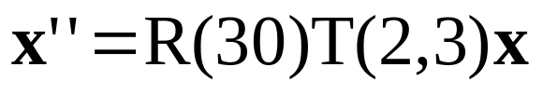
Order of transformations 1
Rotation, translation… Translation, rotation…
y’
y’’
y’’
x’’
x’’
y
y
y’
x’
x’
x
x
Matrix multiplication does not commute.
The order of transformations makes a difference!

Slide 39
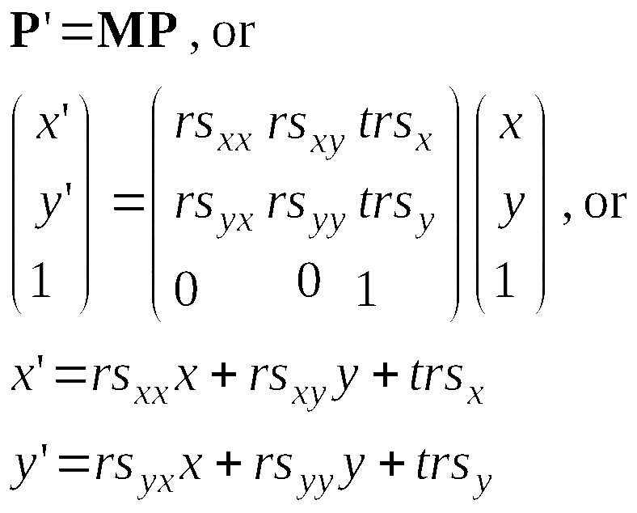
Matrices in general
rotation and scaling
translation

Slide 40
Direct construction of matrix
If you know the target frame:
Construct matrix directly.
Define shape in nice local
u,v coordinates, use matrix
transformation to put it
in x,y space.
y
v
u
B
A
T
x

Slide 41
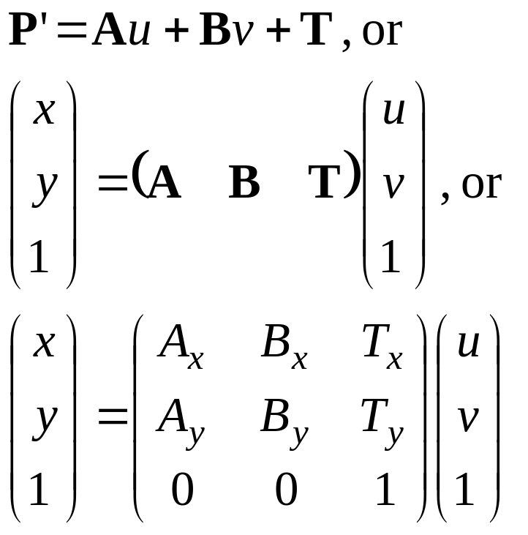
Direct construction of matrix
If you know the target frame:
Construct matrix directly.
y
v
u
B
A
T
x

Slide 42
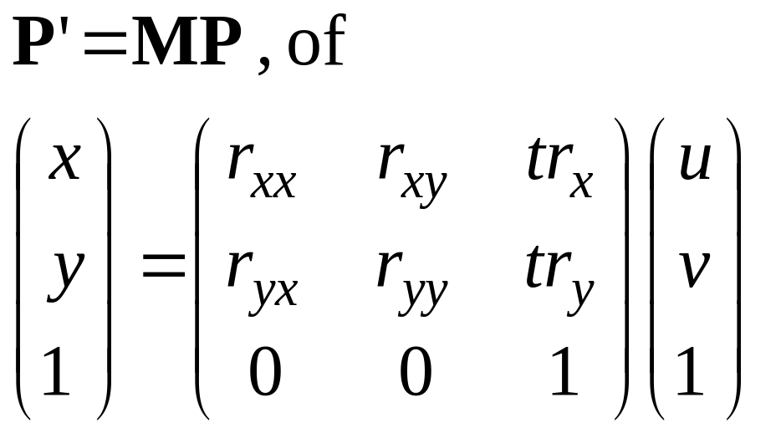
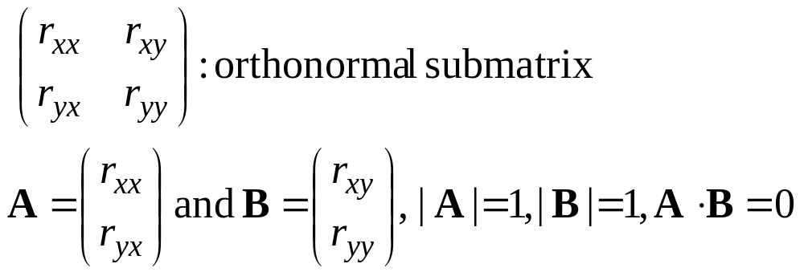
Rigid body transformation
only rotation
translation
y
u
v
B
A
T
x

Slide 43
Other 2D transformations
Reflection
Shear
Can also be combined

Slide 44
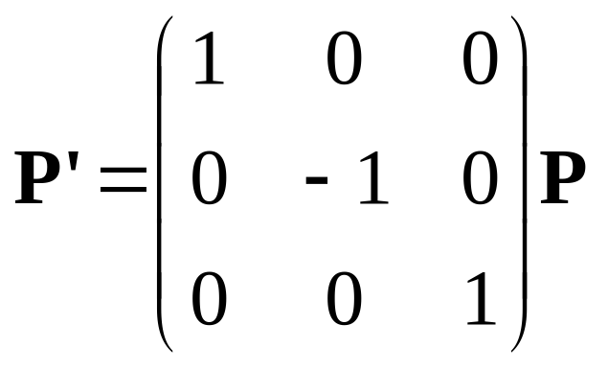
Reflection over axis
Reflext over x-axis:
x’= x, y’= −y
or
y
x

Slide 45
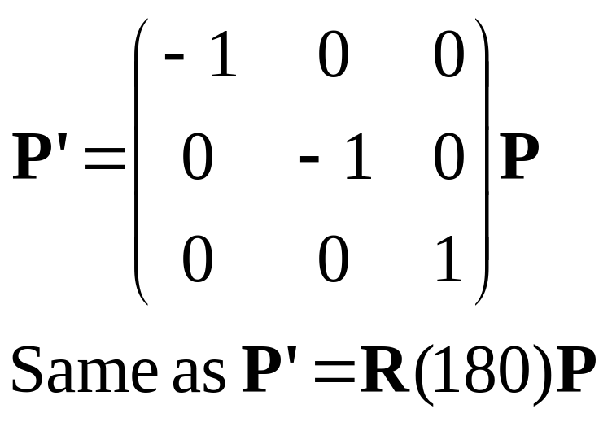
Reflect over origin
Reflect over origin:
x’= −x, y’= − y
or
y
x

Slide 46
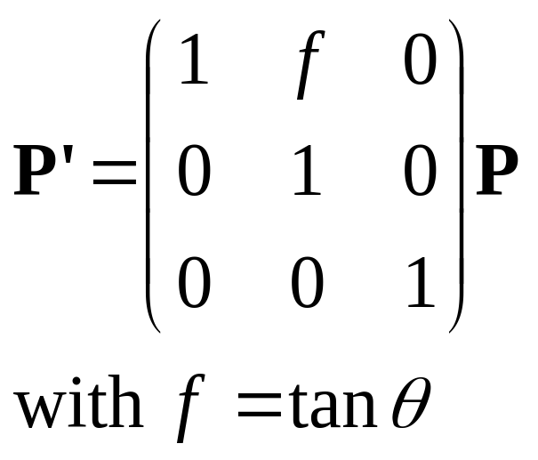
Shear
Shear the y-as:
x’=x+fy, y’=y
or
y
θ
x

Slide 47
Thank You

