Slide 1
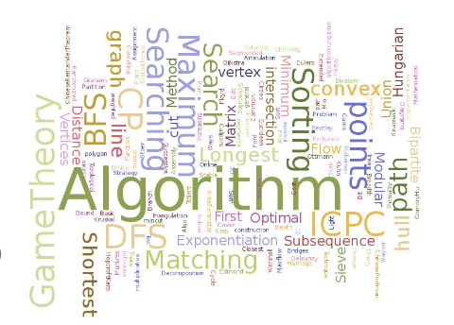
C Programming: Function
Dr. Durgesh Kumar
SCOPE, VIT Vellore
DSA:
C Programming : Function
Week 1: Lecture 01

Slide 2
Lecture Outline
Introduction to Function
What is function?
Advantage of using Function?
Function key concepts:
Function declaration, Function definition, Function call
Return type: void vs int, char, float
actual argument vs formal argument.
Scope of variable.
library function:
stdio.h - printf, scanf
math.h - pow, sin, cos, tan
C Programming : Function
Week 1: Lecture 01

Slide 3
Lecture Outline
Function Examples
Calculate Simple Interest.
Sum of digits, Check Prime, Check even/odd.
Sum of prime.
Sum of series.
Function Advanced:
Recursion
Factorial, Fibonacci, GCD.
Function with variable number of inputs.
C Programming : Function
Week 1: Lecture 01

Slide 4
GOALS
Get basic understanding of Function
Be able to
Create a function and use it.
Understand the parameter passing between function.
Recursive function.
C Programming : Function
C Programming : Function
Week 1: Lecture 01

Slide 5
Function
A coherent lines of code to do a well-defined task.
check_prime: A function to check whether a number is prime or not.
product: A function to multiply two number.
print_star_format: A function to print star like below
*
* *
* * *
C Programming : Function
Week 1: Lecture 01
2 / 19

Slide 6
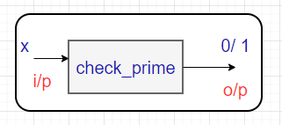
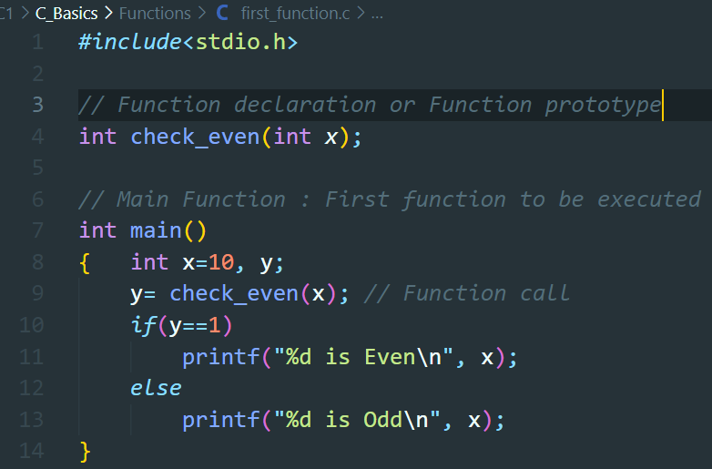
Function : C syntax
C Programming : Function
Week 1: Lecture 01
2 / 19

Slide 7
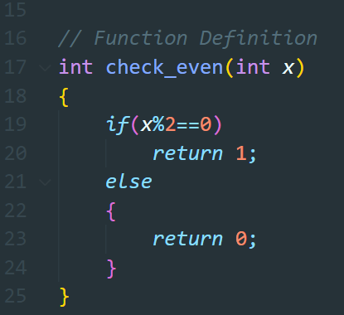
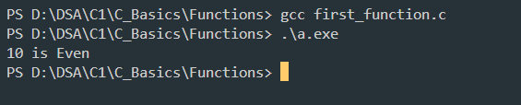
Function : C syntax
C Programming : Function
Week 1: Lecture 01
2 / 19

Slide 8
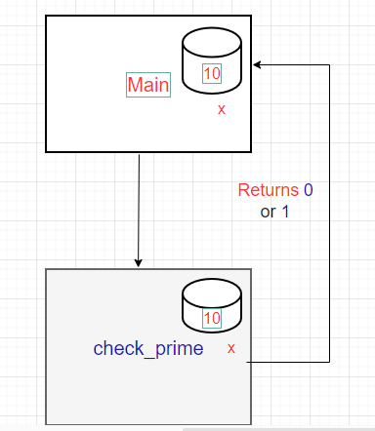
Function : C – order of call
C Programming : Function
Week 1: Lecture 01
2 / 19

Slide 9
Advantage of Function
Increase code readability.
Easy to debug and fix errors.
Code become Modular.
Easy to re-use.
C Programming : Function
Week 1: Lecture 01

Slide 10
Return type of function
void vs int, char, float, int *
C Programming : Function
Week 1: Lecture 01

Slide 11
Actual vs Formal Arguments
C Programming : Function
Week 1: Lecture 01

Slide 12
Practice Function Code
Write a program to check a prime number.
WAP to find sum of all primes within a given range.
WAP to find simple interest given p, r, and t.
WAP to find factorial of a number using iteration.
WAP to find sum of series
1+ x + x^2 / 2! + x^3/3! + … + x^n/ n!
C Programming : Function
Week 1: Lecture 01

Slide 13

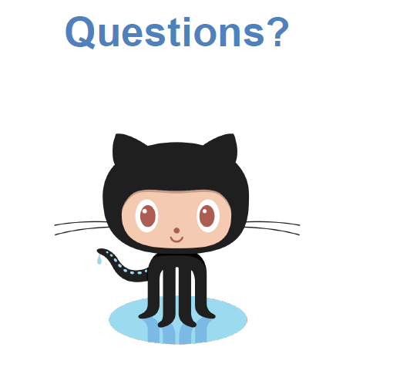
Computer Programming : Python
Week 1: Lecture 01
2 / 19

Slide 14


