Slide 1
Module VI: Functions in Python
Dr. Durgesh Kumar
Assistant Prof., SCOPE, VIT Vellore

Slide 2
Outcome
Learn and articulate problem solving through python using functions
To learn why you would want to divide your code into smaller, more specific pieces (functions!)
To be able to define new functions in Python
To use functions to reduce code duplication and increase program modularity

Slide 3
Outcome
Learn about function related vocabulary
def keyword
return keyword
arguments/parameters
Function call, Function definition
To understand function definition vs function call

Slide 4
A program can proceed:
In sequence
Selectively (branching): make a choice
Repetitively (iteratively): looping
By calling a function

Slide 5
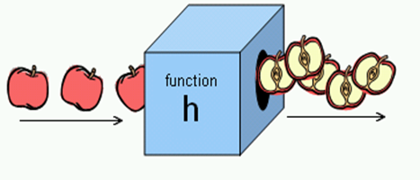
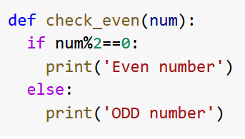
Function
o/p
i/p
One or more statements to perform a coherent taskre valid python sta

Slide 6
What are Functions?
A function is like a subprogram
A small program inside of a program
The basic idea:
We write a sequence of statements
And give that sequence a name
We can execute this sequence at any time by referring to the sequence’s name

Slide 7
Why Use Functions?
Having identical (or similar) code in more than one place has various downsides:
Don’t want to write the same code twice (or more)
The code must be maintained in multiple places
Code is harder to understand with big blocks of repeated code everywhere
Functions reduce code duplication and make programs more easy to understand and maintain

Slide 8
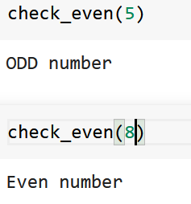
Function - Advantage
reduces number of line code.
makes code more readable
and modular.
easy to debug.
increasing re-usability of code.
It increases the speed of execution due to cache memory.
specially small functions
More reference: Link

Slide 9
Function - disadvantage
a couple of extra machine code instructions to do the “call” and “return”
Stack Pointer loads a non-sequential virtual address.
using a function unnecessarily may slow your program down.
specially recursive function.
a tradeoff

Slide 10
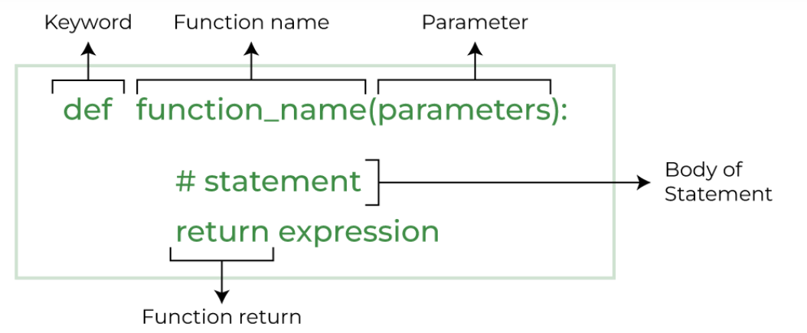
Functions - Syntax

Slide 11
Parts of a Function
function defintion
use “def”keyword to create a function
def main():
a = 5
print(a)
print(type(a))
function name
calls built-in “print” function
function body
2. function call
calls built-in “type” function
calls “main”

Slide 12
Function Vocabulary
A colon (:) to mark the end of the function header!
Function definition:
The part of the program that creates a function
For example: “def main():”, “def emoji():”,
“def electricity_bill():” etc
Function call (or function invocation):
When the function is used in a program
For example: “main()” or “print("Hello")”

Slide 13
Function - Advantage
Function defintion | Function call

Slide 14
Function
A function is a set of statements starting with the keyword def,
followed by function name and ( ), inside which arguments/parameters are given.
Inside the function definition, a return statement that returns the final result of the function is usual.
The function definition must always come before the function call.
A function call is made by referring to the function name, followed by ( ) inside which variables/values called arguments are given

Slide 15
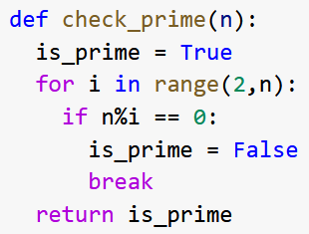
Type of Function
built-in function: defined by the python language library.
print( ), int( ), str( ), bool( ), id( ),
range( ), enumerate( )
user-defined functions:
the function definition need to be
written by user

Slide 16
What is a Parameter?
A parameter is a variable that is initialized when we call a function
We can create a generic hello() function that takes in a person’s name as a parameter
def hello(name):
"""
This function greet the
the name of person passed in as
a parameter
"""
print("Hello, " + name + ". Good morning!")

Slide 17
What is a Parameter?
Passing parameters provides a mechanism for initializing the variables in a function
Parameters act as inputs to a function
We can call a function many times and get different results by changing its parameters

Slide 18
Return Statements
To have a function return a value after it is called, we need to use the return keyword
def square(num)
# return the square
return (num*num)

Slide 19
Return Statements
When Python encounters return, it
exits the function
return control back to where the function was called
The value provided in the return statement is sent back to the caller as an expression result

Slide 20
Code Trace: Return from square()
Let’s follow the flow of the code
def square(num1):
return num1 * num1
def main():
x = 5
y = square(x)
print(y)
# calling main function
main()
Step 1: Call main()
Step 2: Pass control to def main()
Step 3: Set x = 5
Step 4: See the function call to square()
Step 5: Pass control from main() to square()
Step 6: Set the value of num1 in square() to x
Step 7: Return to main() and set y = return statement
Step 8: Print value of y

Slide 21
Testing: Return from square()
>>> print(square(3)) 9
>>> print(square(4)) 16
>>> x = 5 >>> y = square(x) >>> print(y) 25
>>> print(square(x) + square(3)) 34

Slide 22
Lecture Outline
my_list_1
Passing Information to function
positional arguments
keyword arguments
parameters with default values
function with arbitrary number of arguments
Scope and lifetime of variable
local and global scope of variable
lambda function
recursion

Slide 23
Passing information to Function
Python must match each argument in the function call with a parameter in the function definition.
positional arguments: - match the order of values - simplest way
using a function unnecessarily may slow your program down.
specially recursive function.
a tradeoff

Slide 24
Passing information to Function
Python must match each argument in the function call with a parameter in the function definition.
positional arguments: - match the order of values - simplest way
using a function unnecessarily may slow your program down.
specially recursive function.
a tradeoff

Slide 25
Scope and Lifetime of variables
Scope of a variable is the portion of a program where the variable is recognized.
local scope: Parameters and variables defined inside a function are not visible from outside the function. local scope.

Slide 26
Scope and Lifetime of variables
The lifetime of a variable is the period throughout which the variable exists in the memory.
The lifetime of variables inside a function is as long as the function executes.
They are destroyed once we return from the function. Hence, a function does not remember the value of a variable from its previous calls.

Slide 27
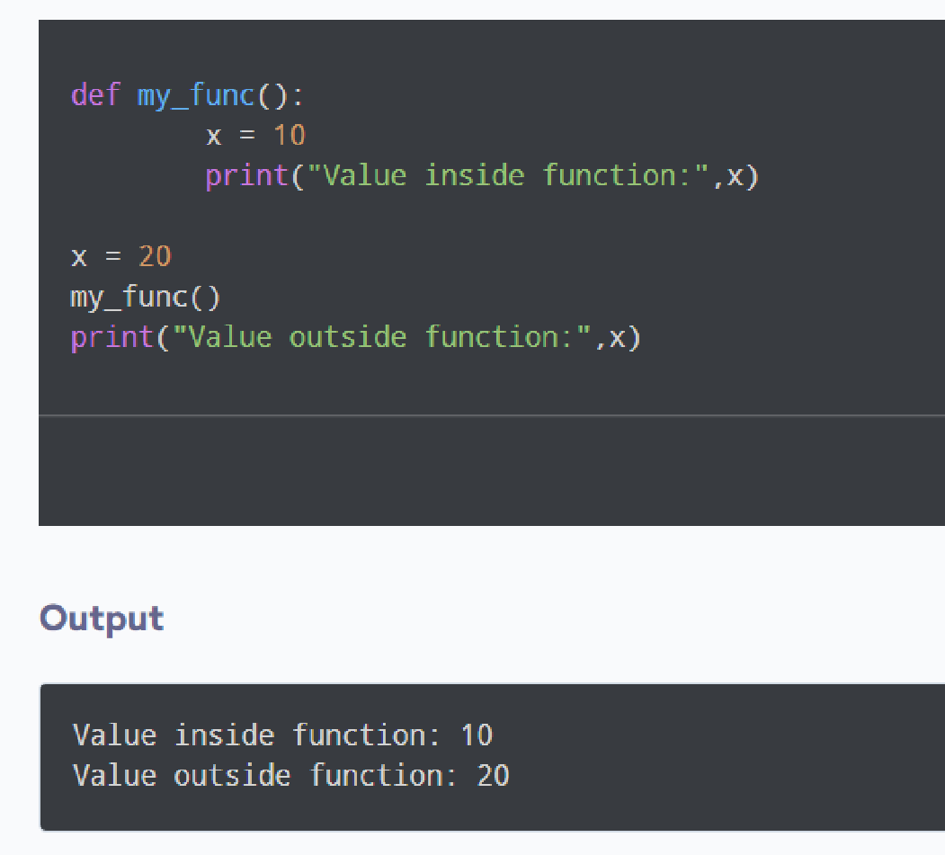
Scope and Lifetime of variables

Slide 28
Function - Exercise
WAF to check whether an integer is even or odd.
WAF to find index of maximum number from a list of integers.
WAF to find factorial of a number using iterative approach.
WAF to find GCD of two integers.
WAF to find LCM of two numbers.
Write a Python function to check whether a number is perfect or not

Slide 29
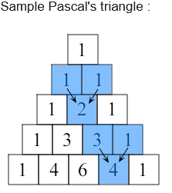
Function - Exercise
7. WAF to print n rows of a pascal triangle

Slide 30
Acknowledgement
https://www.programiz.com/python-programming/function
Based on concepts from: http://mcsp.wartburg.edu/zelle/python/ppics2/index.html
Lecture slides of Prof. Katherine Gibson, Prof. Jeremy Dixon, UMBC

