Slide 1
Module 6: Function & File
File
Dr. Durgesh Kumar

Slide 2
Index
While File is needed ?
Important File methods
open, close
read, create, write, append
tell, and seek

Slide 3
Why File is needed
I/O using input() and print(): till now terminal-based I/O
What-if we want to input 50 or 100 inputs?
Or save the O/P for later use?

Slide 4
Why File is needed
FILE-based I/O is needed
To have large i/p and O/P
To save i/p and o/p for re-use and later usages
Practical difference between File-based and terminal-based I/O

Slide 5
File processing
Open file
Read file contents
Write contents to file
Close the file
Move the file pointer to different positions

Slide 6
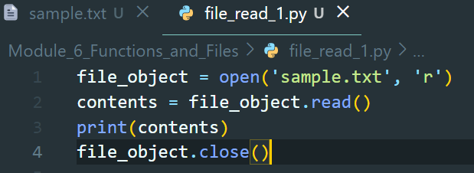
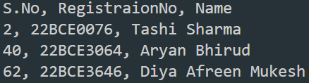
OPening and reading File
Open file, read file contents, close the file
file_object = open(“FILENAME”, “r”)

Slide 7
Different access mode during opening a File
Open file, read file contents, close the file
file_object = open(FILENAME, ACCESS_MODE)
ACCESS_MODE is optional argument
r - read
w - write
a - append

Slide 8
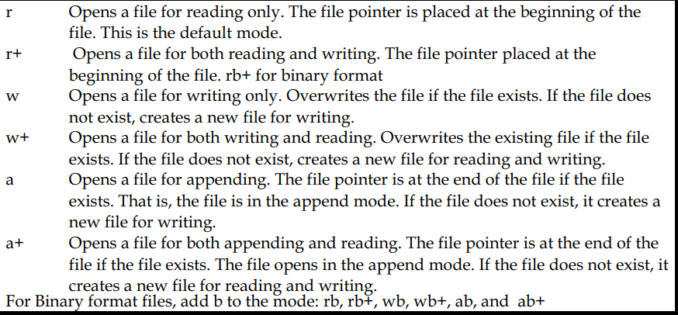
More access mode during opening a File

Slide 9
Types of files
Text files: each line of text is terminated with a special character called EOL (End of Line)
EOL is the new line character (‘\n’) in Python by default.
In the case of CSV(Comma Separated Files, the EOF is a comma by default.
Binary files: In this type of file, there is no terminator for a line
and the data is stored after converting it into machine-understandable binary language, i.e., 0 and 1 format.

Slide 10
Different ways to read file content
Open file, read file contents, close the file
file_object = open(FILENAME, ACCESS_MODE)
Different ways to read file contents
.read() - read whole content as a string
.readline() - read each line of file using iterator object. Optimal use of memory
.readlines() - read whole contents as a list of lines

Slide 11
THANK YOU !

