Slide 1
CHAT APPLICATION
Name:- Durgesh Giri

Slide 2
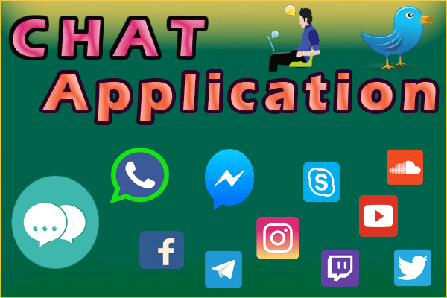

Slide 3
What is chat?
Online chat may refer to any kind of communication over the Internet that offers a real-time transmission of text messages from sender to receiver.
Online chat may address point-to-point communications as well as multicast communications from one sender to many receivers and voice and video chat, or may be a feature of a web conferencing service.

Slide 4
What is chat application?
Online chat in a less stringent definition may be primarily any direct text-based or video-based (webcams), one-on-one chat or one-to-many group chat (formerly also known as synchronous conferencing), using tools such as instant messengers, Internet Relay Chat (IRC), talkers and possibly MUDs.

Slide 5
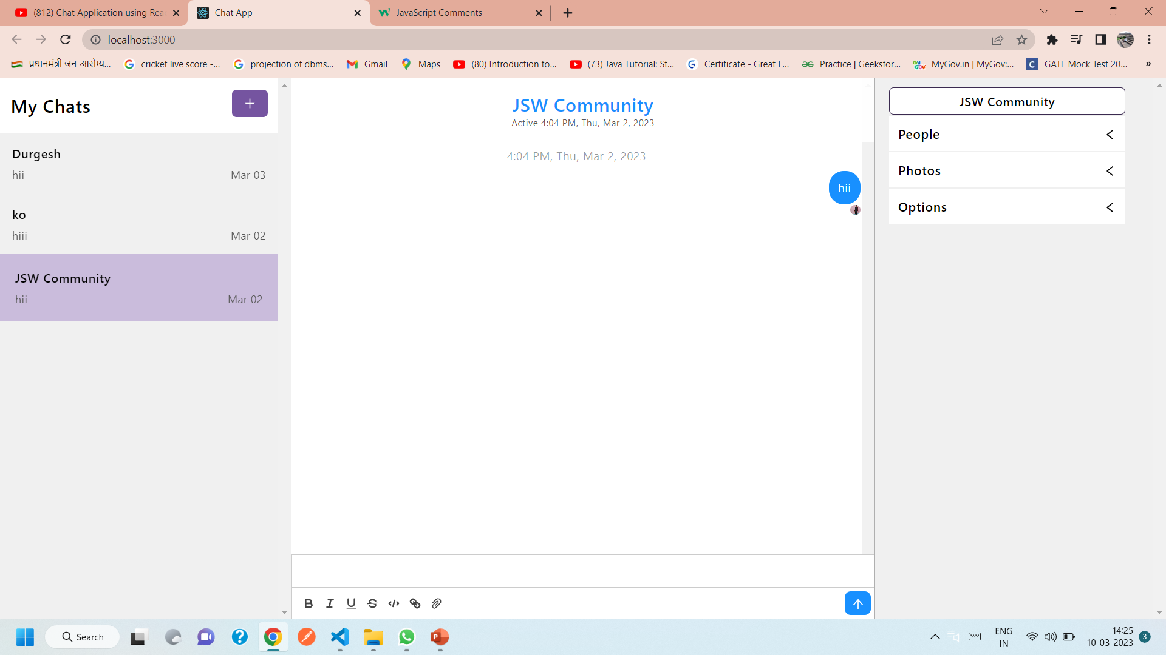

Slide 6
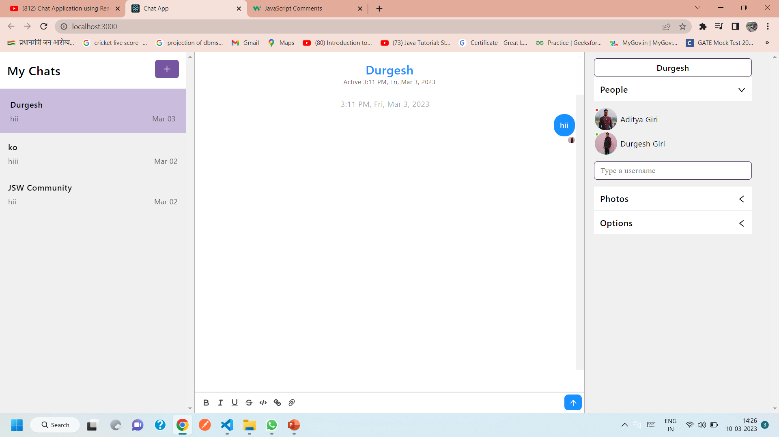

Slide 7
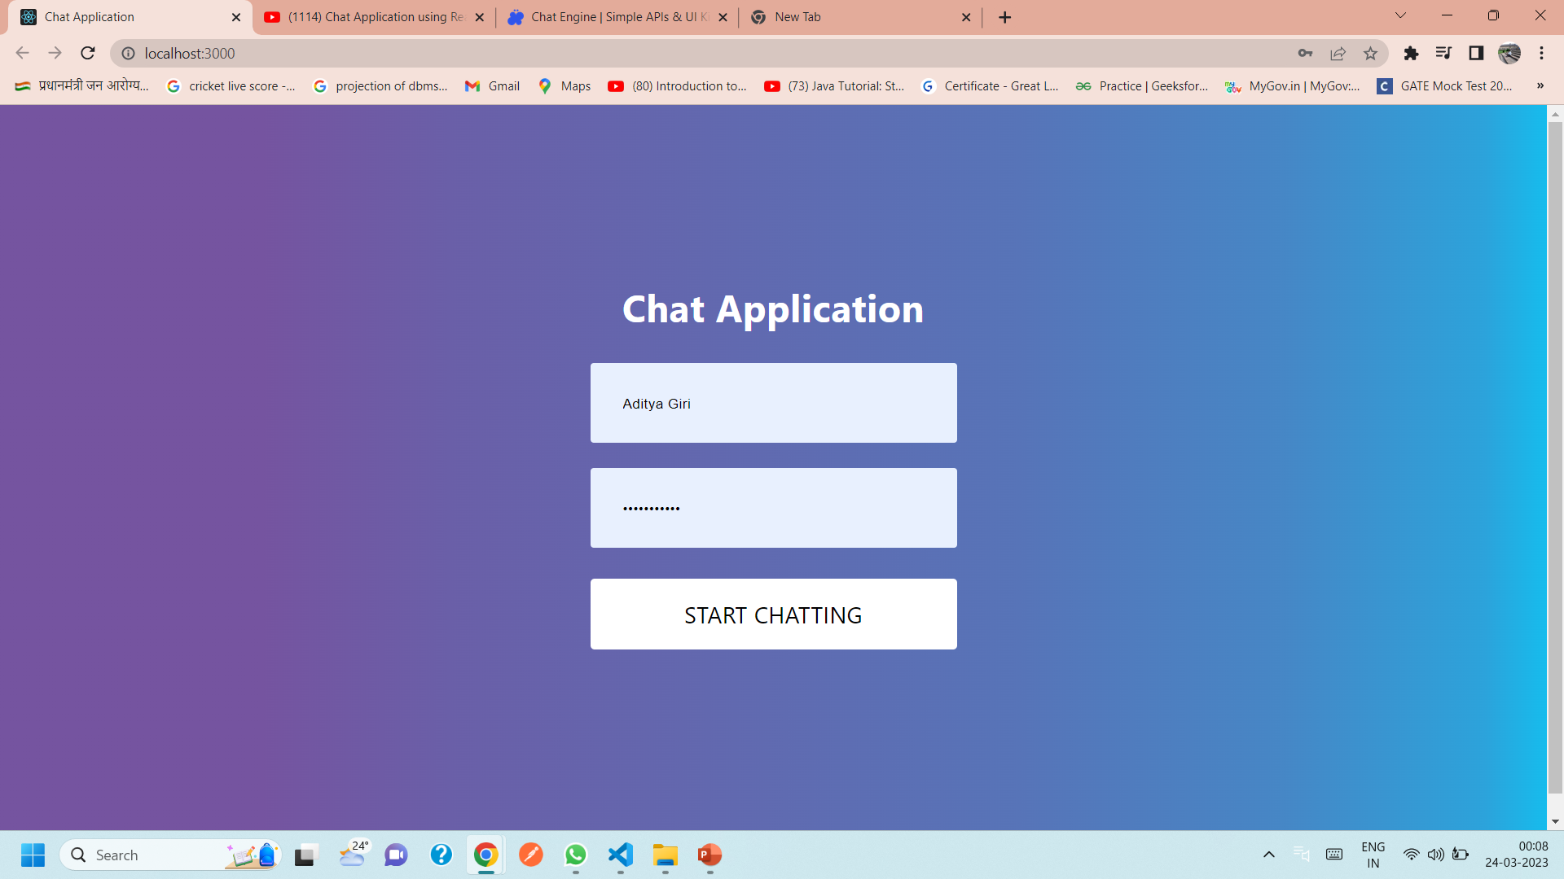

Slide 8
THANK YOU

